Slide 1
Implementing MTSS for Behavior in School Settings
Taipei, Taiwan
Summer 2018
Hank Bohanon
hbohano@luc.edu
http://www.hankbohanon.net
https://twitter.com/hbohano
https://www.facebook.com/hank.bohanon
Notes:
Who is here – you 15 minutes for set up - 5
Coaches – internal external
Middle schools/ High Schools
Parents
General education teachers
Special Education teachers
Counselors
School Psychologists
Social workers?
Administrators?
Academic focused schoolwide approach? Behavior? Social/emotional?
How many years?
5 or more
3 or more
1 or more
Fact finders?

Slide 2
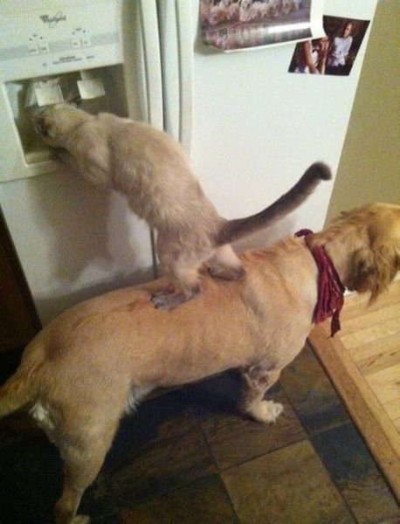
We All Need Support
Notes:
1 minute
Was teacher in DISD - better I got more students my way
KC- middle school PBS-
Chicago and other states around schoolwide behavior
Worked with other approaches academic- behavior – social/emotinal

Slide 3
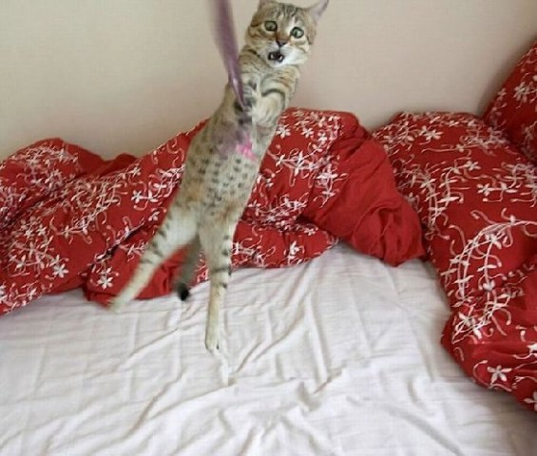
Hang in there!
Notes:
30 sec
From IKEA

Slide 4
Powerpoints: Enduring Understandings
Prepare our staff for implementation
Help our teams work together
Be efficient and effective with our time
We need to use data to plan for interventions
Teams should able to identify the components of developing an effective school climate
Notes:
1 min

Slide 5
Essential Questions
How do you prepare systems to enhance the support in your environment
How do you organize personnel in ways to enhance your environment
What are effective ways to encourage teams to work together efficiently and effectively?
Notes:
1 minute

Slide 6
Essential Questions
What are effective methods to consolidate actions and activities
How can teams convert data to a plan of action
What are the components of effective school environments? How do these components connect with an effective instructional model?
Notes:
1 minute

Slide 7
Outline
Enduring Understanding:
Prepare your staff
Develop teams
Prioritize efforts
Organize multiple data sources
Select effective instructional models

Slide 8
Thank you!
Montana Behavior Initiative (MBI)
Dr. Li-Yu Hung
Dr. Pei-Yu Chen
Dr. Tina Wang
Dr. Hsiu-Tan Liu
Students of “Seminar on Special Education” from NTNU
Jack Yu – NTNU
Ms. Hu - New Taipei City
Ms. Lin - New Taipei City
Mr. Su - Tao-Yuan City
Notes:
8
8
1 minute

Slide 9
Thank you!
“Systematic Analysis and Model Development for High School Positive Behavior Support” Institute for Education Science, U.S. Department of Education, Submitted with the University of Oregon.
(Q215S07001)
“Character Education: Application of Positive Behavior Supports” to U.S. Department of Education, Safe and Drug Free Schools. (R324A070157)
Notes:
9
9
30 sec

Slide 10
Key Principles
What does an effective learning environment look like for all students?

Slide 11
MTSS: 4 Domains of School Climate
Safety
Behavioral Expectations
Teaching and Learning
Support for Learning
Social Skills Development
Interpersonal Relationships
Respect for Diversity
Social Supports for Students
Health & Wellness Expectations
Sense of Physical Security
Sense of Social-Emotional Security
Physical Environment
School Connectedness & Community Engagement
Physical Surrounding
Student Engagement & Self-Direction
Leadership
Professional Relationships
(Vermont Agency of Education, Accessed July 27, 2016)
Notes:
Make connections in handbook with VT
How familiar are you?

Slide 12
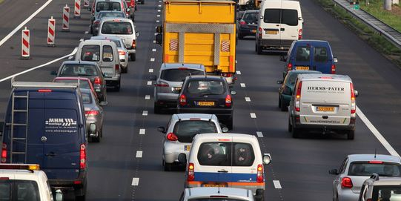
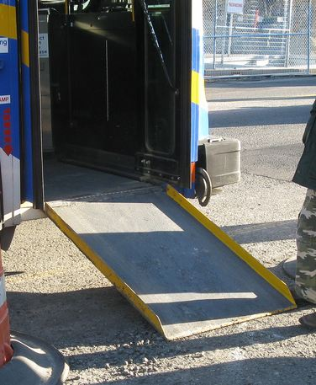
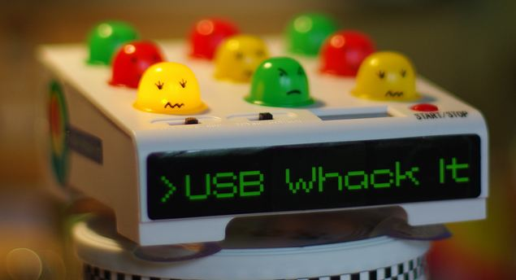


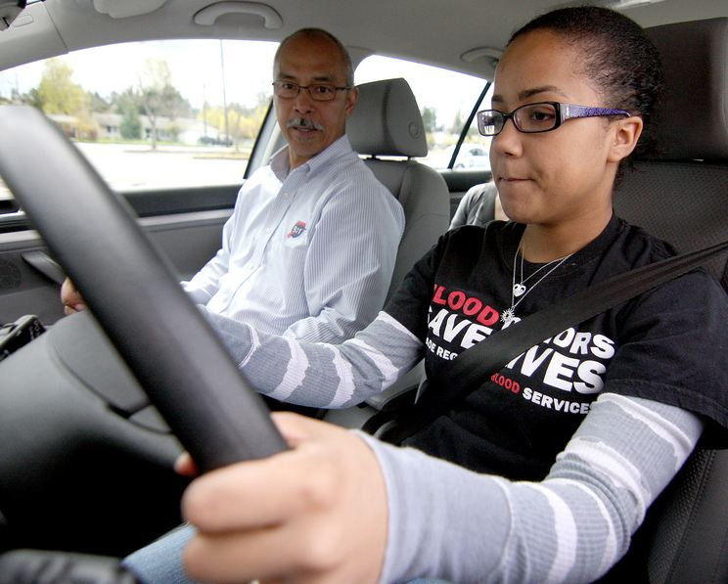
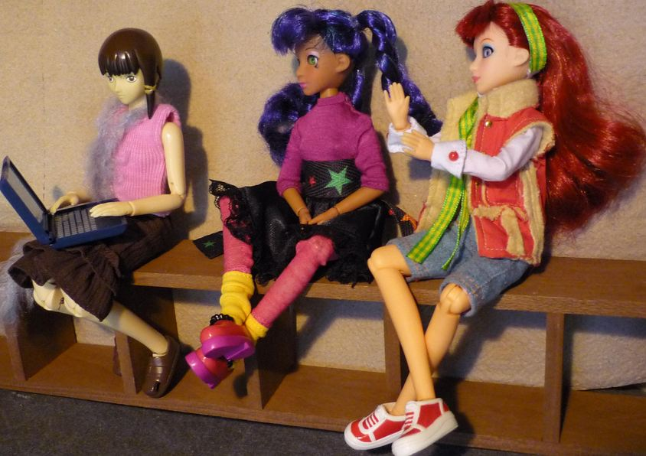
Key Principles
Incidental Benefit
Schoolwide
Schoolwide
Punishment
Reinforcement
Shaping
Reinforcement
Notes:
Whack a mole – don’t start individual
Highway - schoolwide
Ramp – incidental benefit
Yelling teacher – reinforcement
Student in the office - reinforcement
Stop sign – punishment
This works for teachers..teaching vs learning…
Learn to drive - shaping

Slide 13
Activity
While music plays, walk around
When music stops, find partner
Discussion
  When did you see examples or non-examples of implementation practices? (P. 12 of Handbook)

Slide 14

Reflective Question
Even with the best group counseling and functional behavioral assessments, why do some students still fail?
Image from https://flic.kr/p/o6WuJ

Slide 15
Designing School-Wide Systems for Student Success
A Response to Intervention Model/MTSS
Questions
Answers
Tertiary Interventions/Tier 3:
Dig deeper – why?
Tertiary Intervention/Tier 3:
Ask questions,
Teach what works better *
Antibiotics/Zhong Yao
1-5%
1-5%
Secondary Interventions/Tier 2:
Can’t do/won’t do
5-10%
5-10%
Secondary Interventions/Tier 2:
Coke test analogy..
Aspirin, Soup*
Universal Intervention
Tier 1:
Were we clear? Does it work?
How do we respond?
80-90%
80-90%
Universal Intervention/Tier 1:
Be clear on expectations,
make sure they work, be humane
Rest, Vitamins*
*Scott, T. examples
Notes:
15
You may have a large copy of this in your handouts
tatoo..it is washable (just kidding)..
Example –
SW – Respect – Response Be kind – show poster ahead
Secondary – student could not write very well – even when given coke..skill deficit – then accommodate with writing prompt and remediate – teach skills
Tertiary – attention – personal greetings at the door and pre-correction was enough

Slide 16

Implementation of Schoolwide
38% More Tier 2/3 Interventions
  (Eber, Phillips, Upreti, Hyde, Lewandowski, & Rose, 2009)
50% decrease in outside school placements
6% increase in students 80% or more in general education (compared to state 3%)
  (Illinois Positive Behavior Intervention and Support Network, 2011).
Image from https://flic.kr/p/25UMFK4

Slide 17
Ask before you tell: Gathering Information
See Handout: Exploring Some Other Schools (academic/behavior support)
  What is working well?
  Next steps?
How are your schools similar or different from the strengths or next steps on the list?
Notes:
Teachers were able choose the steps they would take before referral
Some schools teaching – banners – posters – matrix
Check and connect in some schools.

Slide 18
Exploration Examples From 4 High Schools
  Communication - timeliness
  School climate
  Efficient meetings
  Integration of PD
  Work with PLCs
  Define academic and behavior expectations
  Use data for decisions
  Braid initiatives
  Align administrative supports with strategies
  Students within special support needs
  Need for increased school spirit
  Distribute roles
  Parental involvement
See example of questions: http://www.hankbohanon.net (Resources tab)
Notes:
Focus groups – across students, teachers, administrations
See Handbook – Niles West

Slide 19
(Bohanon & Wu, 2014)

Slide 20
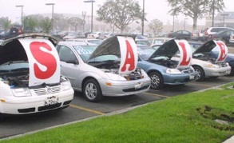
Buying a car
List out the steps people take to buy a car…
bestig.blogspot.com

Slide 21
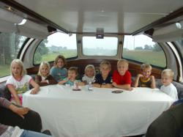



Steps
Consider Needs
Research
Not First!
Sample
Sign Up
Car http://www.prweb.com/releases/2012/8/prweb9815542.htm
Research http://www.uic.edu/uic/research/
Test drive http://www.familyhyundai.com/family-hyundai-customer-reviews/
Contract http://www.icts.uiowa.edu/content/contract-negotiation
Notes:
Place the steps for purchasing a car in the right order – at each step – what are people afraid of? Why did you not see the contact first? People are not the change – but the loss – you have to build the why before what and how. See Being Boss

Slide 22
Implementation
Exploration and adoption – buy in, urgency
Program installation – team, roles
Initial implementation – piloting, examples
Full operation – changing staff roles (some/all)
Innovation – use credibility, codifying roles
Sustainability – new leaders, share with all
(Kotter, 1995; Blasé, Fixsen, Sims, & Ward, 2015)
Notes:
1 introduction and universals 2 setting up your team, 3 is data, 4th is best practices (MT Approach)

Slide 23
Show Similar Example
Joe Zima, LMSW, Behavior Specialist St Clair County RESA

Slide 24
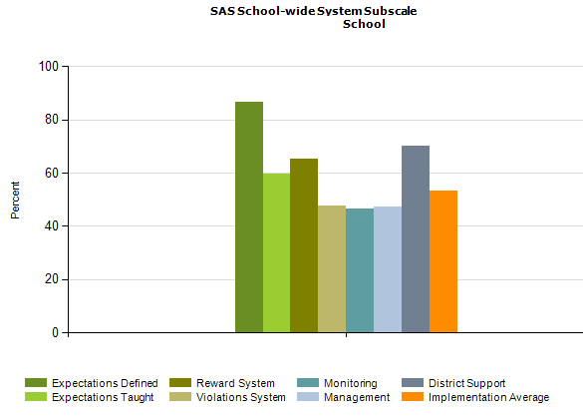
PBS Self-Assessment Survey – www.pbis.org
Notes:
See my website under resources – academic and behavior self- assessment from Niles West high school – based of Flordia’s RtI model

Slide 25
Designing School-Wide Systems for Student Success
A Response to Intervention Model
Academic Systems
Behavioral Systems
Tertiary Interventions/Tier 3:
*Young Leaders
*National Honor Society; Eyes on the World
Secondary/Tertiary-SLC teams
Tertiary Intervention/Tier 3:
- Assessment based…Wraparound,
1-5%
1-5%
Secondary Interventions/Tier 2:
Secondary/Tertiary-SLC teams
AVID; Mentor Moms
Credit Recovery
After School Matters
ELL
Summer School/(First Year Connection)
Gear-Up
5-10%
5-10%
Secondary Interventions/Tier 2:
- AVID, After School Matters
- ELL;Gear-up;
Summer School(First Year Connection)
- In HouseTutoring- Mentor Moms
80-90%
80-90%
Universal Intervention
Tier 1:
In-House Tutoring; Summer
School (First Year Connection),ASPIRA;_
Service Learning;
Attendance andTardies_
SLC; PARR; First Year Seminar
Universal Intervention/Tier 1:
-PARR
Attendance and Tardy
- Small Learning Communities (SLC)
Notes:
25
Shock and Awe

Slide 26
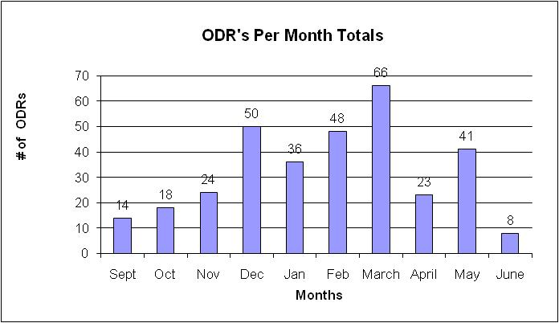
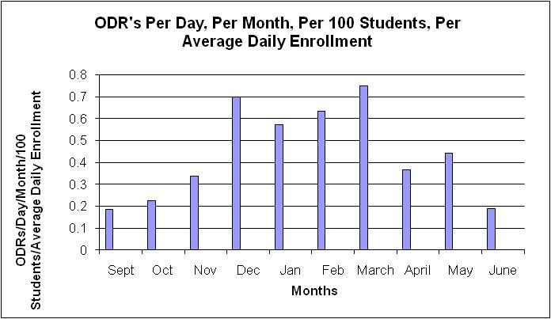
What are our priority months for support?

Slide 27
Build Case with Data:
Create Urgency (Kotter, 1995)
Writing a referral is not a bad thing, it is necessary!
We hope you have fewer reasons
Instructional time given to referrals
(20 Minutes per referral)
77,400 Minutes = 1,290 Instructional Hours

Slide 28
Developing futures plan (i.e., RENEW), FBA/BIP, Academic Remediation
Connections with your core curriculum?
Intensive
supports
Teaching individual replacement behaviors classwide: Expectations; Group interventions
Explicitly teaching effective self-expression, self-evaluation, problem solving, goal setting, within the academic and behavior core: CCSS, RtI, SEL
Embedding student choice into the academic, behavioral, social core curriculum: RtI, SEL, UDL
Teaching specific social expectations: SWPBIS, SEL
Universal supports
Adapted from: Bohanon, H., Castillo, J., & Afton, M. (2015). Embedding self-determination and futures planning within a schoolwide framework.
Notes:
For example 9th and 10th grade students are expected to express themselves effectively and develop rules for collegial discussions and decision making when working with peers (CCSS.ELA-Literacy.SL.9-10.1 and CCSS.ELA-Literacy.SL.9-10.1b). Learning how to develop and evaluate a plan by gathering information (problem solving) is directly related to standards involving writing (CCSS.ELA-Literacy.WHST.9-10.5 and CCSS.ELA-Literacy.WHST.9-10.8). Skills related to self-advocacy (e.g., making your point effectively) are related to anchor standards for college readiness CCSS.ELA-Literacy.CCRA.SL.1and CCSS.ELA-Literacy.CCRA.SL.4.). Addressing the key standards may be one effective way to encourage participation in self-determination supports. Addressing another general education initiative (i.e., executive functioning) may be another.

Slide 29
Question
Given these example, what are some ways you can “ask before you tell” to obtain, maintain, or increase buy-in from staff/schools?
See page 24 of Handbook, steps 1-4

Slide 30
Supporting Social Competence &
Academic Achievement
4 PBS Elements
OUTCOMES
Supporting
Decision
Making
Supporting
Staff Behavior
SYSTEMS
DATA
PRACTICES
Supporting
Student Behavior

Slide 31
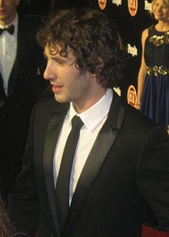


Key Elements
Systems – Josh, flight, checklist
  Administrative Commitments, Coaching (external/internal), Representative Teams, Audit of practices, Priority
Practices
  Based on evidence
Data
  Process and impact – dropout
    What and with whom?
http://en.wikipedia.org/wiki/Josh_Groban
http://www.inmagine.com/searchterms/private_jet.html
Notes:
31

Slide 32
Napkin Test
Write and/or draw the purpose of Schoolwide supports on a napkin, present to colleague at a party who asked about MTSS. What is it and why do we need it?
Stand up and share

Slide 33
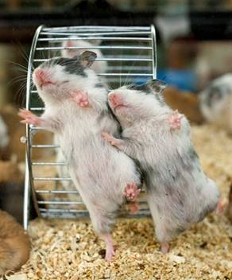
Effective teams in school settings
Duck video
Notes:
45 minutes for section
Duck Video

Slide 34
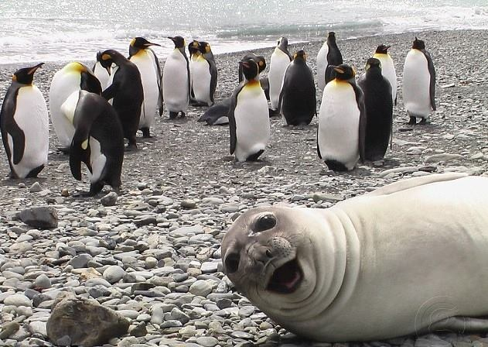
Different backgrounds, one goal

Slide 35
Defining yourself
What is the mission of your universal team
What is the mission of your vision team
  See what works https://www.youtube.com/watch?v=LJhG3HZ7b4o
  See Handout
Notes:
Play video on missions that don’t suck

Slide 36
Possible Structures for MTSS

Slide 37
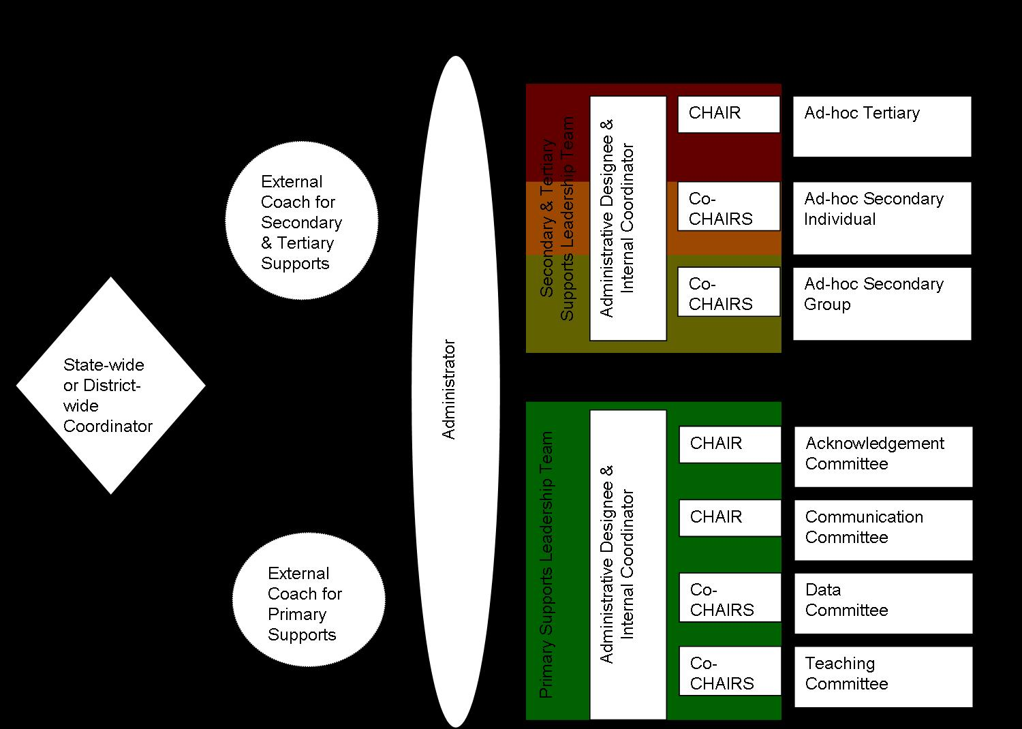
ICEPS Project, 2008
http://www.luc.edu/cseit

Slide 39
Model Positions Document
Building Based Staff
School Liaison | Administrator who oversees functioning and makes administrative decision for all tiers of MTSS within the building (e.g. attends meetings, allocates resources) | 10 hours a month | Sara,
Internal Coordinator (Primary Support Leader Team) | Internal staff who can lead staff, with support from the External Coach, in implementing MTSS schoolwide academics and behavior practices, run meetings and oversee sub-committees | 10 hours a month | Sara
Acknowledgement CHAIR | Lead the acknowledgement of student and staff behavior for schoolwide efforts, sub-committee in planning for celebrations and reinforcement systems within the school, meet with internal coordinator 2 times a month | 8 hours a month | Terry
Acknowledgement Sub-committee | Facilitate schoolwide acknowledgment activities, including design and implementation. | 4 hours a month | Janet

Slide 40
Possible Structures for MTSS
Who is/could be on your core universal team?
How do you assign roles?
How are responsibilities distributed?
Notes:
Example from Spaulding? Distributive leadership

Slide 41
Designing School-Wide Systems for Student Success
A Response to Intervention Model
MTSS/SIP Teams
Examples
Few: Leadership Team
From problem-solving room
coordinator to data
chair. Department reps
1-5%
1-5%
5-10%
5-10%
Some: Subcommittees.
Prepare for leadership team
Clusters/divisions,
grade levels
review data.
Shadow chairs
80-90%
80-90%
All: Responsible for
MTSS/SIP
All staff teach
expectations
Job descriptions
reflect MTSS/SIP
Notes:
41

Slide 42
Northfield Middle/High School, VT
(Bohanon, Gilman, Parker, Amell, & Sortino, 2016)

Slide 43
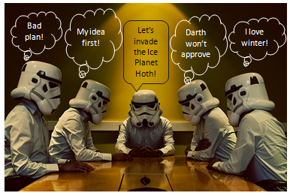

Slide 44
Effective Meetings
Scheduling and communication
Creation and use of an agenda
Meeting begins and ends on-time
Keeping the meeting on track
Action plan/delegating tasks
Meeting Participation
Dissemination of meeting notes
See examples: Herding Cats, Bad Meetings, Action Plans, Sample VT agenda
Rate yourself –
handbook
Notes:
Herding cats video
See Handbook

Slide 45
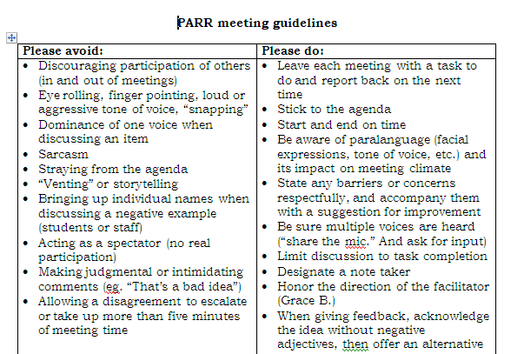
Notes:
45
Key things
Helped meetings become more efficient because
Helped keep everyone on task and respectful – depersonalized challenges
Everyone had to leave the meeting with a task – kept the spectators and ventors away
45

Slide 46
Reflection
Rate the health of their teams on each item
  (use Effective Meetings slide)
  5 positive things are going great
  1 not at all and we need to work on this
Choose one area to address
  See examples
  Meeting Facilitation Rubric for more detail
  Virginia MTSS Agenda Example

Slide 47
Possible Structures for MTSS
Who is/could be on your core universal team?
How do you assign roles?
How are responsibilities distributed?
Notes:
Example from Spaulding? Distributive leadership

Slide 48
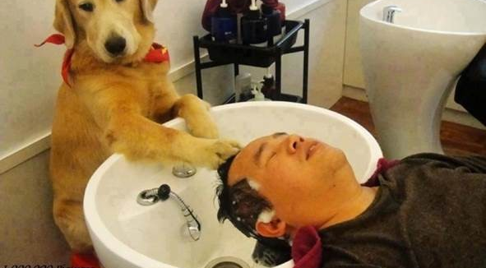
Work smarter and effective teams in school settings

Slide 49
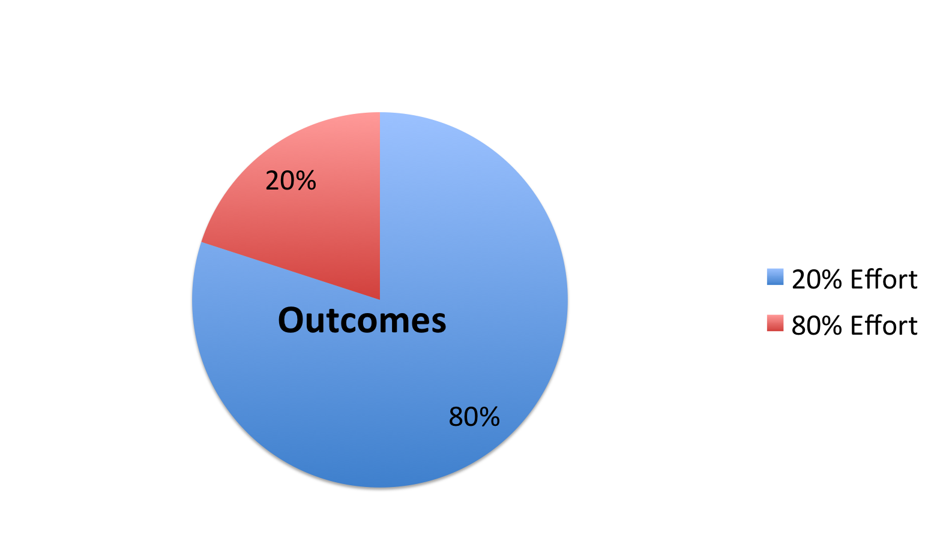
Pareto’s 80/20 Rule
McKeon, 2014
Notes:
Mention Steve Jobs

Slide 50
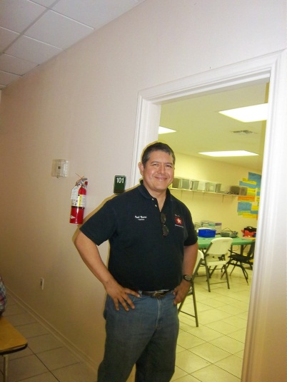
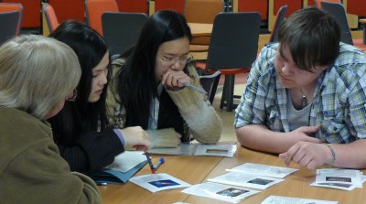
Alterable Variables
8th/9th attendance, 8th/9th GPA
predict graduation (Burke, 2015)
Reading assessment scores
predict college readiness
(Koon & Petscher, 2016)
Engagement
and failure rates
(Allen et al., 2013)
http://www.bristol.ac.uk/physics/

Slide 51
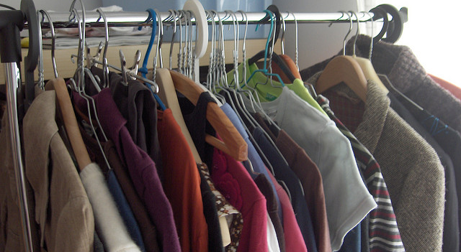
Describe Your Closet
https://flic.kr/p/aDLzzs
Rate it on a scale from 1-10 before you buy
Would you buy it again?
Have you used it one year? (McKeon, 2014)

Slide 52
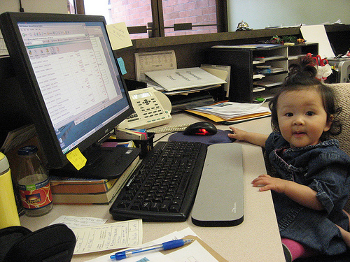
Northfield Middle/High School, VT
Revised master schedule
All students could participate in Study Island Program
https://accounts-flickr.yahoo.com/photos/jenkim/2248275918/sizes/m/in/photolist-4qF16U-bUQXfn-edNnEu-3csa6n-5sgmyu-edGH9z-53piaq-mVMTRx-3XsPp-fWBZ75-7hkzE5-83prtu-4qruLT-81Yq7e-6RycDm-4j8ri-2shYkc-akHDaG-dNJpxB-4q9VJ4-KTPYW-4urrjg-bSv1hk-4FgyQG-4adsUK-cXd2yE-3gNij7-4RxFTH-9AwVns-4WRbFq-5xMwUJ-eNBioc-84xBVn-9sp4J-7JYZqT-5Zdkxt-dbAtWt-ckEAPd-5wvNsm-6MYR4A-dq71AH-5GbP34-bm5Qmj-jvsXuS-dbAvD1-7kS2Dv-5PVFe1-niJtLf-mBVEDF-2jPkVf-edNeH3/
(Bohanon, Gilman, Parker, Amell, & Sortino, 2016)

Slide 53
Designing School-Wide Systems for Student Success
A Response to Intervention Model
Academic Systems
Behavioral Systems
Tertiary Interventions/Tier 3:
*Young Leaders
*National Honor Society; Eyes on the World
Secondary/Tertiary-SLC teams
Tertiary Intervention/Tier 3:
- Assessment based…Wraparound,
1-5%
1-5%
Secondary Interventions/Tier 2:
Secondary/Tertiary-SLC teams
AVID; Mentor Moms
Credit Recovery
After School Matters
ELL
Summer School/(Freshman Connection)
Gear-Up
5-10%
5-10%
Secondary Interventions/Tier 2:
- AVID, After School Matters
- ELL;Gear-up;
Summer School(freshman Connection)
- In HouseTutoring- Mentor Moms
80-90%
80-90%
Universal Intervention
Tier 1:
In-House Tutoring; Summer
School (freshman Connection),ASPIRA;_
Service Learning;
Attendance andTardies_
SLC; PARR; Freshman Seminar
Universal Intervention/Tier 1:
-PARR
Attendance and Tardy
- Small Learning Communities (SLC)
Notes:
53

Slide 54
ACTIVITY
Designing School-Wide Systems for Student Success
A Response to Intervention Model
Academic Systems
Behavioral Systems
Tertiary Interventions/Tier 3:
_______________________
_______________________
_______________________
Tertiary Intervention/Tier 3:
______________________
______________________
______________________
1-5%
1-5%
Secondary Interventions/Tier 2:
________________________
________________________
________________________
5-10%
5-10%
Secondary Interventions/Tier 2:
________________________
________________________
________________________
80-90%
80-90%
Universal Intervention
Tier 1:
__________________
__________________
__________________
Universal Intervention/Tier 1:
______________________
______________________
______________________

Slide 55
See example
Working Smarter (Sugai, 2008)
Initiative, Project, Committee | Purpose | Outcome | Target Group | Staff Involved | SIP/SID/etc
Attendance Committee
Character Education
Safety Committee
School Spirit Committee
Discipline Committee
DARE Committee
EBS Work Group
Notes:
55
5 minutes to review – home work – ask before you tell – do not train what you cannot support
Buy –in , Mission, role assignment, meeting healthy teams, working smarter

Slide 56
You Gotta Love It!
See the activity in your handout

Slide 57
Preparing Data for Decisions
Video – Sales are up

Slide 58
Data
See Handout – Key ideas for schoolwide data – where are you?

Slide 59
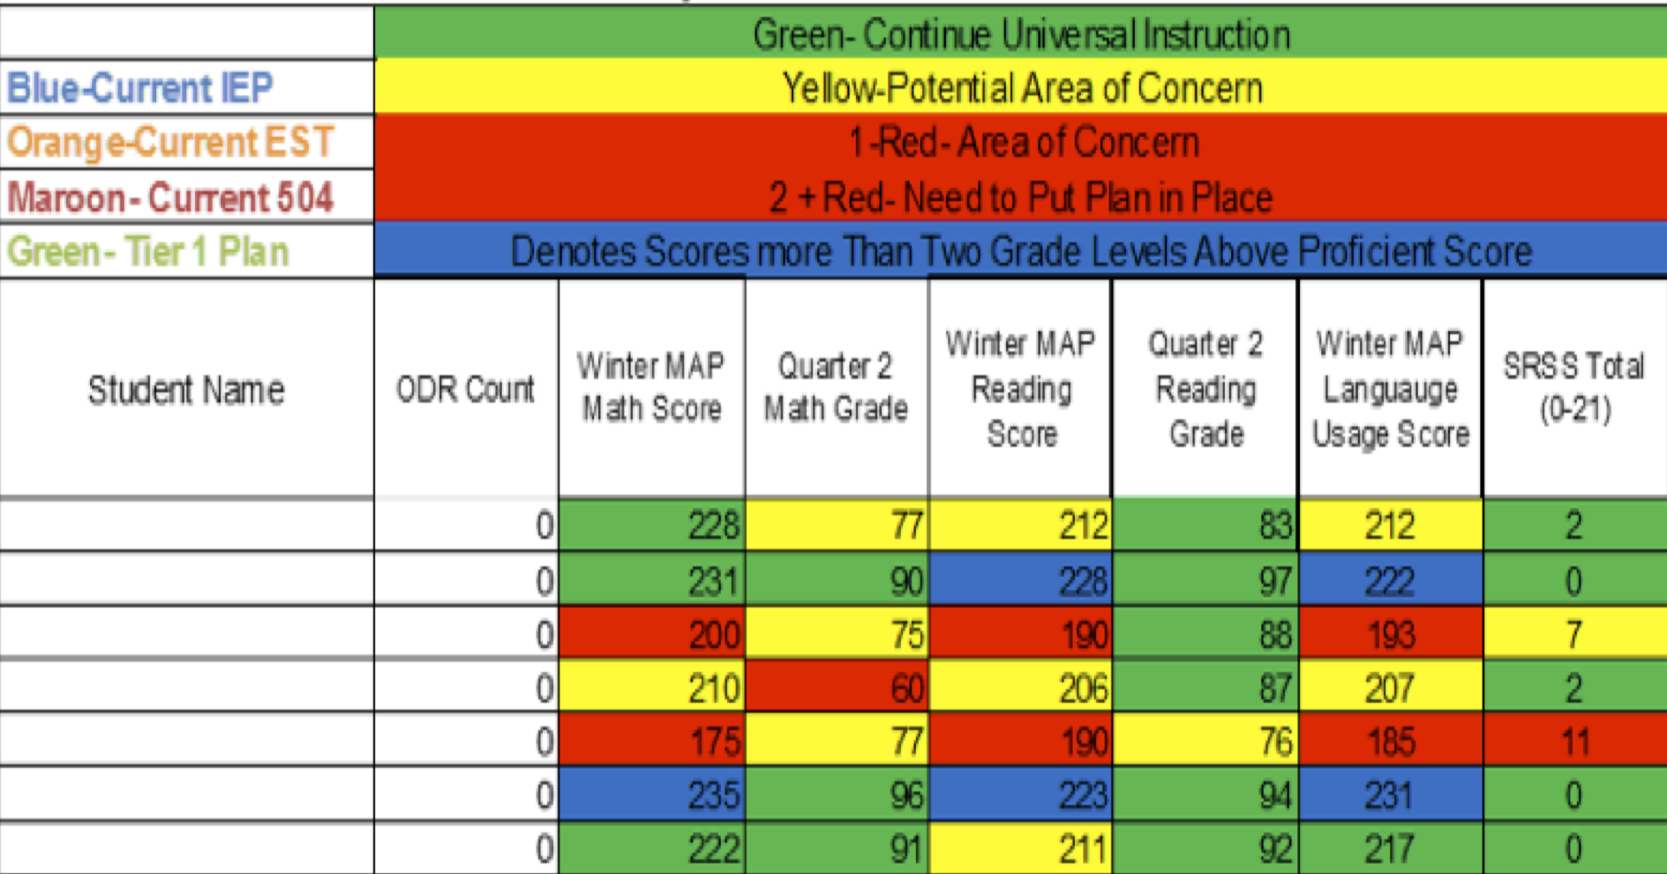
Integration of datasets
Northfield Middle School and High School, VT

Slide 60
Factors
Graduation
  Passing Year 9 English, Algebra 1
  8th-9th grade GPA and attendance > 80%
    (Burke, 2015; Link: fb.me/7sCfLI2QD)
  School Connectedness – lack of leads to
    use substances
    engage in violence
    initiate sexual activity at an early age
National High School Center, National Center on Response to Intervention, and Center on Instruction (2010)
McNeely, Nonnemaker, & Blum (2002)

Slide 61
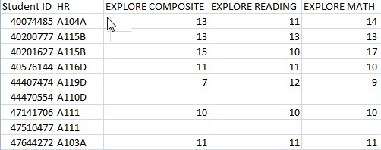
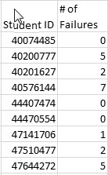
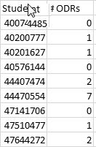
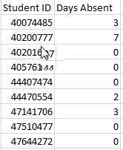
Separate Data Sets

Slide 62
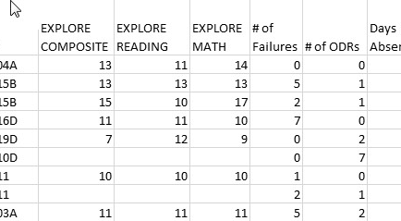
Combined Data Using VLookup
See YouTube examples: http://www.youtube.com/watch?v=3tk_Mif7040

Slide 63
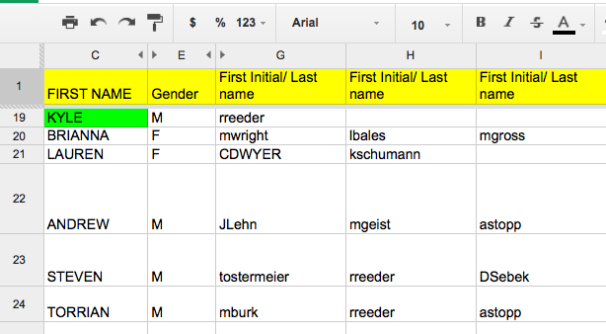
Staff Google Document
Keri Applebee, Associate Principal, Lincoln Southwest High School, NE
Notes:
Plus 10 challenge
Google docs- First initial, Last name- emphasize that it is ok if teachers could not put name by students – due to types of classes taught- important so we can see if students have academic/athletic connections
Criteria:
Do you know something about them outside of the classroom.
(Post -secondary plans, family structure, challenges)
Have you had a conversation with this student outside of normal class time?
Have you congratulated this student on an accomplishment or activity?
Has this student sought you out to share information with you about their life?

Slide 64
Deciding the Level of Intervention

Slide 65
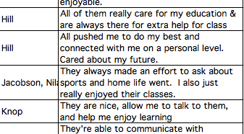
Results of student survey
Keri Applebee, Associate Principal, Lincoln Southwest High School, NE

Slide 66
Question
If these were your data, how would you respond? (see workbook)

Slide 67
SET Data School 2 (year 1)

Slide 71
Priorities
Teaching, Acknowledging, Redirection training for teachers of first year high school students
Orientation for first year high school students
Circuit training for staff during opening of school
School store opens and training provided for staff
Notes:
Circuit training script part of your handout and on my website

Slide 72
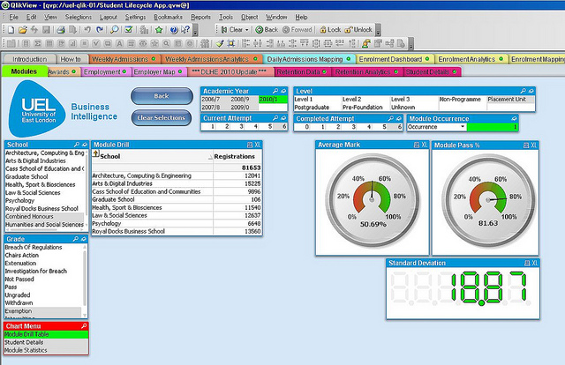
See Sample Dashboard

Slide 73
Data
Using data from the school's perspective http://buff.ly/1Fex5hb
Helping teachers collect data on their teaching to improve instruction buff.ly/1G0wwYY
Toolkit for data decision making fb.me/6z6iyxCU2
8th and 9th grade GPA and Attendance are predict drop out. http://fb.me/7sCfLI2QD
Data dashboard – webinar and examples http://bit.ly/2qSfzie
Videos about using data http://bit.ly/2aAo1MO

Slide 74
Reflection Activity
How are your going to prepare to use data next year? (see other resources in handbook)

Slide 75
Effective School Environments
Career Builder

Slide 76
Reflection
See Handout “Supportive Environments Quiz”
Take the quiz

Slide 77



Answers
1-3
4-5
6
See short example video 0-1:36; 2:17-2:32
Notes:
Show Zappors video

Slide 78
Classroom
Tell me about your favorite class and teacher

Slide 79
Components of Effective Classroom Settings
Maximized Structure
Post, teach, model reinforce expectations
Active engagement
Varity of ways to acknowledge
  Including success!
Continuum of ways to respond
(Simonsen, Fairbanks, Briesch, Myers, & Sugai, 2008)
See MO PBIS Great 8 training
http://pbismissouri.org/educators/effective-class-practice/

Slide 80
What’s in your syllabi?
What do you include in your class syllabus or materials for students/families

Slide 81

Mark Shinn (http://markshinn.org)

Slide 82
The Syllabus
Goals
Contact information
Success Traits
Rules/expectations
Activities
Grades/Status
Procedures
Entering
Tardy/Absence
Materials
Assignments (returns)
Due dates
Late, missing work
Communication
Ending class
Consequences
Model projects
Checklists
Sprick (2006)/Shinn http://markshinn.org
See examples – http://www.hankbohanon.net (Resources page under “Teaching”
Sample first days of school for high school teacher)
Notes:
Show handout, look at student expectations

Slide 83
Planning
See example
What connections can you make for your staff?

Slide 84
Teaching Expectations
High School Football?

Slide 85
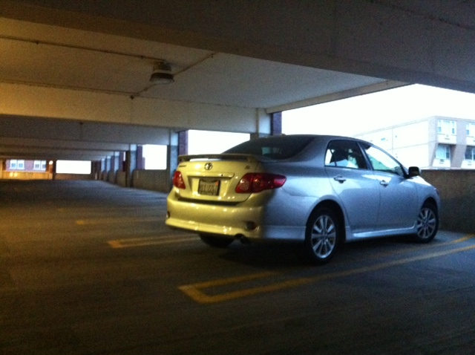
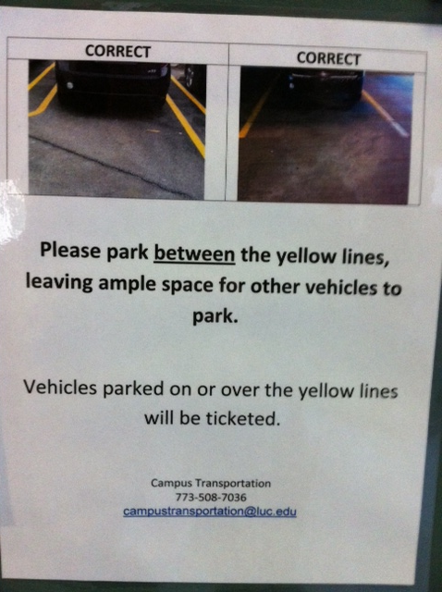
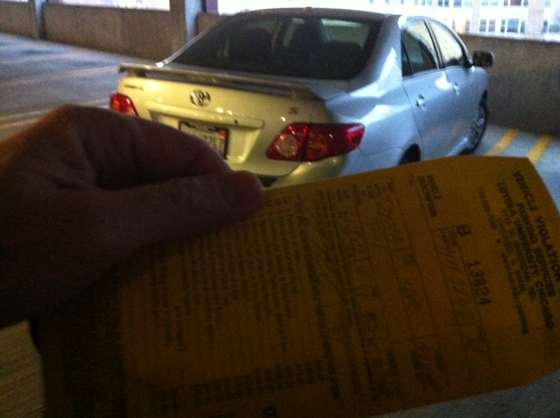
Learning through punishment
Notes:
Working on holiday break on university related tasks
Came up and apparently my car was parked over the line and clearly I was hindering the parking of others - $40 ticket..Are you kidding me? Complained – they said this time we will let you go, but next time it will be enforced..Then..the poster…many of our students learn the rules this way – at home, they say, pass the fn sugar – they are learning a new skill.. Do not assume.. Or you will get “are you kidding me?”

Slide 86
Teaching Expectations
Examples
Staff orientation meetings
Handbooks
Lesson plans
Syllabus
Posters
Booster sessions
Pre-correct/remind
Key Elements
Rationale
Negative examples
Positive examples
Practice/Feedback
Evaluate
See lesson- Blank!! Possible Example Teaching Story 1 or Pre-Teaching
Student example from football
Fruita Monument Example
Notes:
86
Say silk 3 times, then ask what do cows drink
Practice expectations with group

Slide 87
Alignment
Montana College and Career Readiness Anchor Standards for Speaking and Listening 9th and 10th grade students
  http://opi.mt.gov/pdf/CCSSO/ELA_GradeLevel_9_10.pdf
Social and Emotional Standards (SEL)
  Self-awareness and self-management skills
  Social-awareness and interpersonal skills
  Decision-making skills and responsible behaviors
    http://education.qld.gov.au/studentservices/protection/sel/
    http://www.isbe.net/ils/social_emotional/standards.htm
See examples from core?

Slide 88
Aligned with Speaking and Listing Literacy National US Standards
CPS Matrix Aligned with Common Core Standards – See http://www.hankbohanon.net
Notes:
See standards lists or reference in handout

Slide 89
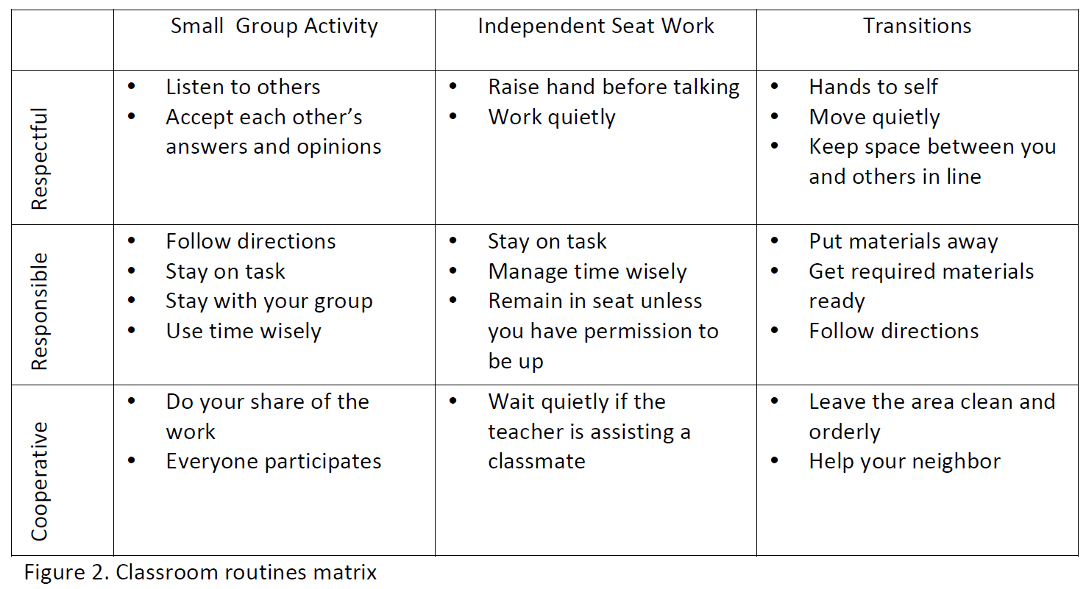
Sample Classroom Matrix
Newcomer (2009)
Which of these behaviors would you like to address?

Slide 90
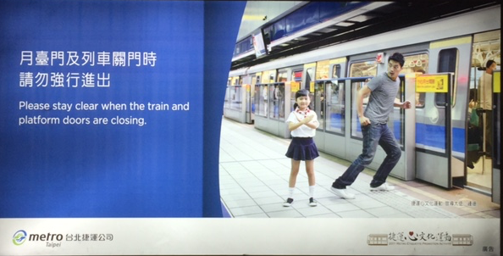
MRT – Be Safe

Slide 91
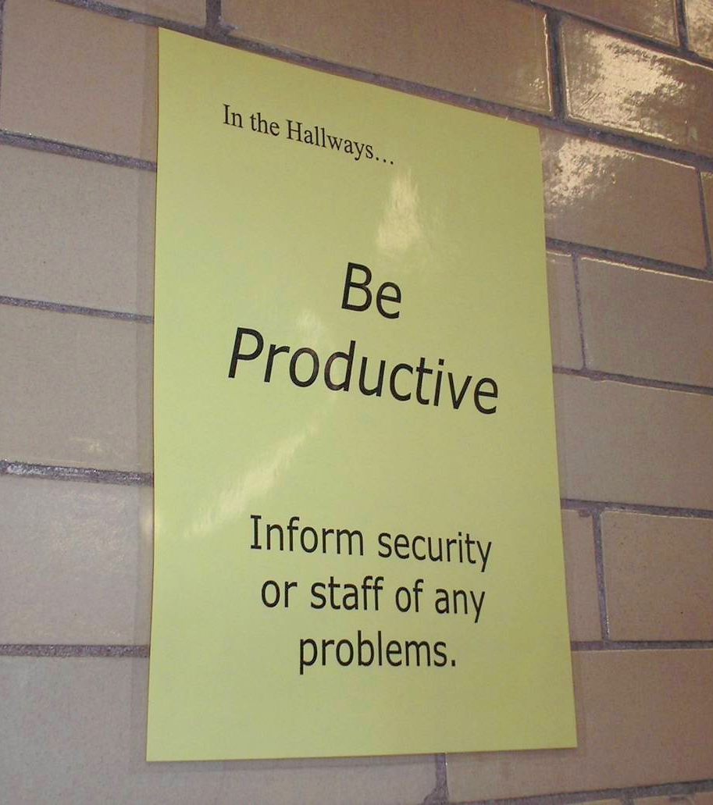
Notes:
91
Mr. Irvin
Defining expectations by location

Slide 92
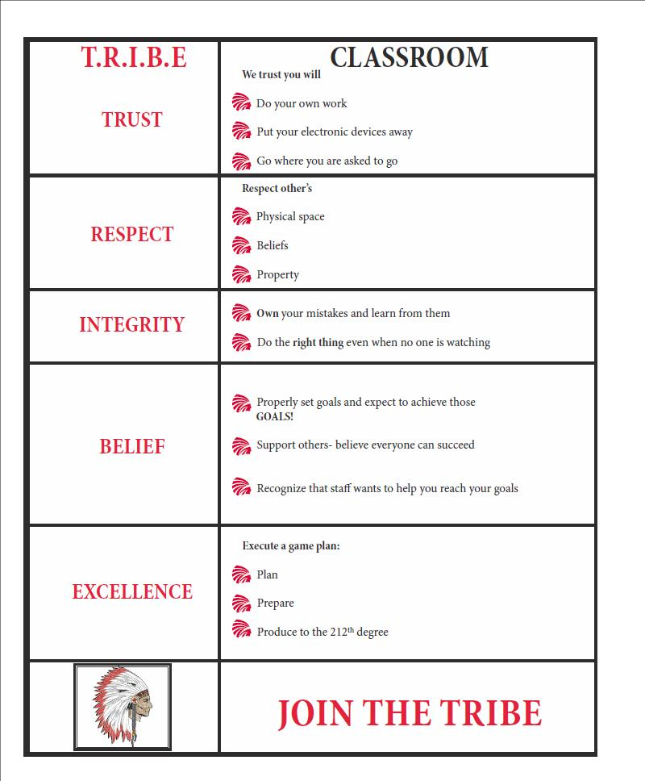
Shawnee Mission Schools, KS

Slide 93
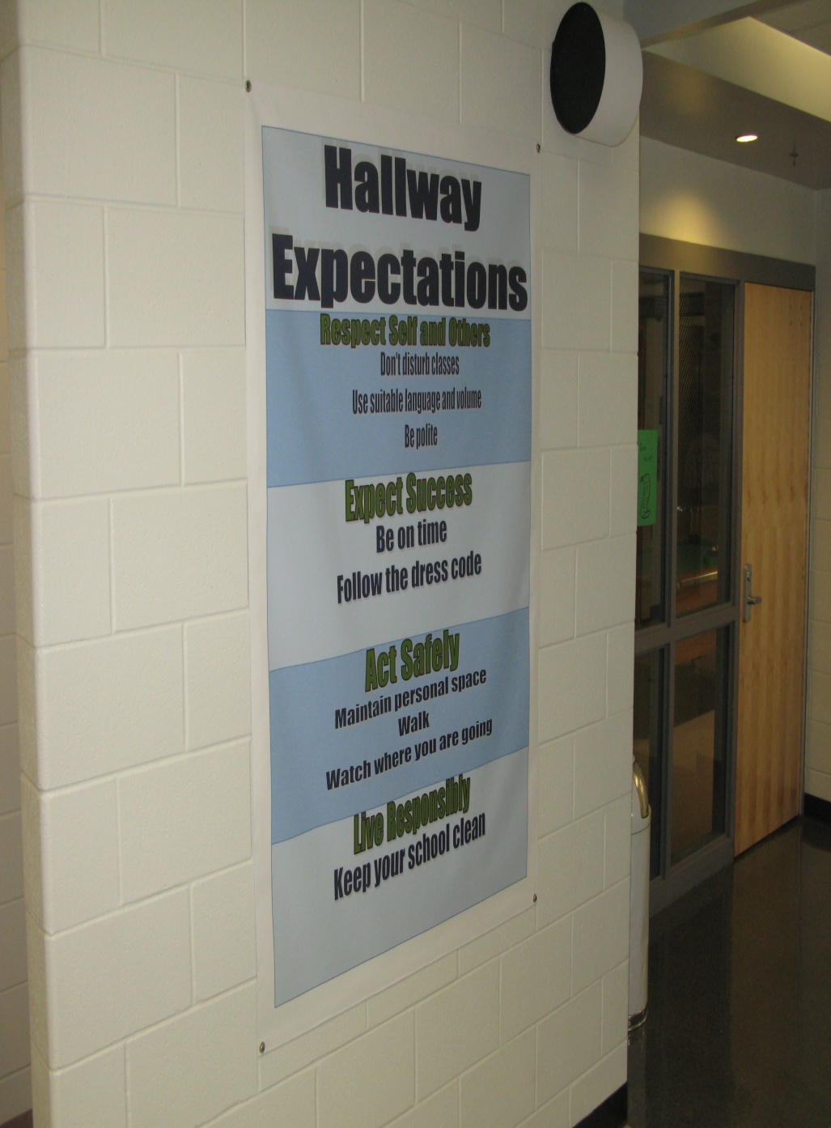
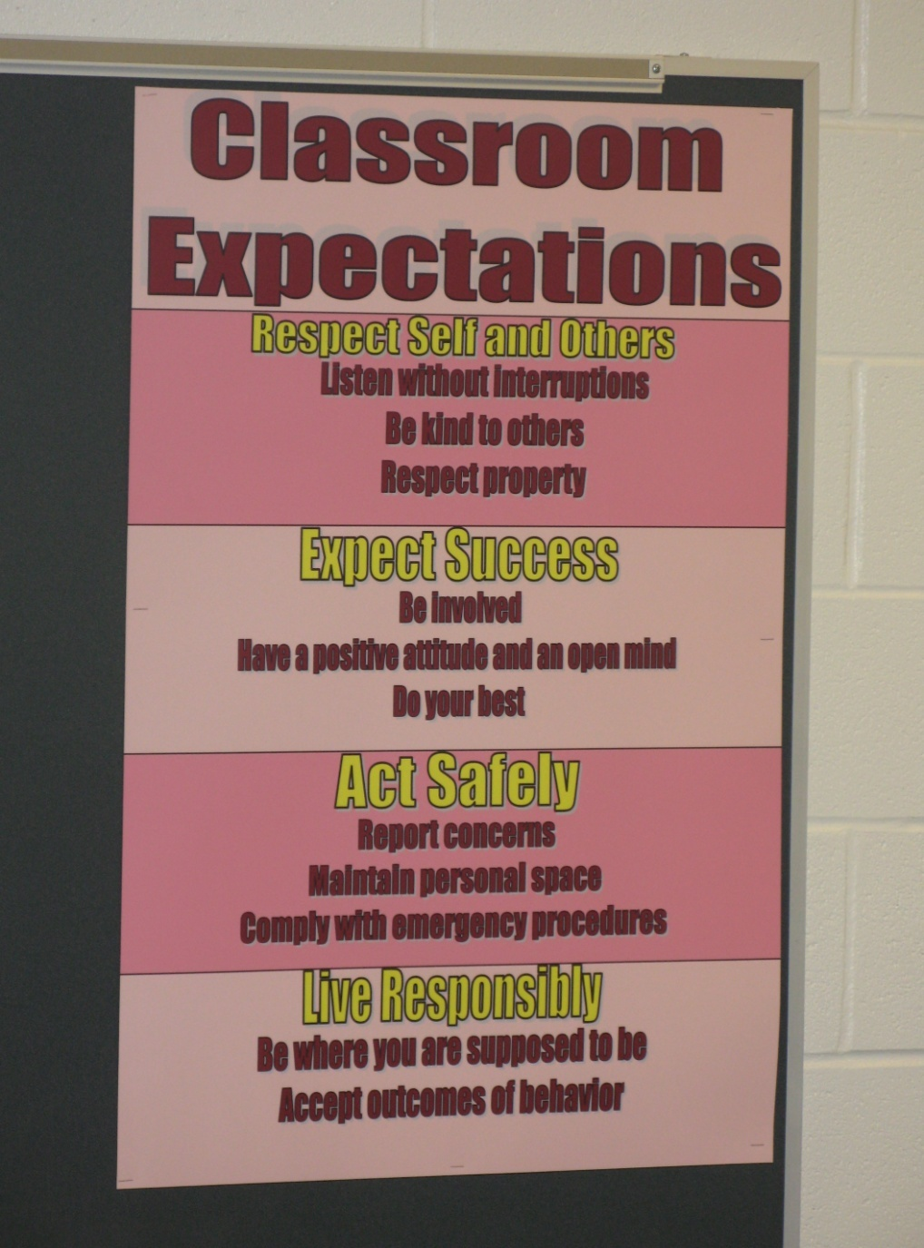
Shawnee Mission Schools, KS

Slide 94

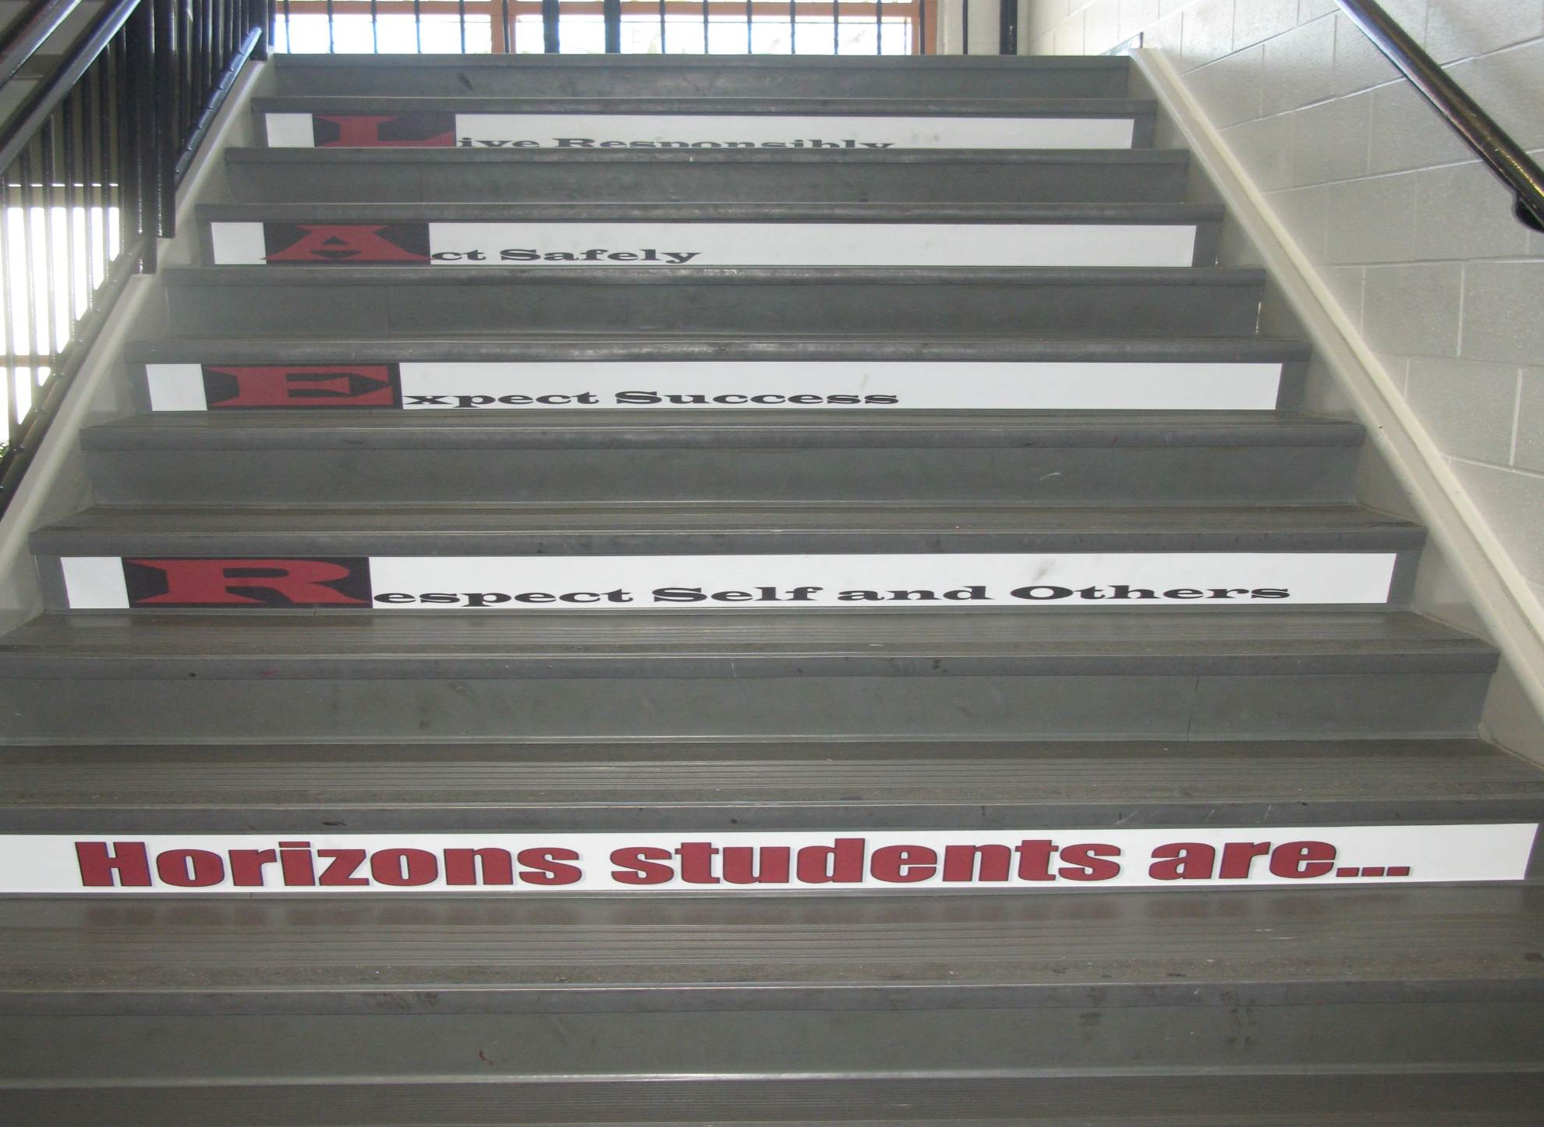
Shawnee Mission Schools, KS

Slide 95
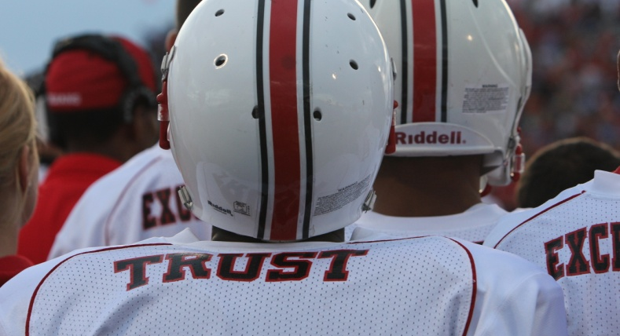
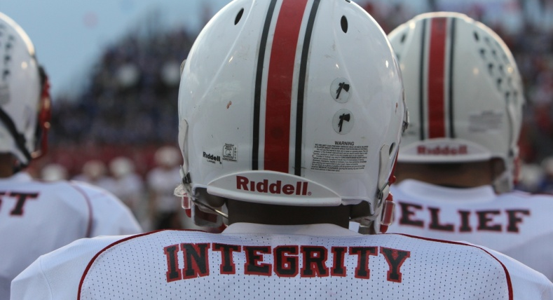
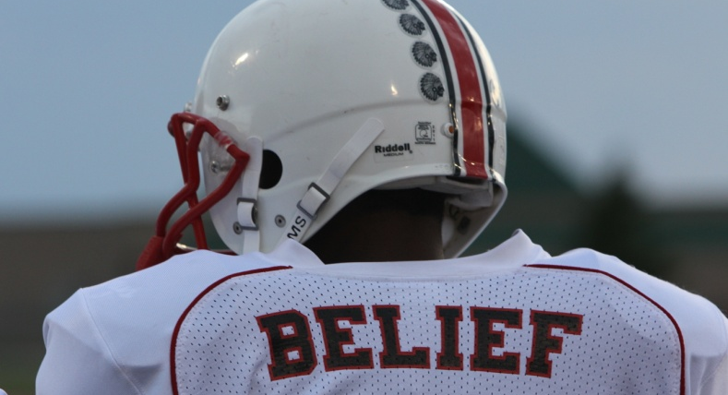
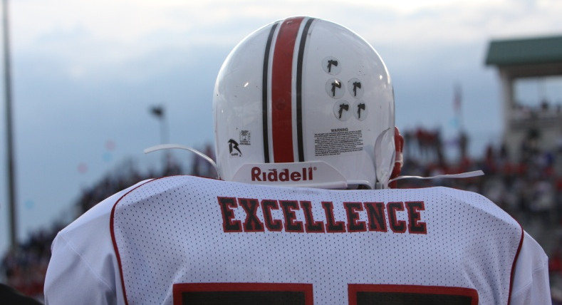
Shawnee Mission North
Football Jerseys
Notes:
Teaching expectations football?

Slide 96

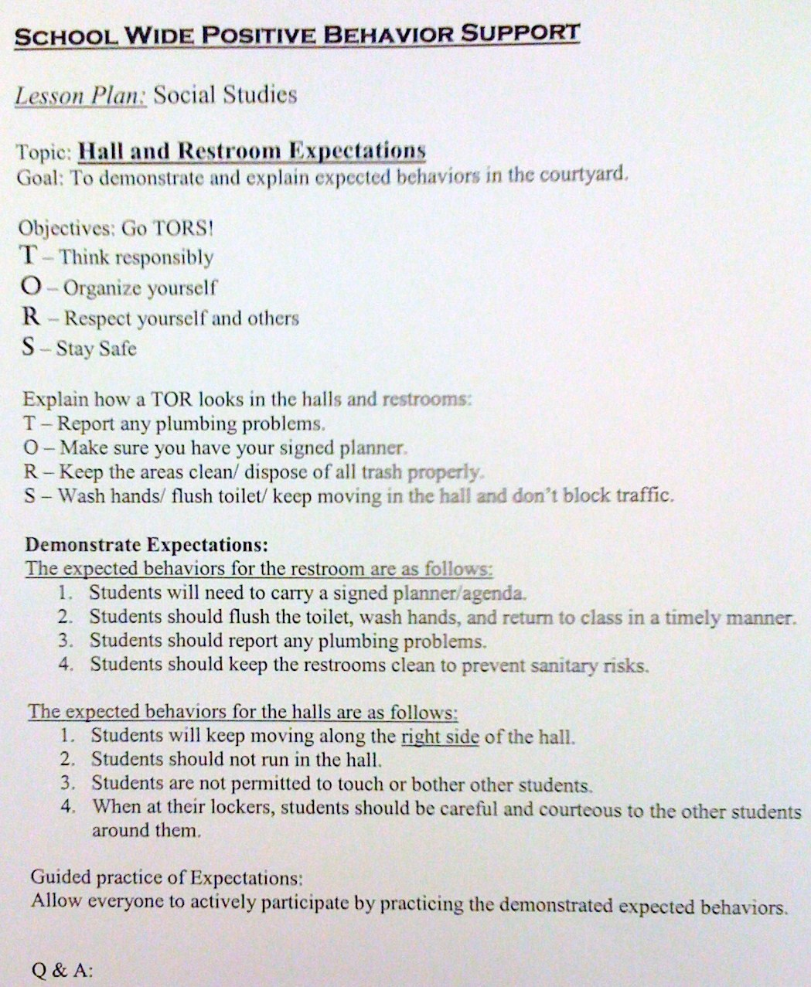
SULPHUR 9th GRADE - PBIS
Lesson Plan
CHUCK HANSEN, Principal
AMY PALMER, Teacher
SULPHUR HIGH SCHOOL, LA

Slide 97
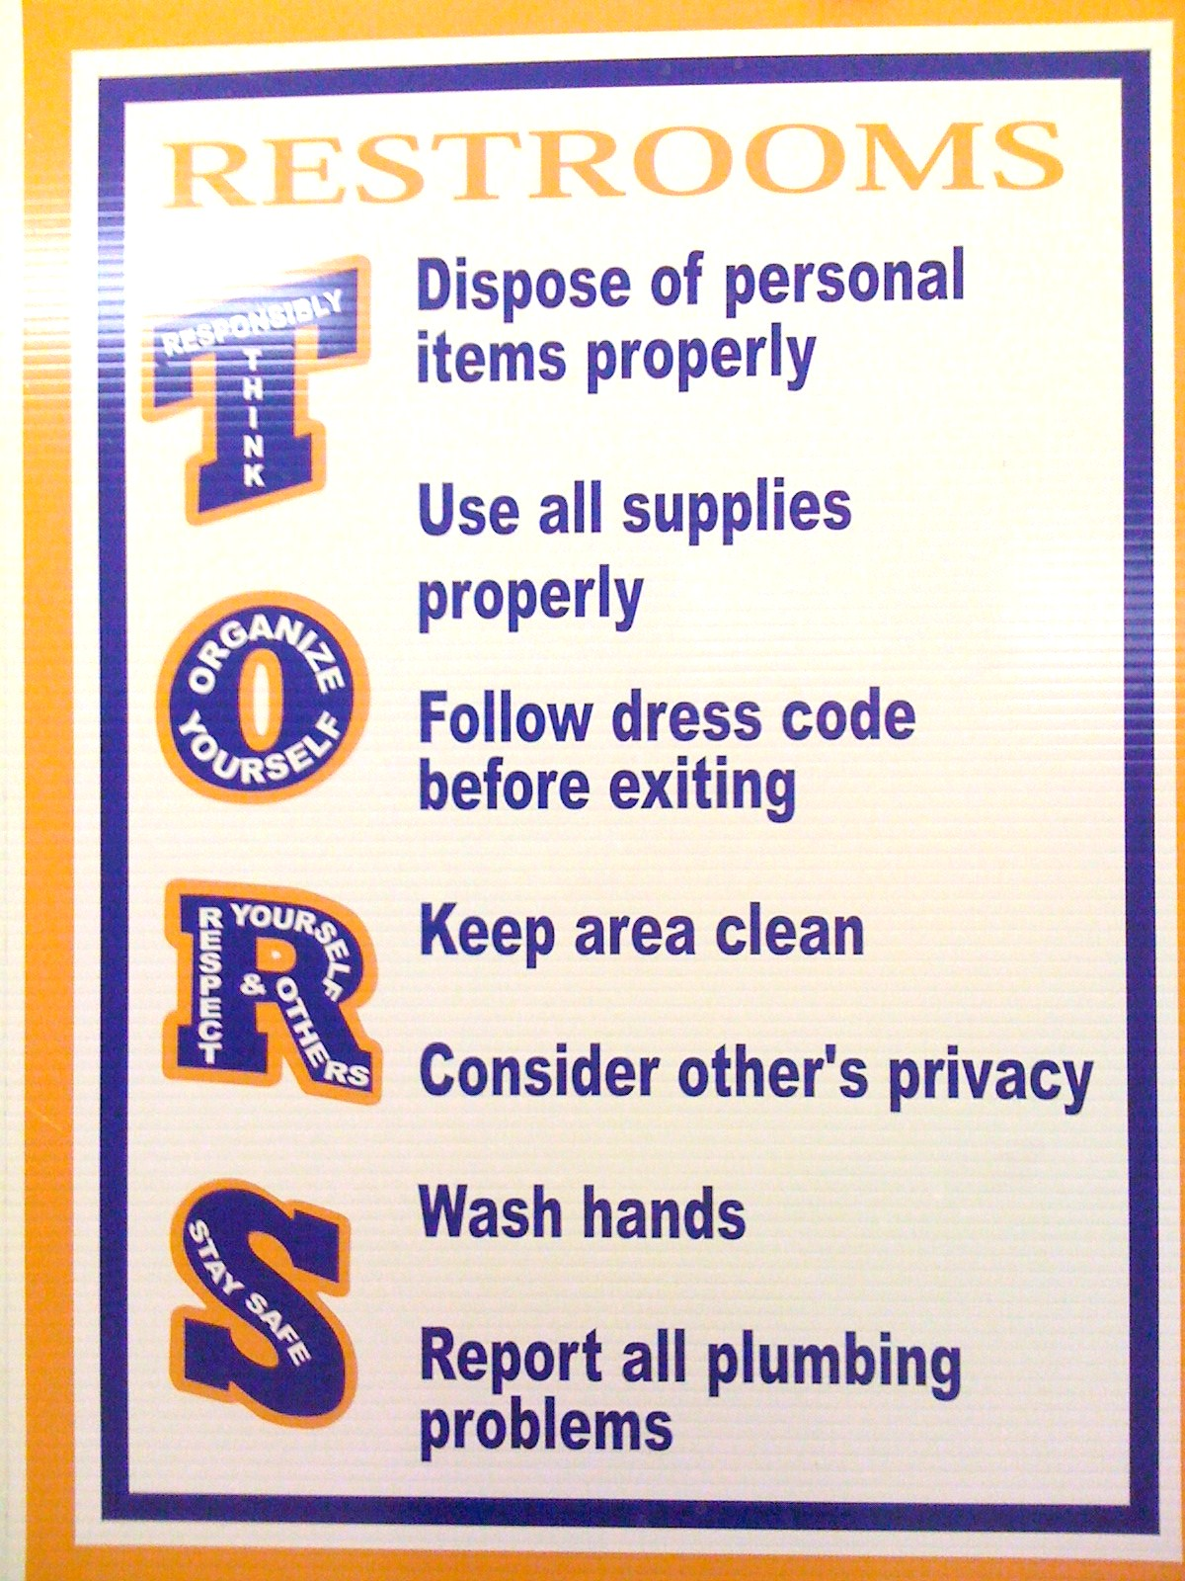
SULPHUR 9th GRADE - PBIS
Posters
CHUCK HANSEN, Principal
AMY PALMER, Teacher
SULPHUR HIGH SCHOOL, LA

Slide 98
See Handout: Matrix for Laptops and Desktops
Notes:
See website for active supervision
If elementary group present – share cafeteria video from Hunstsville

Slide 99
Prepare your staff
http://vimeo.com/14818677 and Huntsville Cafeteria video
See check list in handbook, what did you see?
2 minutes..What does PBS look like…
How long will does it take to teach an expectation?

Slide 100
Change Point Analysis: 2005-2008
Possibly the booster for students and PD for staff in Jan/Feb 2007
Notes:
Hank present
(slide animation)
Explanation of possible factors contributing to decrease in Jan/Feb of 2007 will pop up
CLICK again …

Slide 101
Planning
See example lesson plans on website
How are you going to prepare your staff to teach expectations?
Create 3-5 basic expectations
Create draft matrix for class or schoolwide
Draft one lesson plan for teaching expectations (see examples)
Notes:
See year at a glance

Slide 102
Acknowledgement
Cheerleading Video?
Notes:
Cheerleading video

Slide 103
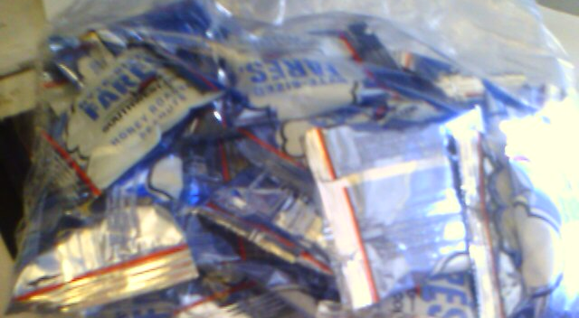
Earned this bag on SW…

Slide 104
Acknowledgement…
As part of schoolwide approach, can lead to improved performance
  Improved attendance (de Baca, Rinaldi, Billig, & Kinnison, 1991).
  Reductions in discipline problems (Bohanon et al., 2012)
Functional outcomes are important
  Relevant curriculum
  Social connection (Dunlap, Foster-Johnson, Clarke, Kern, & Childs, 1995).

Slide 105

Other Advantages of Praise
Decreases in emotional
exhaustion
Higher efficacy
Reinke, W. M., Herman, K. C., & Stormont, M. (2013).
Photo by Josh Thompson

Slide 106
Video
See examples of why this is important
  One page document “Acknowledging Students for Good Behaviors”
  Cool tool
  What are your doing around acknowledgement?
  Zappos example? See short example video 0-1:36; 2:17-2:32
Notes:
Zappos video only if time
Tell them page number -

Slide 107
High Frequency

Slide 108

Buzzy Buck
Notes:
108
108
Brigit

Slide 109

Teacher Rewards Program
2 – Soft Drink
3 – Candy Bar
5 – Preferred Parking
8 – Free Lunch
10 – No Bus Duty
15 – No Morning or
Lunch Duty
20 – Extra Planning
Period
Tonya Ryder, Assistant Principal
Selena Gomes, Graduation Coach / Teacher
Oberlin High School, LA

Slide 110

CHUCK HANSEN, Principal
AMY PALMER, Teacher
SULPHUR HIGH SCHOOL, LA

Slide 111

Notes:
111
111
Brigit

Slide 112

Notes:
112
112
Brigit

Slide 113
Intermediate

Slide 114

Timber Creek High School, FL, JOHN WRIGHT, PRINCIPAL

Slide 115
Notes:
115
115
Brigit

Slide 116

Gold and Silver ID Cards
Notes:
116
116
Brigit

Slide 117

Ron our Liaison
Jody Mimmack, PhD Fruita Monument High School, CO

Slide 118
Large Scale

Slide 119

1st Six Weeks Party –
CHUCK HANSEN, Principal
AMY PALMER, Teacher
SULPHUR HIGH SCHOOL, LA

Slide 120

A Night in Paradise…
Tonya Ryder, Assistant Principal
Selena Gomes, Graduation Coach / Teacher
Oberlin High School, LA
Notes:
With these procedures in place, it became important to recognize our students’ social, academic and behavioral successes. We no longer have a traditional academic awards presentation, but instead have a school-wide academic pep rally that recognizes all of our students’ successes in various areas. This year’s theme will be “Academic Academy Awards…A Night in Paradise.”

Slide 121

Teacher earns vacation
Timber Creek High School, FL, JOHN WRIGHT, PRINCIPAL

Slide 122
Freebies
http://www.kipbs.org/new_kipbs/familyInfo/freebies/

Slide 123

Certificate of Appreciation
Teaching Spartan of the Month
In recognition of excellence in teaching, __________ is awarded this certificate for devotion to the students, commitment to learning, and dedication to the core values of R High School.
Date
R324A070157
, Principal

Slide 124
Reflective Question
What is one high frequency acknowledgement that might work for your students or teachers?
What is one unpredictable/intermittent “BOOSTERS” acknowledgement that might work for your students or teachers?
What is Attention Grabbing “Celebrations” acknowledgement that might work for your students or teachers? See matrix

Slide 125
Reflective Question
How are you/can you encourage staff to implement student/staff behavior recognition?
Think through levels of acknowledgment for students and faculty.

Slide 126
Engagement and Opportunities to Respond
Non-example – Ferris
Jeff Bliss Video Example
Notes:
Jeff Bliss Video Example

Slide 127

Quiz
What percentage of the American workers
consider themselves engaged at their jobs?
31.7 %
(Gallop, 2015) http://buff.ly/1Gna5NO
Photo from Flicker Creative Commons https://www.flickr.com/photos/pennwic/8142281815/in/photolist-dpvjHe-dpvjNz-dpvths-pQoPx7-aMi2SZ-8vEXtU-8vBWcM-5C6oVt-pEQiQm-97vCko-rKn1F-h7BuWg-h7ybkV-h7wXts-h7y2AF-h7y1NP-8vBVJ2-8vBW8g-8vBVL8-8vBVZr-8vEXGf-8vBWgB-8vBWdB-8vBVTe-8vBW8X-8vBW4Z-h7wVwR-h7x7bs-aMi6nD-5pYDTp-aMiarZ-aMi2xk-aMhLrn-aMhSLR-aMhUsa-aMhK7i-aMhJQz-aMhUbT-aMhJxr-aMhYfc-aMhURP-aMhTt2-aMhV48-aMhKk8-aMhKyV-aMhKRR-aMhLHT-aMhTFt-aMhTXz-aMhUEp

Slide 128


Engagement
Image from http://2015.oimf.jp/en/news/detail/104
Image from http://bit.ly/1ZIfcPF
Good merchandise alone will not appeal to the customer, it …[stores]…must attract the five senses (ANA Innovations)
  Goichi Itokazu, President of Ryubo Holdings, and former president of Family Mart
Notes:
Talk about unicycle

Slide 129



Instructional/Emotional Support
Failure rates
from 17% to 11%
  Choice of responding
  Laughing with students
  Out of desk greeting
Allen, Gregory, Mikami, Lun, Hamre, & Pinata (2013)
  Ask about events
  Ask “why”?
http://mzteachuh.blogspot.com/2012/05/that-kid-drives-me-nuts-tweets-of-day.html
http://ignitebrownsville.blogspot.com/p/picture-gallery.html
http://english.vietnamnet.vn/fms/sports/57762/hanoi-to-host-5th-asean-student-sports-games.html
http://www.phy.bris.ac.uk/news_archive1.html
http://www.hillel.org/jewish/ask-big-questions
Notes:
See Blog in handout and onwebsite

Slide 130
Reflective Question
See example, what are the natural reinforcers in the classroom?
See steps in handout (see video up to 2:43)

Slide 131
Student Engagement
Webinar on using data to improve student engagement http://fb.me/4vHawmKtz
Webinar for increasing student engagement through real world projects http://bit.ly/1K5ZplN
Assessing school climate webinar http://bit.ly/1IRJgBH
Online survey: student hope, engagement, belonging, and classroom management.... http://fb.me/2bX9tbQh4
Teaching algebra in middle and high school http://buff.ly/1CqNf2c

Slide 132
Example
What connections do you make with behavior and your instructional model?
Schoolwide examples https://www.youtube.com/watch?v=y0H5XsZ1gzA
See example, how is this teacher preventing problem behavior through engagement?
  See steps in handout (see video up to 2:43)
  https://www.youtube.com/watch?v=zxTuPVtayOI

Slide 133
Redirection and Active Supervision
JcPenny’s does this very well
How some mom’s handle the pressure video – Whitney Young

Slide 134


Redirection
Images from Flickr Creative Commons
If you need to correct someone, speak to the person personally – do not embarrass them in front of others. Treat the person with dignity (Ng & Foo, 2016)
  Stephen Raidy, president and CEO of the LIPPO Group
Notes:
(US $20 Billion Dollar Conglomerate and Executive Chairmen of OUE Singapore

Slide 135
What do people like about Starbucks? Is it just the coffee?

Slide 136


Redirection, Starbucks Style
Problem=
Listen
Acknowledge the problem
Take action
Thank the customer
Encourage their return
https://www.flickr.com/photos/jack79_mi/295241529/in/photolist-s6c2c-snPcA-cBe9L5-4MCv86-deQWpH-5Hrfq8-deQWmG-bs8WbE-8QwTKz-54v7jN-deQWkH-4LQZDz-pTk24-5Hrew-7zYn6p-jhtJ2-3PrS4-93M6u-5ZRgv-7iCBqP-7zXPki-cfkpQ1-cAWgMq-o3Essy-4bX7QK-jhB4Qw-oi8bk3-HPLbR-d11jb-cv4v-69dDt-5Zqe12-3KZ51j-7CSQRL-4BUac-deQWaJ-733Hyf-27bFgT-63CyTY-4JMpRY-4E56j9-dWAY9h-hHxqqw-bkD5C-5u4KaH-2ND7vr-dF4Szc-uigrX-5pETae-4V632M
https://www.flickr.com/photos/sfj/5460895004/in/photolist-9jyvQ9-4EDQCx-ciq9gq-acTCLV-or6MBF-opyZQr-7HD4bD-2VTQV-ecdhtd-oc3FqA-7uuFQf-2vECfM-5HQQga-EZgJA-7eVbg-a95T3-jGwNrD-atfY75-MaAHM-5T63vU-8Nx9W-c51DLd-4D98Gt-2WbnRa-cdr3WN-dvcKjv-7iGxjN-3jVKDf-dsbnCL-5iSejM-ci7Qe-cUGZfN-4pH6PT-8xfZ1S-9oTxv4-u8Rr6-5HXUFU-6jkHSR-cBaiHL-h6VisX-ctjB7u-dHpzzL-69sPWA-5nXi3n-s2Qe-478wUK-neMFoz-dGVCiR-jJgKTt-8MnN24

Slide 137


Is the behavior office- managed?

Slide 138
McClatchy Students Video, Dean?
Notes:
138
Alissa present (1 minute max)
138

Slide 139
Be at post
Escort students
Brief interactions
(Johnson-Gros et al., 2008)
See article about hallways @
http://hankbohanon.net
on publications page
Notes:
139
139
Mr. Irvin – tardy policy
being at post, escorting, and interacting with students

Slide 140
Support Staff: Preventing and Responding
Teach skills for prevention
  Good classroom instruction
  Non-classroom settings
Teach skills for redirection
  Classroom
  Non-classroom settings
See Handout “Professional Development on Redirection”

Slide 141

Videos
  What does PBIS Look Like? – Active Supervsion..opennnig
  Redirection examples 6.12 mins
  http://vimeo.com/14818677
Notes:
Tell story from NC when your said slurs about my family - how I handled – how I did not react…

Slide 142
Reflective Question
Create T-Chart of expectations for handing problem behavior
Identify who handles behaviors in your school
List out behaviors that should be handed by each on each side
(see handbook)

Slide 143
Gallery Walk
See each poster, add what are you doing well in one or more area – school name..
  Structure to learning (e.g., syllabus, routines)
  Teaching expectations
  Engaging content – environment
  Acknowledging (students/staff)
  Policies and Redirection (e.g., tardy, train staff)

Slide 144
Videos
Michael Kennedy
http://vimeo.com/14818677
  See What does PBIS Look Like? – Opening, Redirection examples 6.12 mins
Other tools
Notes:
Tell story from NC when your said slurs about my family - how I handled – how I did not react…

Slide 145
Resources
Year-at-a-glance
  http://www.hankbohanon.net/Resources_1.html
Training script for booster for staff
  http://www.hankbohanon.net/Resources_1.html

Slide 146

Strategies
Mendler, A. N. & Mendler B. D. (2011) Power struggles: Successful techniques for teachers. Bloomington, IN: Solution Tree.

Slide 147

Classroom Management
Knoster, T. (2013). The Teacher’s pocket guide effective classroom management (2nd Ed.), Baltimore, MD: Paul H Brookes

Slide 148

Addressing Tardies
Start on Time!
Randy Sprick
http://www.safeandcivilschools.com/products/program_previews.php

Slide 149
Student Engagement
Webinar on using data to improve student engagement http://fb.me/4vHawmKtz
Webinar for increasing student engagement through real world projects http://bit.ly/1K5ZplN
Assessing school climate webinar http://bit.ly/1IRJgBH
Online survey: student hope, engagement, belonging, and classroom management.... http://fb.me/2bX9tbQh4
Teaching algebra in middle and high school http://buff.ly/1CqNf2c

Slide 150
Preparing Your Teams
How will you prepare your staff?
See examples and action plan
Notes:
Tell page number

Slide 151
Where are you?
Complete
  Classroom management self-assessment
  http://www.pbis.org/pbis_resource_detail_page.aspx?Type=4&PBIS_ResourceID=164
Free training on active supervision (limited time only)
  https://www.irised.com/freecourse&?utm_source=IRIS+Educational+Media+Mailing+List&utm_campaign=9d73acd430-FREEprog_SysSupEvElem_8_5_2014&utm_medium=email&utm_term=0_cb7ab95a8b-9d73acd430-291122974#.U-U6UPldWSq

Slide 152
Resources
State Implementation & Scaling-up of Evidence-based Practices Center
  http://sisep.fpg.unc.edu/
Kotter, J. (1995). Leading change: Why transformation efforts fail. Harvard Business Review, 73(2), 59–67. Retrieved from http://hbr.org/
http://www.hankbohanon.net/Resources_1.html

Slide 153
Videos
Michael Kennedy http://vimeo.com/channels/129830
  Fruita Monument
  Consistent
Scott’s Pride https://sites.google.com/a/ddouglas.k12.or.us/scotspride/

Slide 154
Finding more plans
Sample Lesson plans
  http://www.pbismaryland.org/
  http://www.hankbohanon.net
More Video Example
  http://vimeo.com/groups/pbisvideos

Slide 155
Other Supports
Defusing Disruptive Behavior in the Classroom
  Geoff Colvin http://www.lookiris.com/store/K-12_Professional_Development/Defusing_Disruptive_Behavior_in_the_Classroom/
Classroom management training
  http://pbismissouri.org/class.html
The FAST Method
  http://www.lookiris.com/store/K-12_Professional_Development/The_FAST_Method_ONLINE/
Notes:
See website

Slide 156
Other Supports
IRIS Online Modules
  http://iris.peabody.vanderbilt.edu/resources.html
Rti Action Network Article Behavior and Academics
  http://www.rtinetwork.org/Learn/Behavior/ar/Integrating-Behavior-and-Academic-Supports-Within-an-RtI-Framework-General-Overview
National Center on PBIS
  http://www.pbis.org
Association of Positive Behavior Support
  http://www.apbs.org
CASEL – SEL Center
  http://casel.org/
Direct behavior rating
  http://www.directbehaviorratings.com/cms/

Slide 157
Summary
Ask before you tell
Do not implement what you cannot support
Remember your humanity and that of the people you serve

Slide 158
References
Allen, J., Gregory, A., Mikami, A., Lun, J., Hamre, B., & Pianta, R. (2013). Observations of effective teacher– student interactions in secondary school classrooms: Predicting student achievement with the classroom assessment scoring system—secondary. School Psychology Review, 42(1), 76–98.
Benbenishty, R., Astor, R. A., Roziner, I., & Wrabel, S. L. (2016). Testing the Causal Links Between School Climate, School Violence, and School Academic Performance: A Cross-Lagged Panel Autoregressive Model. Educational Researcher, 45(3), 197-206. doi:10.3102/0013189X16644603
Bohanon, H. (2015). Changes in adult behavior to decrease disruption from students in non-classroom settings. Intervention in School and Clinic, 15 (1), 12-18. http://ecommons.luc.edu/education_facpubs/39
Bohanon, H. & Wu, M. (2014). Developing buy-in for positive behavior support in secondary settings. Preventing School Failure, 58 (4), 1–7. doi: 10.1080/1045988X.2013.798774 http://ecommons.luc.edu/education_facpubs/17/
Bohanon, H., Castillo, J., & Afton, M. (2015). Embedding self-determination and futures planning within a schoolwide framework. Intervention in School and Clinic. 50 (4), 203-209. http://ecommons.luc.edu/education_facpubs/16/
Bohanon, H., Fenning, P., Hicks, K., Weber, S., Their, K., Akins. B., Morrissey, K., Briggs, A., Bartucci, G., Hoeper, L., Irvin, L., & McArdle, L. (2012). Case example of the implementation of schoolwide positive behavior support in a high school setting. Preventing School Failure, 56 (2), 92-103. http://ecommons.luc.edu/education_facpubs/7

Slide 159
References
Bohanon, H., Gilman, C., Parker, B., Amell, C., & Sortino, G. (2016 online first). Using school improvement and implementation science to integrate multi-tiered systems of support in secondary schools. Australasia Journal of Special Education. pp. 1–18. DOE: 10.1017/jse.2016.8. http://ecommons.luc.edu/ education_facpubs/80/
Blase, K. A., Fixsen, D.L., Sims, B.J., Ward, C.S. (2015). Implementation science – changing hearts, minds, behavior, and systems to improve educational outcomes. Paper presented at the Wing Institute’s Ninth Annual Summit on Evidence-Based Education, Berkeley, CA. http:// nirn.fpg.unc.edu/resources/ implementation-science-changing-hearts-minds-behavior-and-systems-to-improve
Brawley, S. (accessed March 22, 2011). PBS in the classroom. M.Ed. Heart of Missouri RPDC. http://www.cesa7.org/pbis/Classroom_Management.asp
Burke, A. (2015). Early Identification of High School Graduation Outcomes in Oregon Leadership Network Schools. REL 2015-079. Regional Educational Laboratory Northwest.
de Baca, M. R. C., Rinaldi, C., Billig, S., & Kinnison, B. M. (1991). Santo Domingo School: A rural schoolwide project success. Educational Evaluation and Policy Analysis, 13(4), 363-368. doi: 10.3102/01623737013004363
Eber, L., Phillips, D., Upreti, G., Hyde, K., Lewandowski, H., & Rose, J. (2009). Illinois positive behavioral interventions & supports (PBIS) network 2008-09 progress report (pp. 245). La Grange Park, IL.
Flannery, B. K., Guest, E., & Horner, R. (2010). SWPBS: Schoolwide positive behavior supports. Principal Leadership, 11(1), 38-43. doi: 2123461661
Illinois Positive Behavior Intervention and Support Network (2011). FY11 end of the year summary report. La Grange, IL: Illinois Positive Behavior Intervention Network.

Slide 160
References
Johnson-Gros, K. N., Lyons, E. A., & Griffin, J. R. (2008). Active supervision: An intervention to reduce high school tardiness. Education & Treatment of Children, 31(1), 39-53.
Koon, S., & Petscher, Y. (2016). Can scores on an interim high school reading assessment accurately predict low performance on college readiness exams? (REL 2016–124). Washington, DC: U.S. Department of Education, Institute of Education Sciences, National Center for Education Evaluation and Regional Assistance, Regional Educational Laboratory Southeast. Retrieved from http://ies.ed.gov/ncee/edlabs.
Kotter, J. (1995). Leading change: Why transformation efforts fail. Harvard Business Review, 73(2), 59–67.
McKeon, G. (2014). Essentialism: The disciplined pursuit of less. Crown Business
McNeely, C. A., J. M. Nonnemaker, J.M., & Blum, R. W. (2002). Promoting School Connectedness: Evidence from the National Longitudinal Study of Adolescent Health. The Journal of School Health 72(4): 138-146.
McIntosh, K., Filter, K. J., Bennett, J. L., Ryan, C., & Sugai, G. (2009). Principles of sustainable prevention: Designing scale-up of School-wide Positive Behavior Support to promote durable systems. Psychology in the schools, 47(1), n-a-n/a. doi:10.1002/pits.20448
McIntosh, K., Flannery, K. B., Sugai, G., Braun, D., & Cochrane, K. L. (2008). Relationships between academics and problem behavior in the transition from middle school to high school. Journal of Positive Behavior Interventions, 10(4), 243–255. doi:10.1177/1098300708318961
Morrissey, K. L., Bohanon, H., & Fenning, P. (2010). Positive behavior support: Teaching and acknowledging behaviors in an urban high schools. Teaching Exceptional Children, 42(5), 26-35.

Slide 161
References
National High School Center, National Center on Response to Intervention, and Center on Instruction. (2010). Tiered interventions in high schools: Using preliminary “lessons learned” to guide ongoing discussion. Washington, DC: American Institutes for Research. http://bit.ly/2r0SaeE
Newcomer, L. (2009). Universal positive behavior support for the classroom. PBIS Newsletter, 4(4). Retrieved September 24, 2009 from http://www.pbis.org/pbis_newsletter/volume_4/issue4.aspx
Ng, J. & Foo, A. (2016). Heart to heart with Asian leaders: Exclusive interviews on crisis, comebacks, and character. Singapore: World Science Publishing.
Rowan, B., Correnti, R., Miller, R. J., & Camburn, E. M. (2009). School improvement by design: Lessons from a study of comprehensive school reform programs. Consortium for Policy Research in Education. Retrieved from http://www.cpre.org/school-improvement-design-lessons-study-comprehensive-school-reform-programs
Sherif, M., Harvey, O. J., White, B. J., Hood, W. R., & Sherif, C. W. (1961). Intergroup conflict and cooperation: The Robbers Cave experiment (Vol. 10): University Book Exchange Norman, OK.
Simonsen, B., Fairbanks, S., Briesch, A., Myers, D., & Sugai, G. (2008). Evidence-based practices in classroom management: Considerations for research to practice. Education & Treatment of Children, 31(3), 351-380. doi: 10.1353/etc.0.0007
Therriault, S. B., Heppen, J., O’Cummings, M., Fryer, L., & Johnson, A. (2010). Early warning system implementation guide. Retrieved from http://www.betterhighschools.org/documents/NHSCEWSImplementationGuide.pdf
Vermont Agency of Education (Accessed July 28, 2016). The 13 dimensions of school climate. Vermont Agency of Education, Retrieved from: http://education.vermont.gov/documents/edu-school- climate-13%20Dimensions.pdf

Slide 162


