Slide 1


Judicial Privacy Act Project
By Johnny Khuu

Slide 2
Table of Contents
01
02
03
U.S. District Court Internship
Judicial Privacy
Act
Background
Information
04
05
06
Methods
Results
Final Thoughts
Responsibilities and Project Team Members
Summary and Short History
Federal motivations and preliminary framework
My approaches and reasonings
Contributions to project
Reflection on experience

Slide 3

U.S. District Court Internship
01

Slide 4

Responsibilities
Recording Data
Presenting
Communications
Investigations
Managing research data, tracking data, and correspondence data within court databases.
Presenting updates on project progress through emails and office meetings
Communicating with all the violators and consenting federal judges.
Coordinating online research, updating research documents, and analyzing data.

Slide 5
District Threat Investigator
Clerk of Court
Assistant Deputy Marshal
U.S. Marshal Service
Clerk’s Office
Executive Assistant
Project Team Members
Head Circuit Librarian
Clerk of Court’s Intern
Me
Circuit Libraries
Circuit Librarian

Slide 6

Judicial Privacy Act
02

Slide 7

Is a state statute
Requires written request from judicial officer
Protection includes judicial officers' immediate families
  Spouse & Children
Violation is a Class 3 Felony
  Exception if consent is given in government setting
Persons, businesses, and associations have 72 hours to comply
Applies to other government agencies
  5 days to comply
Judicial Privacy Act
Summary - Prohibits soliciting, selling, trading, and publicly posting a judicial officer’s personal information on the Internet by persons, businesses, and associations.

Slide 8


Short History
In 2005 U.S. District Judge Joan Lefkow’s mother and husband were murdered at their home.
  Motive was believed to be revenge for a ruling she had made
  Incentivized judicial protection
Bill was supported by the Illinois Judges Association.
Officially passed in 2012

Slide 9

Background Information
03

Slide 10
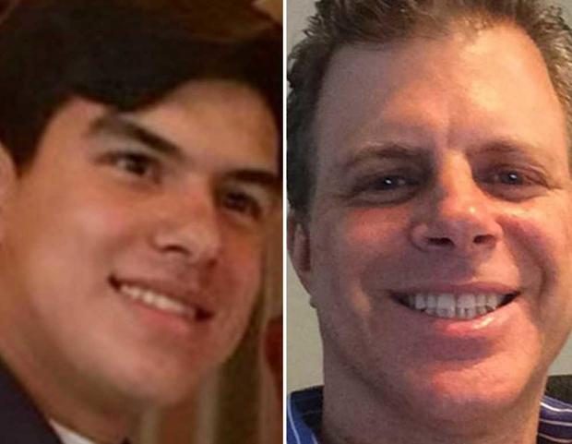
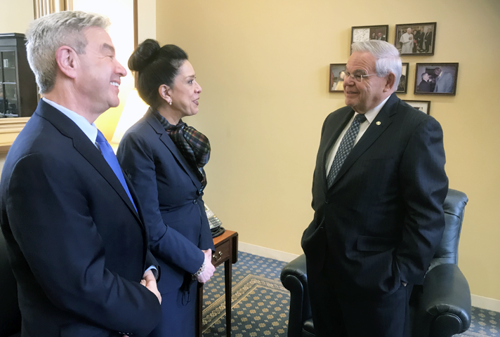
Federal Motivations
In July 2020 Daniel Anderl and Mark Anderl were attacked at their home.
  The shooter was disguised as a delivery man
  Mark Anderl survived however Daniel Anderl had succumbed to his wounds and died.
  The shooter was believed to hold resentment against a ruling of Judge Esther Salas who was mother to Daniel Anderl and wife to Mark Anderl
  Judge Salas believes that the shooter had found her personal details on the internet and pushed for Bills that would improve the safety and security of the Federal Judiciary
    The Daniel Anderl Judicial Security and Privacy Act

Slide 11
Preliminary Framework
U.S. District Court, Northern District of Illinois had wanted to utilize Illinois’ Judicial Privacy Act
  Federal court requested information
    No Data
      Who have they sent them to? Did they had received them? Did they had complied?
The federal court had to begin building information to develop a framework to work with
  Who are violating the Judicial Privacy Act?
  How should we communicate with these violators?
  What are the different means of tracking removal request letters?
  What should the request letters include?

Slide 12
Preliminary Framework
Who are violating the Judicial Privacy Act?
  Data Brokers – entities that trade personal information online for money
  List of over 70 data brokers
    Major and Minor data brokers
How should we communicate with these violators?
  1st physical mailing, 2nd email, 3rd phone
What are the different means of tracking removal request letters?
  USPS and UPS data
  Emailing receipt and server pings
What should the removal request letters include?
  Judge’s request to remove
    private information they wish to be removed

Slide 13

Methods
04

Slide 14

Judicial Consent Forms
Data Broker Research
Data Broker Correspondence
Data Broker Compliance

Slide 15
Judicial Consent Forms
7 Consenting Federal Judges
  Required documents contained two sections
    1st document, consent form
    2nd document, information removal request form
      Name
      Main Address
      Secondary Addresses
      Phone numbers
      Emails
      Spouse
      Children under 18
    All documents were saved within court database
1 Federal Judge had been processed
  I oversaw processing the other 6 federal judges

Slide 16
Data Broker Research
Personal information filled in by federal judges were used for investigations
  I sent information to the Head Librarians from Seventh Circuit
    Circuit Librarians to perform soft checks online
      Judges with ongoing threats received priority
      Data was received by me, I reviewed their results
Data brokers that librarians marked to contain related information to federal judges
  Reviewed by me
    Must have a link between name and other personal information
      Name – Address, Name – Phone Number, Name – Email
Data brokers that librarians marked to contain no information related to federal judges
  Hard checked by me for missed data
    Business profile investigations, Login-walls, navigation issues

Slide 17
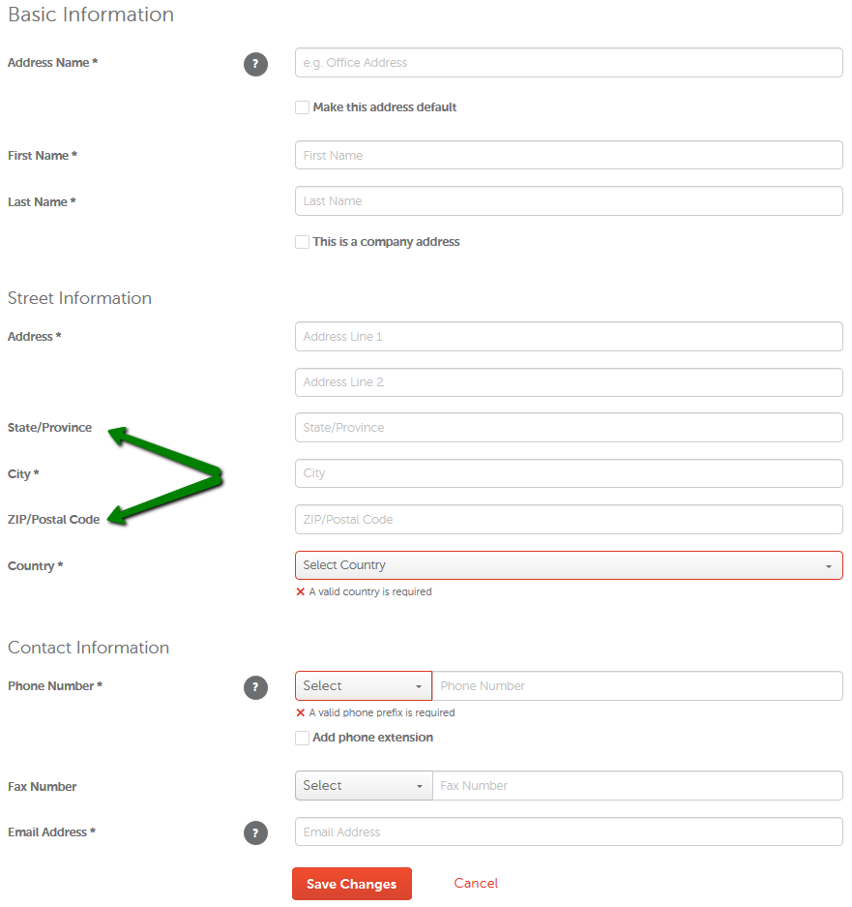
Librarians Soft Checks Example
Data Recording Example
Pay-wall are websites that require monetary subscription in order to view data

Slide 18
Data Broker Communication
Data broker companies marked with “info found”
  Preliminary investigations had listed the business addresses of data brokers
  I Individualized and prepared letters and forms for federal judges whose information was found
    Most mail were tracked via USPS tracking
    USPS Domestic Return Receipt applied
      Will require the addressee to sign and list their forwarded address
        Receipt is sent back to the Clerk’s office
    I recorded and monitored all tracking data
If mailing address does not work
  Contacted data brokers via email then phone to inform them of violation
    If this does not work, I notify my project members in the U.S. Marshal Service

Slide 19
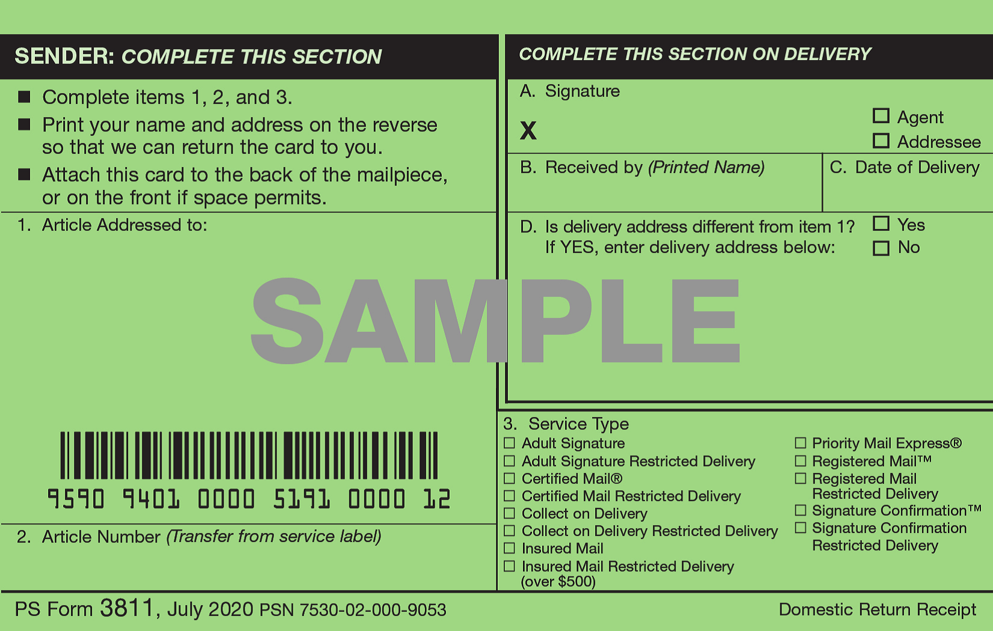
Domestic Return Receipt
Mail Tracking Data Example

Slide 20
Data Broker Compliance
72-hour compliance period
  Not a strict rule
  Afterwards, I investigated their websites for compliance results
  Depending on results they are labeled “Full Removal”, “Partial Removal”, “No Compliance”
    Partial Removals and No Compliance statuses are sent a second follow-up letter emphasizing the consequences
      Follow-up removal request letter
      information removal request form
  Data brokers who refused to comply after being contacted again will be listed and their information sent to our federal judges to consider legal pursuits

Slide 21
Compliance Data Example

Slide 22

Results
05

Slide 23
Results
Correspondences and Violations
Compliance Results
Judiciary Response
144 recorded Judicial Privacy Act Violations
221 recorded letter and email correspondences sent
68 Full Removals
35 ongoing communications
5 New Consenting Federal Judges
12 total involved in project

Slide 24
Results (continued)
Established two data broker networks
  Data broker network is a collection of data brokers who share data in order to maximize profits
  Qualitative similarities between data brokers
    Ex. Email signature, domain address, similar business addresses, close vicinity of business addresses, similar language used in communications, website layout, pay-wall layouts, etc.
      Confront data broker network with evidence
Data broker cooperation
  Developed a relationship between the court and data brokers
    Helps streamline the removal process
Created a budget plan for pay-walled websites which is 5965$ so far

Slide 25

Final Comments
06

Slide 26

Thank You
Sources
https://www.npr.org/2020/11/19/936783691/judge-esther-salas-remembers-the-night-of-assailants-attack-on-her-family
https://www.chicagotribune.com/opinion/commentary/ct-opinion-federal-judges-threats-lefkow-20201209-4vypwpafvfb35jy7x5tjkhlutm-story.html

