Slide 1
Fall 2021 Internship at the Urban Wildlife Institute, Lincoln Park Zoo
Ashriya Patel
Notes:
I’m senior at Loyola University Chicago, studying biology with an emphasis in ecology.
Throughout my undergraduate career, I have developed an interest in wildlife biology, often spending my summers doing fieldwork in Chicago and surrounding areas. As I began my senior year, I wanted to extend my summer passions into the school year.
I applied for an internship program at the Lincoln Park Zoo, Urban Wildlife Institute during the fall 2021 semester.

Slide 2
Urban Wildlife Institute Project Summaries
Assist Mist Netting
Check Camera traps
Identify IOR photos
Help with Chicago Rat Project
Notes:
I learned mist-netting techniques to assess the effects anthropogenetic pollutants have on American Robins
I helped check and collects camera traps around the city, and learned what factors increase the likelihood of observing wildlife.
Identify the mammals photographed on the motion detector cameras for city census data.
I help with the Chicago Rat Project, where we communicated with Chicago residents and set rat traps on their property in order to study population movement and abundance of rats in Chicago.
Picking a research topic from experience at the UWI
I examined the possible consequences of human interaction with urban wildlife, like the transmission of zoonotic diseases, known as spillover events.
Rat infestations were observed in areas of high human traffic, increasing the likelihood of possible contamination.
I decide to focus on rats and diseases, because although these are often associated together, what do individuals know about rat zoonotic diseases?

Slide 3
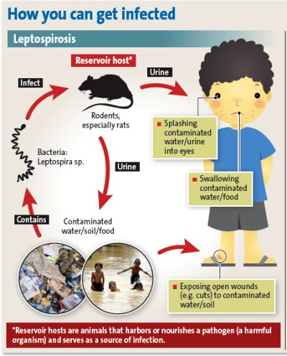
Why could Chicago, IL become at risk for a Leptospirosis outbreak in the future.
“Rattiest city”
Increase flooding
High Population
Notes:
Leptospirosis
Rats are reservoir host of the bacteria Leptospira, and infection can result from indirect or direct exposure to infect rodents that shed parthenogenic Leptospira in their urine.
Why is Chicago At risk?
Previous study concluded some rats are carriers of Leptospirosis in Chicago area. According to Orkin Pest Control company Chicago was voted “rattiest city” for the 7th year in a row. The number of 3-1-1 rat associated complaint increased by 30% this past year
Increase flooding from climate change prediction will lead to high amounts of standing water, due to poor city drainage. Leptospira thrive in standing water where microhabitats create ideal conditions for transmission.
Due to future climatic factors, we should expect a high migration of people toward city centers. High population density coupled with increased flooding and high density of rats can increase the likelihood of individuals unknowingly interacting with contaminated water. Hence Leptospirosis could be on the rise.
L
Ll

Slide 4
The Relationship between Knowledge, Concern and Exposure in Disease Systems
Notes:
If we expect Leptospirosis threats to rise, how can residents minimize possible spillover events?
Covid-19 has taught us the gravity of outbreaks and transmission rates can be influenced by an individual's knowledge of disease, concern of disease and behaviors surrounding possible exposure to diseases.
I aim to understand the relationship between knowledge, concern and exposure in regard to disease systems

Slide 5
Data Obtained from Survey data Distributed to Chicago Residents from the Chicago Rat Project
Are rats' carriers of Leptospirosis?
How concerned are you about rat associated disease?
Have you notice a strong smell of rats or rat urine?
Notes:
Methods
Data obtained from survey data distributed by the Chicago Rat Project across 12 of the 77 community areas in Chicago. These 12 community areas represent a variation I residents experience with rats and socio-economic status.
Households were mailed postcards that with information on where they can take an online or sudatory survey produced in English/ Spanish/ Chinese
Surveys available from May – August 17th, 2021
Questions examine in survey
Are rat’s carriers of leptospirosis? This question assess resident's knowledge surrounding rat associated disease.
How concerned are you about rat associated disease? This assesses disease concern
Have you noticed a strong smell of rats or rat urine? This asses possible exposure to Leptospirosis since urine is the main source of contamination.

Slide 6
Are individuals who frequently notice a strong smell of rat urine concerned about rat zoonotic diseases? Exposure + Concern = Positive Correlation Do these individuals that are exposed have accurate knowledge of this disease? Exposure + Knowledge = No Correlation Is accurate knowledge of rat-associated disease correlated with disease concerns? Knowledge + Concern = No Correlation
Notes:
Research Questions with Hypothesis
Hypothesis 1: People who are exposed to rats, by frequently noticing a strong smell of rat urine, will be more concerned about diseases from rats than people who are not exposed to rats. I hypothesis that concern is positively related to exposure.
Hypothesis 2: Knowledge regarding leptospirosis is a rat associated disease is not dependent of indivduals noticing a strong smell of rat urine or not. I hypothesis that Exposure/risk is unrelated to knowledge.
Hypothesis 3: People who are concerned about diseases associated with rats and people who are not concerned about diseases associated with rats are equally likely to know that rats carry Leptospirosis. The concern is unrelated to knowledge.

Slide 7
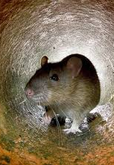
There were 697 responses to the Survey
81.6% Concerned
36.1% Exposed
29.4% Knowledgeable
Notes:
There were a total of 697 responses to the survey over the course of 2.5 months from the end of May to August 17th, 2021. However, since not all individuals responded to every question in the survey, the number of total responses for each question fluctuated.
As a result, 81.6% (502 out of 615) respondents were concerned about rat-associated diseases
36.1% (222 out of 615) respondents were exposed to rat urine in the past six months.
29.4% (177 out of 610) of respondents correctly identified that Leptospirosis is a rat-associated disease.

Slide 8
Significant Positive Relationship between Exposure and Concern
In the past six months… | Exposed to rat urine | Not exposed to rat urine | Total
Concerned about rat-associated diseases | 191 | 311 | 502
Not concerned about rat-associated diseases | 31 | 82 | 113
Total | 222 | 393 | 615
Notes:
There was a significant positive relationship between exposure and concern (X² = 4.505, p=0.034; Table 1).
Of the 222 respondents exposed to rat urine 191 individuals (86.0%) were concerned about rat-associated diseases,
whereas of the 393 respondents not exposed to rat urine within the past six months, only 311 individuals (79.1%) were concerned about rat-related diseases
This relationship could be derived from historical interconnection between rats and diseases.
Rats have been to blame for the bubonic plague

Slide 9
No Relationship between Knowledge and Exposure
 | Correctly identified Leptospirosis as a rat associated disease | Did Not correctly identify Leptospirosis as a rat associated disease | Total
Exposed to rat urine | 65 | 155 | 220
Not exposed to rat urine | 107 | 283 | 390
Total | 172 | 438 | 610
Notes:
There was no relationship between knowledge regarding Leptospirosis as a rat-associated disease and exposure to rat urine in the past six months (X²=0.309, and a p=0.578; Table 2).
Of the 172 respondents that correctly identified Leptospirosis as a rat-associated disease, only 65 (37.8%) were also exposed to rat urine within the past six months.
Similarly, of the 438 respondents who did not indicate Leptospirosis is a rat-associated disease, only 155 (35.4%) of people were exposed to rat urine.
People who are more likely to be at risk of possible spillover or contamination (by having possible exposure), cannot accurately identify the diseases they risk and/or know the protocols to protect themselves and their families.

Slide 10
No Relationship between Knowledge and Concern
 | Correctly identified Leptospirosis as a rat associated disease | Did Not correctly identify Leptospirosis as a rat associated disease | Total
Concerned about rat-associated diseases | 147 | 335 | 482
Not concerned about rat-associated diseases | 28 | 85 | 113
Total | 175 | 420 | 595
Notes:
There was no significant relationship between this knowledge regarding Leptospirosis as a rat-associated disease and concern about rat-associated disease (X² =1.44, p-value = 0.230; Table 3).
The majority (335 out of 595) of people were not knowledgeable about Leptospirosis and yet were concerned about the disease.
Interestingly, there was a low level of knowledge surrounding rat-associated diseases independent of whether individuals were concerned or not concerned about disease.

Slide 11
Are individuals who frequently notice a strong smell of rat urine concerned about rat zoonotic diseases? Exposure+ Concern = Positive Correlation Do these individuals that could have possible exposure, have an accurate knowledge of this disease? Exposure + Knowledge = No Correlation Is accurate knowledge of rat-associated disease correlated with disease concerns? Knowledge + Concern = No Correlation
Notes:
After analyzing my data I found that my hypotheses coincided with my results.
There was only a positive relationship between exposure and concern. Chicago resident lack a general Knowledge associated with rat zoontic disease.

Slide 12
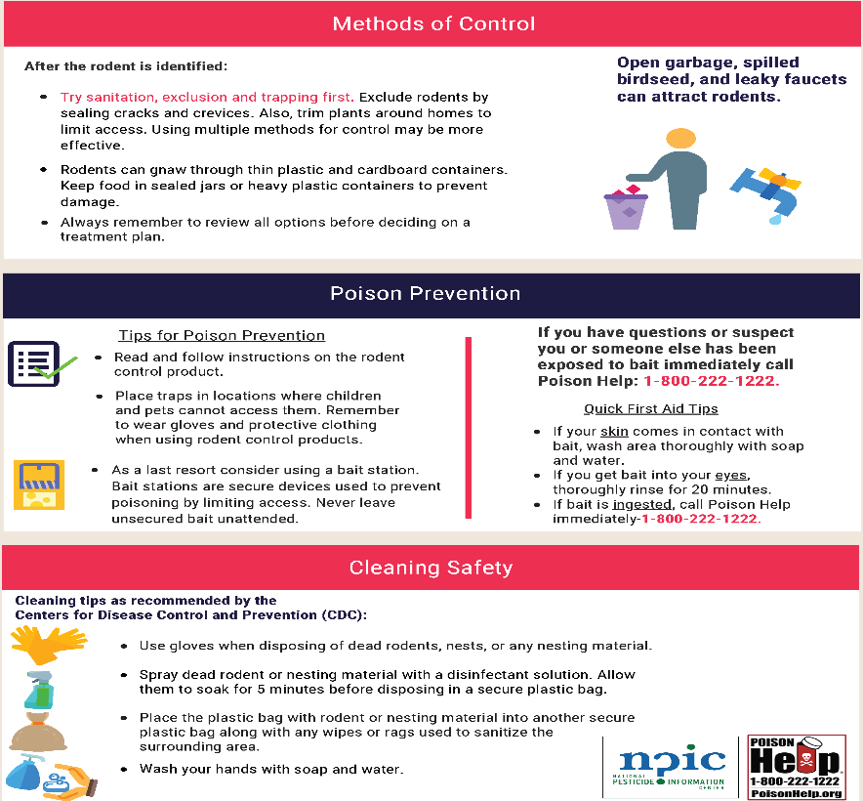
A Lack of Knowledge Surrounding Rat Associated Diseases
Prevention
Safety and warning
Disinfecting
Notes:
This study emphasizes the inability of Chicago residents to accurately identify rats as carriers of Leptospira. Regardless of being concerned or exposed to possible rat-associated diseases, had no effect on this knowledge, highlighting apprehensions for public health.
I suggest educational information on rat zoonotic diseases, and their route of transmission should be printed on labels of a variety of rodent control products (example image in PowerPoint) . Many rodent control methods have warnings directly associated with the rat control product, like the risk of rodenticide contamination. However, these products never caution the consequences associated when directly exposed to rats and how to minimize contamination when attempting to properly dispose of rat carcasses or clean up rat excrement/urine.
Future research should aim to understand why residents have limited knowledge of rat zoonotic diseases.
This research should estimate what areas of knowledge are vital to minimizing behaviors that can increase the risk of spillover events, and how to effectively communicate this information.

Slide 13
Acknowledgements
To the other interns:
Paige/ Steph / Deirdre / Marlen
To my advisors:
Liza / Maureen
Special thanks to:
Kim /Jackie

Slide 14
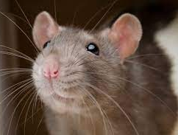
Questions?
Notes:
Common questions

Slide 15
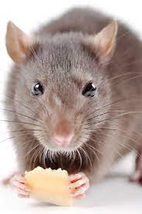
Thank you!

