Slide 1
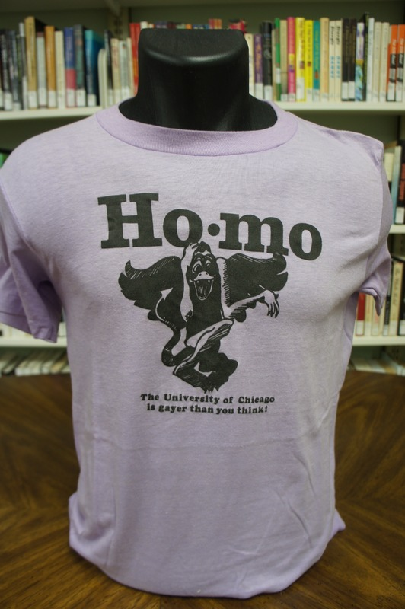
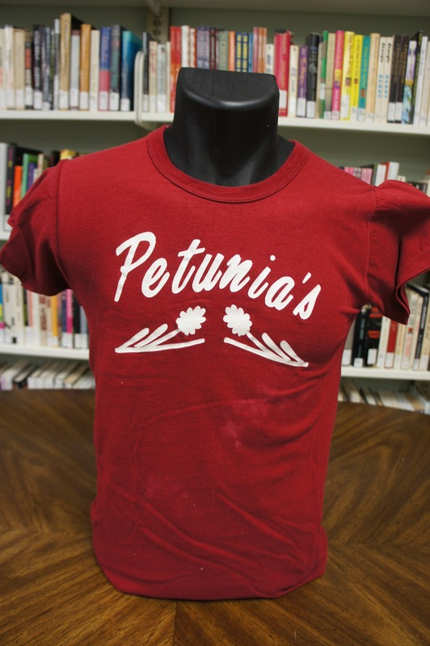
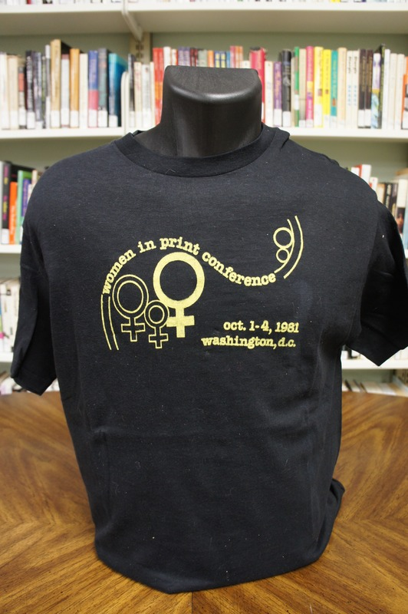
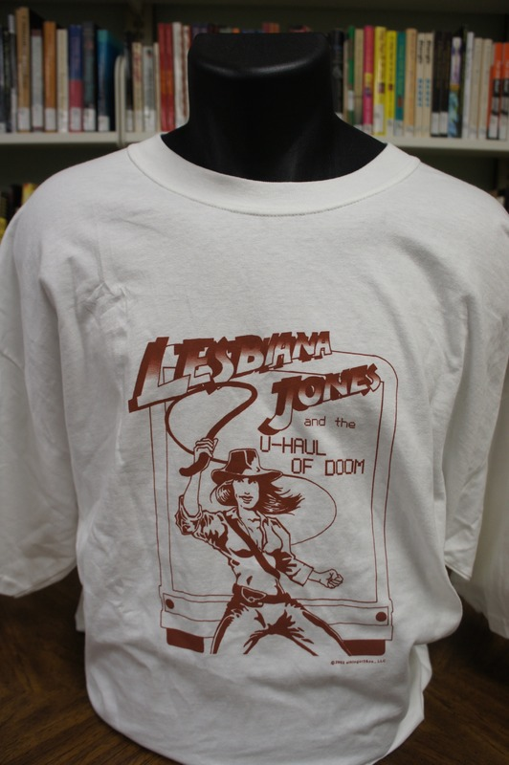
Gerber/Hart Library and Archives Internship
Gerber/Hart Library and Archives Internship
By: Sarah Gerards
Loyola University Chicago
The T-shirt Project
As an intern, my project for the semester focused on cataloguing, preserving, dating, photographing, and digitalizing Gerber/Hart’s collection of t-shirts. These t-shirts came from a wide variety of sources in the Queer community, ranging from benefits, to bars, to activism. Each shirt contained within it its own history, both personal and public. Through my experience working with the t-shirts, I gained a greater understanding about the scope of LGBTQ+ history and what matters to people in the community. I loved researching each t-shirt to find its origins in history and culture, and I learned about corresponding historical events, protests, action groups, cultural events, nightlife, community groups, politics, and so much more. The photographs featured on this poster are shirts that I archived.
On Right: Petunia’s (lesbian bar), Chicago, circa 1970s
About Gerber/Hart:
Gerber/Hart Library and Archives was founded in 1981, and it is the Midwest’s first and largest LGBTQ+ library and archive. G/H was created through the efforts of the Chicago Gay and Lesbian History Project and Gay Horizons. Gerber/Hart’s collections focus on Queer history and culture in Chicago and the Midwest. The organization serves the LGBTQ+ community by collecting, preserving, and making accessible collections of items from individuals, organizations, and businesses. Gerber/Hart has a free library (one of the largest LGBTQ+ literature collections in the country), puts on exhibits, has a podcast, runs programing, and the collections are accessible to anyone interested in learning more about LGBTQ+ history and culture.
On Left: University of Chicago, Ho-mo, date unknown
Queer History or the Lack Thereof
“Finding our history is going to be a tool for our liberation.” Gerber/Hart was a revolutionary institution when it opened in 1981. LGBTQ+ history has historically been neglected and excluded from mainstream histories. Due to this exclusion from academia and history, LGBTQ+ community members had to preserve their own artifacts, books, and papers so they could be accessed by the next generations. Established archives and libraries would not hold items from LGBTQ+ history, so the responsibility for the maintenance of culture and history fell onto individuals. Gerber/Hart only has half of the items it preserves due to the careful work of members of the LGBTQ+ community in storing important materials in their basements and attics, somehow sensing their future significance. Individual donations are still the backbone of the development of community archives and queer history. To learn more about this topic, listen to the podcast episode “A Library and Archives for Us: The Story of Gerber/Hart Library and Archives” by Unboxing Queer History.
On Right: Lesbiana Jones and the U-Haul of Doom, 2002, unknown creator
Dating, Preservation, and Digitalizing Historical Artifacts
Dating a t-shirt was sometimes as easy as recording the date written on the shirt for event, or as hard as researching the origins of an organization or business to place a t-shirt in a historical timeframe. After dating, describing, and giving each shirt a collection number (so they can be easily found in the archive), each shirt had to be steamed and photographed as a mode of preservation. The final step in the T-shirt project was to upload all the research, information, and photographs of the collection online, so that the collection is accessible to all members of the community.
On Left: Women in Print Conference, 1981, Washington D.C.

