Slide 1


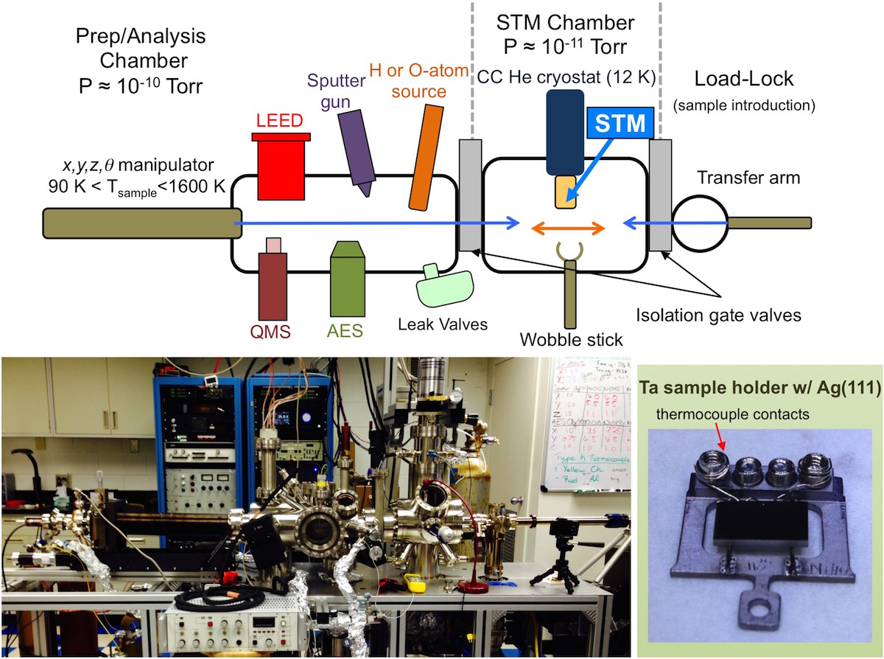
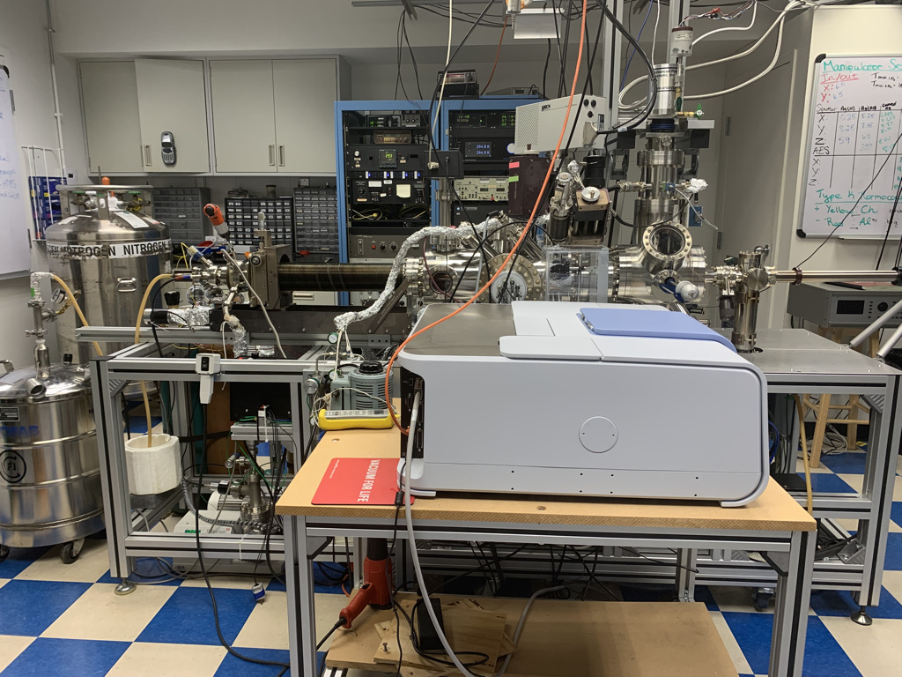
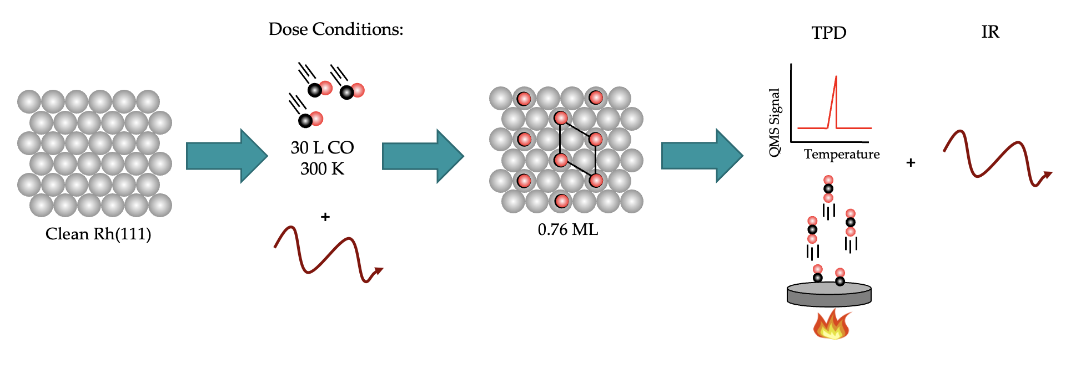

Investigation of carbon monoxide (CO) oxidation on Rh(111) with IRRAS
Faith Lewis, Elizabeth A. Jamka, Maxwell Z. Gillum, Christina Giger, and Dan R. Killelea
Department of Chemistry and Biochemistry, Loyola University Chicago, Chicago, IL USA
Introduction
Group
Experimental Setup
Fourier Transform Infrared Spectroscopy (FTIR) is a technique that allows for the measurement of a range of wavelengths in the infrared region that are absorbed by a material. In Dr. Killelea’s lab, there is an FTIR under Ultra-High Vacuum (UHV). FTIR uses a light beam which is polarized in a dry, CO₂ free environment, and then gets directed at the crystal’s surface. The beams reflect off of the surfaces and gets directed to an MCT detector.
Temperature Programed Desorption (TPD) is a technique that measures when different absorbates come off of the surface of a crystal. By using a mass spectrometer, the partial pressures of gases are measured as the temperature of the crystal is ramped linearly.
In this experiment, an Rh(111) crystal was exposed to CO under UHV conditions. After the surfaces had been dosed, a TPD was run from 100K to 600K for CO, and then another TPD is run from 300K to 1300K to moderate any residual species on the surface and to clean the crystal in between experiments. The FTIR is run during the TPD from 100K to 600K, taking a scan every 10 seconds.
MCT Detector
IR
Christina Grytsyshyn-Giger, Brooklyn Gasiorek, Elizabeth Jamka,
Faith Lewis, Maxwell Gillum, Dr. Dan Killelea
Coverage Study
TPD
FTIR
CO Exposure
Dry CO₂ Free Air
Environment
Dry CO₂ Free Air
Environment
IR
Polarizer
Mirror
Sample
Mirror
MCT Detector
UHV Chamber
Future Directions and Support
Results
Partial pressure on the right show when CO came off of the surface
Different colors indicate increasing coverages of CO
Near Future
Look into oxygen and carbon monoxide on Rhodium’s surface
Future
Looking into different temperature exposure affects shifts in IR
Characterize surfaces via STM
Integrated coverage of CO on the surface as coverages increase.
Surface saturates with CO at 30L, θ_{CO} = 0.75 ML
Peak Assignments
Coverage (ML) | ν_{co,atop} (cm⁻¹) | ν_{co,bridge} (cm⁻¹) | Dose Temp (K)
0.76 | 2071.1 | 1853.2 | 300
0.667⁽¹⁾ | 2082 | 2011 | 123
0.78⁽¹⁾ |  | 1851 | 123
0.72⁽²⁾ | 2067 | 1861 | 273
0.75⁽³⁾ | 2070 | 1861 | DFT
saturation⁽⁴⁾ | 2070 | 1861 | DFT
0.75⁽⁵⁾ | 2070 | 1870 | -
Loyola University Chicago Department of Chemistry
Provost Fellowship
Mulcahy Scholarship
References
Jamka, E.A.; Gillum, M.Z.; Grytsyshyn-Giger, C.; Lewis, F.; and Killelea, D.R.; “Temperature-Resolved Surface Infrared Spectroscopy of CO on Rh(111) and O/Rh(111)” in preparation
Derouin, J.; Farber, R. G.; Killelea, D. R.; J. Phys. Chem. 2015.
(1)Krenn, G.; Bako, I.; Schennach, R. CO Adsorption and CO and O Coadsorption on Rh(111) Studied by Reflection Absorption Infrared Spectroscopy and Density Functional Theory. Journal of Chemical Physics 2006, 124 (14).
(2) Nakamura, I.; Kobayashi, Y.; Hamada, H.; Fujitani, T. Adsorption Behavior and Reaction Properties of NO and CO on Rh(1 1 1). Surface Science 2006, 600 (16), 3235–3242.
(3) Hopstaken, M. J. P.; Niemantsverdriet, J. W. Structure Sensitivity in the CO Oxidation on Rhodium: Effect of Adsorbate Coverages on Oxidation Kinetics on Rh(100) and Rh(111). Journal of Chemical Physics 2000, 113 (13), 5457–5465.
(4) Köhler, L.; Kresse, G. Physical Review B 2004, 70.
(5)Hoffmann, F. M. Surface Science Reports 1983, 3 (2–3), 107–192.
Our values near 300K match previous literature values, showing that our method is working
Contact: flewis1@luc.edu
More information can be obtained at: www.killeleagroup.com
On Top
Bridge
Notes:
After 1.5L CO exposure, CO inserted into (2x1)-O creating the (2x2)-O+CO patches on the terraces (some CO inserted into the (2x1) (bright pink circles), RhO2 unaffected
Little CO sticks to the Rh oxide surface because it has a small
adsorption energy.12,17 Therefore CO exposure only disrupted
the RhO2 moiréat defect sites, as indicated by the large cluster
of adsorbates in Figure 2B. Further imaging of the sample
following CO exposure showed triangular features on the
moiré pattern but not on the bare RhO2 surface (Figure S2).
These triangular structures protrude from the surface, and their
lateral spacing remains consistent with the spacing for RhO2.32
Protrusions seen along the step edges and defect sites of the moiré suggest that either CO adsorbed or, perhaps reacted
away some oxygen, preferentially at these undercoordinated
positions.16 While previous work has suggested that oxygen is
replenished by oxygen from RhO2 during the course of CO
oxidation,12 we saw that the surface composition was
essentially unchanged (aside from some CO insertion) after
the 1.5 L CO exposure in Figure 2B,C, in which approximately
1 ML of oxygen was consumed. There must be another source
of oxygen: Osub. The terraces remained covered in coexisting
domains of the (2 Å~ 1)-O adlayer and the surface oxide, and in
any case, the surface oxide alone could not account for the
approximately 1 ML of O that was removed during the CO
exposure. If that were so, the areas of the oxide brims on the
terraces would have been significantly reduced; this was not the case. Emergent Osub replenished any surface O reacted
during the CO exposure; this supply of O retained the two
surface phases. Because it was unlikely that Osub could have
regenerated the oxide at 300 K, and the lack of changes to the
(2 Å~ 1)-O domains, the reaction likely took place at the
boundary between the two phases. Osub spilling onto the
surface maintained the oxygen surface coverage and accounted
for the disruptions observed along the boundary.

