Slide 1
General Motors
By: Brian Seeber

Slide 2
Table of contents
Executive Summary → 3
Business Overview → 6
Industry Analysis → 11
Financial Analysis → 16
Valuation → 20
Investment Risks → 25

Slide 3
Executive Summary

Slide 4
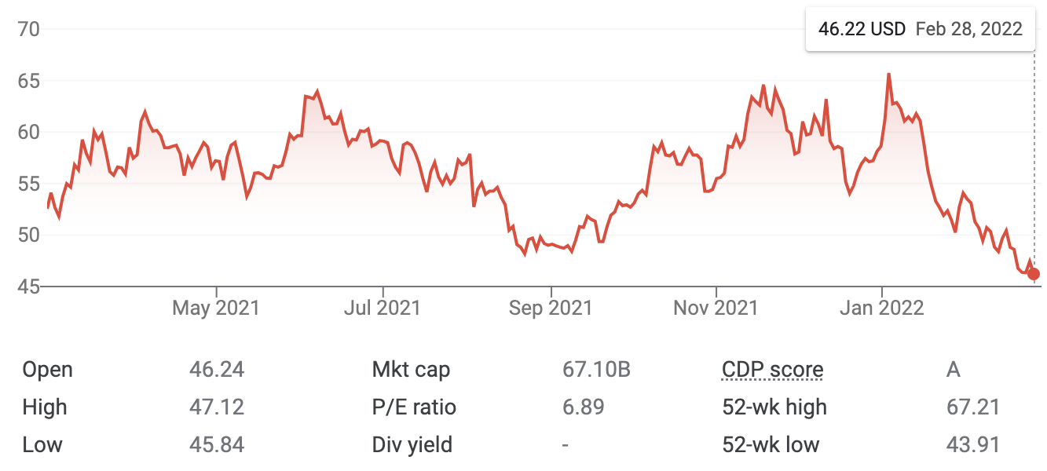
Price Chart and Key Statistics
Share Price | $46.10
Market Cap | 67.10 B
P/E | 6.89
P/B | 1.15
Debt/Eq | 1.83
EPS | 6.71
ROE | 18.40%
Inst. Own (%) | 84.60%

Slide 5
Investment Thesis
Buy General Motor shares
Price (closing price 2/28/22) = $46.72
Target Price = $71.47
Upside: 52.98%
Key Drivers:
Growth and development of EV’s and Autonomous vehicle technology
Software enabled services and new business
Improved revenue diversification
Increased demand for vehicles in Asia Pacific (Increasing revenues and margins)

Slide 6
Business Overview

Slide 7
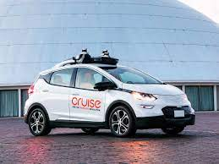
Segments
GM North America (GMNA)
GM International (GMI)
GM Financial
Cruise

Slide 8
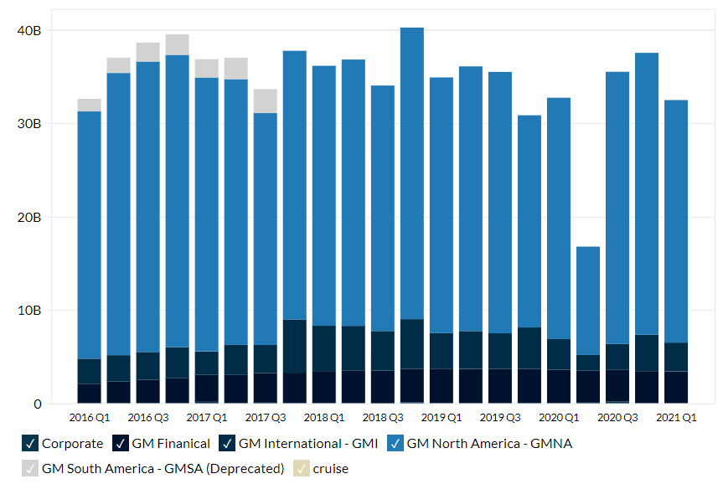
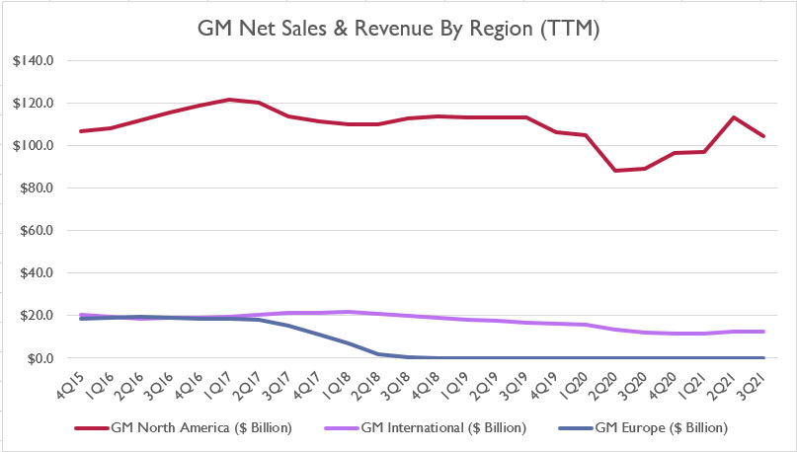
Segments

Slide 9
Key Drivers

Slide 10
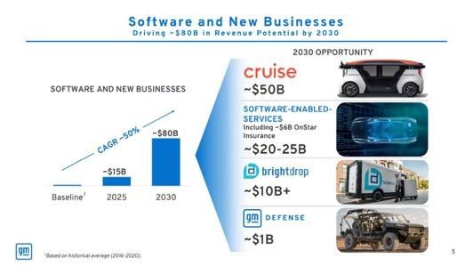
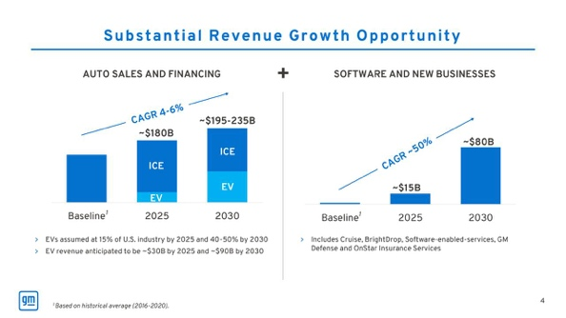
Key Drivers

Slide 11
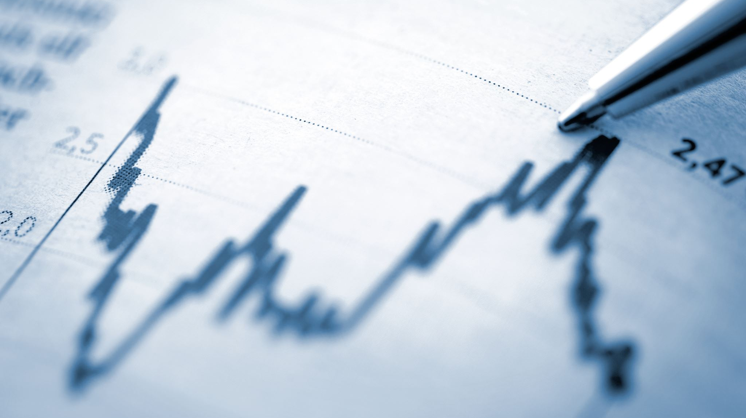
Industry Analysis

Slide 12
Industry Analysis
Overview
The Global Automotive Market is growing (increasing units on the road)
EV’s and MHEV’s are technological advances that are promoting growth for the industry
Increased demand for automobiles (MHEV’s) internationally – stricter emission standards
Government incentives to promote EV development and sales

Slide 13
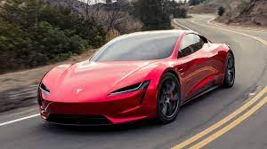
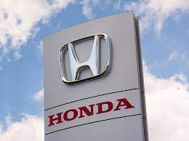
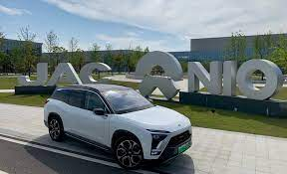
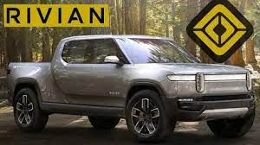
Competitors

Slide 14
Industry Competition

Slide 15
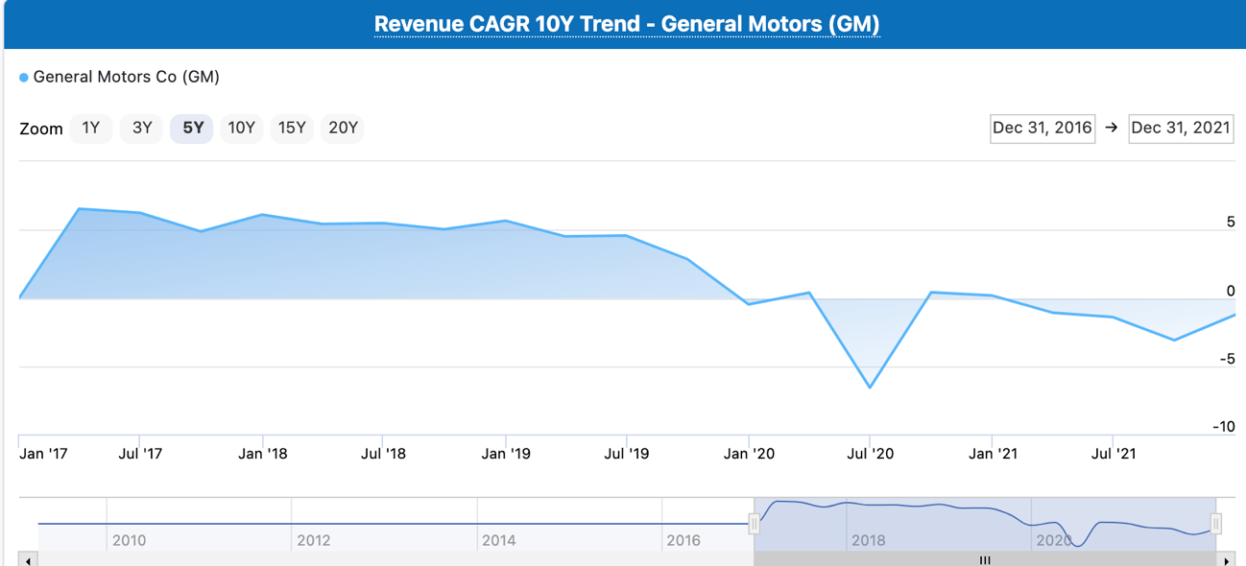
COVID-19 and Semiconductor Shortage
People losing jobs due to COVID-19 restrictions and shutdowns (less disposable income)
Automobile industry job cuts and shutdowns (slowing down production)
Chip shortages slowing down EV manufacturing and development

Slide 16
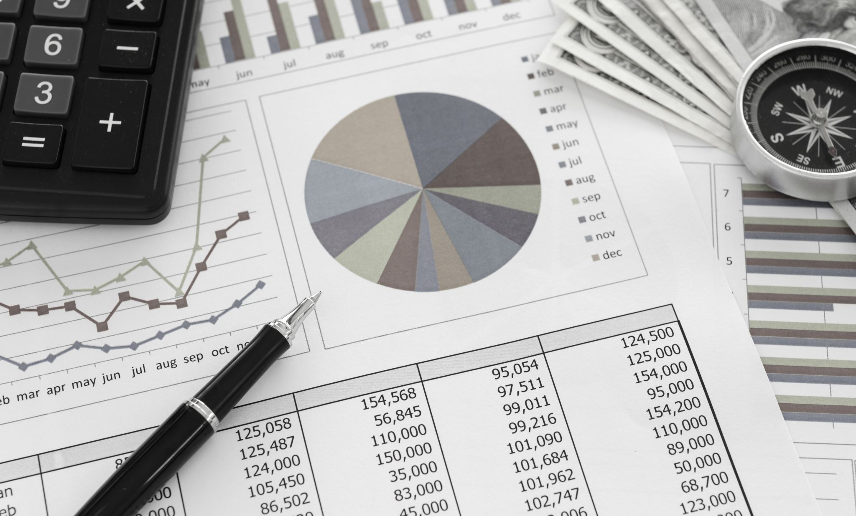
Financial Analysis

Slide 17
Financial Analysis

Slide 18
Financial Analysis

Slide 19
Financial Analysis

Slide 20
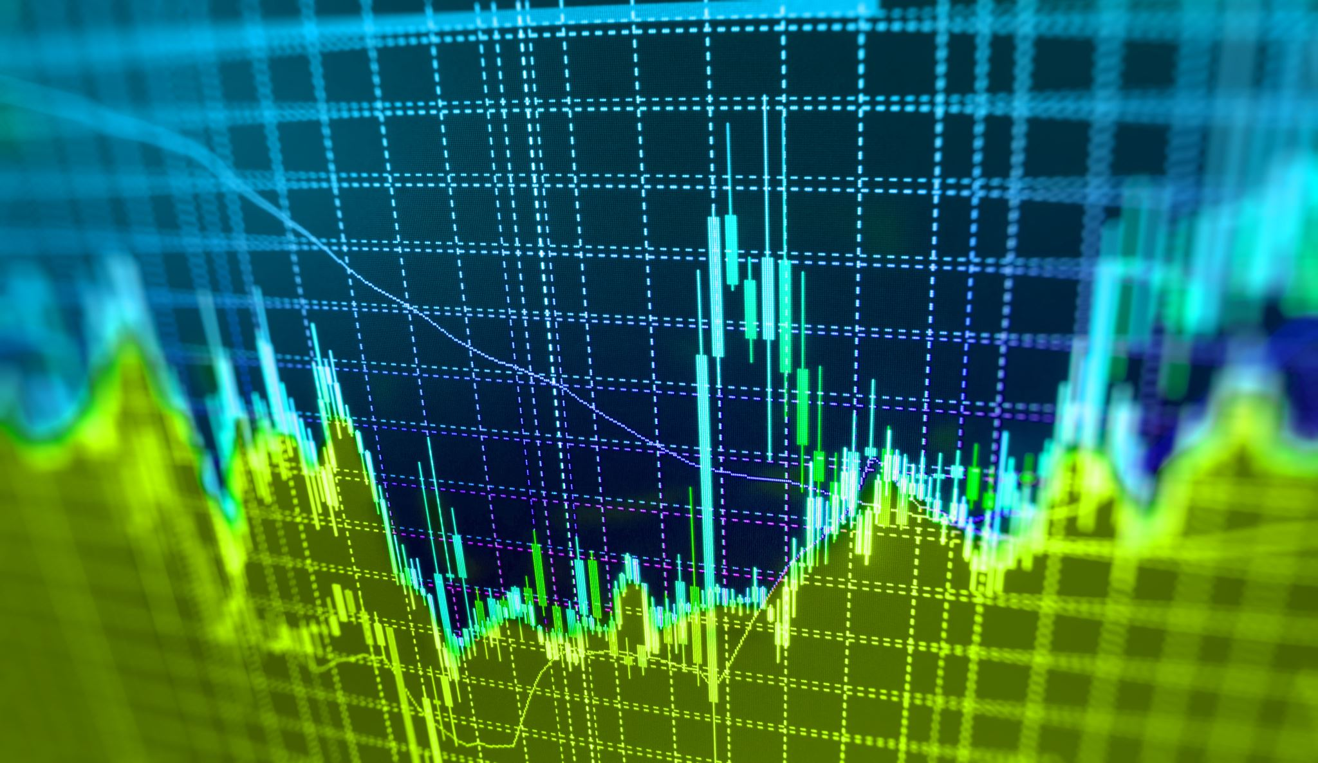
Valuation

Slide 21
Dividend Discount Model
Column1 | k / terminal g | 3.34% | 3.84% | 4.34% | 4.84% | 5.34% | 5.84% | 6.34%
 | 6.00% | $59.05 | $73.07 | $95.54 | $137.38
 | 6.50% | $49.71 | $59.34 | $73.42 | $96.00 | $138.03
 | 7.00% | $42.92 | $49.95 | $59.62 | $73.78 | $96.46 | $138.69
 | 7.50% | $37.76 | $43.12 | $50.19 | $59.91 | $74.13 | $96.91 | $139.34
 | 8.00% | $33.71 | $37.94 | $43.33 | $50.43 | $60.19 | $74.48 | $97.37
 | 8.50% | $30.44 | $33.87 | $38.12 | $43.54 | $50.67 | $60.48 | $74.83
 | 9.00% | $27.75 | $30.59 | $34.03 | $38.31 | $43.75 | $50.91 | $60.77
Average | $64.18
Dividend Discount Model | Column1
Constant Growth Model
Growth Rate | 4.84%
Number of Years in Stage 1 | 5
Stage 2 Growth Rate | 2.42%
Number of Years in Stage 2
Stage 3 Growth Rate
Growth Path | Constant
Cost of Equity Capital | 7.50%
Dividends per share, LTM | $1.52

Slide 22
Free Cash Flow to Equity Model
Column1 | k / terminal g | -5.77% | -5.27% | -4.77% | -4.27% | -3.77% | -3.27% | -2.77%
 | 6.00% | $40.14 | $40.75 | $41.41 | $42.14 | $42.95 | $43.84 | $44.84
 | 6.50% | $38.52 | $39.06 | $39.64 | $40.28 | $40.98 | $41.75 | $42.61
 | 7.00% | $37.03 | $37.51 | $38.02 | $38.58 | $39.19 | $39.87 | $40.61
 | 7.50% | $35.66 | $36.08 | $36.53 | $37.02 | $37.56 | $38.15 | $38.79
 | 8.00% | $34.38 | $34.75 | $35.16 | $35.59 | $36.07 | $36.58 | $37.14
 | 8.50% | $33.19 | $33.52 | $33.88 | $34.27 | $34.69 | $35.14 | $35.64
 | 9.00% | $32.08 | $32.38 | $32.70 | $33.05 | $33.42 | $33.82 | $34.25
Average | $37.37
Free Cash Flow to Equity Model | Column1
Two Stage Growth Model
Stage 1 Growth Rate | -8.85%
Number of Years in Stage 1 | 10
Stage 2 Growth Rate | -4.27%
Number of Years in Stage 2 | 5
Stage 3 Growth Rate
Growth Path | Linear
Cost of Equity Capital | 7.50%
Free Cash Flow to Equity, LTM | $7,965.90

Slide 23
Valuation Based on Earnings
Multiplying GM’s EPS times the industry average P/E ratio, we can estimate the price at which the stock should be traded if its P/E ratio is equal to the industry average.
GM EPS = 6.71
Industry average P/E = 16.82
Estimated price for GM = $112.86

Slide 24
Final Valuation
Valuation based on the average of the three models used for valuing GM stock.
Target Price for GM = $71.47

Slide 25
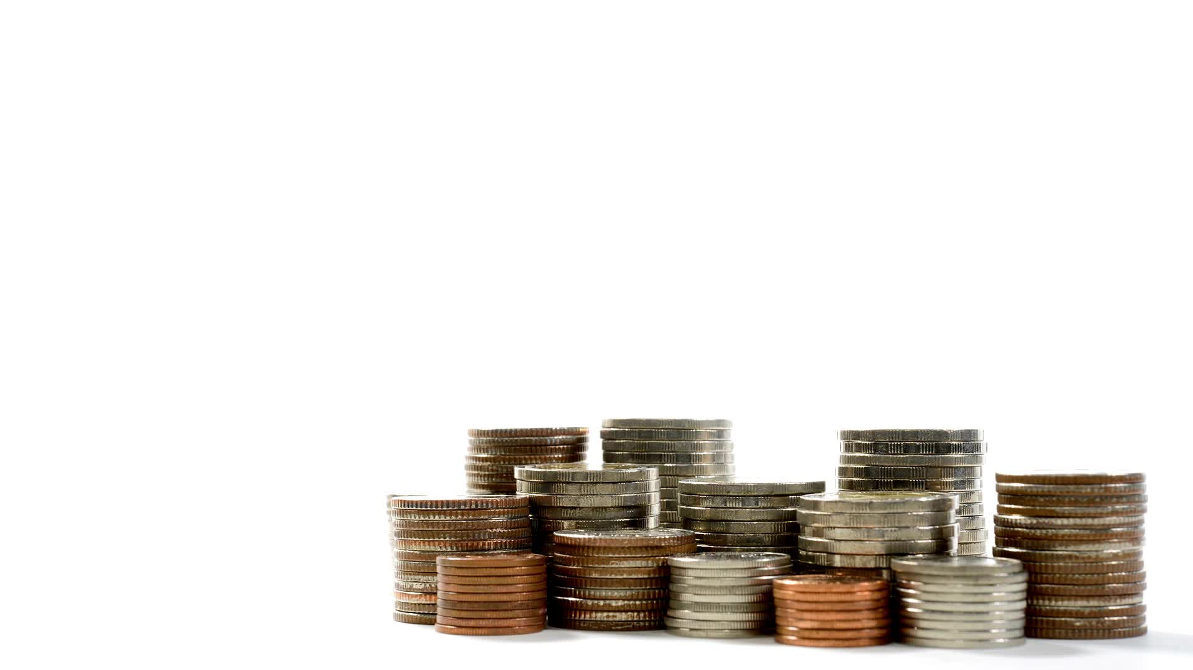
Investment Risks

Slide 26
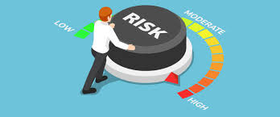
Investment Risks
Key Risks to Consider
Legal and Regulatory Risks
Government Intervention/Political Risk
Tech & Innovation
Ability to Sell (demand for automobiles)
Market Risks (Interest rates, taxes)

