Slide 1
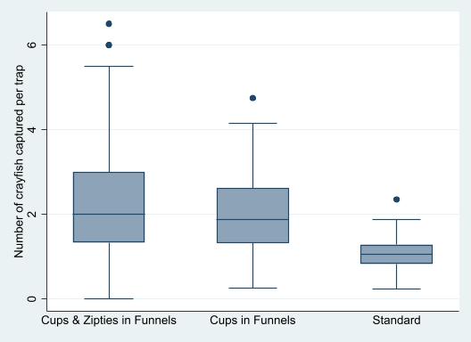
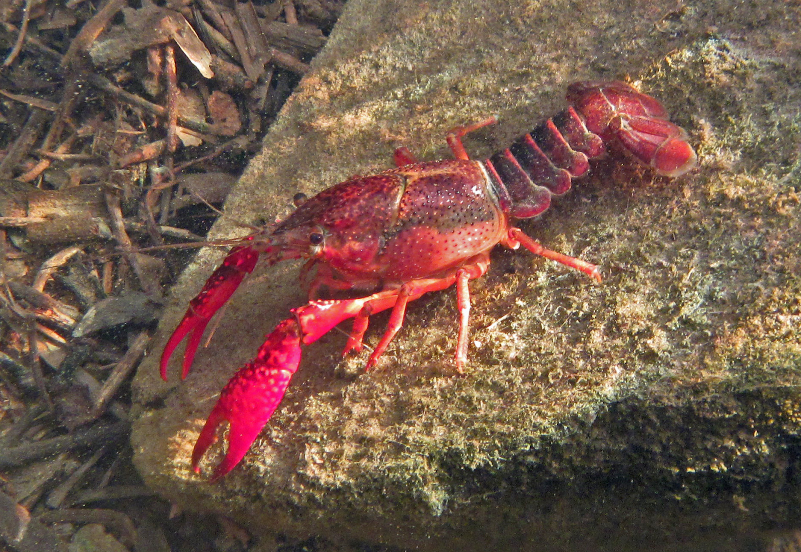
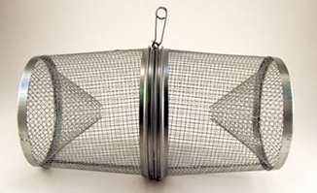
Improving trapping methods to manage invasive
crayfish in the Chicago Region
Emma Donnelly, Rachel Egly, & Reuben Keller | Loyola University Chicago
Introduction:
Red swamp crayfish (Procambarus clarkii) is an invasive freshwater species that is detrimental to the biodiversity of ecosystems that it invades. Invasive crayfish disrupt ecosystems by changing food webs, altering ecosystem services, and causing biodiversity loss. In 2015 Dr. Keller’s lab discovered a large population of red swamp crayfish in the North Shore Channel of the Chicago Area Waterway System. The lab has been successful at reducing populations of invasive crayfish by using traps. However, red swamp crayfish are sometimes able to escape traps, so continued research on improving red swamp crayfish removal is necessary to reduce their harm. I modified traps determine if the efficiency of crayfish removal could be increased.
Results:
ANOVA showed significant differences in trap performance (p<0.00).
Traps modified with cups and Zipties in the funnel caught an average of 2.36 crayfish per trap. This was not significantly different to the number average number captured in traps modified only with cups in the funnels (2.05/trap; p=0.29).
Post hoc test results indicated both of the modified traps captured significantly more crayfish than standard unmodified traps (p<0.00 for both comparisons)
Trap Tap | Mean CPUE
Standard | 1.07
Cups and Zipties in Funnels | 2.36
Cups in Funnels | 2.05
Figure 2: Capture of P. clarkii per trap type
Trap Modifications:
Figure 1: Red swamp crayfish (Procambarus clarkii)
Figure 3: Standard Minnow Trap
Figure 4: Trap modified with cups and Zipties in funnels
Figure 5: Trap modified with cups in funnels
Methods:
190 Standard Minnow Traps (figure 3) were set in 5 sections of the North Shore Channel (figure 6).
I tested trap modifications (figures 4 & 5) on 6 traps in each section for a total of 30 traps out of the 190 total.
Traps were removed twice each week to collect the trapped crayfish.
I compared the CPUE (catch per unit effort) of modified and unmodified traps.
Figure 6: North Shore Channel of the Chicago Area Waterway System
Conclusion:
The results show that modified traps increase efficiency of invasive P. clarkii capture in the North Shore Channel of the Chicago River.
We believe the increased catch rates in modified traps are due to the modifications making it more difficult for crayfish to climb out and escape the openings of the traps.
Using modified traps would likely double crayfish catch rates. This would further reduce the population of this damaging invader.
Acknowledgements:
I would like to thank Rachel, Dr. Keller, and the rest of the Keller Lab for their mentorship and encouragement throughout this project. I appreciate the opportunity to have such a unique learning experience.
Contact Information:
Emma Donnelly edonnelly4@luc.edu

