Slide 1
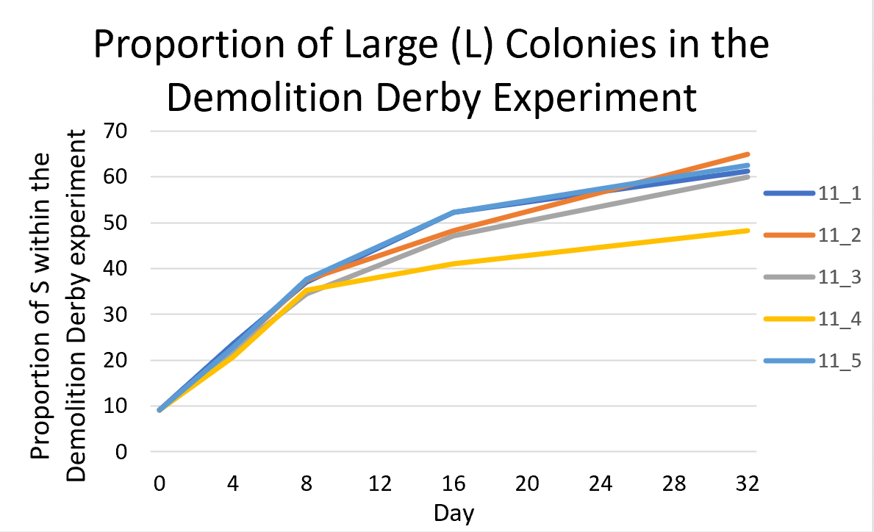
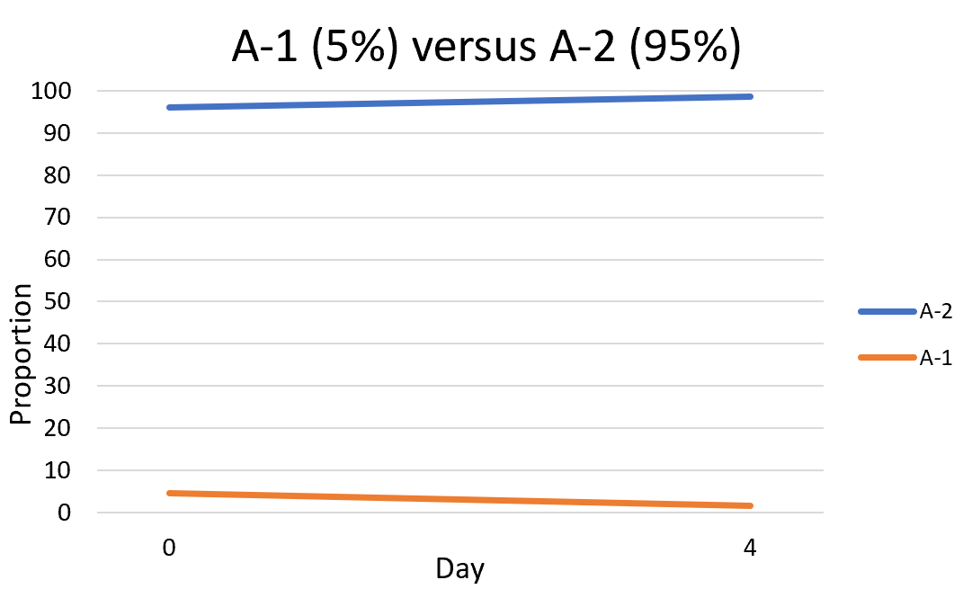
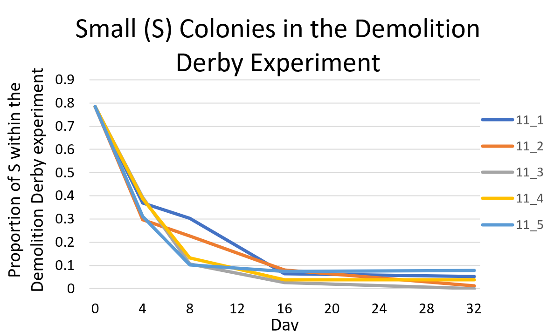
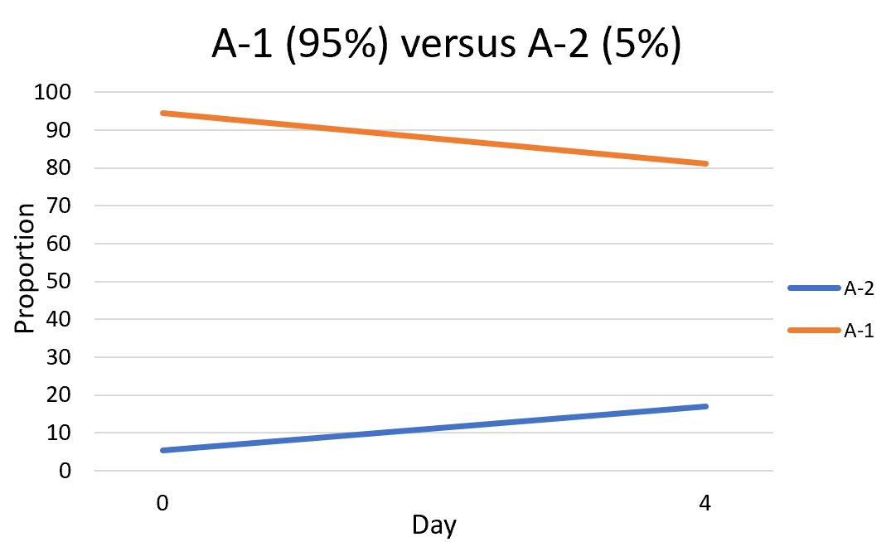
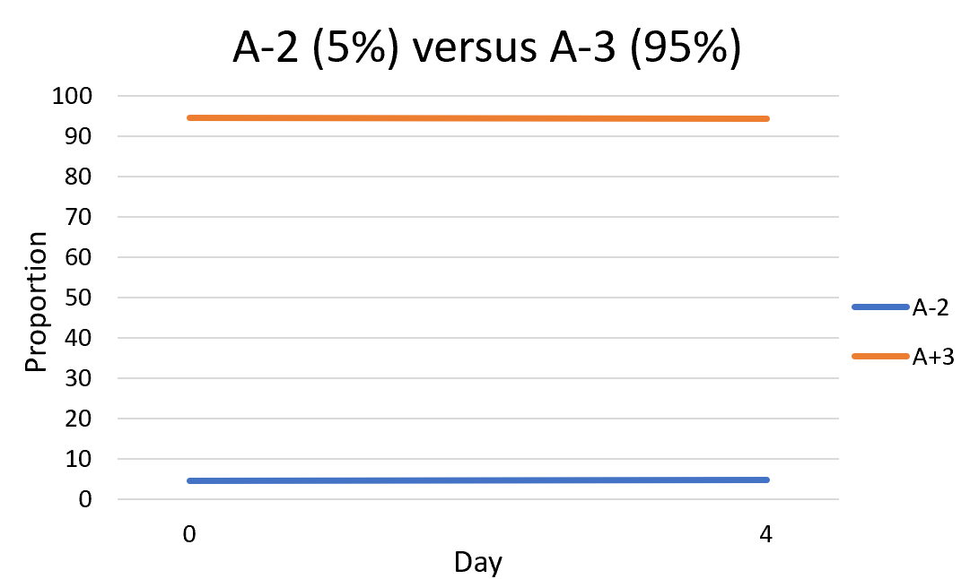
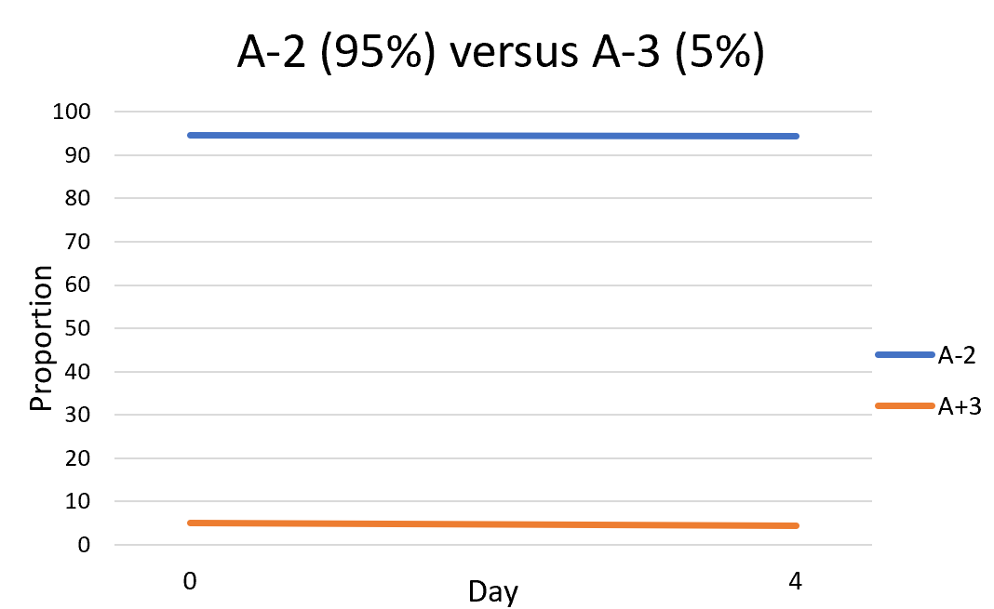
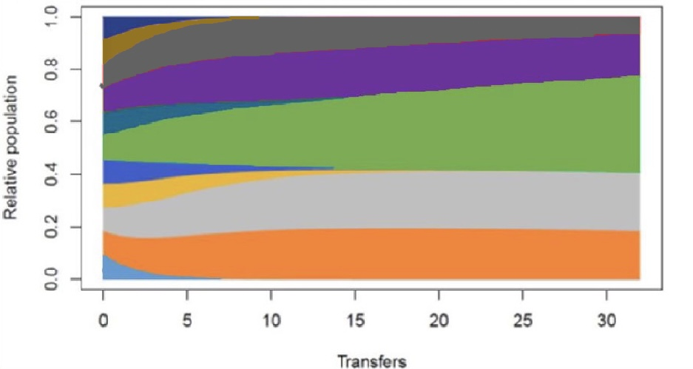
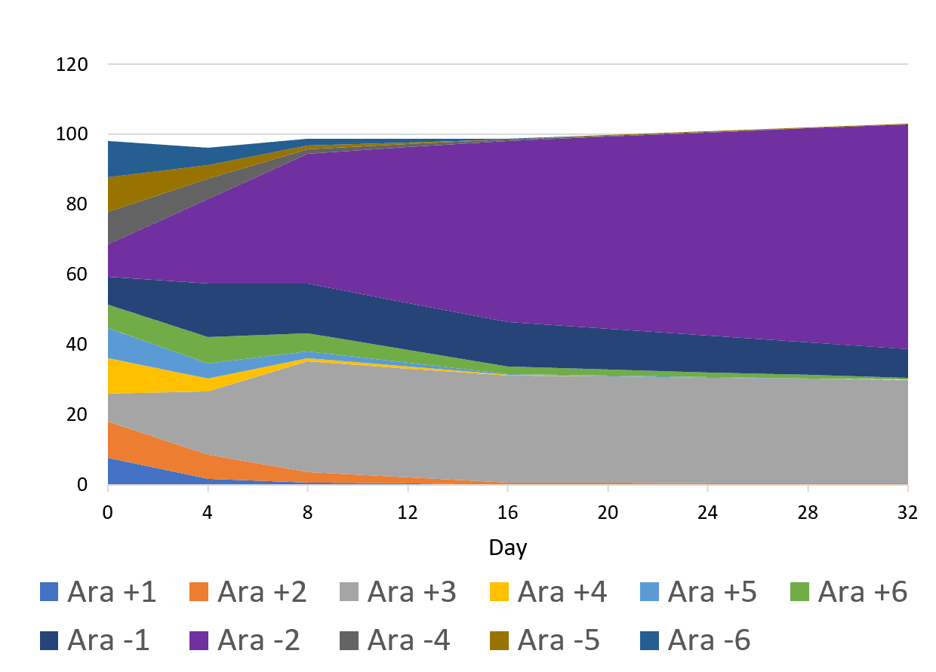
Dynamics of the A-2 subclade within the Demolition Derby Experiment (an extension of the Long-Term Evolution Experiment)
Jessica Tiv¹, Michael Wiser², Vaughn Cooper³, Richard Lenski³, and Caroline Turner, PhD¹
¹Department of Biology, Loyola University Chicago
²Michigan State University, ³University of Pittsburgh
Introduction
Results
The Long-Term Evolution Experiment (LTEE) started in 1988 where genetically identical Escherichia coli (E. coli) were grown in well-shaken flasks. The aim was to see how evolution occurred in a very simple environment. 12 separate populations were each given a different label from A +/- 1-6. These 12 populations were isolated from one another and allowed to grow.
The Demolition Derby experiment expands on the LTEE. After 50,000 generations, all 12 distinct populations of E. coli were combined. The researchers wanted to know if fitness relative to ancestor population would predict fitness to other populations. The experiment concluded that some LTEE populations did better than expected based on their fitness compared to the ancestor population. Specifically, the A-2 population described above was a much better competitor than expected.
My research aims to discover the dynamics of the A-2 subclade (one of the originally labelled populations from the LTEE) in the Demolition Derby experiment.
In the LTEE, two different phenotypes in the A-2 populations were able to coexist and maintain a stable polymorphism. The two phenotypes are the smalls (S) which produced smaller colonies and the larges (L) which produced larger colonies. It was found that this stable polymorphism was a result of negative frequency-dependent selection meaning that the rarer the phenotype, the more fit the phenotype was, enabling it to grow and reproduce more relative to the other population. Rozen et al. discovered that the L colonies were able to use glucose more effectively, but that the S colonies persisted because some metabolite produced by L helped S to grow via cross-feeding and that some metabolite produced by S caused L to die.
Figure 3a- b. Proportion of S (fig 1a) and L (fig 1b) colonies within A-2 in the Demolition Derby Experiment.
Proportion of S colonies decreased while L colonies increased during the Demolition Derby Experiment.
Figure 4a-d. Proportion of competitors from 4-day experiment. All 4 competitions showed no evidence of the S colonies being displaced or negative frequency-dependence between L and the competitor.
Figure 4a
Figure 3a
Figure 4b
Figure 3b
Methods and Materials
Figure 4c
Sequencing was used to track the dynamics of the S and L populations within the A-2 subclade in the Demolition Derby experiment through the selection of genes unique to each population.
Four competition experiments between A-1 versus A-2 and A-2 versus A+3 were performed. Each subclade within a competition experiment either consisted of 5% of the starting population or 95% to total 100%. For example, a competition was performed where A-2 was present at 5% and A+3 was present at 95% and another competition was performed where A-2 was present at 95% and A+3 was present at 5%. This was done to mimic frequency-dependent selection. After establishing the ratios, we transferred 1% of each of the well shaken flasks to a new flask up until Day 4, when the experiment ended. The bacterial DNA was then sequenced using Illumina NextSeq sequencer at the Microbial Genome Center in Pittsburgh, PA and analyzed in a similar manner as above.
Predicted Fitness Outcomes
Figure 1: Predicted fitness outcomes. The predicted frequencies of 11 populations when combined in the Demolition Derby experiment.
Figure 4d
Future Steps
Currently, we are running competition experiments between A-1 and A-2, A-2 and A+3, and A-1, A-2 and A+3 subclades. These experiments will last 32 days and comprise of equal proportions of all competitors. The competition experiment consisting of A-1, A-2, and A+3 subclades is to determine if the combination of A-1 and A+3 together results in the decrease of the S colonies within the A-2 subclade. Additionally, the A-2 subclade alone will be grown to determine the dynamics between the L and S populations within the subclade. Data will be gathered and sequenced for Days 0, 4, 8, 16, and 32 (like the Demolition Derby experiment) to test for frequency-dependent selection. Results will determine further experimentation.
Observed Fitness Outcomes
Figure 2. Observed fitness outcomes. Results of the Demolition Derby experiment. A-2 exceeded fitness predictions and had the greatest fitness.
Conclusions
Our results showed that in the Demolition Derby experiment, the S and L colonies no longer displayed frequency-dependent selection, with the proportion of S colonies nearing zero. Additionally, our 4-day competition experiments did not support the hypothesis that A-1 or A+3 alone was replacing the S colonies in the A-2 subclade. This may be due to the short time frame, by the effects of both A-1 and A-3, or any of the other populations within the Demolition Derby experiment.
Acknowledgements
References
I would like to thank Dr. Caroline Turner for overseeing this this project and for all of her support.
This work was funded in part by the Biology Summers Research Fellowship and the Mulcahy Fellowship awarded by the College of Arts and Sciences at Loyola University Chicago.
Lenski, R. E., M. R. Rose, S. C. Simpson, and S. C. Tadler. 1991. Long-term experimental evolution in Escherichia coli. I. Adaptation and divergence during 2,0000 generations. The American Naturalist 139:1315-1341.
Plucain, J., T. Hindré, M. Le Gac, O. Tenaillon, S. Cruveiller, C. Médigue, N. Leiby, W. R. Harcombe, C. J. Marx, R. E. Lenski, and D. Schneider. 2014. Epistasis and allele specificity in the emergence of a stable polymorphism in Escherichia coli. Science 343:1366-1369.
Rozen, D. E. and R. E. Lenski. 1999. Long-term experimental evolution in Escherichia coli. VIII. Dynamics of a balanced polymorphism. The American Naturalist 155: 24-35.

