Slide 1
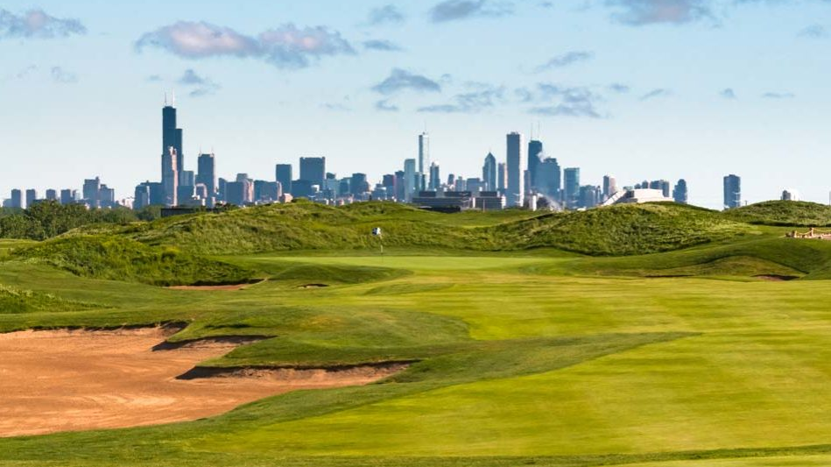
Characterizing lentic habitats in golf courses and adjacent green spaces surrounding the Chicago Metropolitan Region: diversity and abundance of aquatic insects
Ashriya Patel

Slide 2
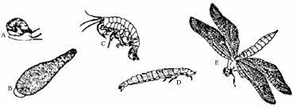
Maximizing the habitat quality of urban green spaces.
With the threat of urbanization in metropolitan areas like Chicago, IL, it is important to maximize and assess all possible urban green spaces to increase diversity and abundance for organism found within the urban matrix threatened by habitat fragmentation.
Urban green spaces can help conserve metapopulations within urban landscapes and can provide important habitats for aquatic invertebrates that are threatened by anthropogenetic factors.
There is a lack of data surrounding lentic urban green spaces, like golf courses and forest preserves.

Slide 3
The continuation of previous research conducted regarding lentic habitats in the Chicago
In a previous study published in 2020 researchers measured pesticides concentrations, water chemistry, physiochemical parameters and algal composition in spring and summer of 2017 from lentic habitats on golf courses and forest preserves in the Chicago Metropolitan Region (Piacente 2020).
Water quality, chlorophyll, chemistry and phycocyanin in permanent ponds, either golf course or forest preserve were similar but differed from ephemeral forest preserve ponds. (Piacente 2020).
These data suggest golf courses could provide similar habitat quality compared to other permanent ponds however, obtaining information regarding aquatic biota at each pond type is needed to understand how these land-use types can play in an urban landscape (Piacente 2020).
Notes:
Jennifer N. Piacente, Joseph R. Milanovich, Martin B. Berg, Timothy J. Hoellein, Andrés G. Muñoz, Armand A. Cann & Isabella S. Lentini (2020) Characterizing lentic habitats in golf courses and adjacent green spaces: water quality, water chemistry, pesticide concentrations, and algal concentrations, Journal of Freshwater Ecology, 35:1, 507-522, DOI: 10.1080/02705060.2020.1853622

Slide 4
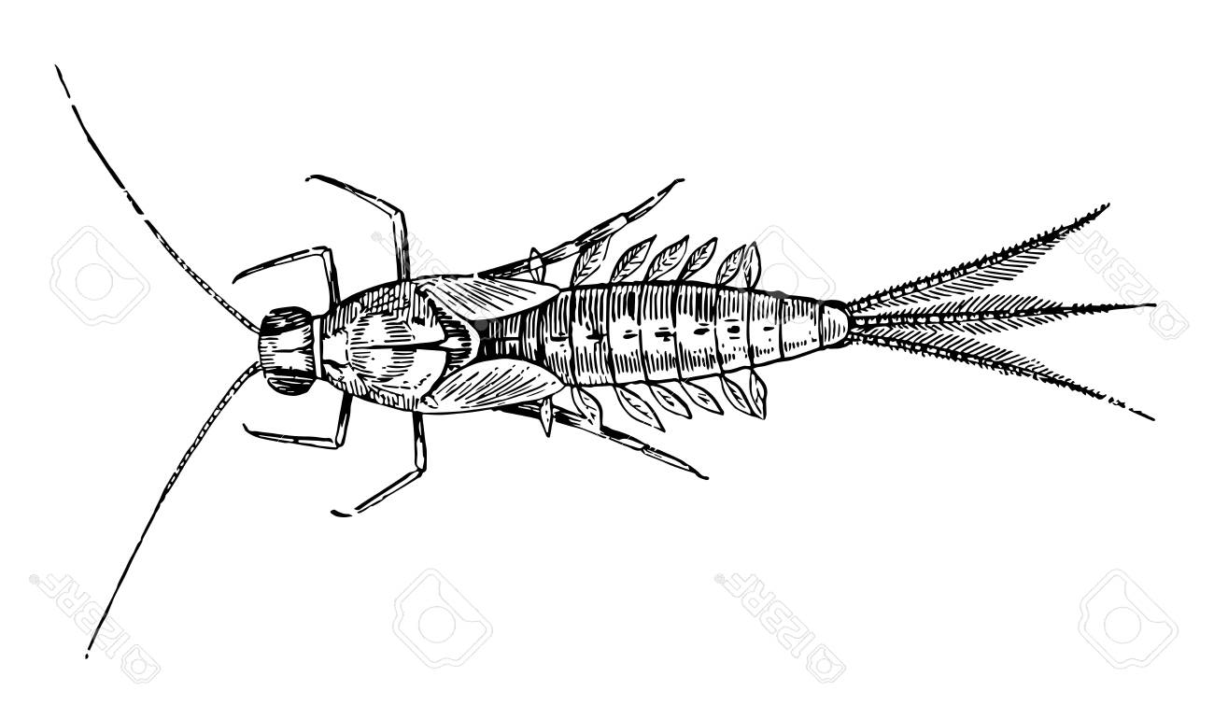
What can aquatic invertebrates tell us about lentic habitats
Aquatic insects are used as indicator species of the biological condition of an aquatic environment. Depending on the species pollution tolerance, their presence or lack of presence can assess the health of an aquatic ecosystem.
In order to assess if golf courses can contribute to biodiversity of macroinvertebrates, seen in other lentic habitats, research on biotic factors across pond types is necessary to make these conclusions.

Slide 5
Summer 2021: assisted with similar sampling techniques on golf courses.
Since it would be difficult to collect, identify and analyze all the data within the year, the data I used for this research was collected and identified in 2017
However, I wanted to broaden my fields sampling and identification skills and spent the summer helping collect aquatic insects and other water quality measurements, with a graduate student. We traveled to many of the same golf courses used in the 2017 field season and applied many of the same protocols for collections.
Although the macroinvertebrates for this research were already identified, during fall 2021 I developed skills identifying a diverse range of aquatic insects in a laboratory setting by using a dichotomous key to identify aquatic insects.

Slide 6
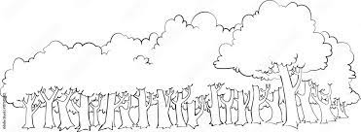
How does species diversity and abundance change between habitat types and month
Habitat type: across five county areas in Chicago (McHenry, DuPage, Winnebago and Cook Counties, IL)
forest preserve – ephemeral (15 sites)
Forest preserve –permeant (15 sites)
Golf course –permanent ( 25 sites)
Over the course of 3 months:
April, June, August

Slide 7
Negative H’ Simpson diversity index suggest high family richness with low family evenness
High family richness may be a factor of habitat dominance. This can be influenced by insect life cycle.
Aquatic insects emerge throughout the warmer months at various times. Some species may be more dominant at certain photoperiods than others, depending on emergent patterns, and therefore could account for variation in H’ index across months.
Average Simpson Diversity Index for lentic habitats across months
April | -1.40233
June | -1.31246
August | -1.44106

Slide 8
Golf Course and forest preserve, both permanent lentic habitats, have similar Simpson diversity indices.
Across pond types, we continue to observe a low Simpson diversity index. However permanent ponds demonstrate similar H’ indexies
Average Simpson Diversity Index across different lentic habitats
Golf Course-Permanent | -1.38234
Forest Preserve –Permeant | -1.36527
Forest Preserve –Ephemeral | -1.40824

Slide 9
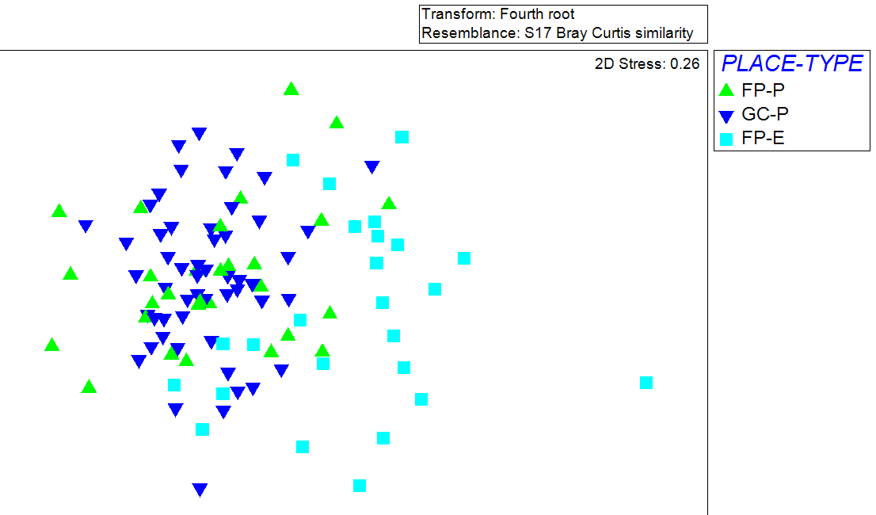
Ephemeral ponds are diverging from Permanent pond.
To further asses this close relationship between golf course permanent ponds and forest preserve permanent ponds, a graphical representation of the diversity sampling data was constructed using PRIMER
We see that permanent ponds and ephemeral ponds are diverging. This indicates a similar relationship between permanent ponds and macroinvertebrate diversity whether they are in forest preserve or golf courses.

Slide 10
Golf courses can be considered a source for biodiversity of aquatic species in urban spaces.
Both permanent ponds (forest preserve and golf curses) can support a similar range of species compared to ephemeral ponds.
This relationship is also seen in Piacente, 2020. That suggest similar water chemistry between both permanent lentic ponds.
Overall, all pond types have a low diversity and water quality surrounding the metropolitan area. In order to maximize biodiversity across urban landscapes conservation work should aim to improve habitat quality maximize diversity evenness.

Slide 11
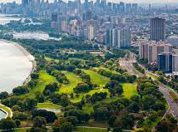
Acknowledgements
My advisor: Joe Milanovich
Special Thanks to: Ligia Hotca
And to the Researchers for allowing me to build upon their data:
Jennifer N. Piacente, Joseph R. Milanovich, Martin B. Berg, Timothy J. Hoellein, Andrés G. Muñoz, Armand A. Cann & Isabella S. Lentini

