Slide 1
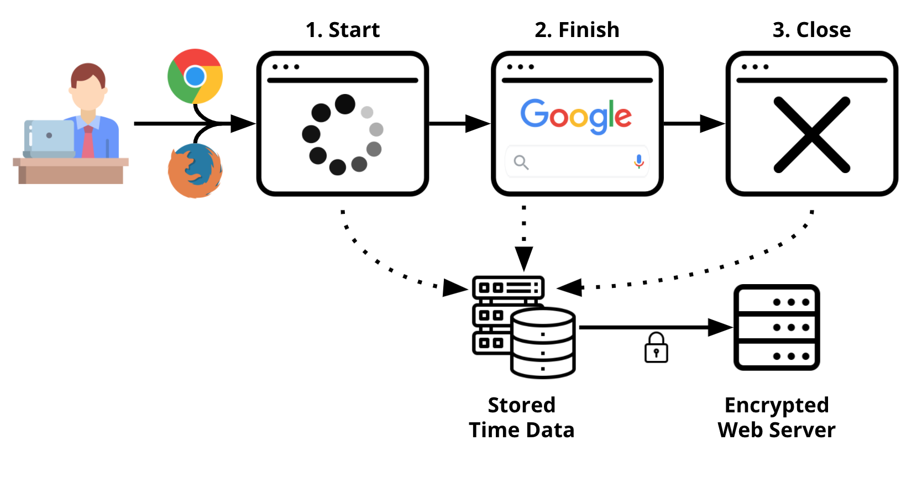
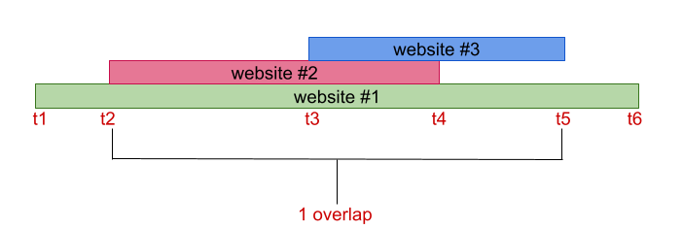
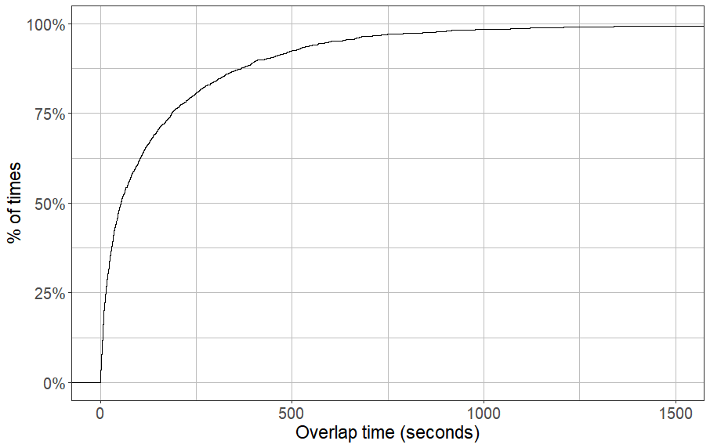
Webtracker: Real Webbrowsing Behaviors
Daisy Reyes, Eno Dynowski, John Mikos
Abstract
Research Design (cont.)
With increased privacy concerns, users are now turning to anonymity tools such as VPNs and Tor
Packet metadata may still be able to be identified by an adversary, known as website fingerprinting
Previous work have tried to evaluate potential of this vulnerability while assuming that victims visit one website at a time
We create a private webbrowser extension called “WebTracker” to analyze user browsing patterns
Overlaps affect effectiveness of fingerprinting—15% of websites overlap, lasting 66 seconds.
Overlaps happen roughly 9 seconds after first website starts
Participants were recruited from Microworkers
We collected data from 06/01/2020 - 12/31/2020
Extension disabled 01/01/2021
As demonstrated in Figure 1, users may turn the extension on and off as desired.
Figure 2 demonstrates how data is transferred during collection
Figure 1. Interface of WebTracker extension
Figure 2. Overview of data collection through WebTracker
Results
Figure 3 shows how we counted overlaps
URLs that did not finish downloading or took > 10 mins were excluded from analysis
Websites normally take seconds to load
WebTracker was installed 83 times
Data collection elapsed 211 days (about 7 months)
Total number of websites counted: 57,097
Users visited on average 270 websites a day
Users spent 50.88% of that time downloading data
15.66% of those websites were overlapping, with 2.11 websites involved on average
Average length of an overlap is 223.19 seconds, with median 66.68 seconds
The length of time between first and second website in an overlap is on average ~9 seconds
22% of the first website is not overlapping, with median 41.46 seconds loading time
Figure 4 demonstrates distribution of overlap time
75% of websites take less than 10 seconds to load
Background
Users want to hide their browsing through installing many different types of privacy tools
VPNs, Tor, etc
However, nothing is truly 100% private
Traffic is encrypted, but adversaries can still collect quantity, size, and direction of packets
ISPs, governments, or someone with nefarious intentions
Previous work have attempted to gauge the accuracy and feasibility of website fingerprinting attacks
Assuming that users only visit one website at a time
We investigate the nature of website overlaps--when users load two or more websites simultaneously
May affect the likelihood of identifying website packets since data overlaps—creates confusion
Figure 3. Diagram demonstrating how an overlap is counted. Though there are more than several overlaps, the overlap is counted when all websites have loaded
Figure 4. Empirical cumulative distribution function demonstrating how overlap times are distributed
Research Design
Discussion
Acknowledgements
We created a web extension "WebTracker" to collect data on users' browsing data
Extension is private, hides user identity
Users may opt out anytime by disabling or uninstalling the extension
Webtracker is available for desktop browsers
Data collected: userID, tabID, URL, timestamp
URL includes status of webpage, whether it has started downloading, finished downloading, or tab closed.
User browsing behavior is indeed different than previously assumed
Adds a layer of complexity thanks to numerous overlaps—acts as a defense against website fingerprinting
Overlaps tended to be long with median 66 seconds – overlapping could be used as a countermeasure
One caveat is that 22% of the first website is not overlapping, leaving room for identifying the trace.
Future work could investigate webbrowsing habits on mobile—mobile browsing may affect overlaps
This research was supported by a LUROP Mulcahy Fellowship.
This material is based upon work supported by the National Science Foundation under Grant No. DGE 1918591 and DGE 1919004
Our labmates—for helping us troubleshoot WebTracker!

