Slide 1
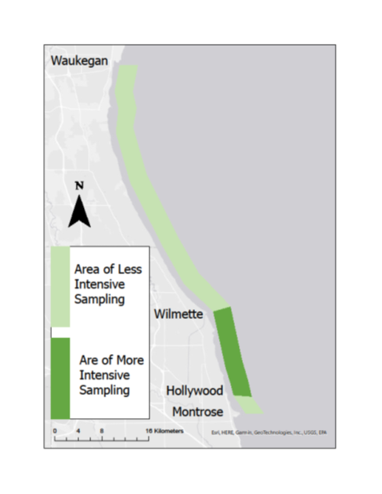
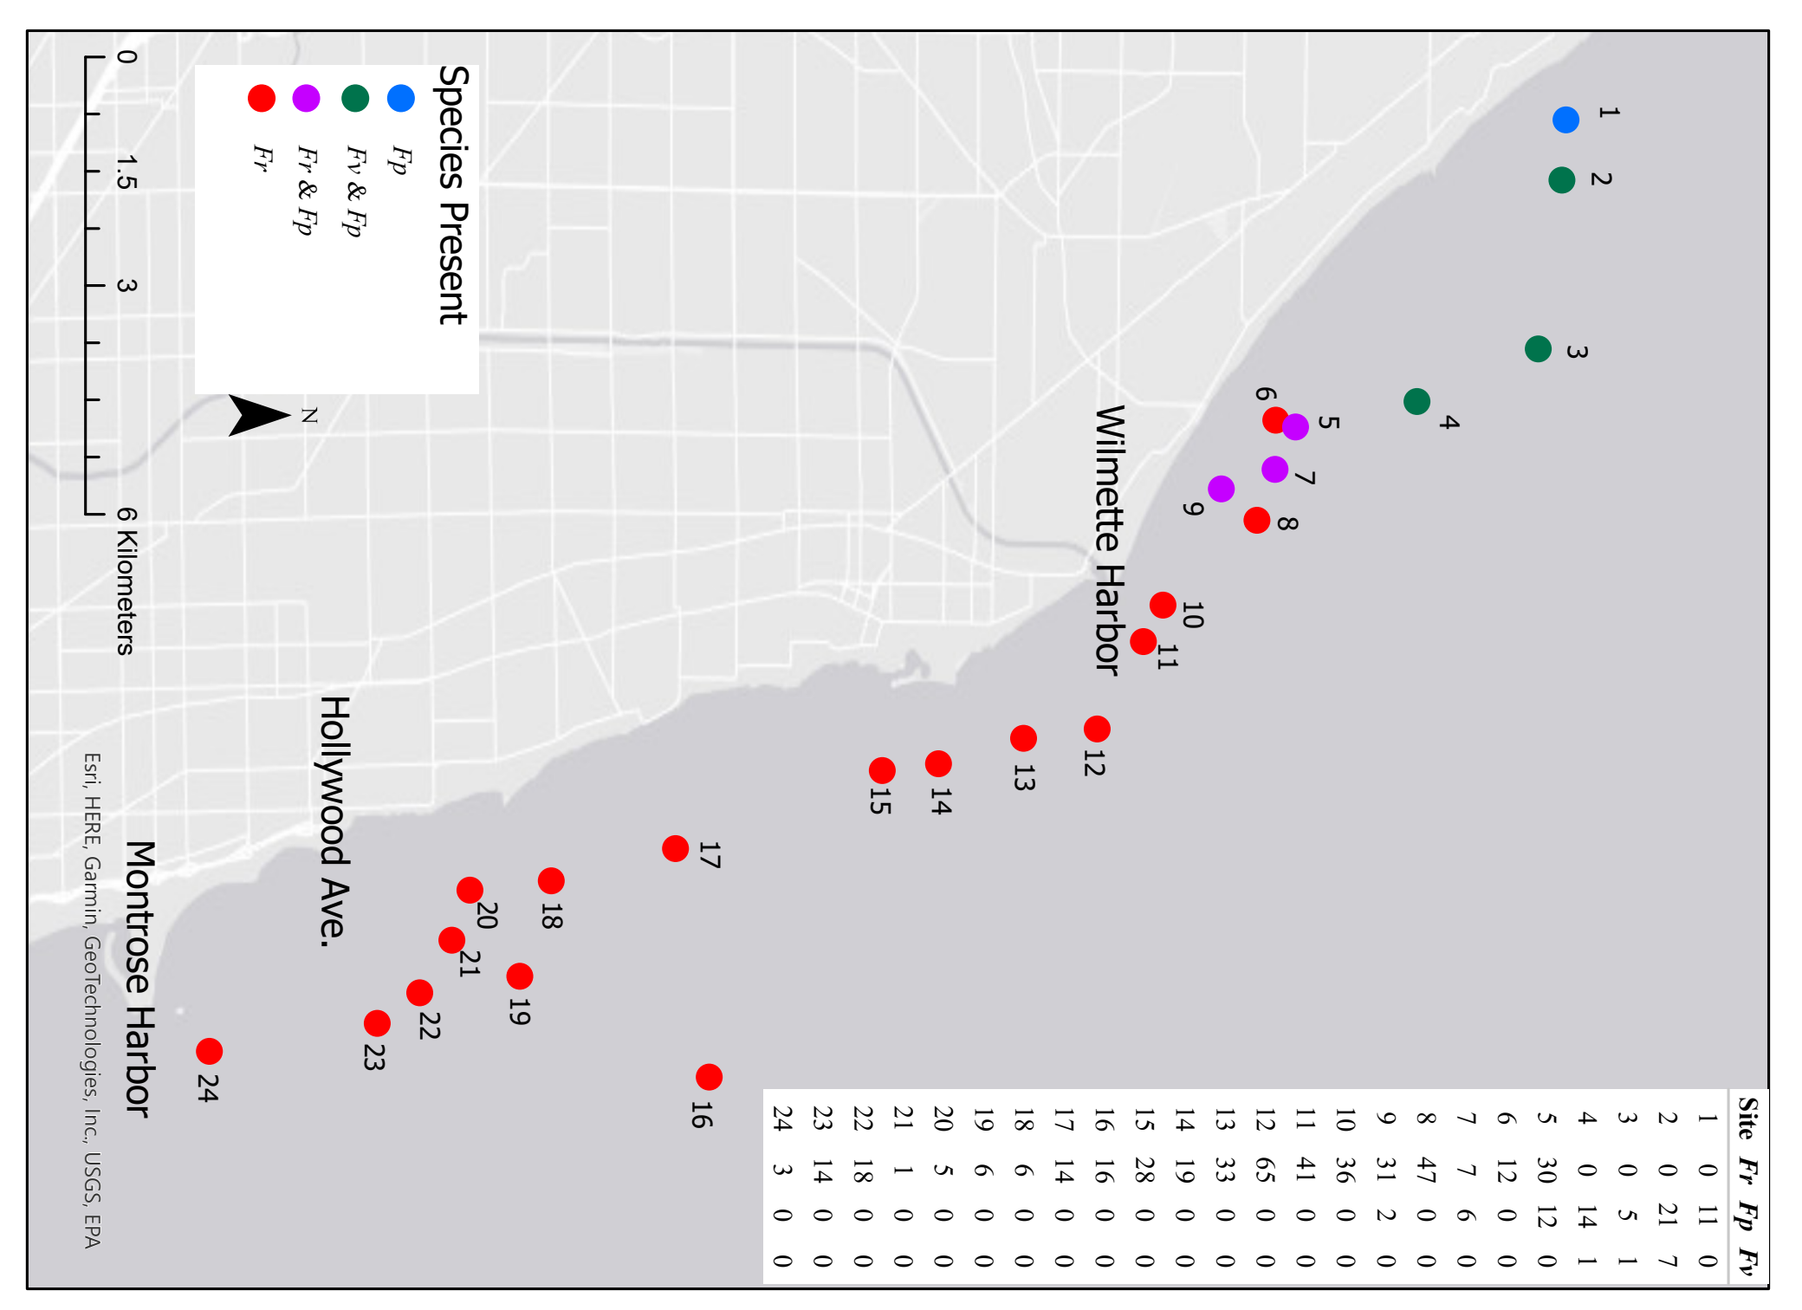
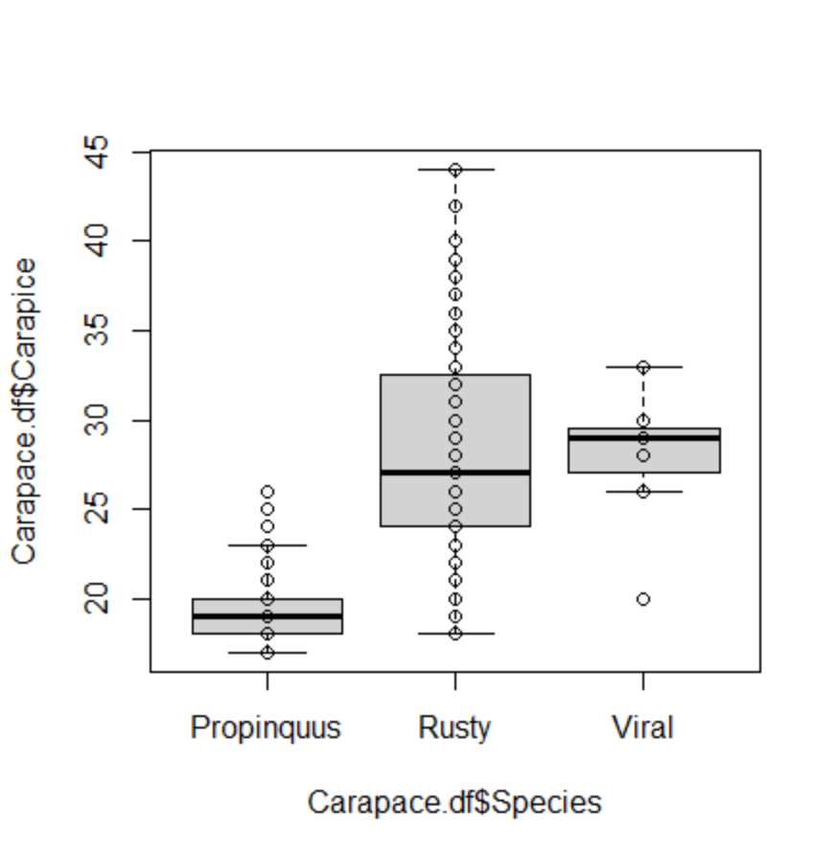
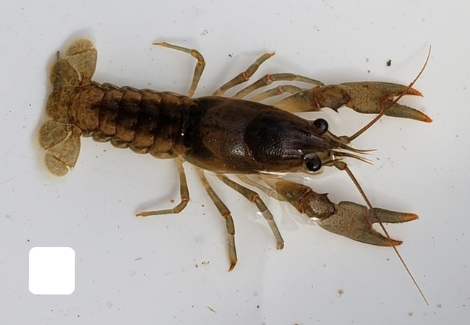
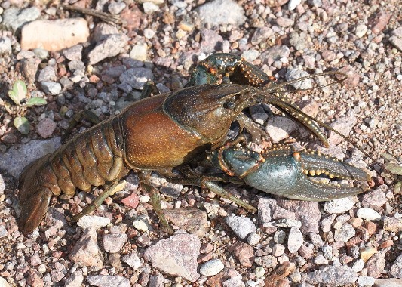
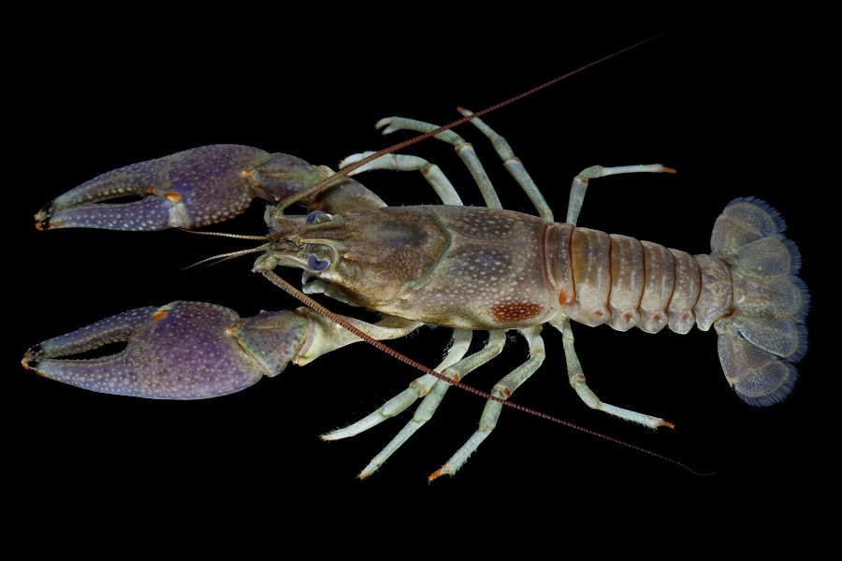
Invasive rusty crayfish displaced native crayfish in nearshore Lake Michigan habitats
Dylan Herald (Jherald1@luc.edu) and Dr. Reuben Keller (rkeller1@luc.edu) | Loyola University Chicago
INTRODUCTION
1987 Sampling Efforts 2020-2021 Sampling Efforts
The Role of Crayfish
Crayfish are responsible for essential ecosystem services such as sediment mixing, nutrient cycling, and energy flow through the food web
Studies have found crayfish are important as prey, predators, and competitors
1980s Sampling Found Only Native Species
From 1979 to 1983 John P. Quinn used SCUBA to sample for crayfish in nearshore rocky areas of Lake Michigan
Faxonius propinquus (Northern clearwater crayfish) and Faxonius virilis (Virile crayfish), both native, were the only species found.
Risks of Faxonius rusticus (Rusty crayfish) Invasion
In smaller lakes F. rusticus have outcompeted local crayfish, causing population declines equivalent to the F. rusticus population growth
F. Rusticus eat a higher biomass of invertebrates and macrophytes than F. propinquus or F. virillis.
F. Rusticus has spread widely across the region since the 1980s, be we don’t know how far they have reached into Lake Michigan
Between 1979-1983, 38 sites were sampled in this region. The only species found were Faxonius propinquus and Faxonius virilis, both native.
METHODS
1979-1983 Sampling Efforts
Sampling from 1 to 4 kilometers off shore, Depth of 6 to 10 meters.
Rocky areas were determined via an anchor drag
Crayfish collected by hand 1 meter on either side of a 50 meter long transect.
2020-2021 Sampling Efforts
Sampling via SCUBA from Montrose to Glencoe, 0.7 to 3.7 kilometers off shore, Depth of 4.8 to 10.4 meters.
Rocky areas determined via sonar on boat
Crayfish collected by hand, 1 meter on either side of a 50 meter long transect.
Discussion
FURTHER RESEARCH
RESULTS
F. Rusticus has spread rapidly into nearshore Lake Michigan habitat causing large changes in diversity
No differences in environmental conditions were observed between the F. rusticus dominated, native dominated, as well as the F. rusticus and native dominated regions of the sample site.
An overlapping population of native and invasive crayfish in Lake Michigan can lead to understanding how invasive rusty crayfish interact with native species.
We have evidence that F. rusticus has displaced native crayfish in these nearshore habitats
We don’t know how this population is moving. Is the F. rusticus population moving north, are native populations moving south, or is this a stable distribution?
We do know that where F. rusticus is present, the presence of native species is unlikely
Based on results from other waterbodies it is likely that F. rusticus is drastically affecting Lake Michigan food webs
The greater size of F. rusticus is likely a factor in its replacement of F. propinquus
Further Sampling
Extend sampling efforts as far north as Waukegan to compare more data with 1980s sampling
Extend sampling to a depth of up to 20 meters to determine how far out rusty crayfish populations reach.
Increased frequency of sampling in overlap zone to monitor for population changes.
Work to determine the impacts of this invasion
2021-2022
Three species were found, Faxonius propinquus, Faxonius virilis, and the invasive Faxonius rusticus
Southern most sites were entirely dominated by Faxonius rusticus
Northern most sites only native species were found
An overlap zone just north of Wilmette Harbor was observed, where populations of all three species exist.
F. rusticus and F. Virilis were significantly larger than F. propinquus
ACKNOWLEDGMENTS & REFERENCES
Thank you to Dr. Bo Zhang for mentorship in ArcGIS analysis. Thank you to Rachel Egly, Carter Cranberg, and Natalia Szklaruk for research support and assistance.
John P. Quinn., (1987) “The Biology of Two Species of Crayfish in Southwestern Lake Michigan”
O’Shaughnessey et. al, (2020) “Distribution of crayfish in the Southern Basin of Lake Michigan and the Greater Chicago Region”
Peters et. al, (2014) “Historical changes and current status of crayfish diversity and distribution in the Luaretian Great Lakes”
Olden et. al, (2006) “The rapid spread of rusty crayfish with observations on native crayfish declines in Wisconsin over the past 130 years”
Olsen et. al, (1991) “Mechanisms of impact of an introduced crayfish on Littoral Congeners, Snails, and Macrophytes
Faxonius propinquus
Faxonius virilis
Faxonius rusticus

