Slide 1
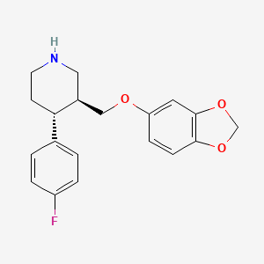
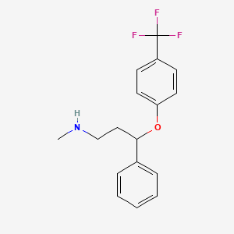
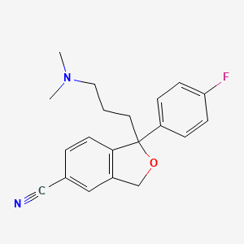
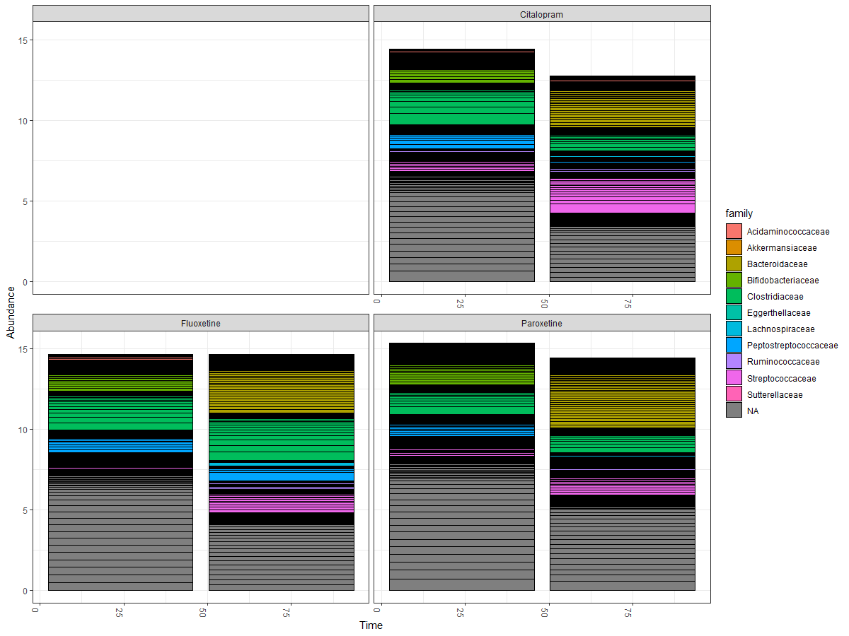
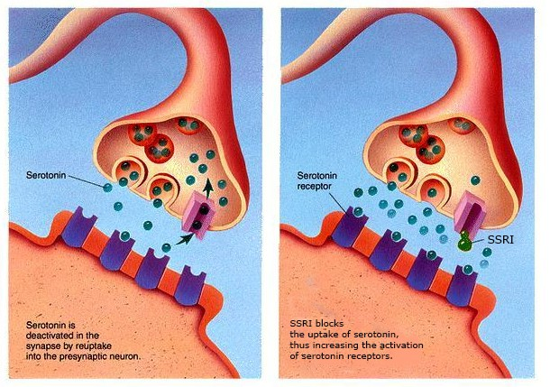
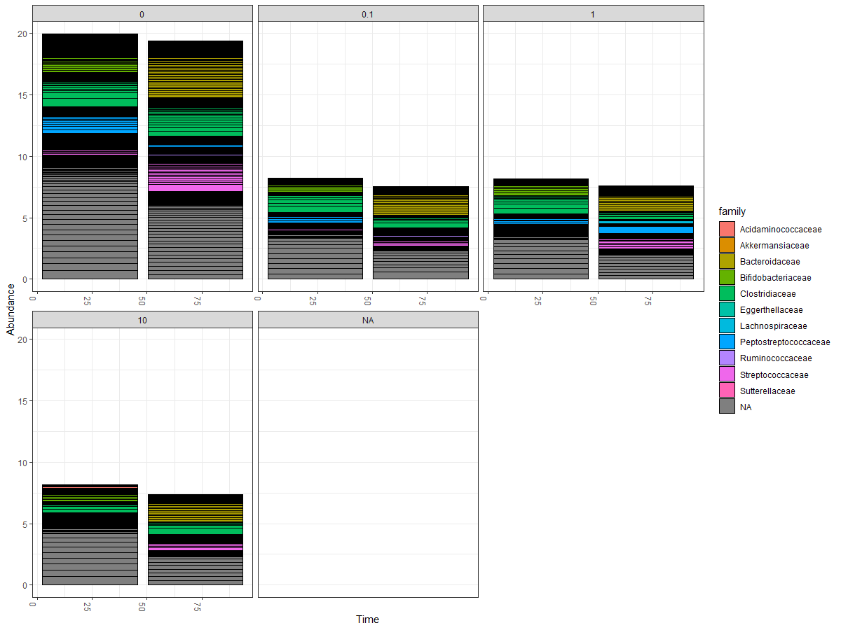
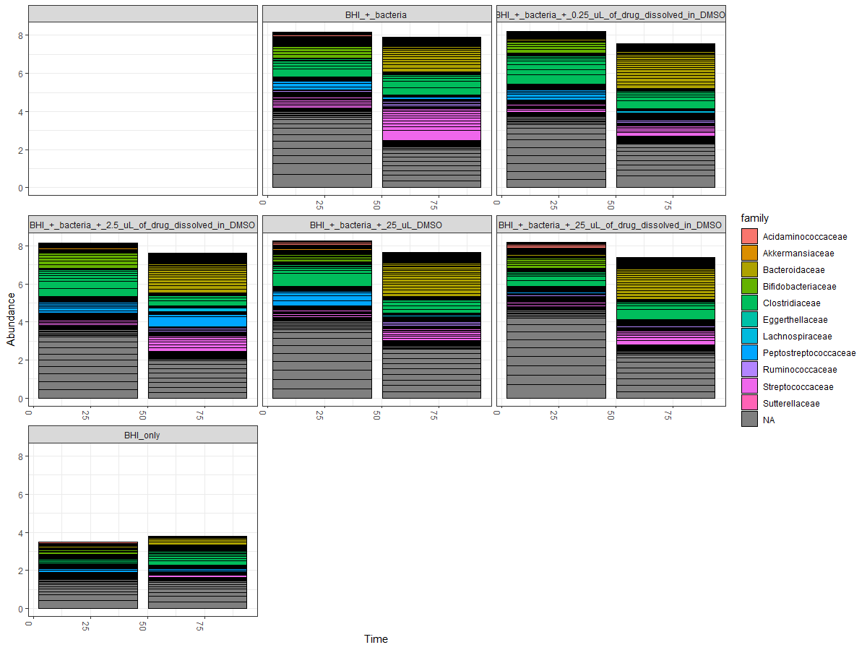
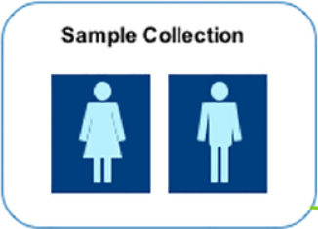
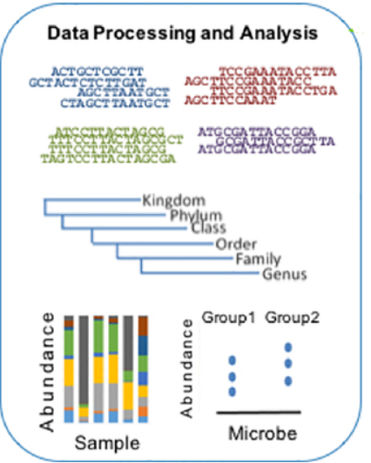
Assessing Influence of SSRIs on the Human Gut Microbiome Kathya Delgado, Sarah Syed, Michael Burns, PhD Loyola University Chicago
Abstract
Results
The human microbiome is comprised of trillions of bacteria that have several functions. Selective serotonin reuptake inhibitors (SSRIs) are U.S. Food and Drug Administration (FDA) approved medications to treat depression. We sought to find whether orally administered SSRIs affect the microbial composition of the human microbiome. The experiments were carried out by isolating live microbial communities and culturing these communities in vitro. SSRIs were administered to these communities across a range of concentrations. The communities were allowed to grow over time and sampled every 24 hours from 0-72 hours. To identify how the microbial communities in the samples changed over time and treatment, the collected microbial samples from the communities were subjected to DNA extraction. The DNA from each sample were sent for marker gene amplification and next generation sequencing at the Loyola Genomics Facility. Upon receiving this data, our lab used a bioinformatic pipeline to analyze the genetic sequences of the marker genes in these microbial communities to determine what differences, if any, different concentrations of SSRIs have on the human microbiome. Investigating the connection between SSRIs and the human microbiome can develop broader scientific understanding of SSRI side effects and create better treatment plans for patients.
Using the phyloseq R package, we were able to get preliminary results on the families of the identified bacteria in our samples. We were able to plot comparisons of drug type, sample type, and concentration with time. There are significant changes in the microbial communities across these components, and in future analyses, we will look to compare different aspects of our samples for more in-depth analyses of SSRI impact on the gut microbiome.
Figure 2: Chemical structure of Paroxetine
Figure 3: Chemical structure of Fluoxetine
Figure 4: Chemical structure of Citalopram
Figure 8: Families of identified bacteria across drug type and time
Figure 9: Families of identified bacteria across concentration and time
Background/Introduction
Figure 5: Neural synapse of neurotransmitter serotonin and how SSRIs block reuptake to increase activation of serotonin receptors
There are many factors that affect the human microbiome, including age, demography, diet, genotype, probiotics, medications, and pharmaceuticals. The bacteria that make up the human microbiome also have a multitude of functions, including breaking down food compounds, stimulating immune system, providing essential pathogen resistance, and metabolism of therapeutics.
Selective serotonin reuptake inhibitors, or SSRIs, are a type of commonly prescribed antidepressants. Our lab used Paroxetine, Fluoxetine, and Citalopram for our analysis. These medications are often given in the form of a pill, meaning they must be administered orally. Due to this, SSRIs must pass through the gut microbiome before reaching the brain.
Our hypothesis is that there will be significant changes in the human microbiome with different SSRIs concentrations and time.
Methods
After receiving the data from the Loyola Genomics Facility, we used R to analyze the genetic sequences. In R, we used the DADA2 pipeline, and used the phyloseq R package.
Stool Sample
Series of Filters
Cont. Ctrl
Neg Ctrl
Sol Ctrl
1.0x at 2.5 µL
Figure 10: Families of identified bacteria across sample type and time
Microbial Community
0.1x at 0.25 µL
10x at 25 µL
Figure 6: Lab method of sample collection and administering SSRIs across different concentrations
Blocks serotonin reuptake to increase activation of serotonin receptors
Citations
Brain
1. How SSRIs work – OCD-UK. (2018). Ocduk.org. Retrieved March 29, 2022 from https://www.ocduk.org/overcoming-ocd/medication/how-ssri-work/.
2. Lukić, I., Getselter, D., Ziv, O. et al. Antidepressants affect gut microbiota and Ruminococcus flavefaciens is able to abolish their effects on depressive-like behavior. Transl Psychiatry 9, 133 (2019). https://doi.org/10.1038/s41398-019-0466-x.
3. Karstens, L., Asquith, M., Caruso, V., Rosenbaum, J. T., Fair, D. A., Braun, J., Gregory, W. T., Nardos, R., & McWeeney, S. K. (2018). Community profiling of the urinary microbiota: considerations for low-biomass samples. Nature reviews. Urology, 15(12), 735–749. https://doi.org/10.1038/s41585-018-0104-z.
4. M Hasan Mohajeri, Giorgio La Fata, Robert E Steinert, Peter Weber, Relationship between the gut microbiome and brain function, Nutrition Reviews, Volume 76, Issue 7, July 2018, Pages 481–496, https://doi.org/10.1093/nutrit/nuy009
5. National Center for Biotechnology Information (2022). PubChem Compound Summary for CID 2771, Citalopram. Retrieved March 29, 2022 from https://pubchem.ncbi.nlm.nih.gov/compound/Citalopram.
6. National Center for Biotechnology Information (2022). PubChem Compound Summary for CID 3386, Fluoxetine. Retrieved March 29, 2022 from https://pubchem.ncbi.nlm.nih.gov/compound/Fluoxetine.
7. National Center for Biotechnology Information (2022). PubChem Compound Summary for CID 43815, Paroxetine. Retrieved March 29, 2022 from https://pubchem.ncbi.nlm.nih.gov/compound/Paroxetine.
SSRIs
Microbiome
Acknowledgements
Interacts with bacteria in gut microbiome
Thank you to the Burns lab and Loyola University Chicago for providing the tools needed to conduct this research. Thank you to the Cura Scholars Program. Thank you to my mentor, Dr. Burns, without your training and guidance, this research would not be possible.
Figure 1: Pathways of SSRIs to the brain and the gut microbiome
Figure 7: Bioinformatic pipeline analysis components

