Slide 1
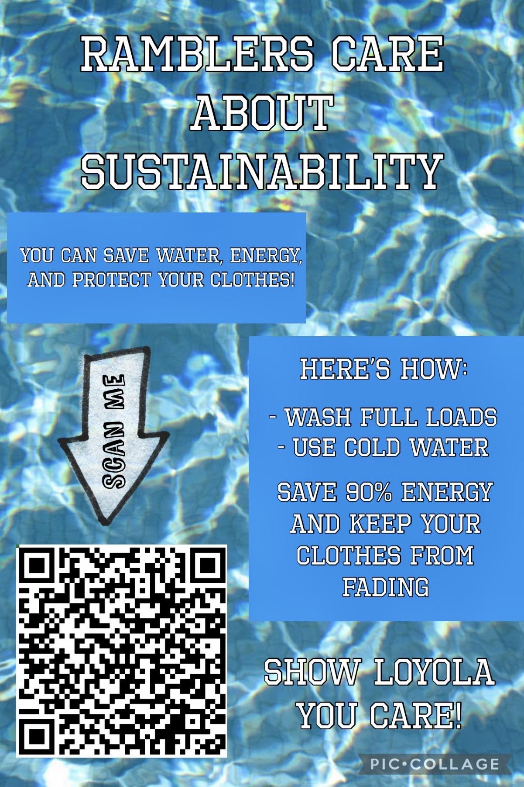
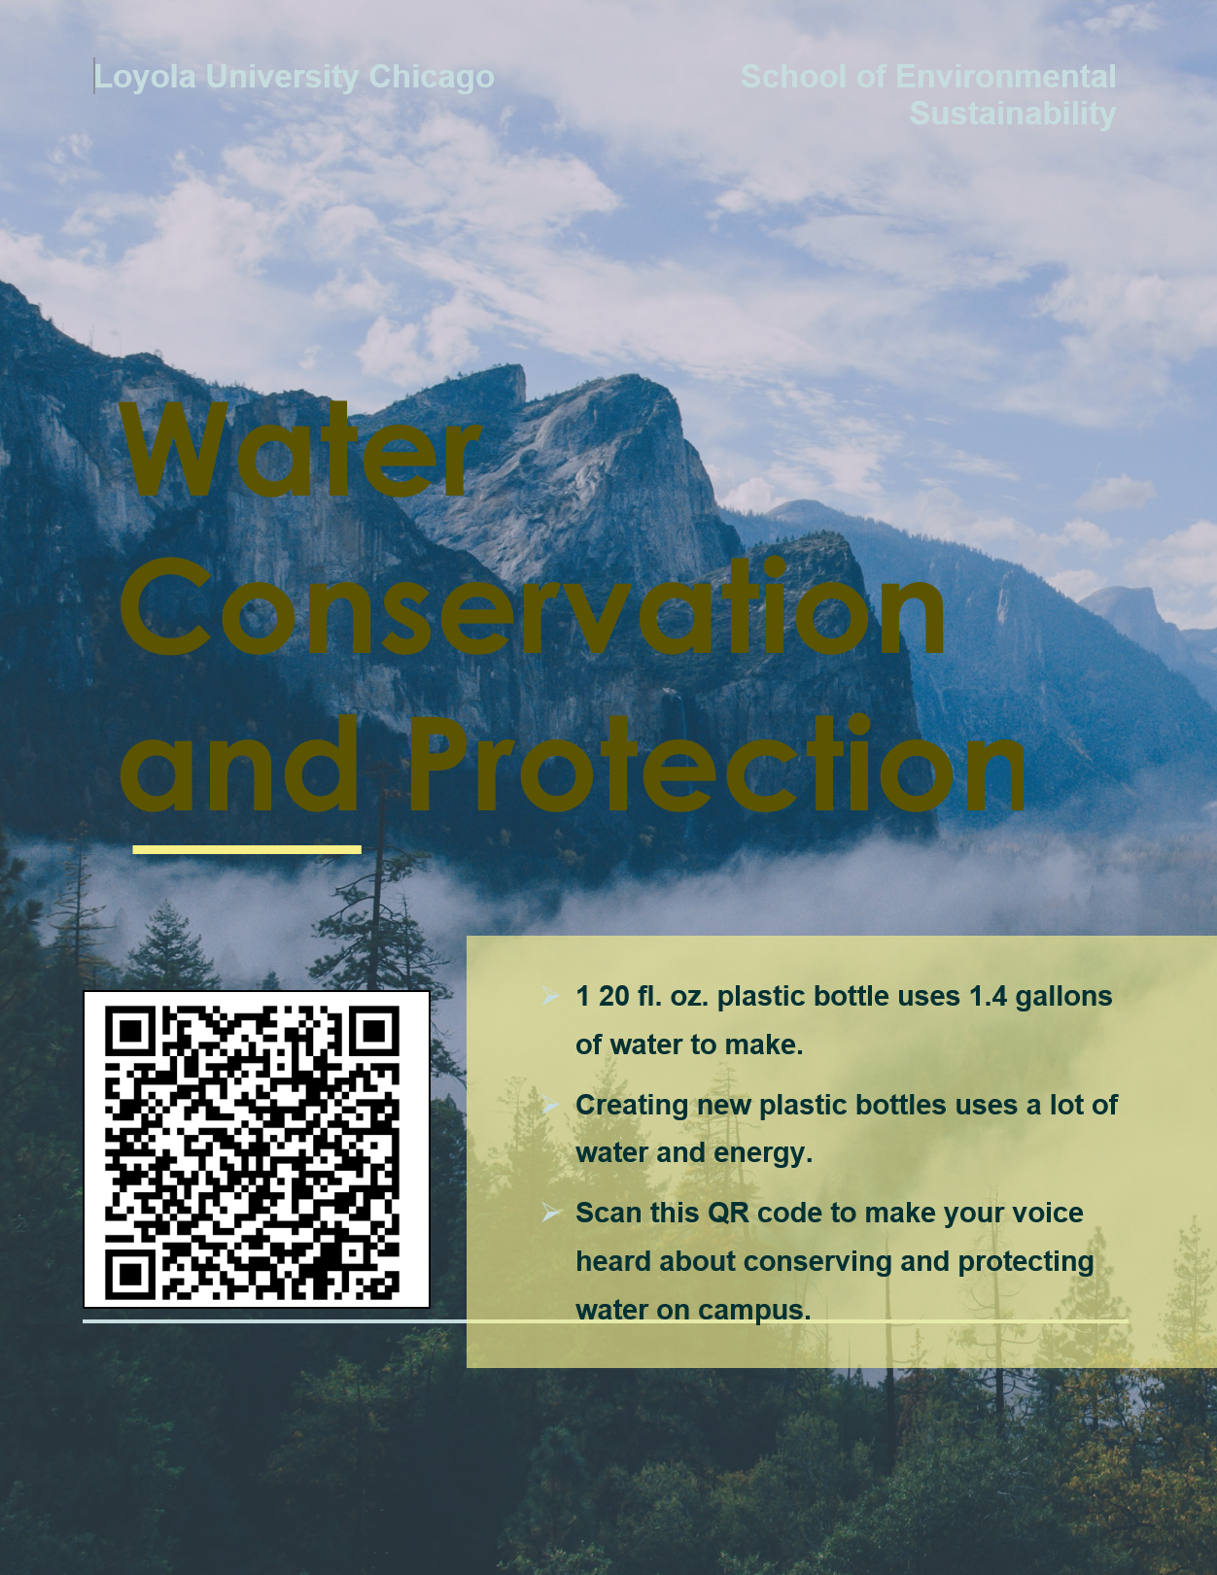
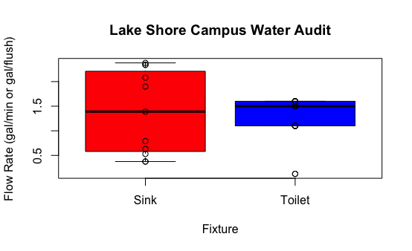
Water Conservation and Efficiency in Recreational Buildings at Loyola’s Lake Shore Campus
ReAnne Baniqued, Elizabeth Hallissey, John Gorman, Kelly Tanquary
Mentors: Megan Conway, Aaron Durnbaugh
Loyola University Chicago School of Environmental Sustainability
Motivation
3. Methods
5. Discussion
The purpose of this project was to explore water efficiency in recreational buildings around campus and raise awareness of water conservation among the student body.
Water Audit: On average, fixtures in both Damen and Halas are near the WaterSense Standards for efficiency, however, there were a number of instances of fixtures with unusually high flow rates. A list was compiled of potentially inefficient and problematic fixtures - defined in this project as a flow rate of greater than 2 gallons per minute. These included sinks in the men’s and women’s restroom outside of Damen Den, as well as men’s restrooms near the food court and on the second floor of Damen. We plan to finish auditing the remaining buildings in the coming weeks, then present our findings to a group of Loyola Administrators and facilities staff.
Poster Campaign: We intend to present the list of Loyola community members supporting increased water conservation to the Administration in the coming weeks. We hope that, by demonstrating community support, the administration will continue to look for more ways to conserve water and boost efficiency around campus in the coming years.
Global water scarcity is a rapidly-worsening problem in part due to water-intensive lifestyles. Although Loyola resides right next to Lake Michigan, and cities around the Great Lakes do not face water scarcity as does the Southwestern U.S., the cost of water is rising. This is due to aging infrastructure that needs repairs and upgrades, and the cost is pushed onto consumers.
The aim of our project is to raise awareness, change behaviors, and improve water efficiency in hopes to make students more cognizant of the issues of water scarcity at hand while also reinforcing Loyola’s pledge of sustainability. To promote both individual and institutional conservation, we set out to address both members of the Loyola community, primarily students, as well as the Loyola Administration.
Water Audit: To conduct the audit, we measured the water flow of sinks, toilets, and showers in all bathrooms. For sinks and showers, we timed how long it took to fill up a container of known volume, then converted those values to gallons per minute - the industry standard for measuring flow rates. For toilets, due to the difficulty of recording the exact rate of flow, we found the model of toilet installed and determined the flow rate from the manufacturers reported data. This data was then compiled and compared to the EPA’s WaterSense standards for efficient plumbing fixtures (EPA, 2022).
2. Overview
This project has two primary components: a water audit and promotion of water conservation.
Water Audit: Recreational buildings across Loyola’s Lake Shore Campus (Halas Rec Center, Damen Student Center, Gentile Arena, Norville Athletic Center, and the Alfie Norville Practice Facility) were explored to determine areas of water inefficiency. These buildings were selected as in past years, water audits have focused on residential and educational buildings over recreational ones. Additionally, the Norville Athletic Center and Alfie Norville Practice Facility are newer buildings on campus, so we hoped to examine the efficiency of the newer infrastructure.
Poster Campaign: We created a poster campaign to encourage the indirect and direct reduction of water usage by students. Moreover, each poster has a QR code linking to a pledge to reduce water usage around campus, with the list of supporters being shown to the Administration at the conclusion of the project to demonstrate the community’s desire to conserve water.
Poster Campaign: We created posters (shown above) that will be placed near vending machines and in residence hall laundry rooms. By doing so, we hope to raise awareness for better water efficiency, while also encouraging students to change the way they think about water on campus. Additionally, on each poster will be a QR code that, when scanned, takes the individual to a survey asking for their role at Loyola (student, staff, etc.), how strongly they care about water efficiency on campus, and for their name and email. The results of this survey will be presented to administration at Loyola to demonstrate community support for water conservation.
4. Results
6. References
Climate ADAPT. 2020. Awareness campaigns for behavioral change.
https://climate-adapt.eea.europa.eu/metadata/adaptation-options/awareness-campaigns
-for-behavioural-change. Retrieved February 6, 2022.
Elevate. (2022, January 8). Water affordability: a growing challenge. Elevate Nonprofit.
https://www.elevatenp.org/water/water-affordability-a-growing-challenge/
Environmental Protection Agency. (2022, March 11). WaterSense. Retrieved from Epa.gov: epa.gov/watersense
Erban, L. and Walker, H. 2019. Beyond Old Pipes and Ailing Budgets: Systems Thinking on
Twenty-First Century Water Infrastructure in Chicago. Frontiers, 5. https://doi.org/10.3389/fbuil.2019.00124
Snyder, S. 2021. Water scarcity - the U.S. connection. TheWaterProject.
https://thewaterproject.org/water-scarcity/water_scarcity_in_us
United Nations. 2021. Water scarcity. United Nations.
https://www.unwater.org/water-facts/scarcity/
Zamudio, M. & Craft, W. 2019. A water crisis is growing in a place you’d least expect it.
NPR.org.https://www.npr.org/2019/02/08/691409795/a-water-crisis-is-growing-in-a-place-youd-least-expect-it
Figure 1: This figure shows the water efficiency of various fixtures throughout LSC recreational buildings. The least efficient fixtures were faucets in the Men’s and Women’s Bathroom near Damen Den (2.34 and 2.38 gpm respectively), Men’s Bathroom near the Food Court (2.34 gpm), and the Men’s and Women’s Bathrooms on the second floor of Damen (2.08 and 1.90 gpm respectively).

