Slide 1




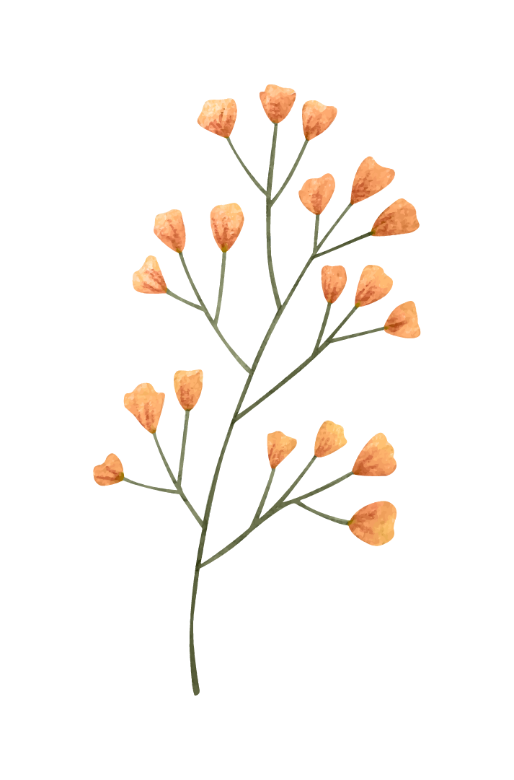
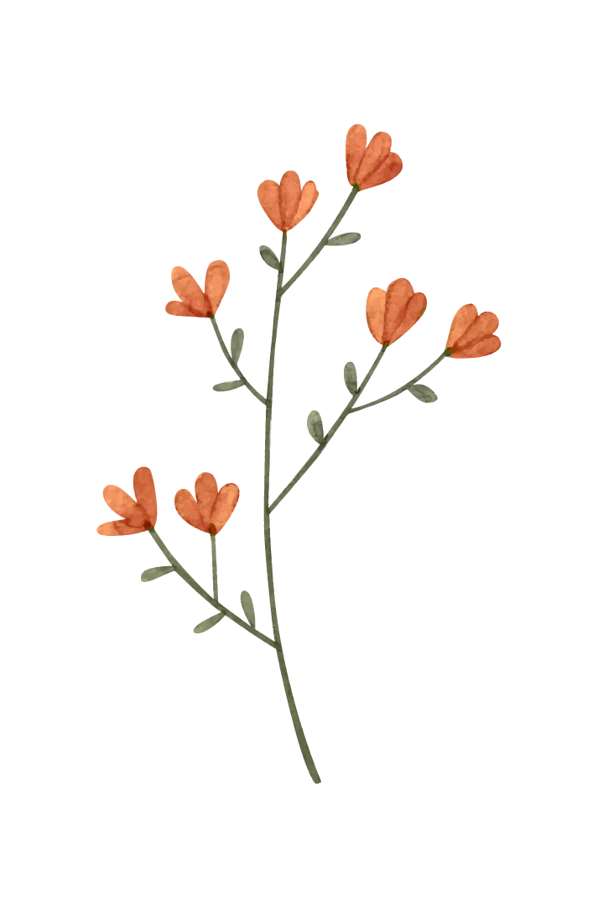
Internship GirlForward
Social Justice Internship
Giselle Hernandez

Slide 2


SJI Program & GirlForward Mission
Social Justice Internship
GirlForward
Girl Forward is a non profit organization located on the North side of Chicago, that looks to provide mentorship and resources to immigrant women. Their mission reads, “GirlForward is a community of support dedicated to creating and enhancing opportunities for girls who have been displaced globally by conflict and persecution.”- GirlForward, 2022
The Social Justice Internship (SJI), is an experiential learning opportunity open to Sophomores, Juniors, and Seniors at Loyola. The program allows for the 13 selected students to engage in meaningful work at 1 of 5 Chicago based non profit organizations.

Slide 3
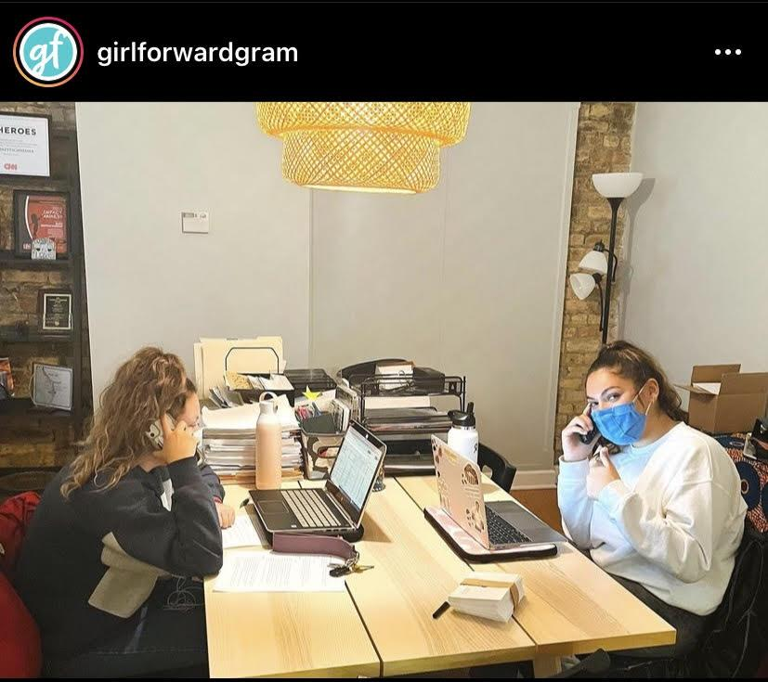
My Work at GirlForward
Grant Writing Intern
At GirlForward, I work as a Grant Writing and Program Development intern. As a Grant Writing intern, I am able to conduct research on potential donors, and help sustain connections between GirlForward and its wonderful supporters.
Here, Fundraising Intern (Olivia Martel) and I are sending personalized thank you’s to all of the individuals who donated during the 2020-2021 year! We called over 500 people on that day!

Slide 4
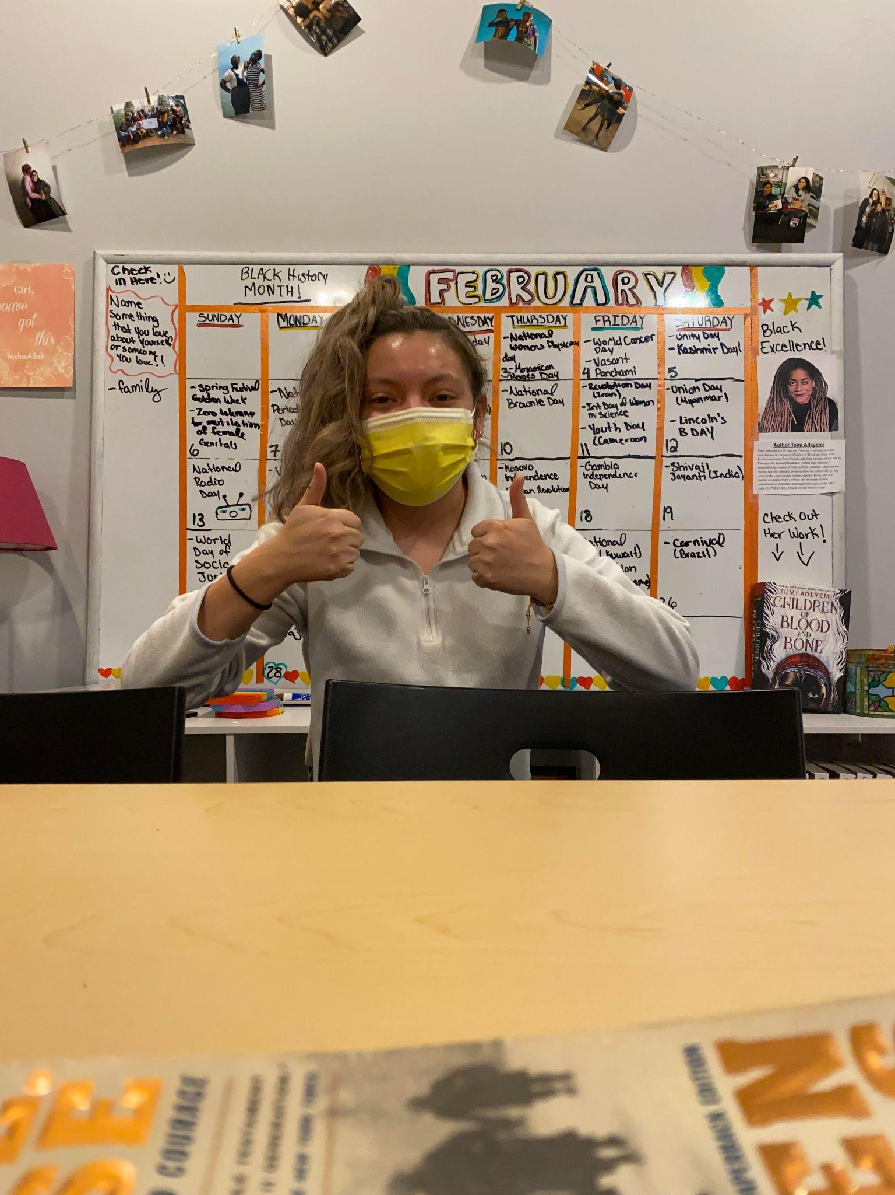
SJI Program & GirlForward Mission
Program Development Intern
When I am not helping with Grant Writing, I assist our Program Director Ashley with tasks targeted towards the development of GirlForward as a whole. Some days I am researching new ways to incorporate youth leadership boards, and others strategizing with our tutoring director on ways to improve the program. Or other days (like the one pictured on the right), I am creating safe spaces at GirlForward through implementations such as inclusive calendars!

Slide 5

Learning & Personal Growth
During my time interning at GirlForward, I have learned several things regarding Program Development, Grant Writing, and myself as a working individual. Through Grant Writing research, and engagement, I have learned the importance of approaching and centering proposals (and your work) to the audience which you hope to work with. Being able to have flexibility in your approach of different individuals, allows us to be able to best meet the needs of those we look to serve, while also establishing meaningful connections with potential partners. Similarly, working with program development matters, has really allowed me to see how complex and intentional change must be, if you’re looking to truly impact the community/environment in which you are working. Interning at GirlForward, has instilled a greater sense of confidence and pride in my work, and constantly encourages me to build community wherever I go.

Slide 6
THANK YOU
Giselle Hernandez, Class’ 23
Sociology Major, PreLaw
ghernandez8@luc.edu

