Slide 1
Long Term Clinical Outcomes for Patients who Underwent Monobloc and Le-fort Procedures
Sara Fuentes-Lara, Reilly Frauchiger-Ankers, Amir Dorafshar, MBChB, FACS, FAAP
Department of Plastic and Reconstructive Surgery
August 12, 2021

Slide 2
Background
Aims and Methods
Results
Conclusion
Acknowledgments

Slide 3
Background
Crouzon and Apert Syndrome
Rare genetic disorders
Common Characteristics
Craniosynostosis
Protruding eyes
Midface Hypoplasia
Sleep apnea
Issues with breathing and swallowing
Syndactyly (Apert Syndrome only)

Slide 4
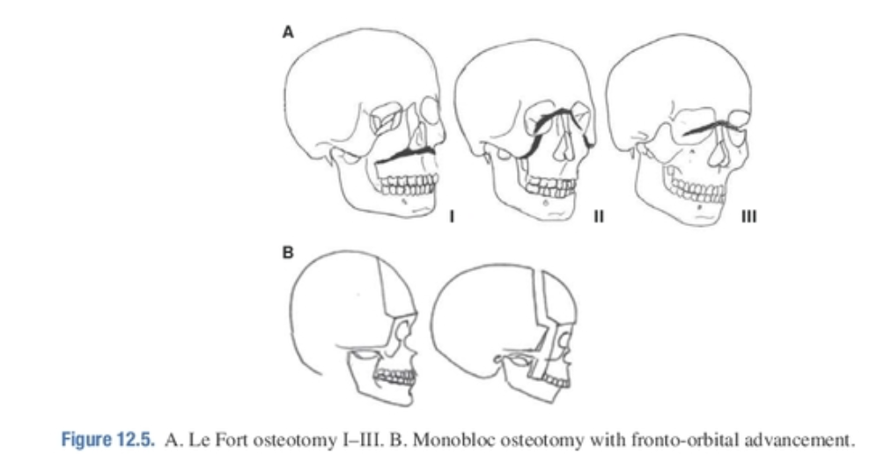
Background
Monobloc and Le-Fort Procedures
Typical procedures for craniofacial syndromes
Monobloc:
Brings the midface forward
Opens the closed joints in the front of the skull
Le-Fort I
Movement of the upper jaw forward
Le-Fort II
Movement of the nose and upper jaw together
Le Fort III
Movement of the entire face forward

Slide 5
Aims and Methods
Criteria: Patient at Rush Medical Center who has Crouzon or Apert Syndrome and underwent a Monobloc or Le-Fort Surgery- 68 total patients on record
1. Sleep Apnea Did the indices decrease after undergoing Monobloc and Le-Fort procedures?
Analysis of pre and post operative sleep studies Variables: AHI, OAHI, O2 nadir %, sleep endoscopy
2. Complications Were there any post operative complications?
Analysis of post operative records CSF leak requiring surgical correction or lumbar drainage Infection Scar revision
3. Other Factors
Analysis of pre and post operative records Snoring Velopharyngeal Insufficiency
Did these factors change after surgery?

Slide 6
Results
Sleep Apnea Indices
Analysis is still underway
Many patients did exhibit a decrease in index values
14 post operative sleep studies, 3 post op. sleep endoscopies
Complications
Analysis is still underway
Majority exhibited no CSF leaks or infection post op.
3 CSF leaks requiring surgical correction, 1 infection, 1 scar revision
Other Factors
Analysis is still underway
Mix of snoring that began, continued, and stopped post operatively
26 notes, majority were a continuation
No patients on record indicated a Velopharyngeal Insufficiency

Slide 7
Discussion
1. Monobloc and Le-Fort Procedures are an effective way to reduce sleep apnea
2. Patients who undergo Monobloc and Le-Fort Procedures are low risk

Slide 8
Acknowledgments
Rush Medical College
Rush University Research Scholars Program: Daniela Pasnick, Dr.Cs-Szabo
Reilly Frauchiger-Ankers, Dr. Amir Dorafshar

