Slide 1
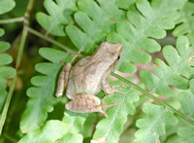
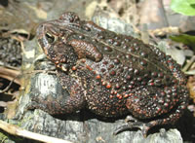
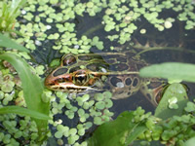
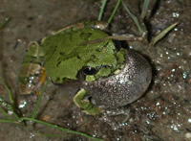
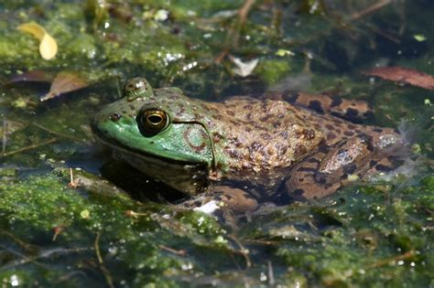
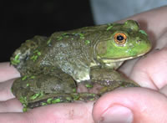
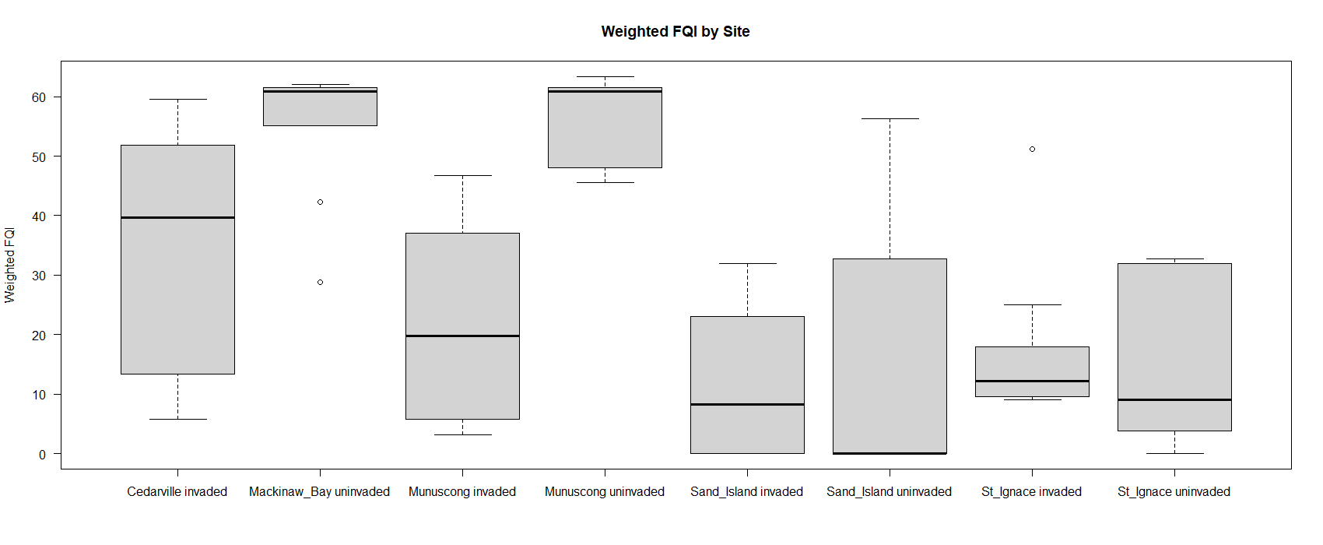
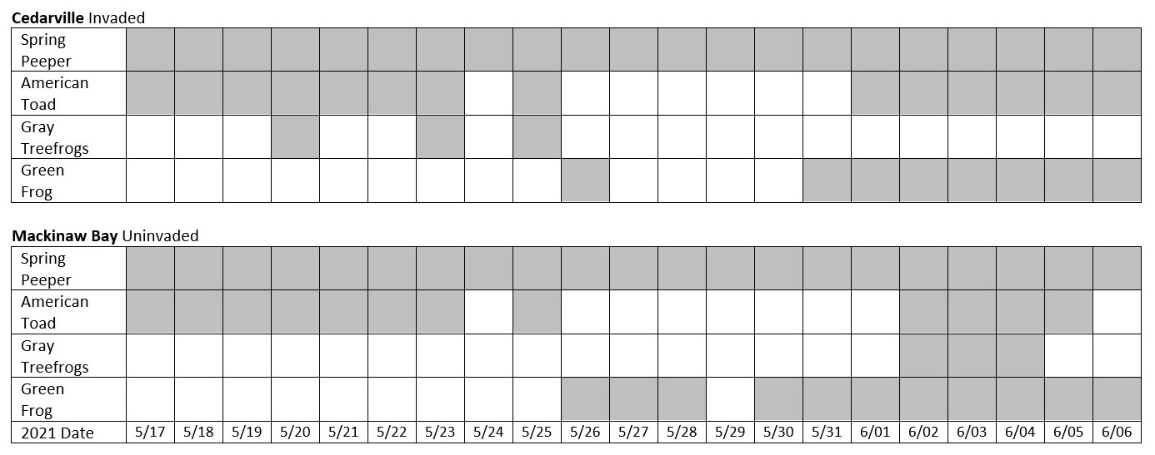
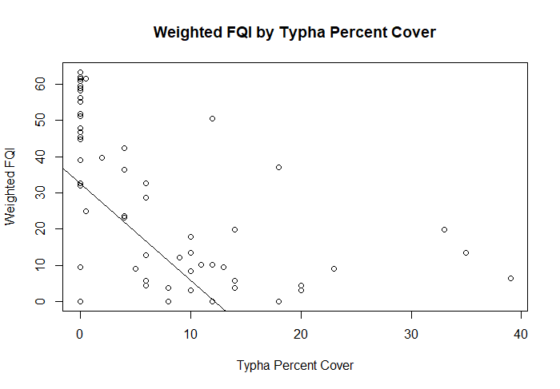
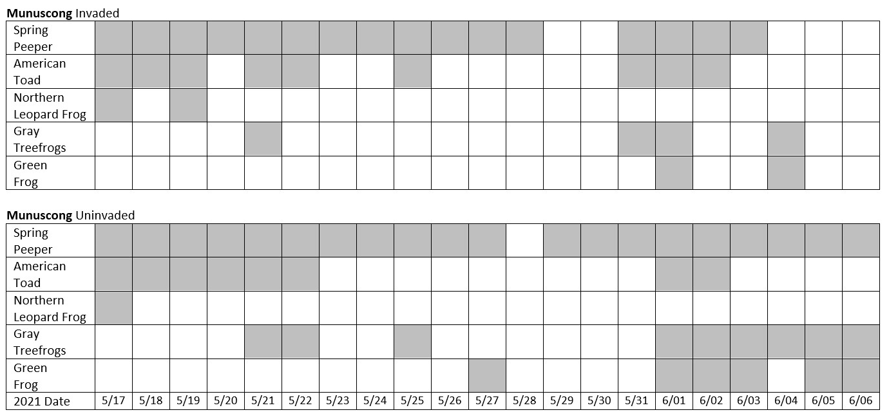
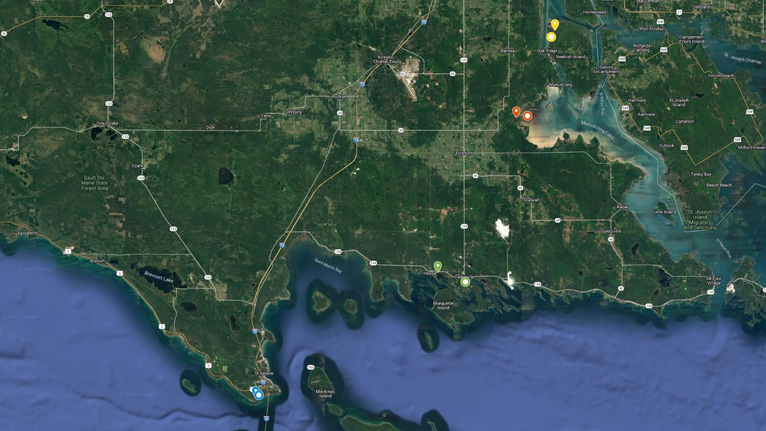
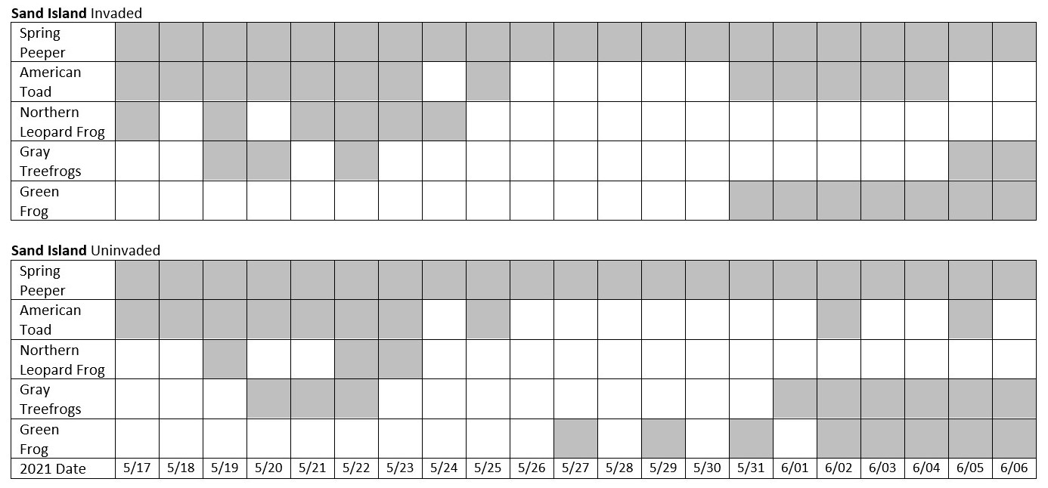
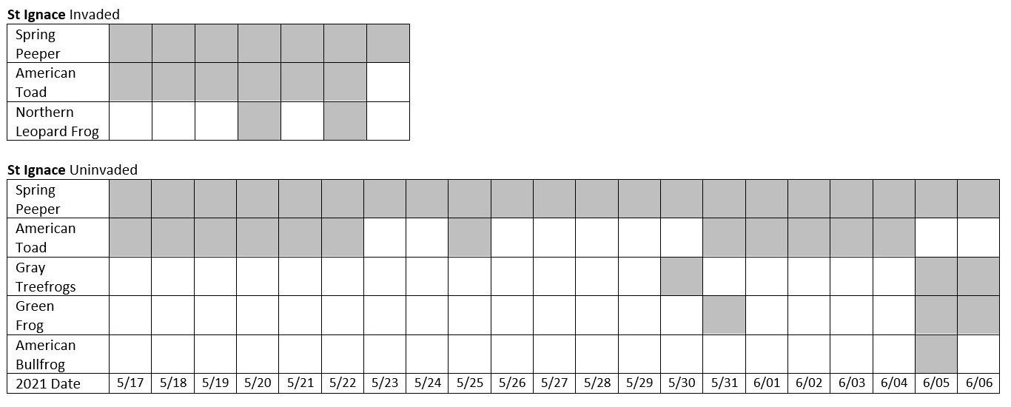
Impacts of Great Lakes Typha Invasion on Anuran Species
Elizabeth Thilges*, Drew Monks, Shane Lishawa, Dr. Brian Ohsowski
School of Environmental Sustainability | Loyola University Chicago
ethilges@luc.edu
Abstract
Methods
Results
Anuran (frog and toad) populations are in decline worldwide, including around the Great Lakes. Simultaneously, the abundance of the hybrid cattail, Typha x glauca, has expanded in Great Lakes coastal wetlands. This invasive plant alters wetlands by forming dense stands, negatively impacting anuran species by fragmenting their suitable habitat. To quantify the effects of Typha on different anuran species, sound recorders were placed in paired invaded and uninvaded wetland sites in the spring of 2021 in northern Michigan. Vegetation surveys were conducted around the sound recorders and I listened to the audio data to determine the presence of anuran species.
In spring 2021, the Sault Tribe Natural Resources Department (STRND) placed Song Meter SM4 sound recorders at each of the paired wetland sites. I analyzed this audio data using bio-acoustic data analysis software (RavenPro), listening to the recording from May 17th to June 6th, 2021 at each site from 10:00 to 10:05 pm. The vegetation around each of the sound recorders was surveyed between July 13th and August 8th, 2021 by estimating the percent coverage of the plant species in nine 1 m² quadrats. The quadrats were placed at 5, 25, and 50 m from the recorder in three lines each 120° from each other. I determined the weighted floristic quality index (FQI) for each of the sites using the Universal FQA Calculator with the Michigan FQA Database (Freyman et al., 2016; Reznicek et al., 2014). An FQI uses the coefficient of conservation of each of the plants in a site to determine the ecological quality of the area. I then preformed analysis of the vegetation data using R (R Core Team, 2021). Two-way ANOVAs were preformed to compare plant diversity between sites and weighted FQI between sites, along with a linear regression to compare the Typha percent cover and diversity. The data was untransformed as all assumptions were met. However, the non-parametric Kendall–Theil Sen Siegel test was used to compare Typha percent cover and weighted FQI as the data was not normal.
There were not significant differences in the plant species diversity between sites (p-value > 0.05), but there were significant differences in the weighted FQI (p-value < 0.01). The highest weighted FQIs were at the uninvaded Mackinaw Bay and the uninvaded Munuscong sites. There were significant differences between the uninvaded Mackinaw Bay site and the invaded Munuscong site (p < 0.01), the uninvaded Mackinaw Bay site and the invaded Sand Island site (p < 0.01), the uninvaded Mackinaw Bay site and the invaded St Ignace site (p < 0.01), the uninvaded Munuscong site and the invaded Munuscong site (p < 0.01), the uninvaded Munuscong site and the invaded Sand Island site (p < 0.01), and the uninvaded Munuscong site and the invaded St Ignace site (p < 0.01). There were also not a significant relationship between Typha percent cover and diversity (p > 0.05), but there was a significant negative relationship between Typha percent cover and weighted FQI (p < 0.01). These results show that increased Typha percent cover is correlated with a lower ecological value of plant communities. My preliminary observations suggest that Typha percent cover is associated with decreased anuran presence, but further analysis is needed.
A
B
C
A
D
B
C
D
E
F
A
E
D
Figure 1. Anuran species: spring peeper (A), American toad (B), northern leopard frog (C), gray treefrog (D), green frog (E), and American bullfrog (F) (USGS, 2018). Top spectrogram is from the uninvaded Sand Island site on May 17th, and bottom is from the uninvaded Munuscong site on June 6th.
Introduction
Audio Analysis
Globally, about 42% of all amphibian species have decreased since 1980 (Stuart et al., 2004). In the Great Lakes, at least 50% of amphibian species are at risk (Hecnar, 2004). Amphibians need unique combinations of terrestrial and aquatic habitat to reproduce, making them especially vulnerable to habitat fragmentation (Kolozsvary & Swihart, 1999). In coastal wetlands, the presence of some species, like the American toad and the eastern grey treefrog, decreases with the presence of nearby forested areas while the presence of the spring peeper increases (Price et al., 2005). Alternatively, the American toad and the eastern grey treefrog are positively associated with nearby grasses and sedges (Price et al., 2005). The invasive hybrid cattail Typha x glauca has expanded its presence in Great Lakes coastal wetlands over the last 50 - 100 years (Bansal et al., 2019). Like the common reed Phragmites australis, another invasive species, the stands formed by Typha likely negatively impact anuran species through the prevention of movement between the habitats they require (Mifsud, 2014). Both Typha and Phragmites can quickly outcompete native species and form monocultures, as they can grow taller and denser than the native wetland plants of the Great Lakes (Tulbure et al., 2007). Male members of many anuran species call in order to signal their reproductive fitness (Cannatella, 2005). In the Great Lakes, almost all anuran species call during the spring or early summer, allowing for their identification via calling surveys (Eagle & Droege, 2019). The use of audio recordings allows for a calling survey to take place over an extended period while minimizing changes in anuran behavior from human observers (Bridges & Dorcas, 2000). I expected an increase in Typha cover to be correlated with a lower quality plant community decreased anuran presence.
The frog species I identified were the spring peeper (Pseuda criscrucifer), the American toad (Anaxyrus americanus), the northern leopard frog (Rana pipiens), the eastern gray treefrog (Hyla versicolor) and Cope's gray treefrog (Hyla chrysoscelis), green frog (Rana clamitans melanota) and the American bullfrog (Lithobates catesbeianus).
Figure 4. Boxplot of the weighted FQI by site.
Figure 5. Scatterplot of the weighted FQI by Typha percent cover.
References
Bansal, S., Lishawa, S. C., Newman, S., Tangen, B. A., Wilcox, D., Albert, D., Anteau, M. J., Chimney, M. J., Cressey, R. L., DeKeyser, E., Elgersma, K. J., Finkelstein, S. A., Freeland, J., Grosshans, R., Klug, P. E., Larkin, D. J., Lawrence, B. A., Linz, G., Marburger, J., & Windham-Myers, L. (2019). Typha (Cattail) Invasion in North American Wetlands: Biology, Regional Problems, Impacts, Ecosystem Services, and Management. Wetlands, 39(4), 645–684. https://doi.org/10.1007/s13157-019-01174-7
Bridges, A. S., & Dorcas, M. E. (2000). Temporal Variation in Anuran Calling Behavior: Implications for Surveys and Monitoring Programs. Copeia, 2000(2), 587–592. https://doi.org/10.1643/00458511(2000)000[0587:tviacb]2.0.co;2
Cannatella, D. (2007). An Integrative Phylogeny of Amphibia. In P. Narins, A. Feng, R. Fay, & Arthur Popper (Eds.), Hearing and Sound Communication in Amphibians (pp. 12–43). Springer.
Eagle, P., & Droege, S. (2019). Evaluating Calling Surveys. In Amphibian Declines (pp. 314–319). University of California Press. https://doi.org/10.1525/9780520929432-050
Freyman, W.A., Masters, L.A., & Packard, S. (2016). The Universal Floristic Quality Assessment (FQA) Calculator: an online tool for ecological assessment and monitoring. Methods in Ecology and Evolution, 7(3), 380–383
Hecnar, S. J. (2004). Great Lakes wetlands as amphibian habitats: A review. Aquatic Ecosystem Health & Management, 7(2), 289–303. https://doi.org/10.1080/14634980490461542.
Kolozsvary, M., & Swihart, R. (1999). Habitat fragmentation and the distribution of amphibians: Patch and landscape correlates in farmland. Canadian Journal Of Zoology-Revue Canadienne De Zoologie, 77(8), 1288-1299. https://doi.org/10.1139/z99-102.
Mifsud, D. A. (2014). A status assessment and review of the herpetofauna within the Saginaw Bay of Lake Huron. Journal of Great Lakes Research, 40(S1), 183–191. https://doi.org/10.1016/j.jglr.2013.09.017
Price, S. J., Marks, D. R., Howe, R. W., Hanowski, J. M., & Niemi, G. J. (2005). The Importance of Spatial Scale for Conservation and Assessment of Anuran Populations in Coastal Wetlands of the Western Great Lakes, USA. Landscape Ecology, 20(4), 441–454. https://doi.org/10.1007/s10980-004-3167-6 .
Reznicek, A.A., Penskar, M.R., Walters, B.S., & Slaughter, B.S. (2014). Michigan Floristic Quality Assessment Database. Herbarium, University of Michigan, Ann Arbor, MI and Michigan Natural Features Inventory, Michigan State University, Lansing, MI. http://michiganflora.net
R Core Team (2021). R: A language and environment for statistical computing. R Foundation for Statistical Computing, Vienna, Austria. https://www.R-project.org/.
Stuart, S. N., Chanson, J. S., Cox, N. A., Young, B. E., Rodrigues, A. S. L., Fischman, D. L., & Waller, R. W. (2004). Status and Trends of Amphibian Declines and Extinctions Worldwide. Science, 306(5702), 1783–1786. https://doi.org/10.1126/science.1103538
Tulbur, M. G., Johnston, C. A., & Auger, D. L. (2007). Rapid Invasion of a Great Lakes Coastal Wetland by Non-native Phragmites australis and Typha. Journal of Great Lakes Research, 33(sp3), 269–279. https://doi.org/10.3394/0380-1330(2007)33[269:rioagl]2.0.co;2
USGS. (2018, April 3). Frog and Toad Calls. Upper Midwest Environmental Sciences Center. https://www.umesc.usgs.gov/terrestrial/amphibians/armi/frog_calls.html
Sand Island
Munuscong
Mackinaw Bay
Cedarville
St. Ignace
Figure 2. Invaded sites are marked by circles, uninvaded sites by teardrop shapes.
Acknowledgments
Thank you to my mentors Drew, Shane, and Dr. Ohsowski for their ongoing help with my project. My project was made possible due to funding from the Loyola Undergraduate Research Opportunities Program and the Lee Bots Fellowship.
Figure 3. The presence of a frog species is shaded grey if its call was identified at the wetland site.

