Slide 1

Cook county Community survey

Slide 2
Cook County Community Survey
Our Team:
2021-2022
  Faculty: Dr. Dana Garbarski & Dr. David Doherty
  Grad students: Keyla Navarrete, Juanita Vivas Bastidas
  Undergrad students: Sophia Bardelli, Sarah Jack, Andrew Byrne, Ben Stringer, Emma O’Driscoll, Pablo Guzman Rivera, Maddie Jackson

Slide 3
Goals
Establish a repeated cross-sectional survey of residents of Cook County, IL
How public thinks of distinctive political and social issues
Shed light on enduring and emerging local issues for public and policy makers
Notes:
Establish a repeated cross-sectional survey of residents of Cook County, IL
Offer new insights into the public’s views regarding the distinctive political and social issues facing urban areas in the contemporary United States
Provide an opportunity for researchers to shed light on enduring and emerging local issues and how policy makers and the public might work together to address them
Pedagogical motivation: students have a unique experiential learning opportunity to work with faculty to develop and field a survey that addresses the most pressing issues facing the area

Slide 4
Sample
Cross-sectional online survey of a descriptively representative sample of 1,460 adults in Cook County
  February-March 2022
Dynata: data platform with a large and diverse panel of respondents.
  Slightly underrepresented Latine population, overrepresented white population of Cook County

Slide 5
Characteristics
Age:
  18 – 25: 10%
  26 – 35: 21%
  36 – 45: 24%
  46 – 64: 25%
  65+: 20%
Gender self-identification:
  Woman 57%
  Man 41%
  Transgender, genderqueer, nonbinary 1.3%
Ethnoracial self-identification:
  White 54%
  Black or African American 23%
  Hispanic, Latine, Latinx 19%
    89% born in U.S.
  Asian 5%
    53% born in U.S.
  More than one 2%
  Other 1.5%
Residence
  Chicago 45%
  Suburban Cook County 54%
Notes:
Census estimates for race/ethnicity
White, not HL: 41.8%
Hispanic/latinx, any race: 25.6
Black, not HL: 22.7%
Asian, not HL:7.6%
Some other race, not HL: 0.2%
2 or more, not HL: 1.9

Slide 6
COOK COUNTY COMMUNITY SURVEY
Online Food Delivery Services
Ben Stringer

Slide 7
What is an Online Food Delivery Service?
Online Food Delivery Services (OFDS) are services that connect customers to restaurants with their online order platform and a fleet of delivery drivers.
  Popular services in Cook County in descending order are Grubhub, UberEats, PostMates and DoorDash.
While OFDS differ slightly in terms of offerings, the all work on a very similar business model
  A user places an order on the website, the website takes that order and sends it to the restaurant and then sends a driver to pick up and deliver the food to the user.
During the COVID-19 Pandemic, the popularity of OFDS grew as policy was introduced that limited dining in.
Notes:
Molla, Rani. “What's the Biggest Food Delivery Service in Your City?” Vox. Vox, October 3, 2017. https://www.vox.com/2017/10/3/16384050/food-delivery-service-ubereats-grubhub-doordash-city-takeout.

Slide 8
OFDS and COVID-19
On March 16, 2020, Gov. Pritzker issued an executive order requiring that all businesses in the state that offer food or beverages for on-premises consumption may only operate for take-out and delivery services.
Recognizing rising case numbers across the U.S. OFDS implement two changes, one involving the process of ordering food, one involving advertisements
  No contact delivery and advertisements that directly reference the COVID-19 pandemic.
“Resilience reflects the ability of such corporations to adapt quickly and exploit new opportunities. In the context of COVID-19, this is illustrated via the pivoting of marketing and promotions to leverage both the pandemic and associated policy responses.”
Notes:
SPECTRUM Consortium. “Signalling Virtue, Promoting Harm - Unhealthy commodity industries and COVID-19.” NCD Alliance, September 9, 2020.

Slide 9
Research Questions
What % of Cook County interacts with OFDS at some level?
Who is using OFDS the most and how often are they using an OFDS?
What do people living in Cook County like about using OFDS?
Has the way residents of Cook County use OFDS changed as a result of the pandemic?

Slide 10
Three Questions
In the past month, how often have you or your family used an online food delivery service?
  Never, Once or twice, Once a week, More than once a week
Thinking about online food delivery services such as Uber Eats, Grubhub, Postmates, and DoorDash, do you now use these more or less often than you did prior to the COVID-19 pandemic (that is, prior to March 2020)?
  More often, About the same, Less often
Which of the following is most important to you in considering whether to use online food delivery service like Uber Eats, Grubhub, Postmates, and DoorDash?
  Cost, Convenience, Reducing physical contact, Supporting restaurants directly, Experience, Other (write in)

Slide 11
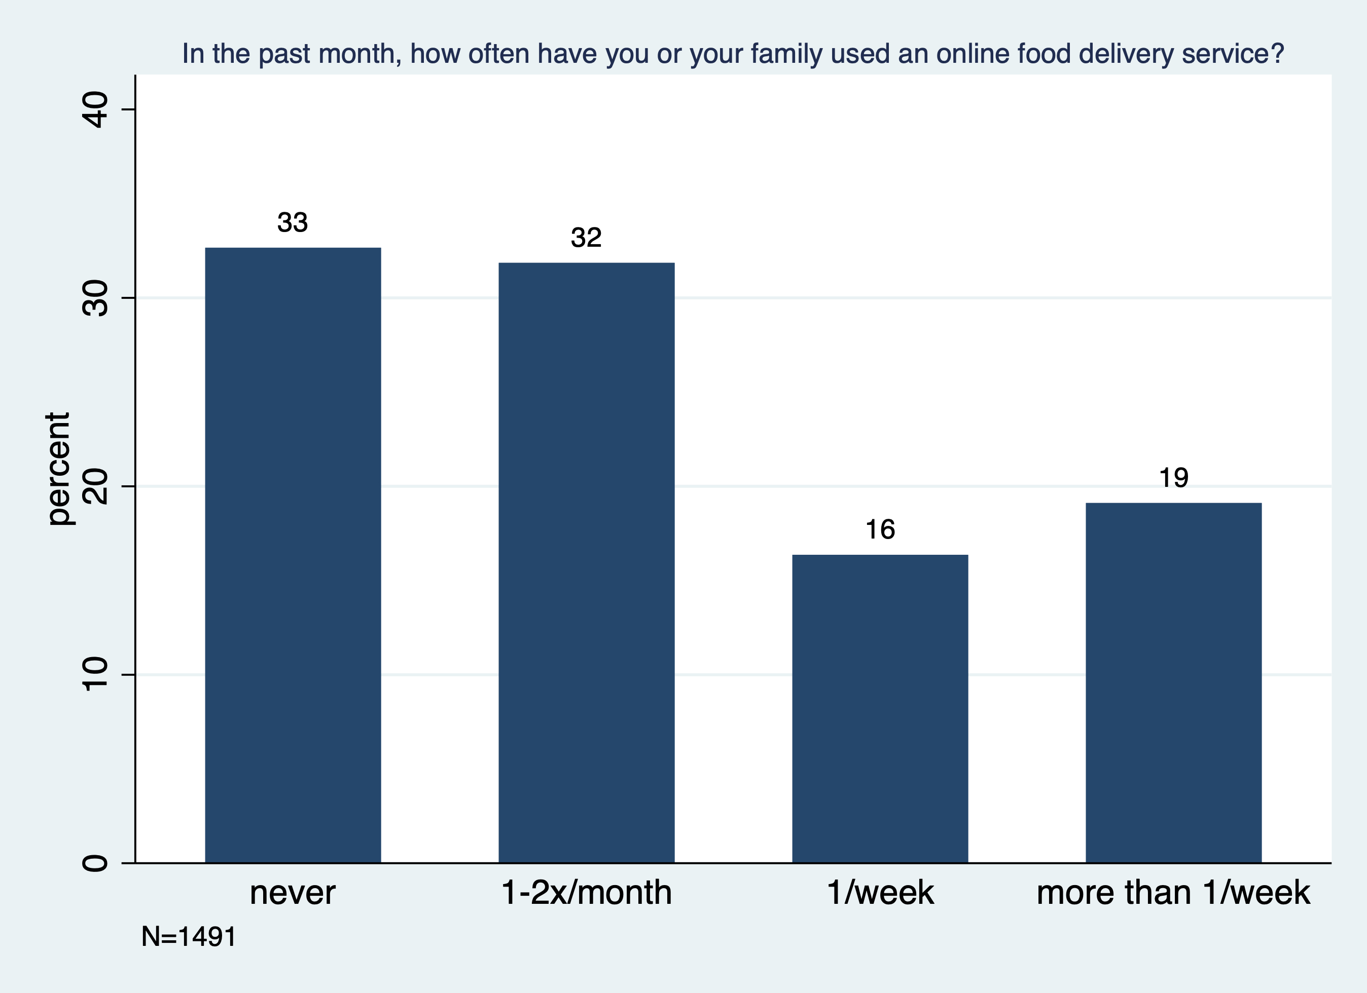
Notes:
Never: 487 32.66
1-2x/month | 475 31.86
1/week | 244 16.36
more than 1/week | 285 19.11

Slide 12
1: Cost
2: Convenience
3: Reducing physical contact
4: Supporting Restaurants Directly
5: Experience
6: Other (write in)
1 2 3 4 5 6
1 2 3 4 5 6 6
3
4
Notes:
Does not use OFDS: 229 73 25 68 16 76
47.02 14.99 5.13 13.96 3.29 15.61
Has not used ofds in last month: 277 360 130 116 108 13
27.59 35.86 12.95 11.55 10.76 1.29
Total: 506 433 155 184 124 89
33.94 29.04 10.40 12.34 8.32 5.97

Slide 13
Notes:
less often | 202 13.55
about the same | 634 42.52
more often | 655 43.93

Slide 14
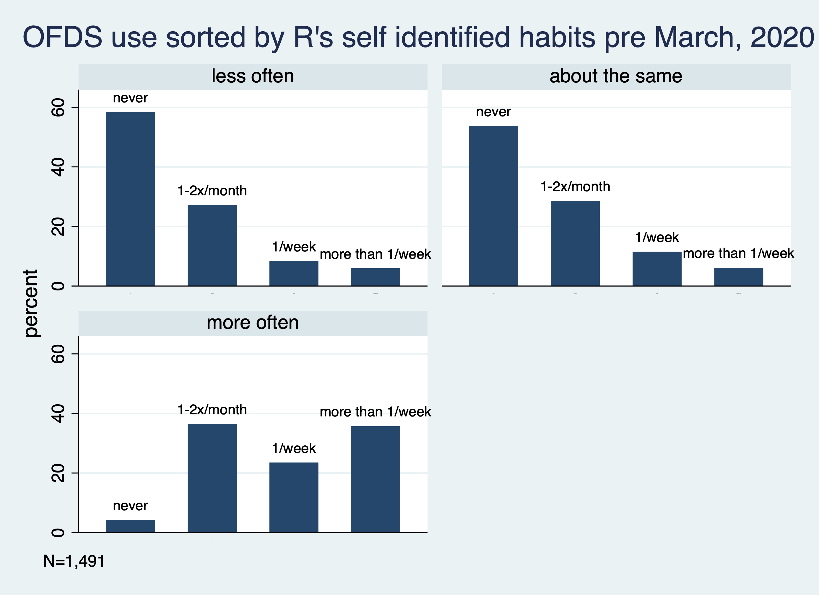
Notes:
Less often: 118 55 17 12 202
58.42 27.23 8.42 5.94
About the same: 341 181 73 39 634
53.79 28.55 11.51 6.15
More often: 28 239 154 234 655
4.27 36.49 23.51 35.73

Slide 16
Notes:
Black:
75 167 59 58
20.89 46.52 16.43 16.16
White:
334 204 121 109
43.49 26.56 15.76 14.19
Hisp:
47 75 53 109
16.55 26.41 18.66 38.38

Slide 17
Notes:
<10k-39,999
123 154 72 41 | 390
31.54 39.49 18.46 10.51 | 100.00
40k-69,999
116 111 52 40 | 319
36.36 34.80 16.30 12.54 | 100.00
70k-119,999
112 89 53 103 | 357
31.37 24.93 14.85 28.85
120k+
93 82 60 91 | 326
28.53 25.15 18.40 27.91

Slide 19
Notes:
18-25 | 16 67 40 30 | 153
| 10.46 43.79 26.14 19.61 | 100.00
26-35 | 26 113 77 88 | 304
| 8.55 37.17 25.33 28.95 | 100.00
36-45 | 45 124 68 120 | 357
| 12.61 34.73 19.05 33.61 | 100.00
46-64 | 165 118 39 37 | 359
| 45.96 32.87 10.86 10.31 | 100.00
65+ | 226 40 16 5 | 287
| 78.75 13.94 5.57 1.74 | 100.00

Slide 20
Overall Summary
2/3 of Cook County Uses OFDS at least once a month.
  1/3 of Cook County Uses OFDS at least once a week.
Use of OFDS is not universal among Cook County residents
  Respondents under 45 years old, making over $70,000 were using OFDS the most (once a week or more). That said significant usage was seen at most levels of age and income.
Respondent’s self identified most important quality differed based on their usage.

Slide 21
What is next?
Create new sub-group that contains users who typically use OFDS the most.
Create zip code analysis.
Possibly connect existing neighborhood perception data.

