Slide 1
Do CAR-T-Derived Exosomes Contribute to Cancer Therapy?
2022
By: Frankie Diaz, Will Zhang, Gina Scurti, Dr. Michael Nishimura, and W. Keith Jones

Slide 2
TABLE OF CONTENTS
01
02
03
Background
CAR-T cells
Exosomes
04
05
qRT-PCR
Future research
2022
Current cancer therapies and effectiveness
Adoptive Cell Therapy
Characterization of Exosomes
Presence of hsa-miR-155-5p in CAR-T
Description of current and continuing research

Slide 3
~600,000
2022
Deaths from cancer every year
U.S. Cancer Statistics Working Group, June 2021. www.cdc.gov/cancer/dataviz

Slide 4
01
Current Cancer Treatments
2022

Slide 5
Cancer Treatments
Surgery
Chemical Therapy
01
- Does not work for all cancers
Chemotherapy
Radiation therapy
Hormone therapy
Immune therapy
Notes:
FIX UGLY

Slide 6
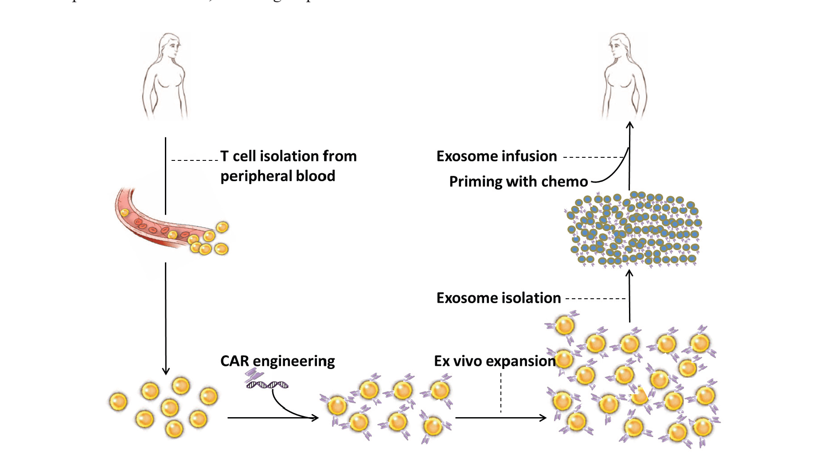
CAR-T Cells
02
Adoptive Cell Therapy
Chimeric Antigen Receptor
Antigen Binding
Activate T-Cells

Slide 7
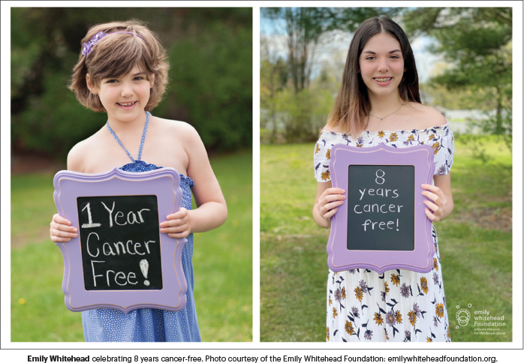
CAR-T Cells
02
Emily Whitehead
Not for all cancers
Not effective in treating solid tumors

Slide 8
Side effects
Other Complications
Cytokine Release Syndrome
Nervous System problems
** 30-40% Success Rate in Lasting Remission **

Slide 9
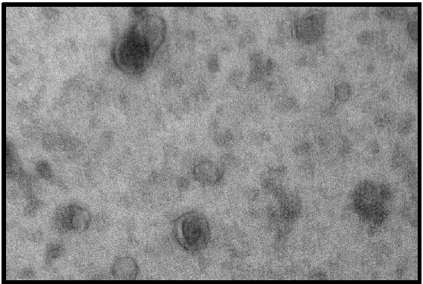
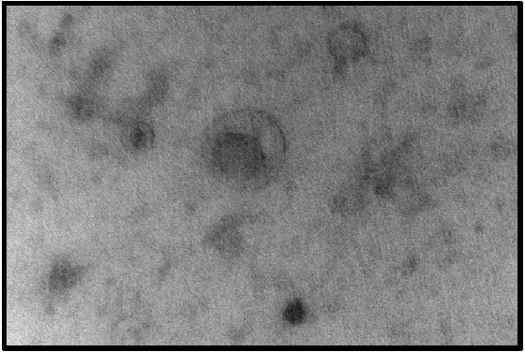
Are Exosomes Secreted by CAR-T Cells?

Slide 10
Isolation Processes
CAR-T Cells
Exosomes

Slide 11
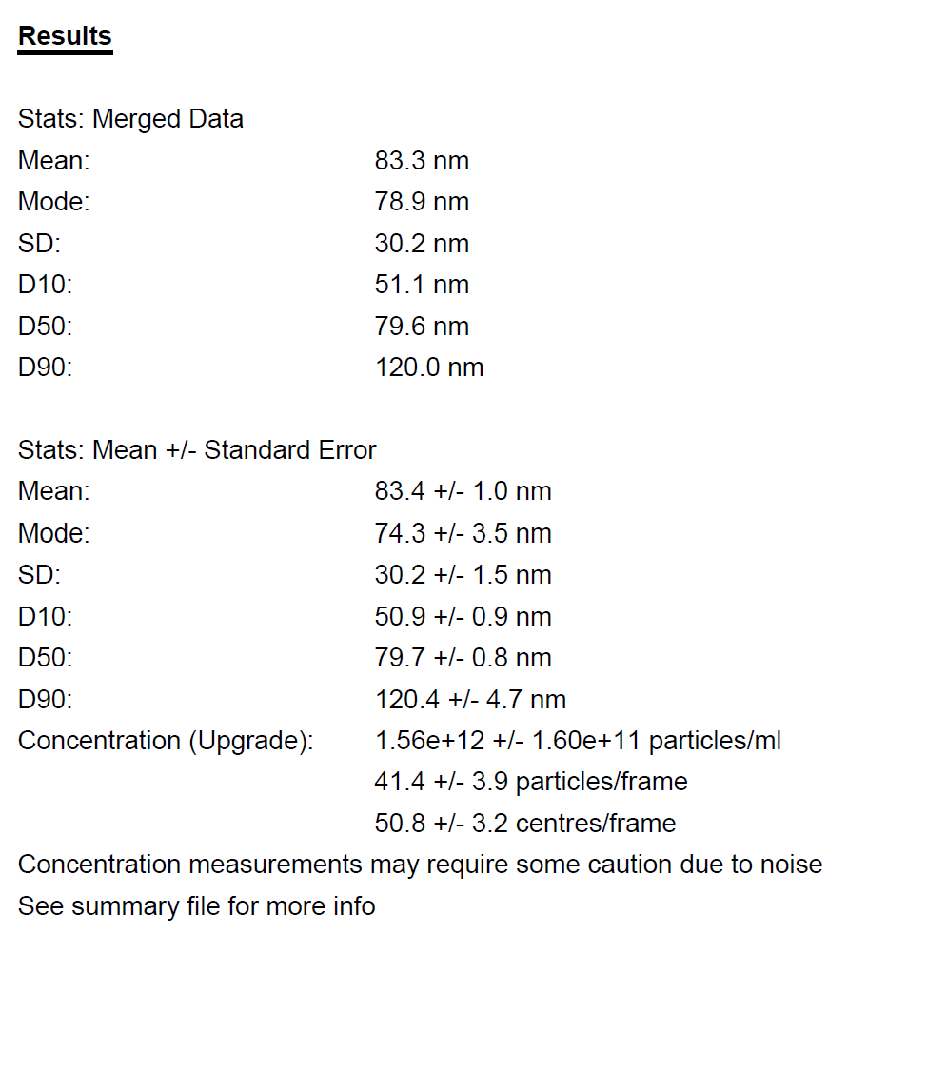
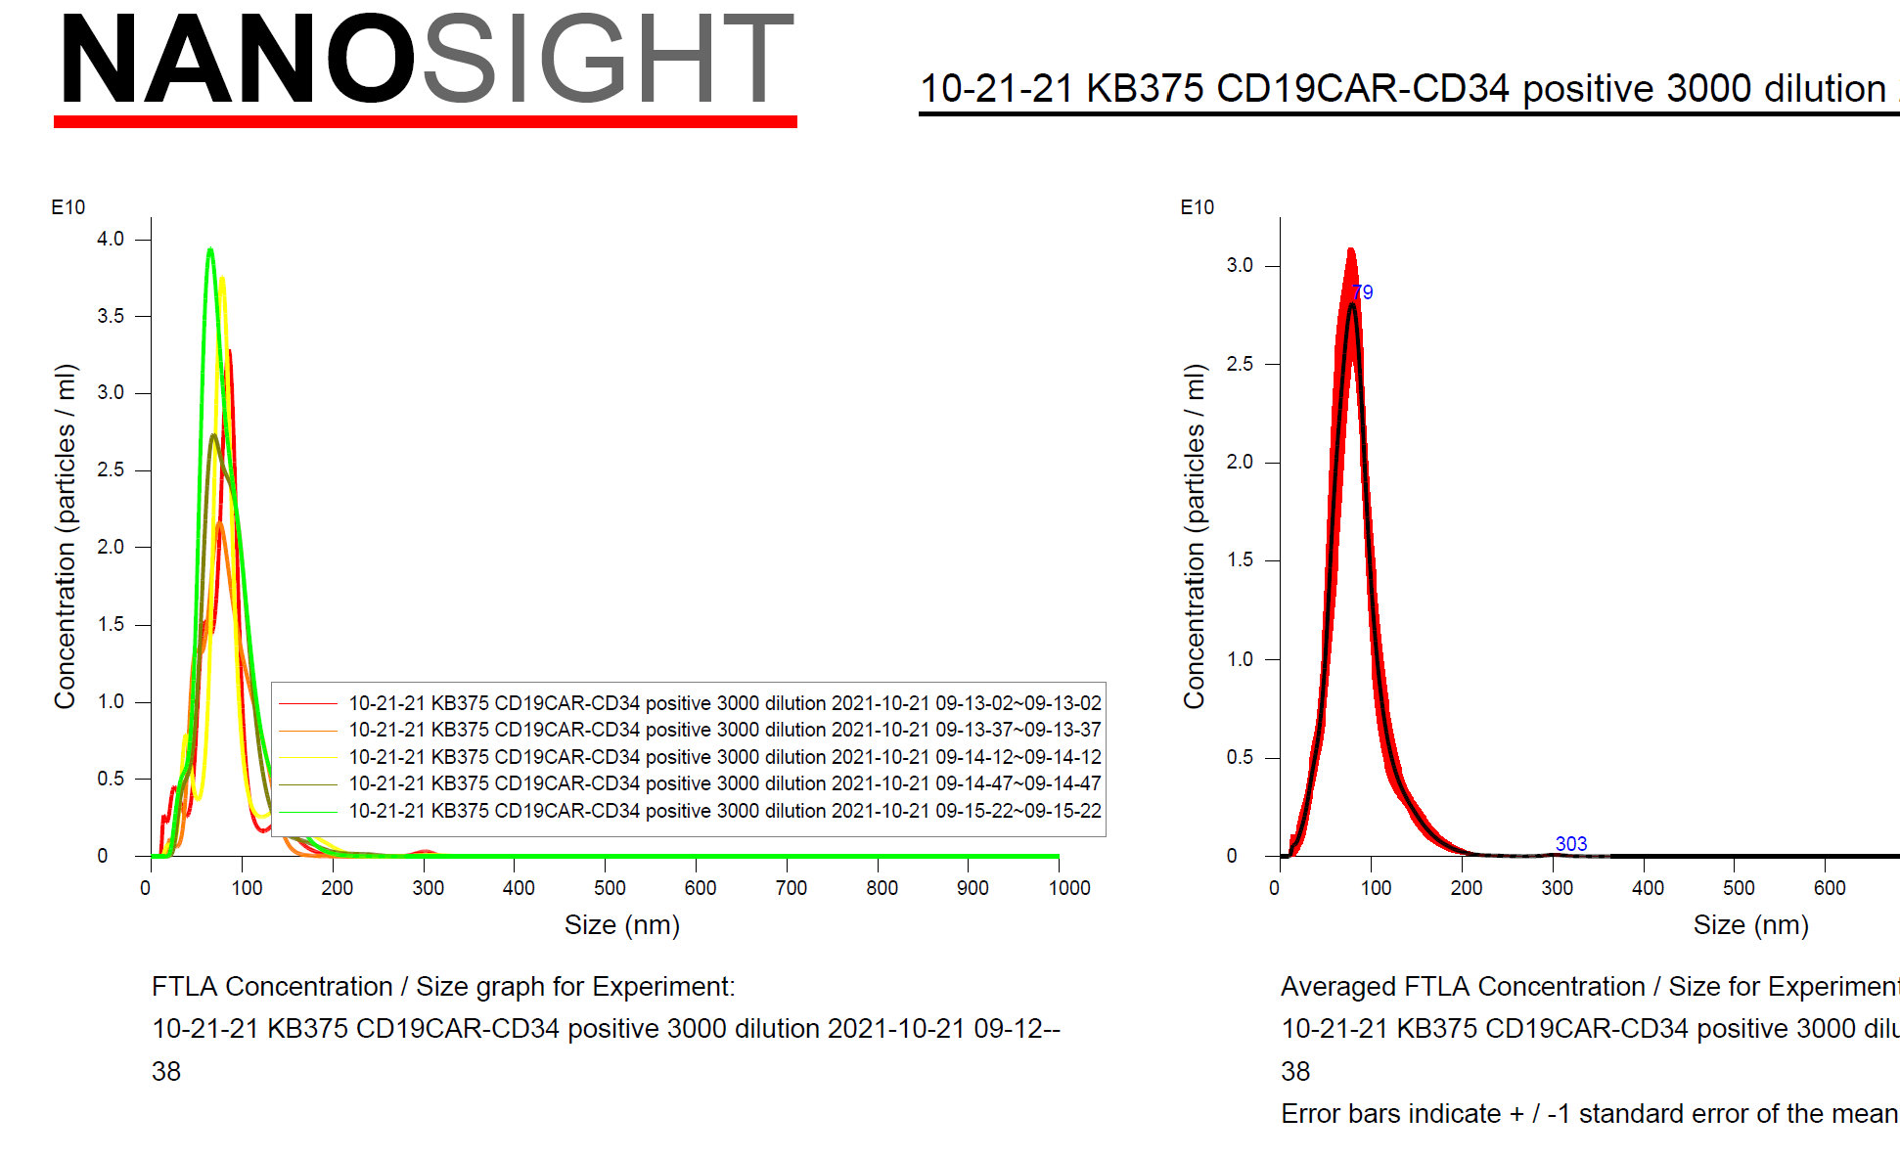
Nanosight: Characterization of Exosomes

Slide 12
CAR-T Exosomes transfer RNA to Cancer Cells

Slide 13
RNA Content of CAR-T cells

Slide 14
qRT-PCR
PCR
How does it work?
miRNAs
hsa-155-5p
hsa-153-3p

Slide 15
Current and Future Research
Secretion
Properties of Exosomes
RNA Seq
Manipulation
Extensively Characterize RNA content
Exosomes assessed for oncolytic activity
CAR-T cells secrete exosomes
CAR-T exosomes have similair properties as CAR-T celss

Slide 16
REFERENCES
Fu, W., Lei, C., et. al. (2019). CAR exosomes derived from effector CAR-T cells have potent antitumor effects and low toxicity. Nature communications, 10(1), 4355.
National Cancer Institute (NCI). (NCI). CAR T cells: Engineering patients’ immune cells to treat their cancers.
Porter DL, Maloney DG. Cytokine release syndrome (CRS).
Tang, X. J., Sun, X. Y., Huang, K. M., Zhang, L., Yang, Z. S., Zou, D. D., Wang, B., Warnock, G. L., Dai, L. J., & Luo, J. (2015). Therapeutic potential of CAR-T cell-derived exosomes: a cell-free modality for targeted cancer therapy. Oncotarget, 6(42), 44179–44190.
U.S. Cancer Statistics Working Group, June 2021. www.cdc.gov/cancer/dataviz
Yang, P., Cao, X., Cai, H., Feng, P., Chen, X., Zhu, Y., Yang, Y., An, W., Yang, Y., & Jie, J. (2021). The exosomes derived from CAR-T cells efficiently target mesothelin and reduce triple-negative breast cancer growth. Cellular immunology, 360, 104262.

Slide 17
THANKS!
DO YOU HAVE ANY QUESTIONS? fdiaz4@luc.edu
Thank you to:
Betsi Burns and Ashley Jackson Williams: Cura Scholars
Will Zhang and Dr. W. Keith Jones: Loyola University Department of Molecular Pharmacology and Neuroscience.
Gina Scurti and Dr. Michael Nishimura: Loyola University Chicago Cancer Center
Notes:
Will Zhang, Gina Scurti, Dr. Michael Nishimura, and W. Keith Jones

