Slide 1
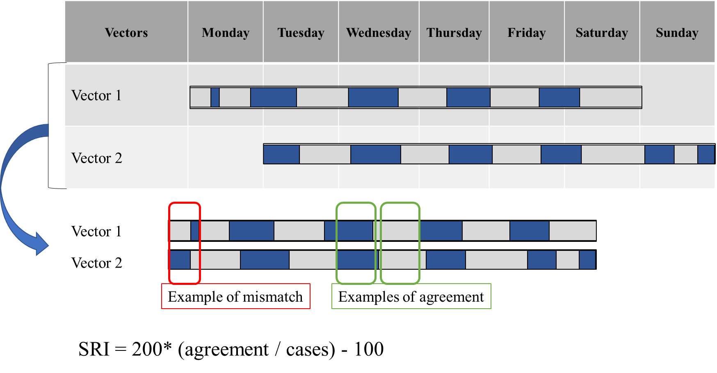
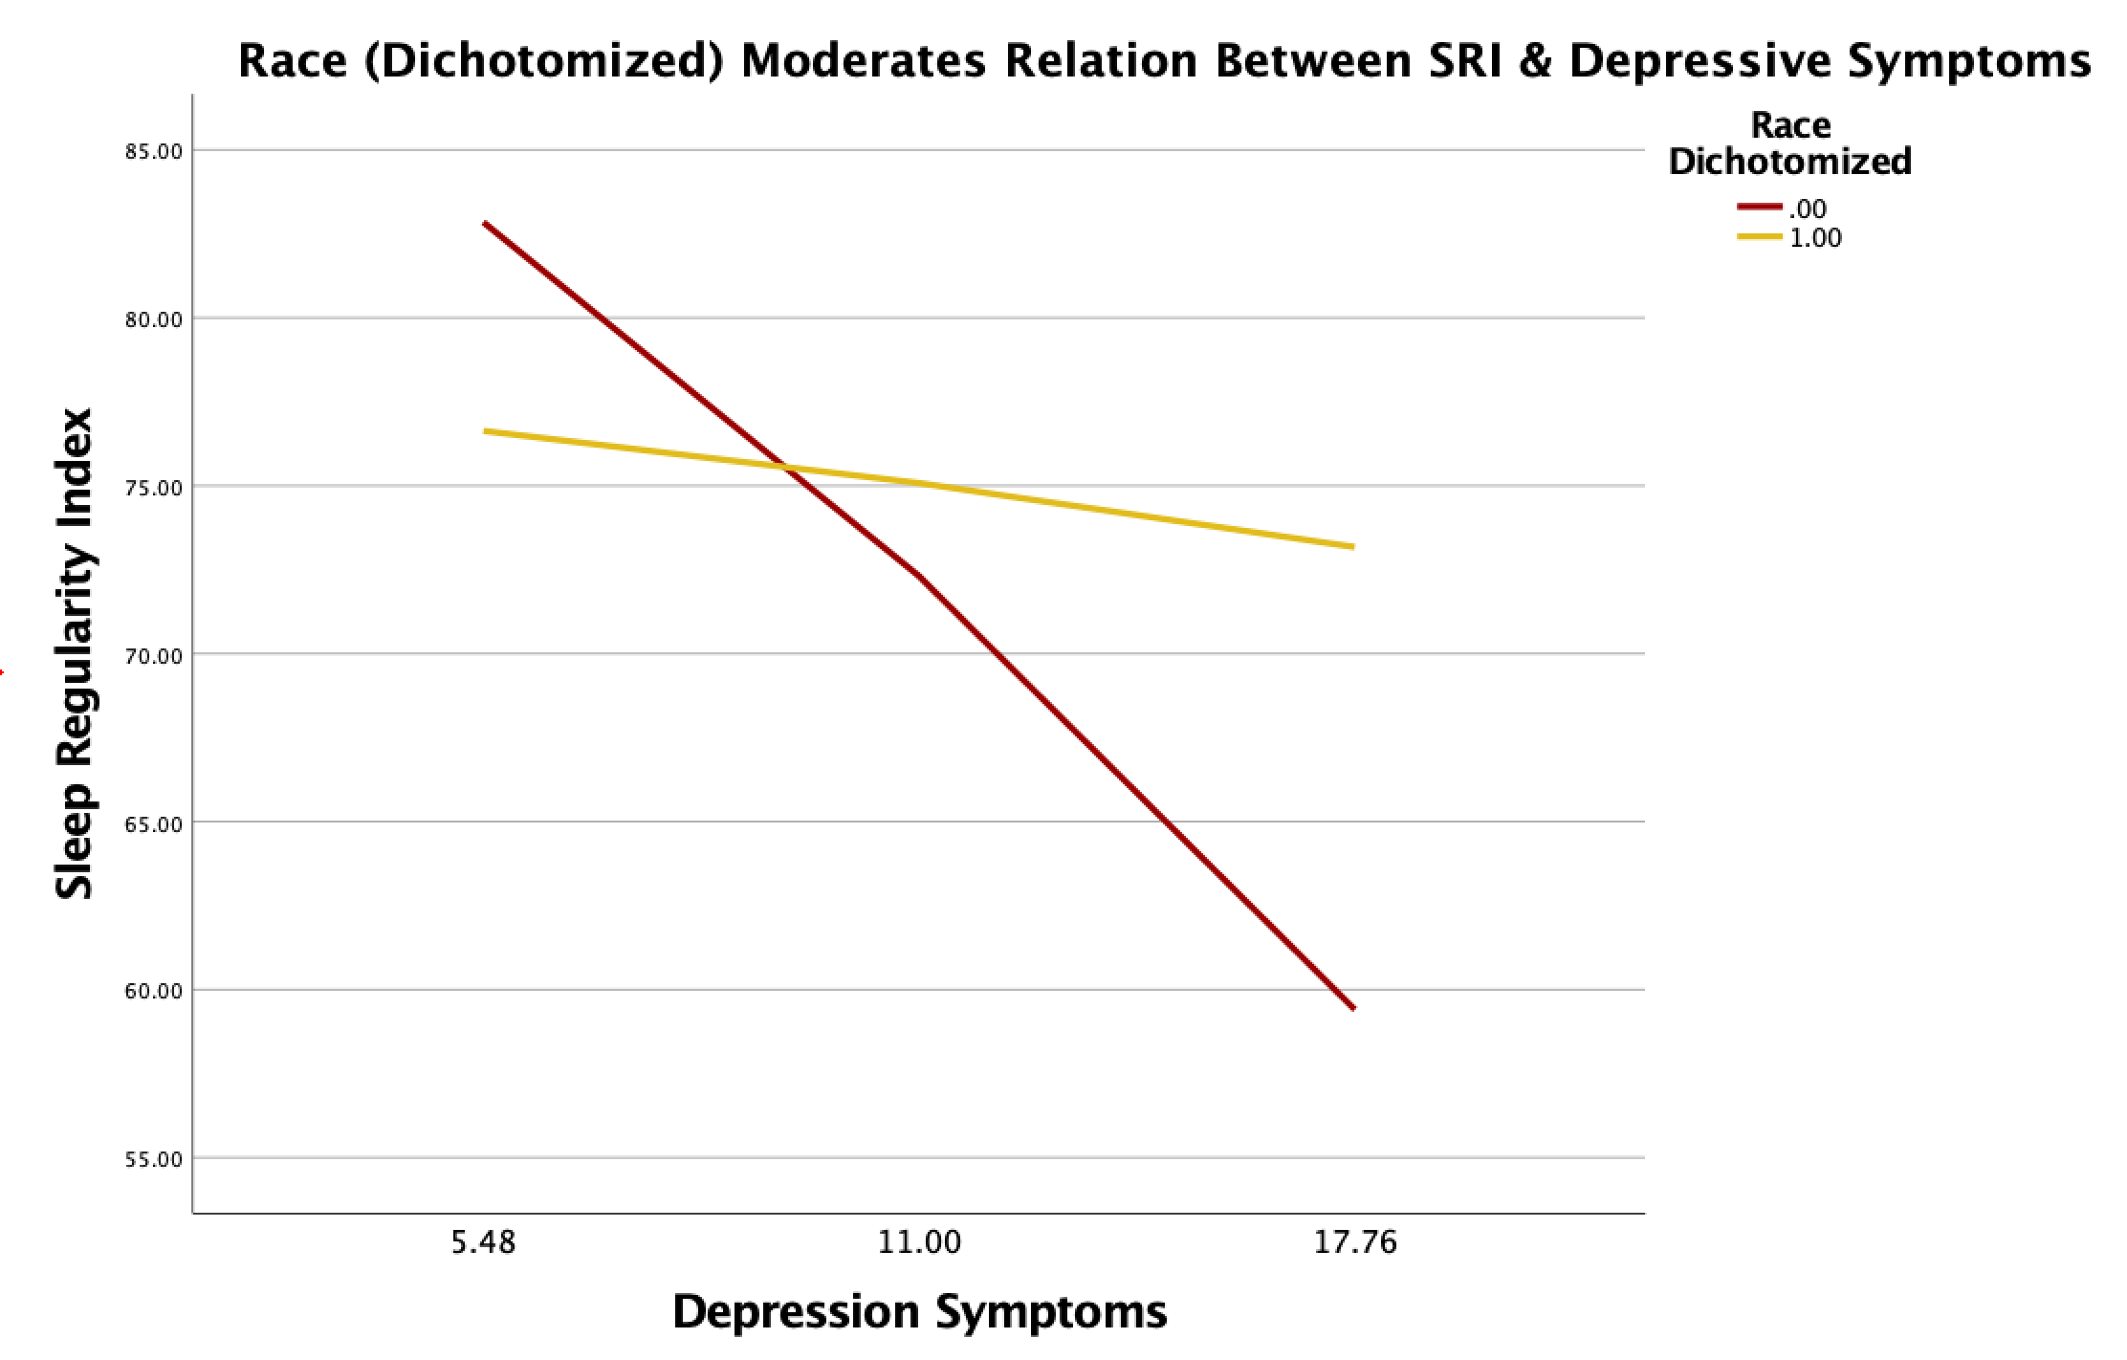
Depressive and Anxiety Symptoms and their Association with Sleep Consistency in Female College Students
Lora Djambov, Elizabeth Rea, MA, Laura Nicholson, MA, Amy Egbert, PhD, & Amy M Bohnert, PhD
Loyola University Chicago
Introduction
Inconsistent sleep, or the lack of a consistent sleep schedule, (e.g., duration and timing), is associated with poorer cognitive outcomes in students.⁽¹⁾
Research thus far has not examined the relationship between sleep consistency in college students, demographic factors (age, race, living arrangement) and mental health outcomes.
The sleep regularity index (SRI), which is a novel metric, captures daily sleep consistency by using daily reports of sleep timing to calculate how consistent an individual’s sleep is over a given period of time.
Calculating the Sleep Regularity Index
Discussion
SRI was negatively associated with depressive symptoms. Participants with a higher SRI score demonstrated fewer depressive symptoms.
Race moderated relations between sleep consistency and depressive symptom such that sleep consistency and depressive symptoms were significantly associated for minority students, but not white students.
Findings indicate a need to establish practices in which students of minority status are given better mental health support.
Previous studies have concluded that minority race status has been associated with more variable sleep duration and quality. Additionally, it was found that reduced sleep time and increased variability in total sleep time was associated with increased depressive and anxiety symptoms in minority individuals⁽²⁾
Future Directions & Limitations
Emphasize importance of consistent sleep schedules when implementing sleep hygiene interventions.
Further explore sleep consistency in a larger, more diverse sample of college students.
Limitations of this study include a small study sample, and an exclusively female participant population. In the future, a more objective measure alongside self-report may be used such as Polysomnography (PSG).
Results
Aims
Examine relations between sleep consistency and college students’ mental health outcomes.
Understand how sleep consistency is influenced by demographic factors.
Examine potential moderators (e.g., race) of the relations between SRI and mental health outcomes.
AIM 1:
SRI
Depressive Symptoms
43%
57%
AIM 2:
Method
Participants
Undergraduate Students (n = 39) , 100% female,M_{age}=19.27, enrolled in a psychology course.
Participants were 51% White, 33% Asian, 10% Multi-Racial, 3% Black/African and 3% other.
Procedure
Participants completed an initial survey with baseline measures followed by 7 days of daily diary.
Participants were emailed daily diaries at 8pm on Mondays and had until 12pm the following day to complete them.
Measures
Baseline
Demographics: Age, race, ethnicity, gender, residential status
Depressive Symptoms: Center for Epidemiological studies Depression Scale (CES-D10).
Anxiety Symptoms: Depression, Anxiety, and Stress scale (DASS-21)
Daily Diary
Sleep Duration + Timing : Daily Self-Report
Sleep Consistency: Sleep Regularity Index (SRI)
SRI
Demographic Variables
AIM 3:
Significant interaction between depressive symptoms and race (ß=-.28, se=.49, p>.05)
Depressive symptoms were significantly associated with SRI for historically marginalized students (ß=-1.91, se=.52, p<.01), but not white students (ß=-.28, se=.49, p>.05).
References
Phillips, A. J. K., Clerx, W. M., O’Brien, C. S., Sano, A., Barger, L. K., Picard, R. W., Lockley, S. W., Klerman, E. B., & Czeisler, C. A. (2017, June 12). Irregular sleep/wake patterns are associated with poorer academic performance and delayed circadian and sleep/wake timing. Nature News. Retrieved December 16, 2021, from https://www.nature.com/articles/s41598-017-03171-4
Johnson, D. A., Jackson, C. L., Williams, N. J., & Alcántara, C. (2019, July 23). Are sleep patterns influenced by race/ethnicity - A marker of relative advantage or disadvantage? evidence to date. Nature and science of sleep. Retrieved December 16, 2021, from https://www.ncbi.nlm.nih.gov/pmc/articles/PMC6664254/

