Slide 1
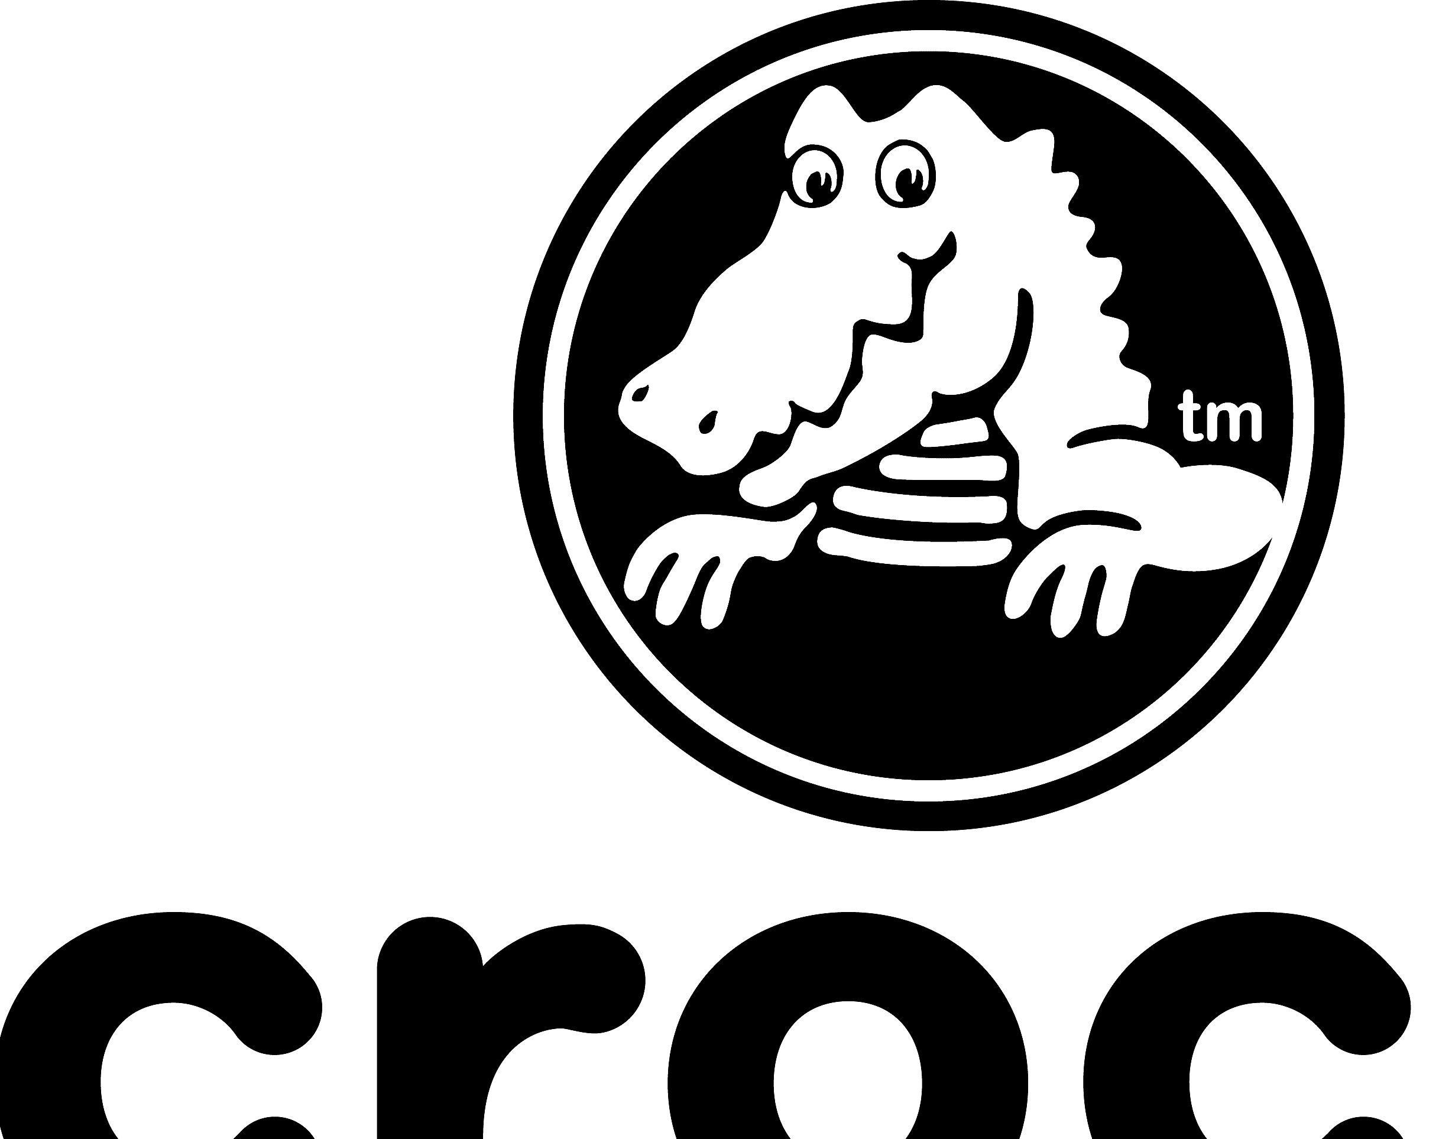
Crocs Inc.
Andrew Turner

Slide 2
Investment Thesis
Buy Crocs Shares
Price Target: $175.00
Key Drivers:
Inorganic Growth
“HEYDUDE” Acquisition
Strong margins growth
Digital-led route to market push
Andrew Turner | CROX

Slide 3
Corporate Overview
Crocs Inc. (NASDAQ: CROX)
World leader in casual footwear
Average Volume Traded: 2,071,430
Founded: 1999
Headquartered in Broomfield, Colorado
Domicile: Delaware
Shareholder Structure:
92.70% of Crocs is owned by institutional investors
Top 3 Shareholders: BlackRock, Fidelity, Vanguard
Key Statistics
Share Price | $83.62
Market Capitalization | $5.13 B
52-Wk Range | $70.34 - $183.88
EPS (TTM) | $11.39
P/E (TTM) | $7.34
ROE (%) | 276%
Instit. Own. (%) | 92.70%
Beta | 1.79
Andrew Turner | CROX

Slide 4
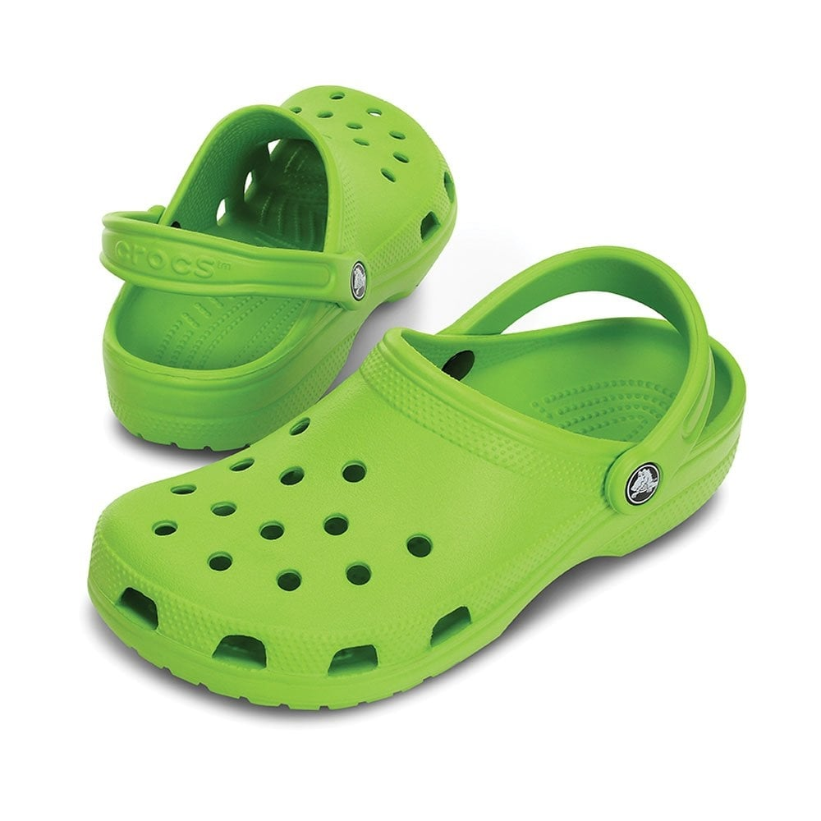
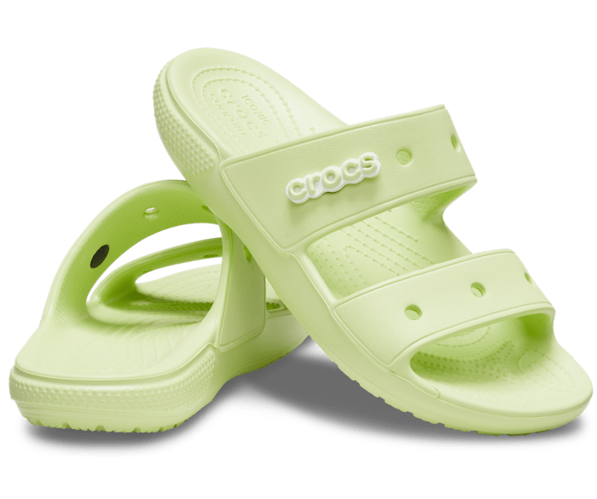
Business Description: Products
Clogs
Sandals
Jibbitz Charms
Andrew Turner | CROX

Slide 5
Business Description: Revenue
FY21 Revenue: $2,313.4 M
Product Breakdown:
Clogs drive current revenue
Sandals will drive LT growth
Jibbitz: benefitting from personalization megatrend
Channel Highlights:
Direct-to-Consumer growth 64.4% YoY
Wholesale growth 69.4% YoY
Digital Sales growth 47.6% YoY
Andrew Turner | CROX

Slide 6
Industry Analysis: Footwear
2021 Worldwide Revenue: $391 Billion
Characterized by continuing trend towards athleisure and eCommerce
Manufacturing shift away from China to elsewhere in Southeast Asia
Increasingly polarized consumer base:
Luxury vs. price-optimizing
Andrew Turner | CROX

Slide 7
Industry Analysis: Footwear
It’s a highly competitive industry
Athletic footwear brands dominate an otherwise fragmented landscape
Andrew Turner | CROX

Slide 8
Financial Analysis: Operating Performance
Andrew Turner | CROX

Slide 9
Financial Analysis: Profitability
Crocs is enjoying high returns on equity and assets
Andrew Turner | CROX

Slide 10
Financial Analysis: HEYDUDE Acquisition
Crocs recently purchased HEYDUDE Shoes for $2.5B
Diversifies CROX product portfolio from single to multi-brand
Builds upon Crocs’ high digital penetration
Ideal fit w/Crocs + LT consumer trends
Accretive to Crocs’ industry leading growth and margins
Immediately accretive to EPS
Management expects delivered revenues of ~$605-$630 million Q1 post-acquisition
Transaction Overview
Purchase Price | $2.5 Billion
Valuation Multiple | < 15x EV/EBITDA
HEYDUDE Revenue | ~$570M
Closing | ~1Q 2022
 | Expected Acquisition of:
Financing | - $2.0B Term Loan B
 | - $450M Crocs shares to be issued to the seller
 | - $50M RCF draw
 | ~3x Net Debt/PF 2021E EBITDA
Leverage | Commitment to use excess FCF for debt repayment
 | No share repurchase in 2022 and until gross leverage is <2.0x
Accretion | Immediately accretive to Crocs earnings
 | Expect ~$700-$750M of PF 2022 revenue for HEYDUDE
Andrew Turner | CROX

Slide 11
Valuation – Free Cash Flow Model
Even under conservative assumptions, it seems likely that CROX is undervalued
Case 1: Base
Two Stage Growth Model
Stage 1 Growth Rate | 15.00%
Number of Years in Stage 1 | 5
Stage 2 Growth Rate (Terminal) | 5.00%
Growth Path | Linear
Cost of Equity Capital | 11.99%
Free Cash Flow, LTM | $511.25
Total Debt ($ millions) | $771.39
Cash ($ millions) | $213.20
Shares Outstanding (millions) | 58.77
Weighted Average Cost of Capital (%) | 11.99%
 |  |  |  |  |  |  |  | Terminal FCF Growth Rate:
 |  |  |  |  |  | 3.50% | 4.00% | 4.50% | 5.00% | 5.50% | 6.00% | 6.50%
 |  |  |  |  | 10.49% | $167.72 | $178.54 | $191.16 | $206.08 | $223.99 | $245.88 | $273.26
 |  |  |  |  | 10.99% | $155.59 | $164.80 | $175.42 | $187.81 | $202.47 | $220.05 | $241.55
Initial Discount Rate (WACC) (Steps down by |  |  |  |  | 11.49% | $144.98 | $152.89 | $161.93 | $172.37 | $184.54 | $198.93 | $216.20
 | 0.5% per year over 5 years): |  |  |  | 11.99% | $135.63 | $142.48 | $150.25 | $159.13 | $169.38 | $181.34 | $195.47
 |  |  |  |  | 12.49% | $127.32 | $133.30 | $140.04 | $147.67 | $156.39 | $166.46 | $178.20
 |  |  |  |  | 12.99% | $119.89 | $125.15 | $131.03 | $137.64 | $145.14 | $153.71 | $163.60
 |  |  |  |  | 13.49% | $113.20 | $117.85 | $123.02 | $128.80 | $135.30 | $142.66 | $151.08
Average: $166.07
Case 2: Conservative
Two Stage Growth Model
Stage 1 Growth Rate | 10.00%
Number of Years in Stage 1 | 5
Stage 2 Growth Rate (Terminal) | 5.00%
Growth Path | Linear
Cost of Equity Capital | 11.99%
Free Cash Flow, LTM | $511.25
Total Debt ($ millions) | $771.39
Cash ($ millions) | $213.20
Shares Outstanding (millions) | 58.77
Weighted Average Cost of Capital (%) | 11.99%
 |  |  |  |  |  |  |  | Terminal FCF Growth Rate:
 |  |  |  |  |  | 3.50% | 4.00% | 4.50% | 5.00% | 5.50% | 6.00% | 6.50%
 |  |  |  |  | 10.49% | $146.74 | $156.18 | $167.20 | $180.23 | $195.86 | $214.97 | $238.87
 |  |  |  |  | 10.99% | $136.14 | $144.17 | $153.45 | $164.27 | $177.06 | $192.41 | $211.18
Initial Discount Rate (WACC) (Steps down by |  |  |  |  | 11.49% | $126.87 | $133.77 | $141.66 | $150.77 | $161.40 | $173.96 | $189.04
 | 0.5% per year over 5 years): |  |  |  | 11.99% | $118.69 | $124.67 | $131.45 | $139.20 | $148.15 | $158.59 | $170.93
 |  |  |  |  | 12.49% | $111.42 | $116.64 | $122.52 | $129.18 | $136.80 | $145.59 | $155.84
 |  |  |  |  | 12.99% | $104.92 | $109.51 | $114.64 | $120.42 | $126.96 | $134.45 | $143.08
 |  |  |  |  | 13.49% | $99.07 | $103.13 | $107.64 | $112.69 | $118.36 | $124.79 | $132.14
Average: $145.26
Andrew Turner | CROX

Slide 12
Valuation – Free Cash Flow to Equity Model
Case:
Two Stage Growth Model
Stage 1 Growth Rate | 5.00%
Number of Years in Stage 1 | 5
Stage 2 Growth Rate | 2.50%
Growth Path | Linear
Cost of Equity Capital | 11.99%
Free Cash Flow to Equity, LTM | $1,075.45
Shares Outstanding (millions) | 58.77
Weighted Average Cost of Capital (%) | 11.99%
Net new debt ($ millions) | $580.00
Interest on debt ($ millions) | $21.65
Shares Outstanding (millions) | 58.77
Corporate tax rate (%) | 27.00%
 |  |  |  |  |  |  |  | Terminal FCF Growth Rate:
 |  |  |  |  |  | 1.00% | 1.50% | 2.00% | 2.50% | 3.00% | 3.50% | 4.00%
 |  |  |  |  | 10.49% | $221.17 | $229.92 | $239.70 | $250.70 | $263.17 | $277.43 | $293.88
 |  |  |  |  | 10.99% | $209.92 | $217.66 | $226.25 | $235.86 | $246.66 | $258.91 | $272.91
Initial Discount Rate (WACC) (Steps down by |  |  |  |  | 11.49% | $199.76 | $206.63 | $214.22 | $222.66 | $232.10 | $242.71 | $254.74
 | 0.5% per year over 5 years): |  |  |  | 11.99% | $190.51 | $196.65 | $203.40 | $210.86 | $219.15 | $228.42 | $238.84
 |  |  |  |  | 12.49% | $182.08 | $187.58 | $193.61 | $200.24 | $207.57 | $215.71 | $224.81
 |  |  |  |  | 12.99% | $174.35 | $179.31 | $184.71 | $190.63 | $197.15 | $204.35 | $212.35
 |  |  |  |  | 13.49% | $167.24 | $171.72 | $176.59 | $181.90 | $187.72 | $194.12 | $201.19
Average: $215.10
Andrew Turner | CROX

Slide 13
Investment Risks
Macroeconomic Risks:
Continued Supply Chain Disruption
Rising shipping & manufacturing costs
Inflationary pressures
Fading government stimulus
Rising unemployment
Acquisition Risk
Cyclicality
Andrew Turner | CROX

Slide 14
Investment Thesis
Key Statistics
Share Price | $83.62
Market Capitalization | $5.13 B
52-Wk Range | $70.34 - $183.88
EPS (TTM) | $11.39
P/E (TTM) | $7.34
ROE (%) | 276%
Instit. Own. (%) | 92.70%
Beta | 1.79
Buy Crocs Shares
Price Target: $175.00
Key Drivers:
Inorganic Growth
“HEYDUDE” Acquisition
Strong margins growth
Digital-led route to market push
Andrew Turner | CROX

Slide 15
Q&A
Andrew Turner | CROX

