Slide 1
The 49th Ward of Chicago Office of Alderwoman Maria Hadden An Intern’s Perspective
Ellery Jenkins Therriault
April 11th, 2022
PLSC 370 – Dr. Meghan Condon

Slide 2
Background
Defining an Alderperson and a Ward
Aldermen and alderwomen are elected members of City Council, the legislative branch of Chicago’s municipal government.
50 elected members represent one of 50 districts across the city of relatively equal sized populations. These districts are referred to as wards – they can vary dramatically by their social, economic, and racial makeups.
Each alderperson is elected to serve four-year terms where they represent their ward.
Alderpersons discuss ordinances and resolutions at Council meetings, covering topics ranging from infrastructure, taxes, education, social programs, etc.

Slide 3
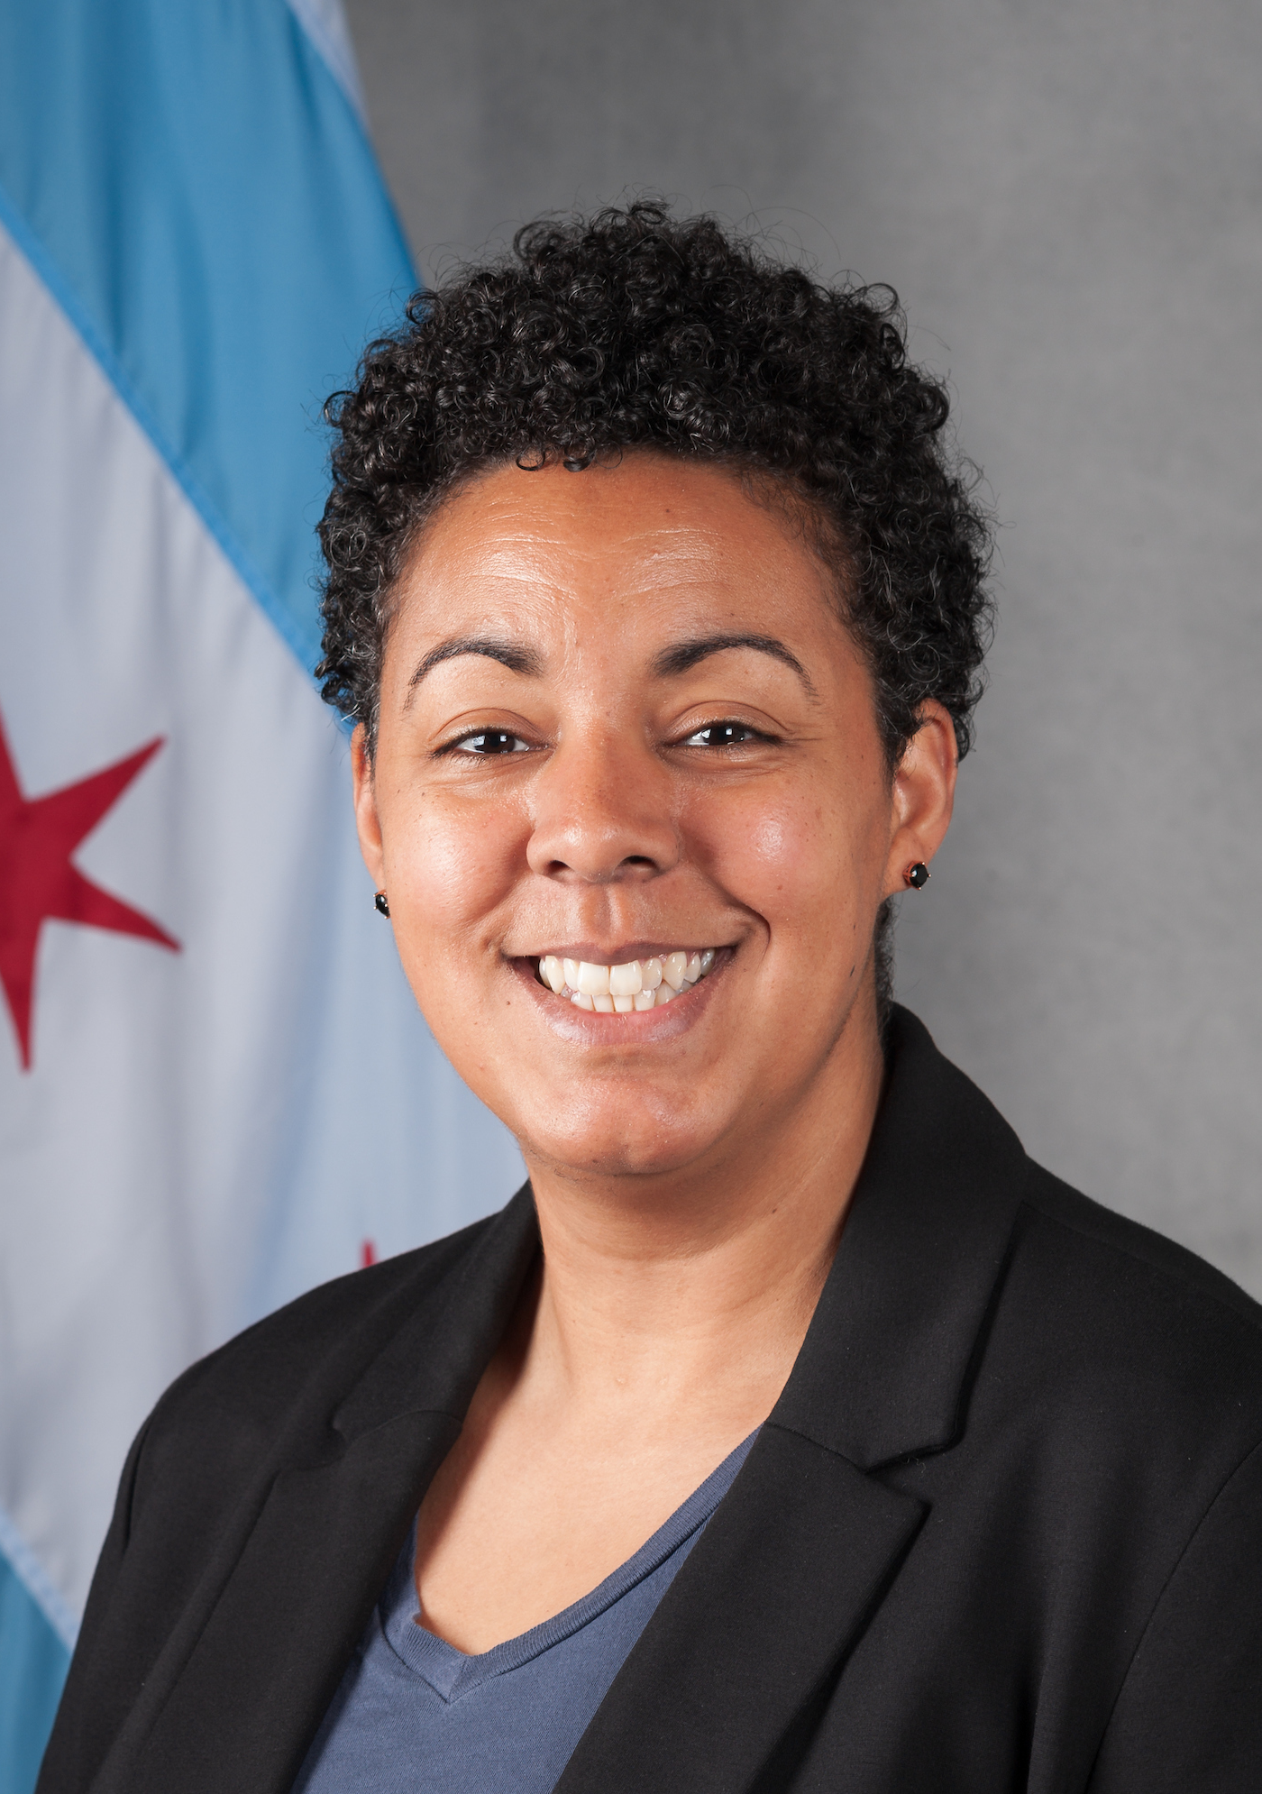
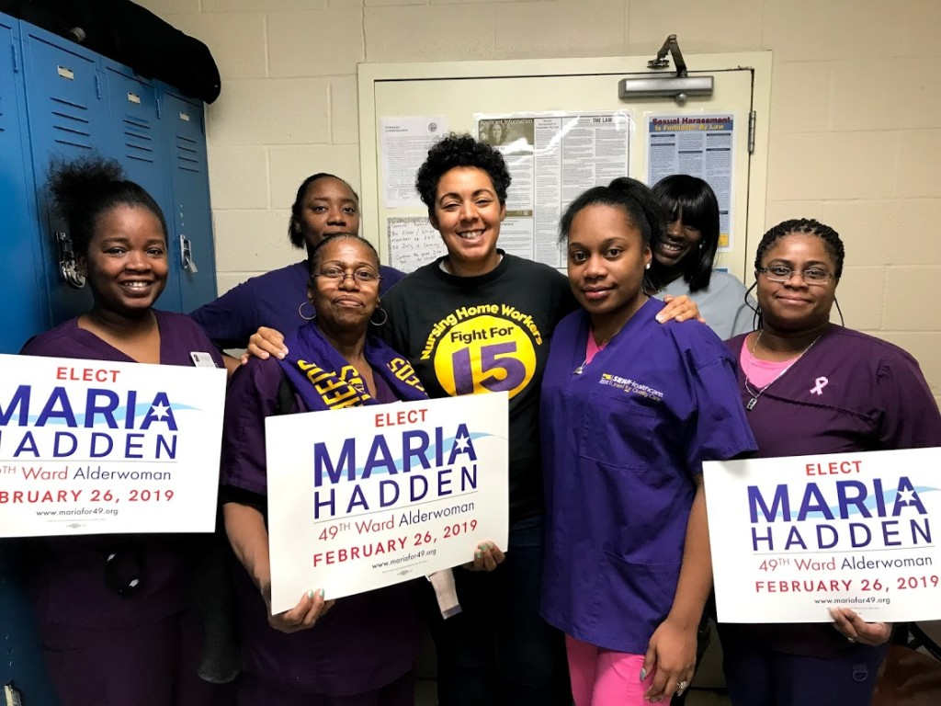
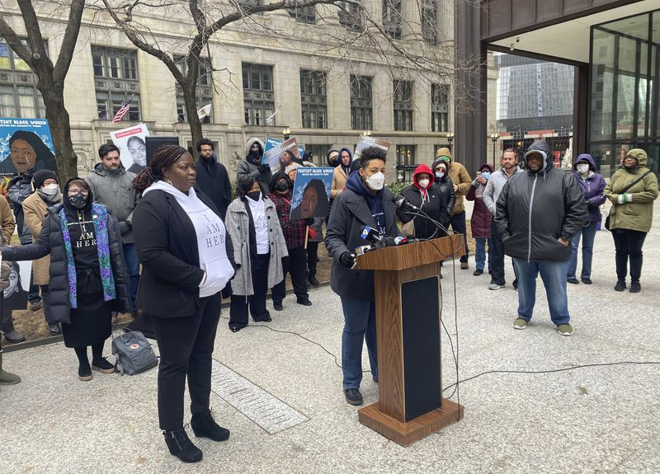
Maria Hadden
49th Ward Alderwoman
Born and raised in the Columbus, Ohio area and became a first-generation college grad at the Ohio State University.
Moved to Rogers Park, Chicago after graduating. When the housing bubble burst in 2007, and the developer of her building fled, Ald. Hadden helped organize her neighbors to save their homes.
Led screen-printing workshops for youth.
Founded a nonprofit organization, Our City Our Voice, to enable communities and governments to empower equitable participation in democracy
Founded The Participatory Budgeting Project, incorporating democracy into public budgeting across the U.S.
Was on the Board of Directors of the Black Youth Project (BYP) 100, and Voqal

Slide 4
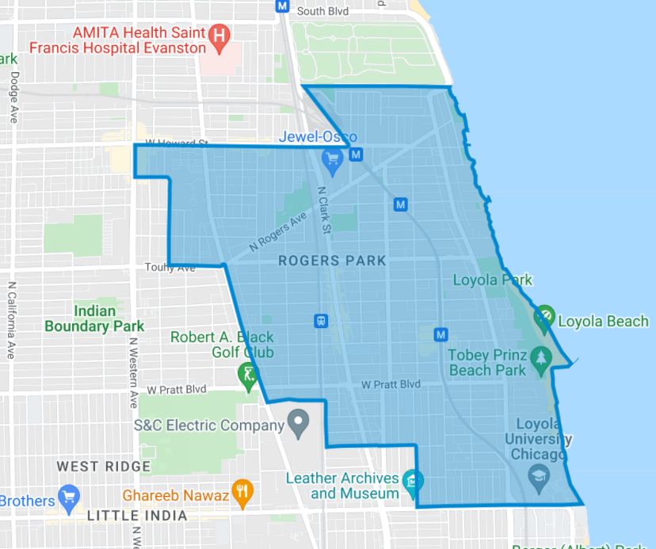
The 49th Ward

Slide 5
What makes The 49th Ward Staff special
Everyone working at the 49th Ward Office is extremely approachable. The working environment is incredibly comfortable which encourages coworkers to ask each other questions and build off each others knowledge.
Chemistry & Teamwork
The staff acknowledge the challenges of serving an entire ward of 55,000 constituents, thus, 49th ward staff delegate tasks so that each member works to their strengths or expertise.
Efficiency
All team members are dedicated to helping constituents in need and are not afraid of reaching out, personally, to third party organizations that are equipped to aid our residents. The staff go above and beyond to resolve individual and niche issues encountered daily.
Resourcefulness

Slide 6
An Office Taking on the World - The 49th Ward Team take on a variety of Issues, but here are some broad categories
Infrastructure Issues
Building/Landlord Disputes
Logistical Flukes
This can range from common instances of alley potholes or busted streetlights to major issues like sewer cave-ins. However, the 49th ward staff also work to get community input on major infrastructure projects via surveys.
Constituents may call in to ask Ald. Hadden’s office to advise landlord-tenant disputes or report blighted buildings towards the best course of action.
The 49th ward staff will often need to rapidly respond to logistical quagmires such as traffic jams caused by gasoline giveaways or erroneously installed permit parking signs catching residents off guard

Slide 7
An Office Taking on the World - The 49th Ward Team take on a variety of Issues, but here are some broad categories
Criminal Reports
Informational Questions
Public Engagement
Constituents will often call us with reports of suspicious activity or actual crime. They often like to have their concerns documented with our office as a formality or want advice on how to proceed with their concern. The office regularly works with CAPS and the 24th precinct on these issues.
Common calls that the office receives are mere requests for information. This typically relates to bureaucratic information such as where they can get residential parking permits, state IDs, COVID-19 testing, etc.
Ensuring that residents are up to speed on community events and opportunities is a large part of office efforts. Putting up flyers disclosing upcoming construction, publishing weekly newsletters, and making pamphlets available are just some examples.

Slide 8
“You’re only as good as your team” - Dominique Wilkins
A leader, regardless of occupation, can only be as good as their team.
Ald. Maria Hadden is clearly one of the most community driven and qualified legislators in City Council.
For Ald. Hadden to do her good work, she needs her team to be top tier.
After my time at the 49th Ward office, I can say without a doubt that the 49th ward team is one of if not the best in the city.
The knowledge held in that office is second to none and the drive to help the community is clearly there.

Slide 9
What did I do?
Tasks and Contributions
Learnings
Manage and develop information on the 49th Ward website
Research constituent resources for utility, housing, and COVID-19 relief
Track constituent call-ins via an archival spreadsheet
Answer constituent calls and respond to concerns and requests to the best of my abilities
Submit service requests to the city via 311
Direct constituents towards government or 3rd party resources
Help constituents fill out logistical paperwork for aldermanic services such as garage sale documentation or disabled parking applications
Web design and management skills
COVID-19 information and programs available at the local, state, and federal levels
Applied my excel/spreadsheet capabilities toward projects in a real work environment.
Developed my communication skills for the sake of public service

Slide 10
Overall, the one thing that I’m learning in my time at the 49th ward office is that collaboration is key to large scale success. Local politics and office holders often have negative stereotypes of being inefficient and unprofessional. However, this is just simply not true – Ald. Hadden and her outstanding staff deal with barebone issues on the daily and maintain the highest levels of professionalism and respect for their fellow Rogers Park residents.
REFLECTIONS

Slide 11
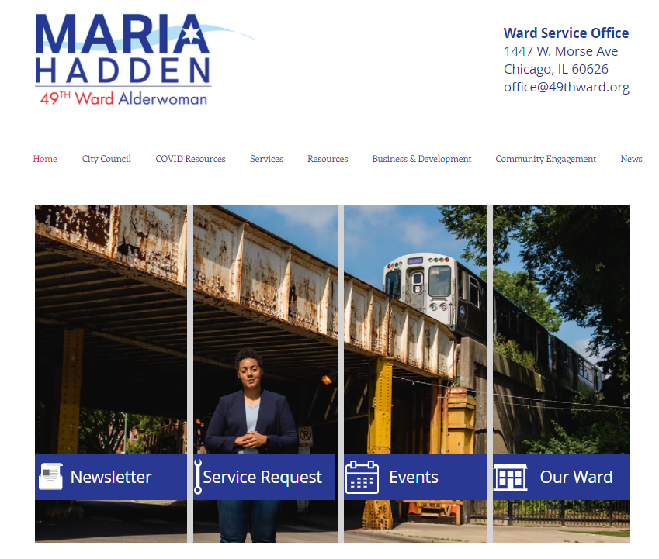
I am overwhelmingly thankful to the staff at the 49th Ward Office for hosting me as an intern this semester. I have a great deal of respect for their knowledge and dedication to my lifelong neighborhood. As a Rogers Park local, born and raised, I am happy to know that they represent us.
FINAL REMARKS

Slide 12
Thank You! - Ellery Jenkins Therriault

