Slide 1
INTERNATIONAL GAMING TECHNOLOGY (IGT)
Drew Kueter – Fall 2022

Slide 2
THESIS
Hold IGT stock
Target Price: 35.99
Current Price: 18.20
Upside: 49%
Key Drivers:
Shaky financial information regarding revenues, FCF and ROE
Unique tie to gambling industry and economic uncertainty
Steady dividends despite volatile financial information

Slide 3
PRICE CHART AND KEY STATISTICS
Share Price | 18.20
Market Cap | $3.50 B
Dividend Yield | 4.55%
52 Week Range | 15.01 - 32.05
Beta | 1.81
Debt / Equity | 4.75
P / E | 22.64
P / FCF | 6.97
P / Book | 2.65
Notes:
Important points to note:
Stock price has dropped almost 50% in the last year
High beta, thus the stock is extremely volatile compared to market
Very high Dividend yield
Price to Free Cash flow is well below average

Slide 4
BUSINESS DESCRIPTION
IGT’s mission is to provide best-in-class content, services, and solutions to the global, regulated gaming industry.
B2B Company
Customers include: Fanduel, PointsBet, Caesars Interactive Entertainment
Over 50% of Revenue is US based
Serves 36 of the 46 U.S. Lotteries
Notes:
Global Lottery = iLottery platforms; instant ticket services; system and software maintenance
Global Gaming = gaming machines (specifically slots); and casino management
Digital and Betting = Online casino software and sports betting software platforms and solutions

Slide 5
IGT VS COMPETITORS
Notes:
4th largest in the gambling industry by market cap
It has the highest dividend yield, with the lowest P/FCF

Slide 6
REVENUES VS EBITDA
Notes:
Revenues have decreased by about 20% over the past 5 years
EBITDA has remained about the same over the past 5 years. Recovered nicely after the pandemic.

Slide 7
FCF VS ROE
Notes:
Free cash flow has been all over the place. As you can see it has been relatively steady and positive over the past 3 years.
As for ROE, that has also been all over the place. It jumped from about -40% to 30% in this past year. Net Income in 2020 was negative

Slide 8
DIVIDEND GROWTH VS NET INCOME
Notes:
Dividends have grown significantly since 2009.
Have stagnated the past 5 years
Impressive to see that the dividends have been the same the past 5 years despite the net income being negative in two of the five years.

Slide 9
FINANCIAL ANALYSIS - SOLVENCY
Notes:
Current ratio has grown over the past 5 years. Shows the company can cover short-term liabilities if need be.
Company became less levered last year. Retired over $1 billion of debt
Compared IGT’s Debt – Equity to Churchill Downs
Only compared to CHDN a lot of the other stocks in the gambling industry either had negative Debt to Equity
Graph shows that IGT is less riskier than investing in Churchill downs.

Slide 10
INDUSTRY ANALYSIS
Industry is down
It’s a small industry that is growing, but the competition is getting smaller
Vertical integration is tough in industry
The industry is not recession proof, but lottery gambling is
Notes:
4 largest gambling stocks are down an average of around 40% on the year
Many mergers and acquisitions in the past few years
DraftKings and SBTech, Ceasar’s and William Hill
Only 7 stocks on the exchange with market cap over $1 Billion. $27.5 Billion Total
2012 Study done in the Netherlands

Slide 11
INDUSTRY ANALYSIS
Lottery and Slots are the most popular types of gambling in the US
Gambling is growing overseas, but trust in fair play is at a low point
Regulation of Anti-Money Laundering and Responsible Gaming has increased due to social and economic pressures
Key market driver is an increase in online gambling implementation
Notes:
Fits IGT’s business model
This momentum will continue to build

Slide 12
INVESTMENT RISKS
Private information breaches
Supply chain issues when it comes to making slot machines
Slow growth or declines in the lottery and gaming industries
Insufficient liquid assets to meet cash flow requirements
Notes:
Company stores lots of private and personal data about businesses and individuals. Constantly improving network security and internal controls.
None
Because of the B2B operations of the company, IGT has a unique tie with the gambling industry.
This hasn’t been a problem in the past, but there is a treasury team put in place to make sure that this doesn’t become a problem

Slide 13
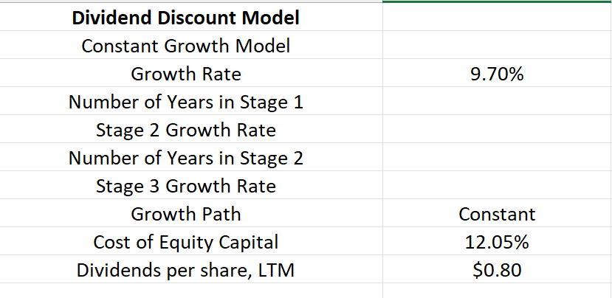
VALUATION – DDM MODEL
Notes:
Growth rate calculated from 2009
Rapid decrease in dividends resulting from Economic Crash
Only just surpassed previous 2007 numbers in 2015

Slide 14
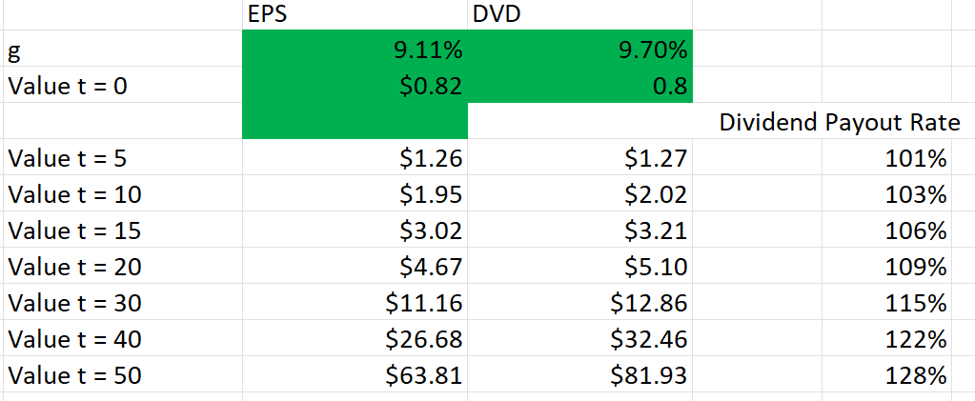
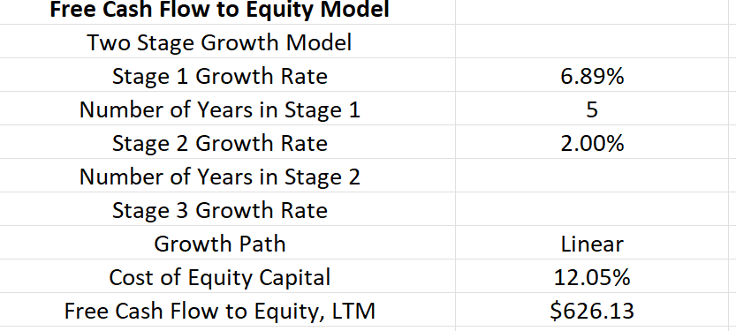
VALUATION – FCFE MODEL
Notes:
EPS growth calculated from 2016
Dividend Growth calculated from 2009
Stage 1 Growth calculated from 2007
Stage 2 Growth = very conservative valuation (Less than Market)
Net new debt: Average of previous 3 years due to an extinguishment of over $1 B in Debt.

Slide 15
THESIS
Hold IGT stock
Target Price: 35.99
Current Price: 18.20
Upside: 49%
Key Drivers:
Shaky financial information regarding revenues, FCF and ROE
Unique tie to gambling industry and economic uncertainty
Steady dividends despite volatile financial information

Slide 16
SOURCES
https://ir.igt.com/financials/annual-reports/default.aspx
https://www.statista.com/study/13717/gambling-statista-dossier/
https://www.statista.com/topics/3400/gambling-industry-in-the-united-kingdom-uk/#dossierKeyfigures
https://www.pwc.com/mt/en/industries/where-next/where-next-for-gaming.html
https://www2.deloitte.com/rs/en/pages/strategy-operations/articles/facing-the-challenges-of-vertical-integration-in-the-gambling-industry.html
https://www.globenewswire.com/en/news-release/2022/09/08/2512847/0/en/Online-Gambling-Market-Size-is-projected-to-reach-USD-153-Billion-by-2030-growing-at-a-CAGR-of-11-7-Straits-Research.html
https://scholarworks.umass.edu/cgi/viewcontent.cgi?article=1202&context=gradconf_hospitality
https://finviz.com/
https://workspace.refinitiv.com/web/layout?layoutTemplate=marketMonitoring
https://www.yahoo.com/now/casinos-among-hardest-hit-businesses-203531184.html#:~:text=The%20study%20found%20that%20casino,%2C%20is%20relatively%20recession%2Dproof.

