Slide 1
William Kelley
October 2022`

Slide 2
Investment Thesis
Recommendation: BUY
Target Price: $151 per share
Upside: ~ 15%
Key Drivers:
Accelerated Investments
Introduction of New Revenue Streams
Shift in International Focus

Slide 3
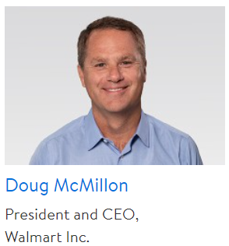
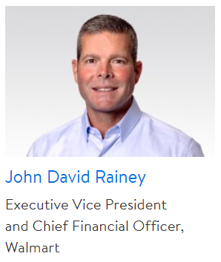
Price Chart and Key Statistics
Share Price | $132.28
Market Cap | 356.03 B
Revenue | 572.8 B
EPS, LTM | $6.05
Dividend Yield | 1.71%
Beta | .51
Debt to Equity | .47
P/E | 25.92
P/Book | 4.63
ROE | 15.24%
Profit Margin | 25.1%
Instit. Own (%) | 33%

Slide 4
Business Description
Walmart is the largest retailer in the world
Everyday Low Pricing Strategy
Recent Evolving its Strategy
Remodeling into Supercenters
Diversifying through alternative revenue streams
Accelerated investments
Notes:
With over 550 billion in revenue and over 10,500 stores worldwide

Slide 5
Business Description - Revenues
Notes:
In coordination with this, from 2014 to 2022, the number of employees in US and PR has rose around 300,000 or 21% while the number of employees internationally has decreased around 200,000 or around 25%. A number of decades ago, Walmart aggressively moved to grow its global footprint. But in the last number of years, they have began to divest in many places as in align with the decreasing revenue and employee numbers. Getting out of cash draining businesses and areas with lower growth. However, it is important to note that Walmart is not transitioning out of Interntational Business completely. Instead they are lowering their global footprint to focuse on markets they are seeing and have seen success in (Mexico, China, Canada, India – Flipkart). Walmart has stated the drop in international net sales is mainly a result of these divestitures.

Slide 6
Business Description - Acquisitions and Divestments
Divesting out of cash-draining businesses with little growth opportunities
Closing of stores in Africa
Sale of retail business in Brazil
Sale of Walmart Argentina
Sale of UK grocery chain – Asda
Sale of Japanese grocery business – Seiya
Focus on markets with past success
India – acquired 77% in Flipkart
Notes:
Specifically, Walmart has sold assets from Africa (Massmart closing stores), Brazil (80% retail business sold in 2018), Argentina (Walmart Argentina sold to Group de Narvaez in 2020 (corporation runs retail stores in Arg., Ecu., and Uru.)), United Kingdom (sold its wholly-owned grocery chain Asda in 2021), Japan (sold majority stake in Seiya, Japanese grocery business, to investment firm KKR and digital commerce firm Rakuten).

Slide 7
Business Description - Products
Notes:
Although specific information is not given on segment data for Walmart International, the Q2 FY 2023 Earnings Presentation provided some insight. They stated that “strength in food and consumables was across all markets while there was some softness in general merchandise. Sales growth in Mexico, Canada, and China all growing faster than inflation even with the current economic trouble seen in those locations and globally in general. This aligns with what is seen in the graphs.

Slide 8
Industry Analysis
Retail and Trade is large and growing
Food and Beverage is also growing in sales
Becoming competitive due to high pressure from multiple retail formats
Major transformational thinking needed
Reimagining the workforce, supply chain resiliency, digital revolution
Technology disruption possible
Climate change and environmental justice issues
Notes:
Sales of 26 trillion with forecast to reach over 30 trillion

Slide 9
Industry Analysis
Warehouse Clubs and Supercenters
Positives: Strong value proposition, shifting consumer preference, labor shortage end
Negatives: Near-term headwinds, profitability issues

Slide 10
Industry Analysis - RTH v. SPY
RTH = VanEck Retail ETF
WMT is the third biggest holding @ 8.2%
Has outperformed SPY for the last 10 years
P/E (RTH) = 22.6 ; P/B (RTH) = 5.74
P/E (SPY) = 18.12 ; P/B (SPY) = 3.78
Notes:
Large number of competitors ; inception 2011

Slide 11
Financial Analysis – Rev. and NI
CAGR = 3.87%
CAGR = 1.24%

Slide 12
Financial Analysis
CAGR = 3%

Slide 13
Financial Analysis – Dividends
CAGR = 8.52%

Slide 14
Financial Analysis – Financial Strength

Slide 15
Financial Analysis – Efficiency

Slide 16
Comparable Company Analysis
Company | Market Cap (B) | P/E | P/Book | EV/EBITDA
Walmart | 356.03 | 25.92 | 4.63 | 11.49
Amazon | 1207.8 | 101.18 | 8.23 | 22.58
Costco | 206.42 | 35.94 | 11.41 | 21.4
Alibaba | 200.5 | 35.56 | 2.11 | 13.02
CVS | 128.82 | 15.52 | 1.62 | 8.2
Target | 72.54 | 16.81 | 7.1 | 10.24
Dollar General | 54.1 | 23.88 | 9.06 | 16.02
Sysco | 36.95 | 26.75 | 31.76 | 15.16
Kroger | 33.51 | 13.37 | 3.5 | 6.7
Walgreens | 27.6 | 5.06 | 1.44 | 9.04
eBay | 20.4 | 48.95 | 4.36 | 8.07
Albertsons | 12.99 | 9.06 | 3.57 | 4.69
BJ’s | 9.82 | 20.48 | 10.71 | 11.36
Casey’s General Stores | 7.69 | 20.27 | 3.17 | 10.48
Pricesmart | 1.8 | 17.69 | 2.51 | 10.33
Median | 36.95 | 20.48 | 4.36 | 10.48
Mean | 158.46 | 27.76 | 7.01 | 11.92

Slide 17
Valuation – Dividend Discount Model

Slide 18
Valuation – Free Cash Flow to Equity

Slide 19
Investment Risks
Strategic
E-commerce
Operational
Suppliers
Health and Wellness
Financial
Legal, Tax, Regulatory, Compliance, Reputational

Slide 20
Investment Thesis
Recommendation: BUY
Target Price: $151 per share
Upside: ~ 15%
Key Drivers:
Accelerated Investments
Introduction of New Revenue Streams
Remodeling to improve store productivity

