Slide 1
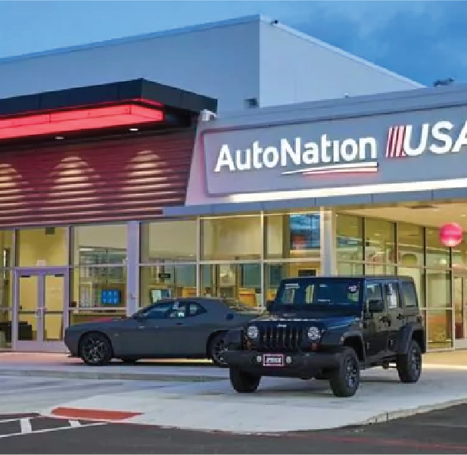
AutoNation Inc (AN)
Adrian Malinowski

Slide 2
Investment Thesis
Buy AutoNation Shares
Target Price of $184.25
Upside of 43%
Key Drivers
Steady growth of the output in the Auto Dealership Industry
Consistent growth in operating profits
Increased focus on parts and service

Slide 3
Price Chart and Key Data
Share Price | $104.94
Market Cap | $5.875 B
52 Week Range | $96.56 - $135.57
Beta | 1.15
P/E | 4.51
P/B | 2.61
ROE | 63.30%
P/FCF | 4.42

Slide 4
Business Description
Consumer cyclical sector – Auto and truck dealership industry
Top player in the industry
Wide variety of vehicles catering to many consumers
Focus on service/ collision centers
Adapting to the industry
Over 13 million vehicles sold 2021

Slide 5
Business Description

Slide 6
Business Description

Slide 7
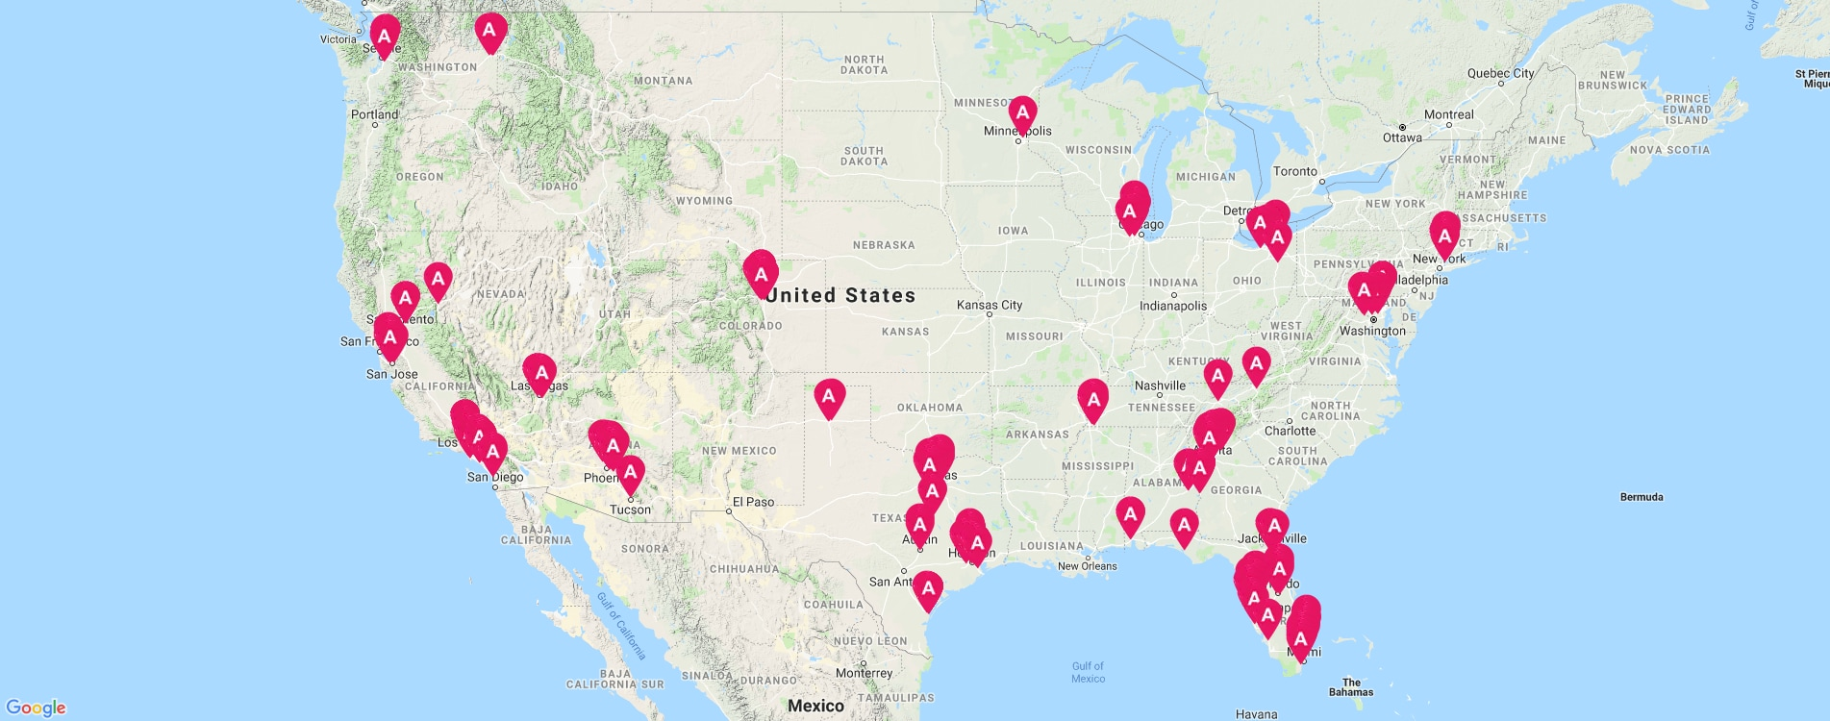
Business Description
340+ Locations
57 Collision Centers
247 Stores
371 Franchises

Slide 8
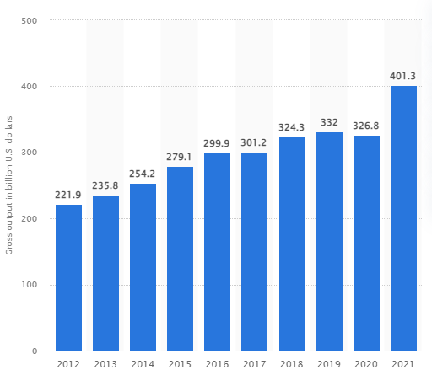
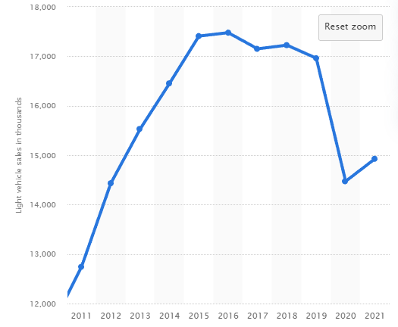
Industry Analysis
Industry Gross Output from 2012 to 2021
Light Vehicle Sales from 2011 to 2021

Slide 9
Industry Analysis
Competitors: Lithia Motors Inc, Penske Automotive, Carmax, Group 1 Auto, Sonic Auto
Indirect Competitors: Carvana, Vroom
Recent Shortage
Increased Value of Used Inventory
Increasing Interest Rates

Slide 10
Financial Analysis

Slide 11
Financial Analysis

Slide 12
Financial Analysis
Company Name | Revenues (Millions) | Market Cap (Billions) | P/E | P/CF | P/Book | Gross Profit Margin
AutoNation Inc | 25,844.00 | 5.874 | 4.58 | 4.27 | 2.53 | 18.40%
Lithia Motors Inc | 22,831.70 | 6.059 | 5.12 | 5.7 | 1.29 | 18.10%
Penske Automotive Group Inc | 25,554.70 | 7.645 | 5.69 | 5.28 | 1.84 | 16.90%
Carmax Inc | 31,900.41 | 9.858 | 12.56 | 13.21 | 1.82 | 9.60%
Group 1 Automotive Inc | 13,481.90 | 2.607 | 3.91 | 3.5 | 1.31 | 17.50%
Sonic Automotive Inc | 12,396.40 | 1.83 | 5.26 | 3.17 | 1.56 | 14.60%
Asbury Automotive Group Inc | 9,837.70 | 3.516 | 4.77 | 4.66 | 1.46 | 18.90%
Lear Corp | 19,263.10 | 7.273 | 64.67 | 10 | 1.64 | 7.30%
Mean | 20,138.74 | 5.58275 | 13.32 | 6.224 | 1.6813 | 15.16%

Slide 13
Valuation Analysis – Free Cash Flow To Equity
Free Cash Flow to Equity Model
Three Stage Growth Model
Stage 1 Growth Rate | 17.12%
Number of Years in Stage 1 | 1
Stage 2 Growth Rate | -8.00%
Number of Years in Stage 2 | 2
Stage 3 Growth Rate | 3.00%
Growth Path | Linear
Cost of Equity Capital | 9.61%
Free Cash Flow to Equity, LTM | $922.86
Case 1
For FCF and FCFE models only:
Net new debt ($ millions) | $613.00
Interest on debt ($ millions) | $118.70
Shares Outstanding (millions) | 62.61
Corporate tax rate (%) | 24.06%
Average $234.57
k / terminal g | 1.50% | 2.00% | 2.50% | 3.00% | 3.50% | 4.00% | 4.50%
8.11% | $229.89 | $246.28 | $265.58 | $288.67 | $316.75 | $351.66 | $396.24
8.61% | $213.90 | $227.85 | $244.09 | $263.22 | $286.09 | $313.91 | $348.51
9.11% | $200.01 | $212.02 | $225.84 | $241.93 | $260.88 | $283.54 | $311.12
9.61% | $187.83 | $198.26 | $210.16 | $223.86 | $239.80 | $258.58 | $281.03
10.11% | $177.06 | $186.20 | $196.53 | $208.33 | $221.90 | $237.70 | $256.31
10.61% | $167.47 | $175.53 | $184.59 | $194.83 | $206.52 | $219.97 | $235.62
11.11% | $158.88 | $166.03 | $174.02 | $183.00 | $193.15 | $204.73 | $218.07

Slide 14
Valuation Analysis – Free Cash Flow to Equity
Case 2
Free Cash Flow to Equity Model
Three Stage Growth Model
Stage 1 Growth Rate | 10.00%
Number of Years in Stage 1 | 1
Stage 2 Growth Rate | -10.00%
Number of Years in Stage 2 | 2
Stage 3 Growth Rate | 3.00%
Growth Path | Linear
Cost of Equity Capital | 9.61%
Free Cash Flow to Equity, LTM | $922.86
Average $133.93
k / terminal g | 1.50% | 2.00% | 2.50% | 3.00% | 3.50% | 4.00% | 4.50%
8.11% | $131.27 | $140.60 | $151.59 | $164.73 | $180.72 | $200.60 | $225.98
8.61% | $122.16 | $130.11 | $139.35 | $150.24 | $163.26 | $179.10 | $198.80
9.11% | $114.25 | $121.09 | $128.96 | $138.12 | $148.91 | $161.81 | $177.51
9.61% | $107.31 | $113.25 | $120.03 | $127.83 | $136.90 | $147.60 | $160.38
10.11% | $101.18 | $106.38 | $112.27 | $118.98 | $126.71 | $135.70 | $146.30
10.61% | $95.72 | $100.31 | $105.46 | $111.30 | $117.95 | $125.61 | $134.52
11.11% | $90.82 | $94.90 | $99.45 | $104.56 | $110.34 | $116.93 | $124.52

Slide 15
Investment Risks
Supply Chain Risk
Restrictions from Manufacturers
Legal/ Compliance Risks
Debt/ Floor Plan Risk
Economic Risks

Slide 16
Thesis
Buy AutoNation Shares
Target Price of $184.25
Upside of 43%
Key Drivers
Steady growth of the output in the Auto Dealership Industry
Consistent growth in operating profits
Increased focus on parts and service

Slide 17
Sources
https://finance.yahoo.com/quote/AN?p=AN
https://workspace.refinitiv.com/web/Apps/Corp/?s=AN&st=RIC&app=true#/Summary
https://investors.autonation.com/home/default.aspx
https://finviz.com/quote.ashx?t=AN&p=d
https://www.statista.com/topics/3594/auto-dealers-in-the-us/#topicHeader__wrapper

Slide 18
Questions?

