Slide 1
Kevin Sachtleben | NOC

Slide 2
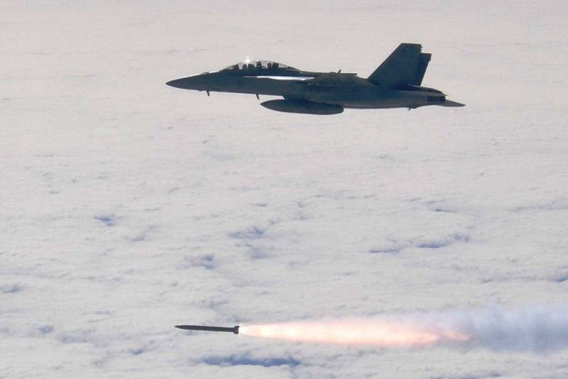
Investment Thesis

Slide 3
Investment Thesis
Key Drivers
Current Price: $484.45
Target Price: $636.55
- Average of all Model Calculations
Upside/Downside: 31.4%
Recommendation: BUY
Government Defense Spending
Geopolitical Conditions
Innovation in Space

Slide 4
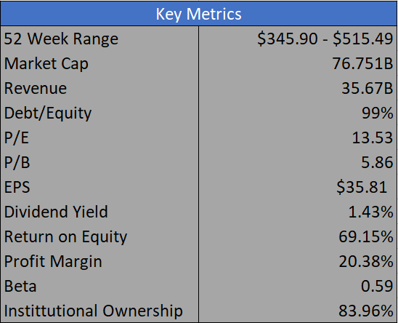
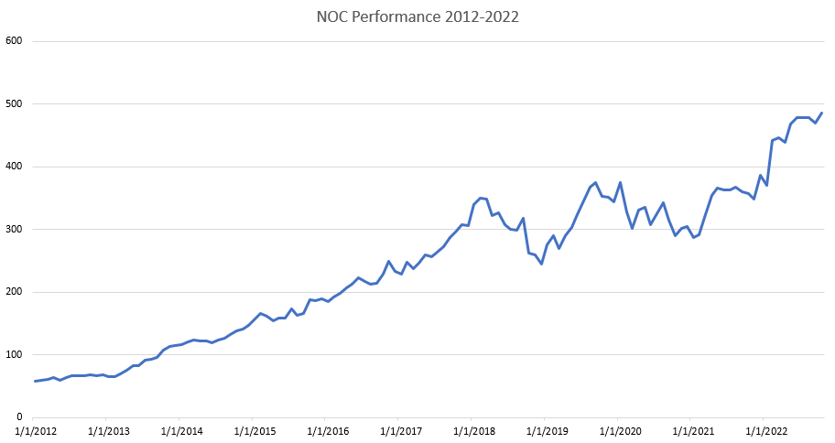
Company Overview
Sector:
Aerospace and Defense
Headquarters:
Falls Church, VA
Employees:
90,000
President and CEO
Kathy Warden

Slide 5
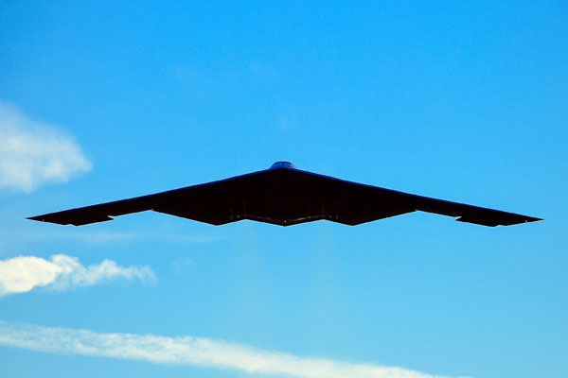
Company Background

Slide 6
Business Description
Aerospace and Defense Firm
Aeronautics
Defense
Mission
Space
Autonomous Systems
Aircraft Sustainment
Battle Management
End to End Space
Training and Simulation
Military Aircraft
Aerospace Structures
Integrated Battle Command
Cyber Solutions
Launch Systems
Advanced Weapons
Surveillance
Software and IT

Slide 7
Business Segment

Slide 8
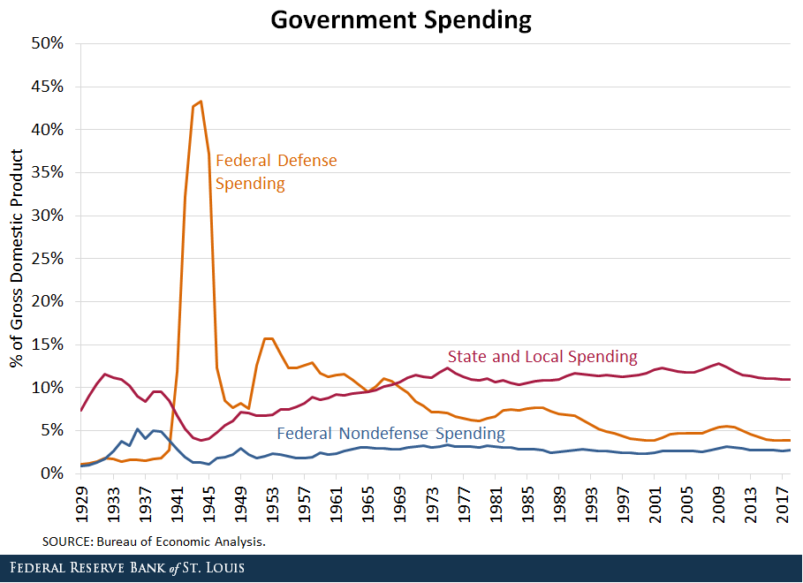
Government Defense Spending

Slide 9
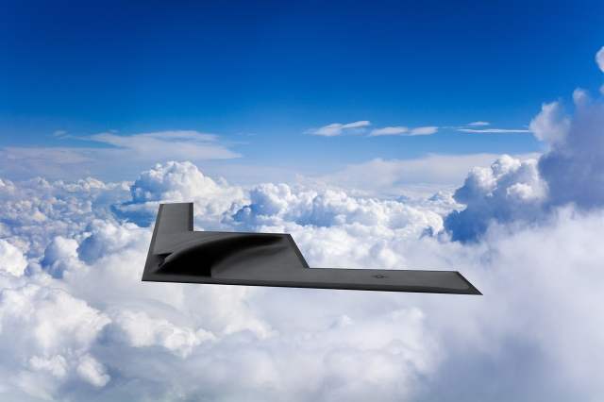
Industry Analysis

Slide 10
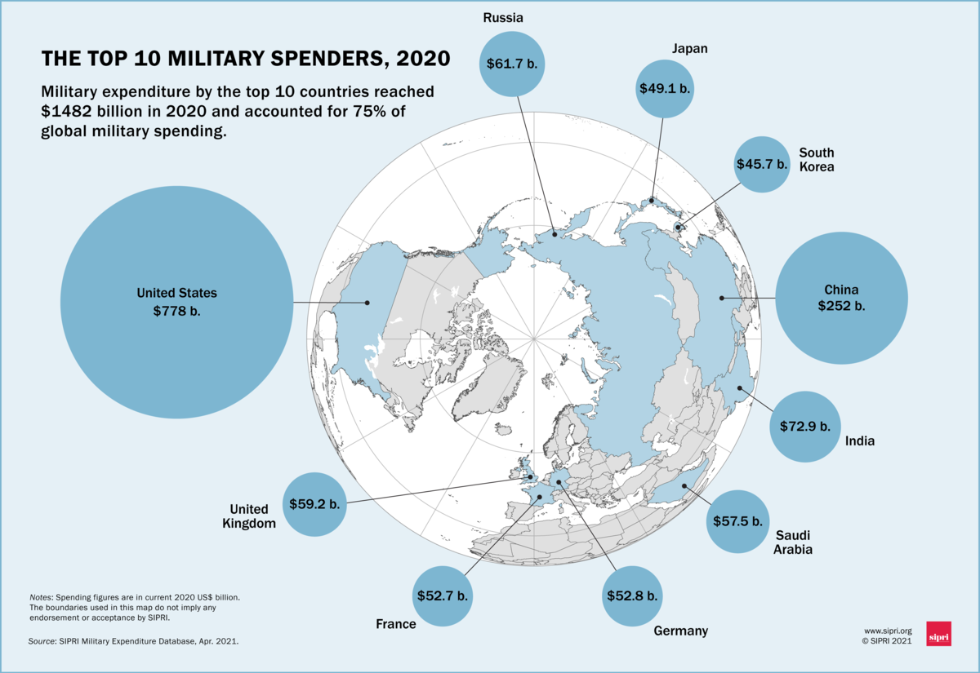
Industry Analysis
Worldwide defense spending is over $2 trillion
Global War Possibilities
- Change in Equipment Priorities
Increase in Technology
Innovation
Space
Supply Chains

Slide 11
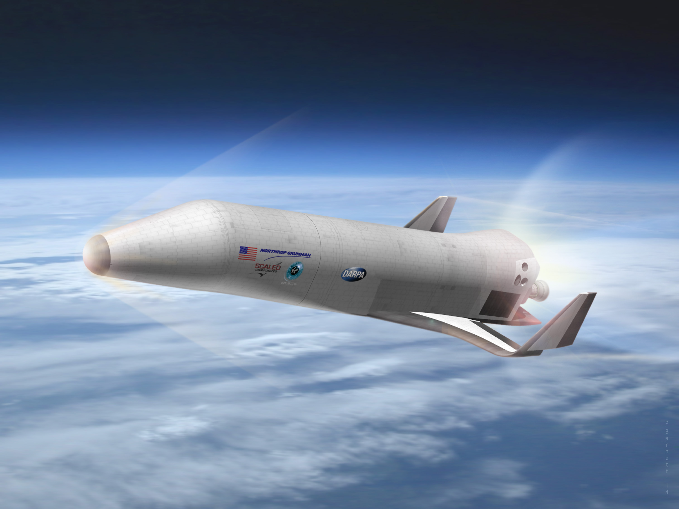
Financial Analysis

Slide 12
Net Income and Revenue

Slide 13
Profitability Ratios

Slide 14
Leverage and Financial Strength

Slide 15
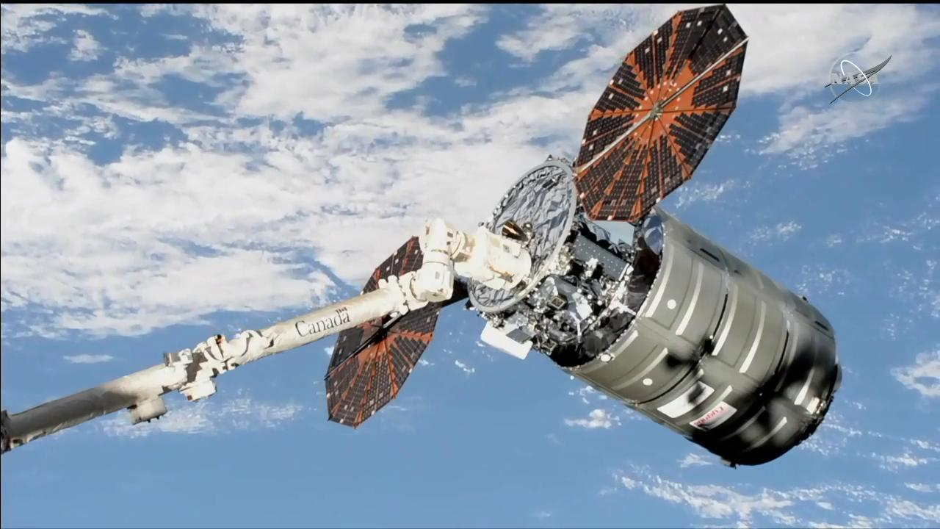
Valuations

Slide 16
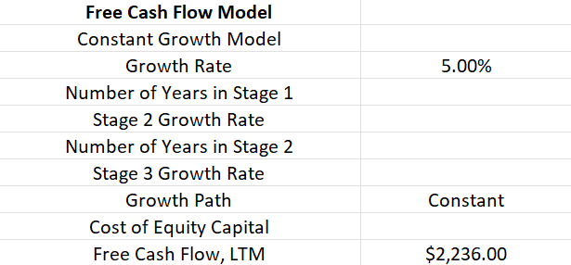
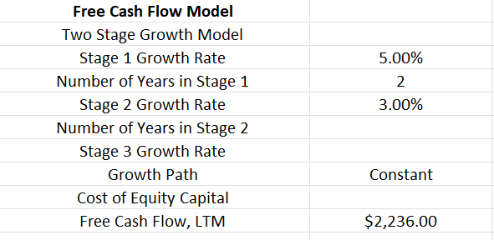
Free Cash Flow Model
Case 1
Results
Case 2
Results

Slide 17
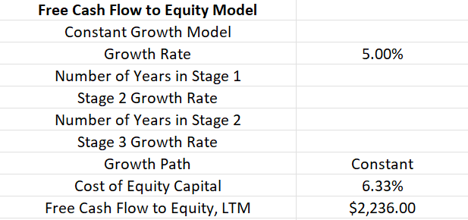
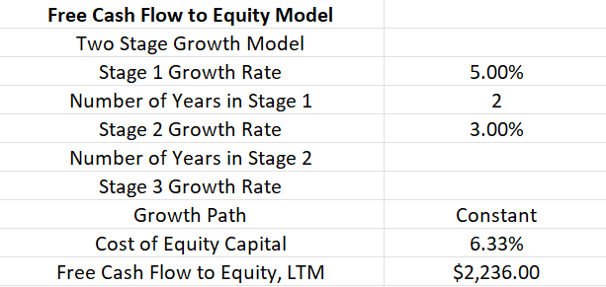
Free Cash Flow to Equity Model
Case 1
Results
Case 2
Results

Slide 18
Comparable Company Analysis
Company | Market Cap | P/E | P/B | ROE | EBITDA
Lockheed Martin | 108.71B | 23.7 | 9.37 | 41.00% | 10.523B
Raytheon Technologies | 123.863B | 28.15 | 1.75 | 6.09% | 9.658B
Boeing | 78.324B | -14.5 | 0 | 35.68% | (1.23B)
Northrop Grumman | 76.751B | 13.53 | 5.86 | 69.15% | 4.91B
General Dynamics | 61.81B | 19.1 | 3. 58 | 19.24% | 5.053B
Mean | 89.89B | 14.00 | 4.25 | 34.23% | 5.783B

Slide 19
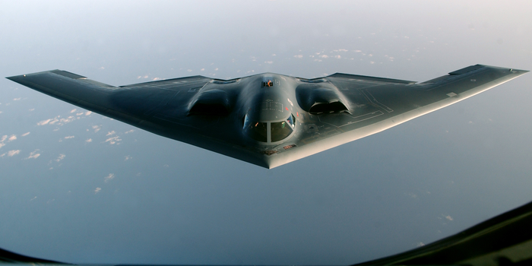
Investment Risks

Slide 20
Investment Risks
Geopolitical
War
Terrorism
Economic
Supply Chain
Deliver on Contracts

Slide 21
Sources
https://www.statista.com/statistics/257381/global-leading-aerospace-and-defense-manufacturers
https://www.pwc.com/us/en/industrial-products/publications/assets/pwc-aerospace-defense-annual-industry-performance-outlook-2022.pdf
https://www.sipri.org/media/press-release/2022/world-military-expenditure-passes-2-trillion-first-time
https://www.statista.com/markets/407/topic/939/aerospace-defense-manufacturing/#statistic2
https://www.visualcapitalist.com/wp-content/uploads/2021/05/Mapped-The-Worlds-Top-Military-Spenders-in-2020-1200px.png
https://www2.deloitte.com/us/en/pages/manufacturing/articles/aerospace-and-defense-industry-outlook.html
https://www.ey.com/en_gr/aerospace-defense/the-top-10-risks-in-aerospace-and-defense
https://www.pwc.com/us/en/industries/industrial-products/library/aerospace-defense-review-and-forecast.html
https://www.refinitiv.com/en

Slide 22
Questions?

