Slide 1
Dell Technologies Inc.
Julia Zdun
01

Slide 2
03
Investment Thesis

Slide 3
Investment Thesis
09
Buy Dell Shares
Target Price: $50.62
Upside: > 40.89%
Key Drivers:
- Value stock
- Increased demand for technology
- Recession resistant

Slide 4
03
Dell at a Glance

Slide 5
Company Overview
09
Sector: Technology
Employees: 165,000
Headquarters: Round Rock, Texas
Industry: Computer Hardware
3 Business Units
One of the largest tech companies in the world
Focus is on sales of personal computers, network servers, data storage solutions, and software
The tech industries "Hidden Gem"
Dell
ISG
VMware
Michael S. Dell
Ceo of Dell Technologies Inc.
CSG

Slide 6
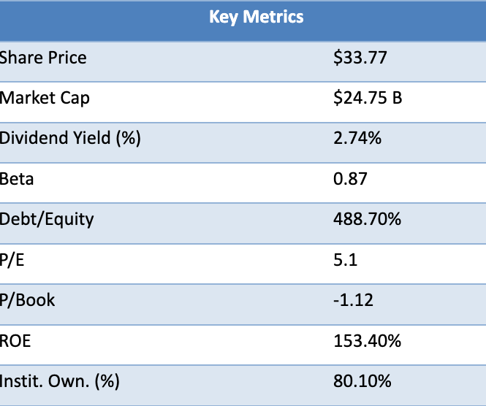
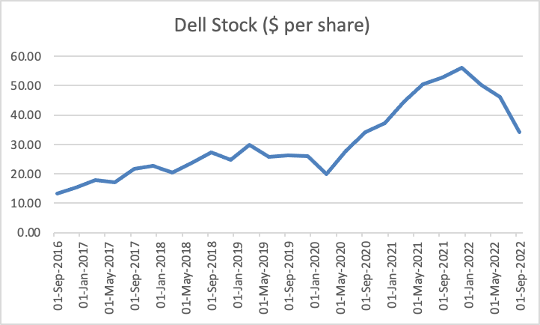
Price Chart and Key Metrics
09
s.

Slide 7
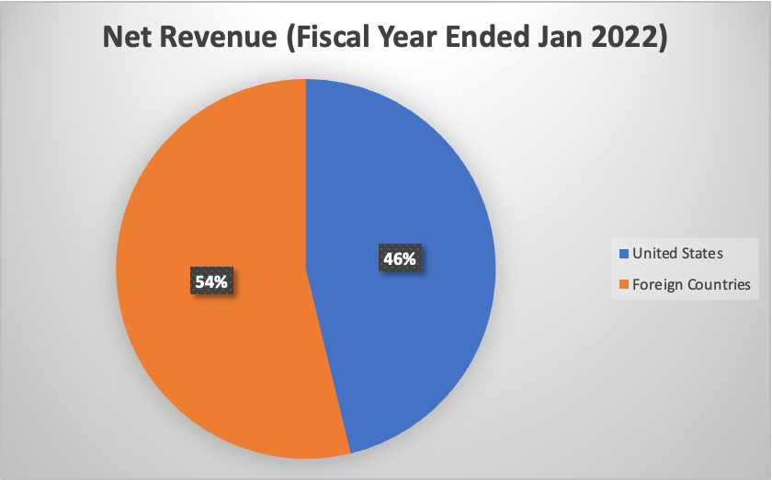
Global Revenue
09
$101,197,000,000 in revenue for fiscal year ended Jan-22
Americas, Europe, the Middle East, Asia, and other geographic locations
Current focus is on emerging markets outside of the US, Western Europe, Canada, and Japan

Slide 8
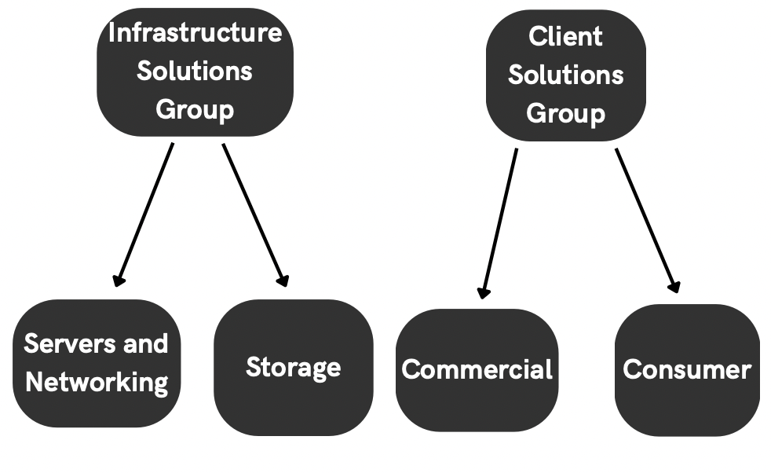
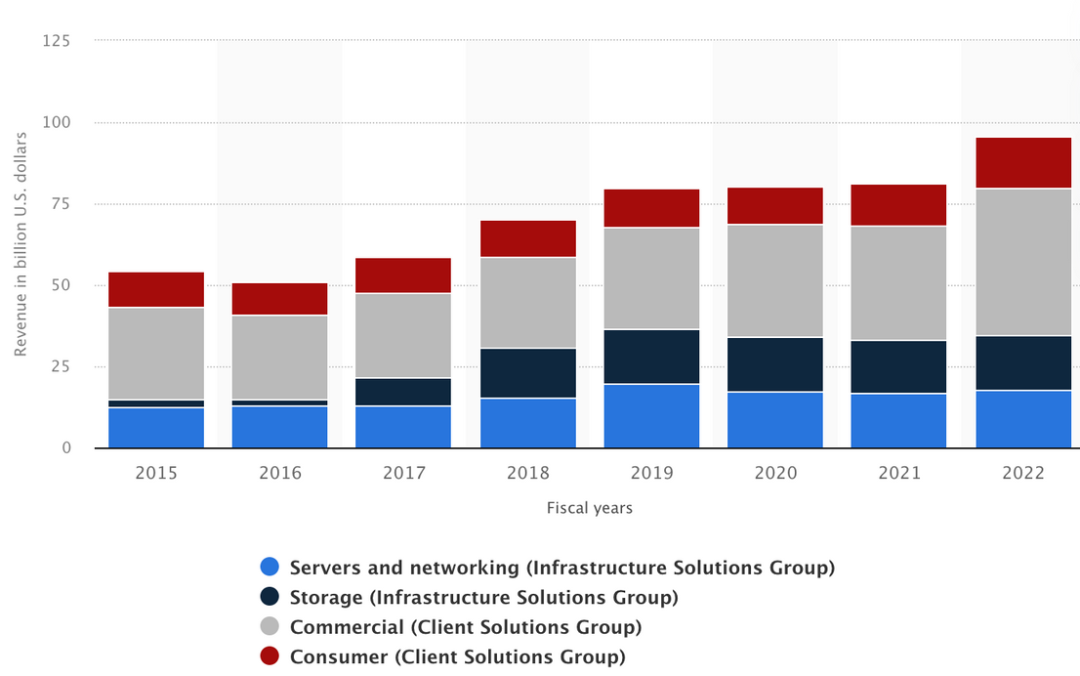
Business Segments
09
Infrastructure Solutions Group
Client Solutions Group
Dell Revenue By Subsegment
Servers and Networking
Storage
Commercial
Consumer

Slide 9
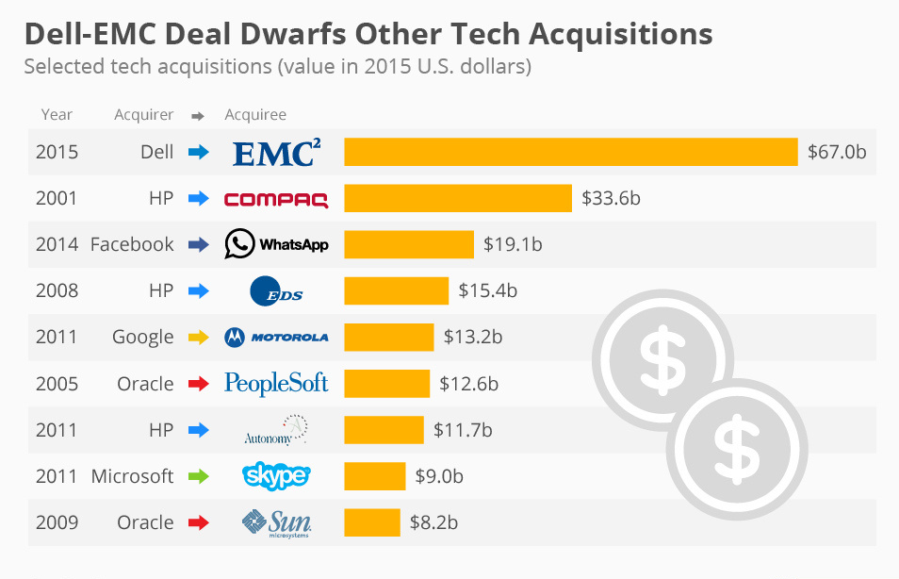
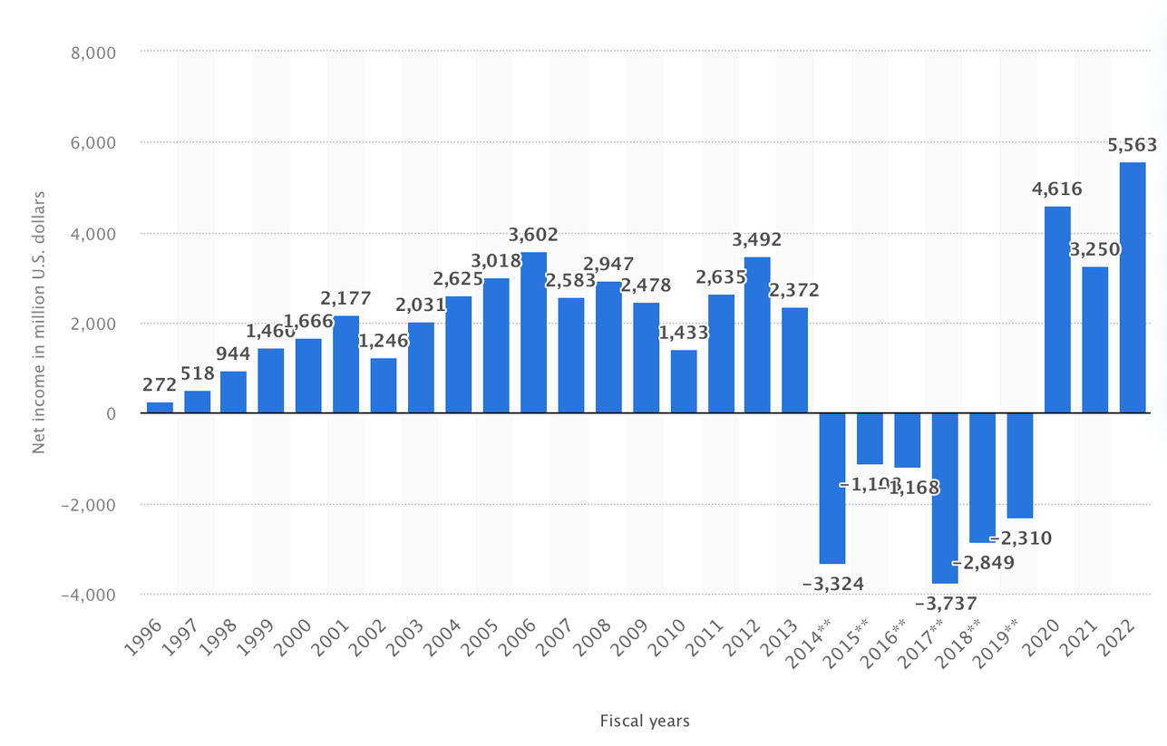
Dell's Acquisiton of EMC in 2015
09
Dell Technologies Net Income/Loss Worldwide

Slide 10
03
Industry Analysis

Slide 11
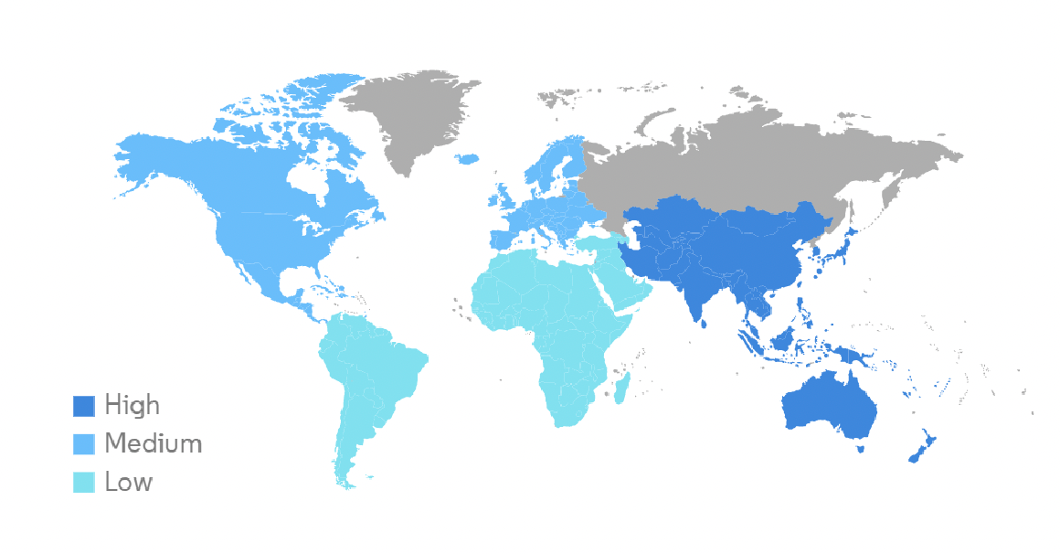
Industry Analysis
09
Global computer hardware market grew from $1,129.39 Billion in 2021 to $1,235.28 Billion in 2022 at a CAGR of 9.4%
Largest Market: North America
Fastest Growing Market: Asia-Pacific
Increased demand for technology and devices to support remote and hybrid future
Changes in technology and consumer preferences
Focus on strong security practices
Globalization of supply chain
Industry Growth Rate by Region

Slide 12
03
Financial Analysis

Slide 13
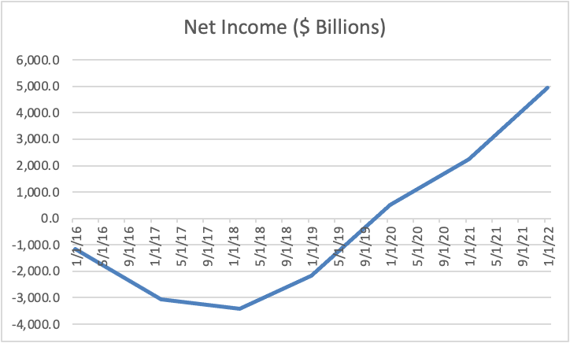
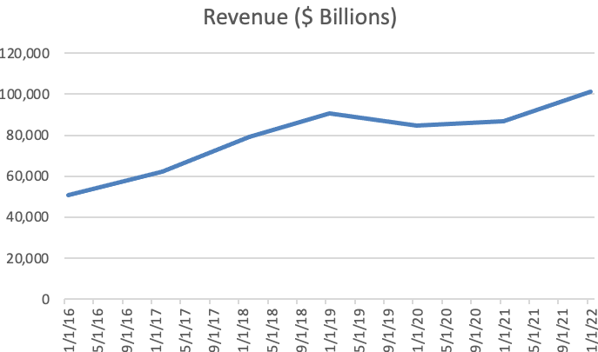
Net Income and Revenue
09
CAGR: 10.31%
Steadily increasing since going public
Moderately Increasing

Slide 14
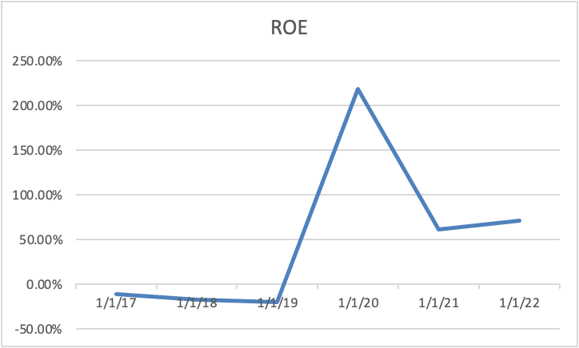
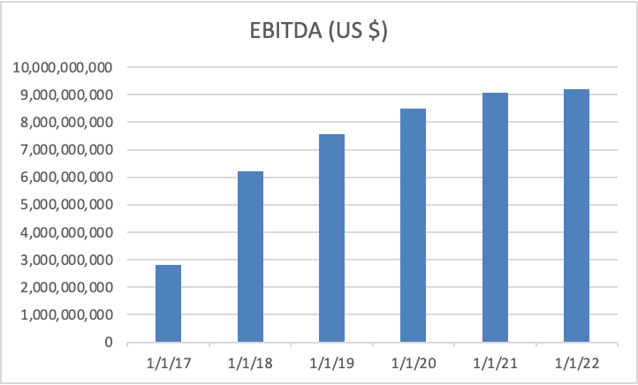
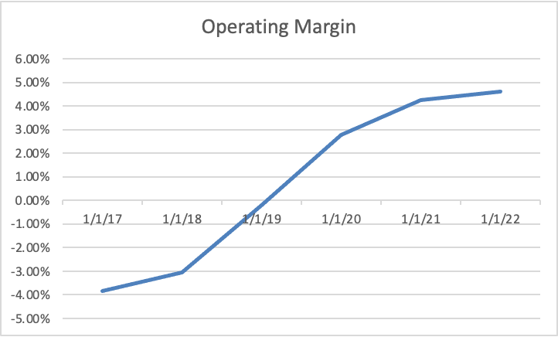
Profitability Ratios
09

Slide 15
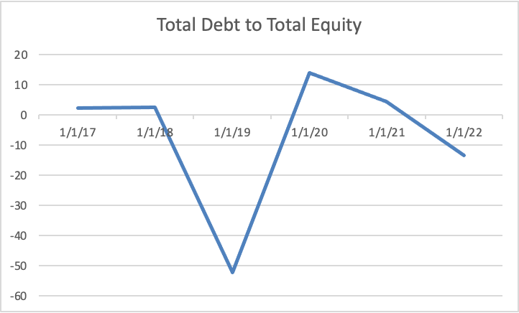
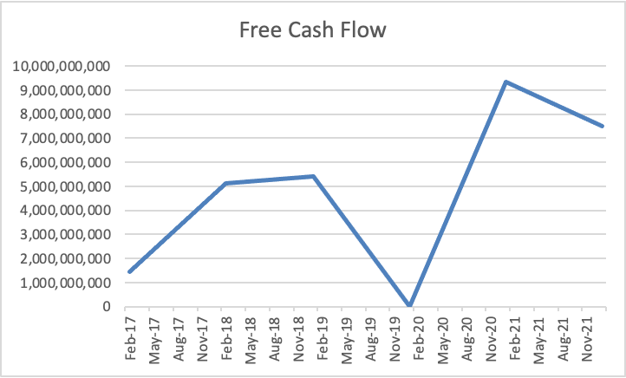
Financial Strength
09
Weakness in financials during transition from private back to public

Slide 16
03
Valuations

Slide 17
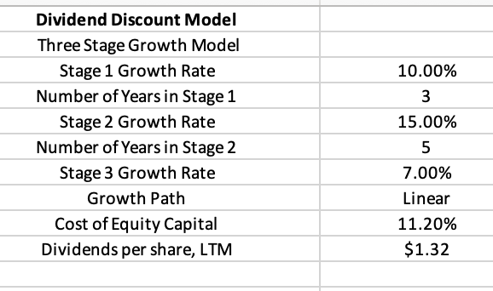
Dividend Discount Model
09

Slide 18
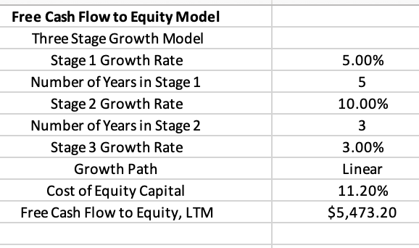
Free Cash Flow to Equity Model
09

Slide 19
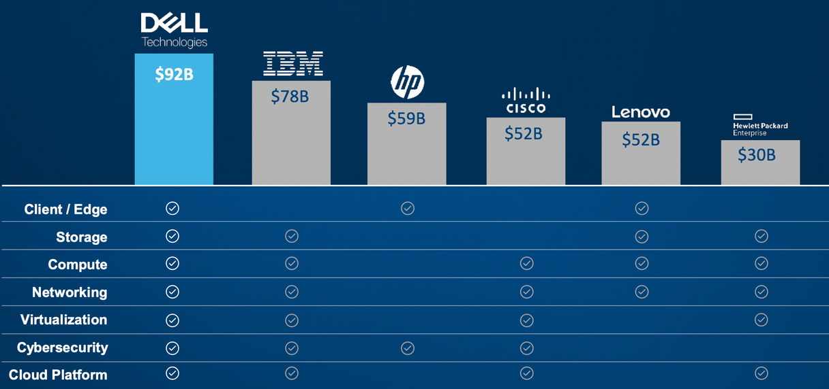
Comparable Company Analysis
09

Slide 20
03
Investment Risks

Slide 21
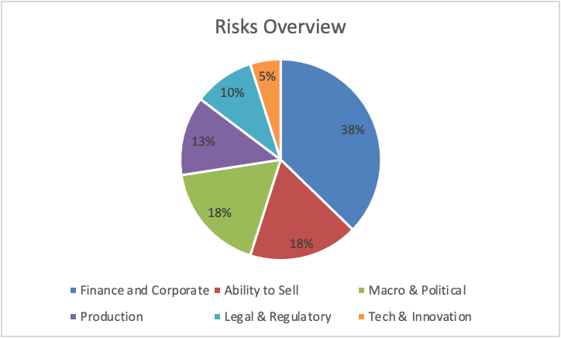
Investment Risks
09
Spin off of VMware might not achieve intended benefits
Pandemic still having ongoing effects
Ability to Sell
Competitive pressures
Weak economic conditions
Additional regulations
Cybersecurity

Slide 22
Investment Thesis
09
Buy Dell Shares
Target Price: $50.62
Upside: > 40.89%
Key Drivers:
- Value stock
- Increased demand for technology
- Recession resistant

Slide 23
Sources
09
https://workspace.refinitiv.com/web/Apps/Corp/?view=FinancialSummary&s=DELL.K&st=RIC#/Apps/CFundamentals?view=IncomeStatement
https://finviz.com/
https://www.macrotrends.net/
https://www.statista.com/

Slide 24
03
Questions?

