Slide 1
Metropolitan Life Insurance Company - MetLife
FINC 356 – Natalia Mendez

Slide 2
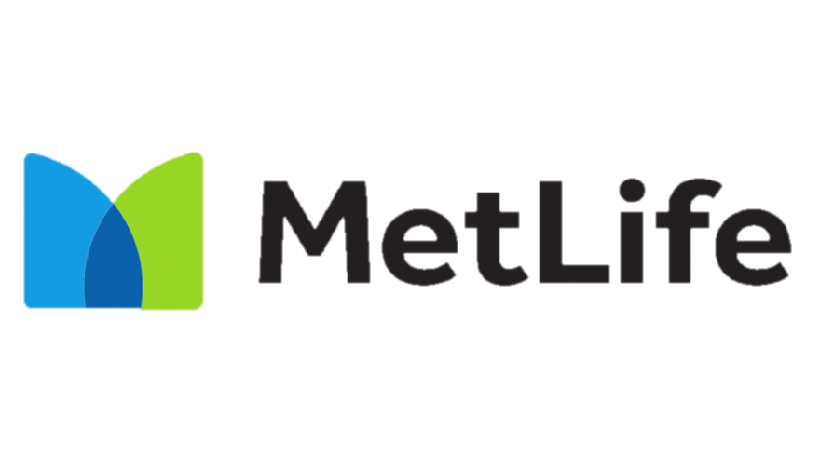
Table of Contents
01
02
03
Investment Thesis
Business Description
Industry Analysis
04
05
06
Financial Analysis
Valuation
Investment Risks

Slide 3
Investment Thesis
01

Slide 4
Investment Thesis
Recommendation: Buy
Current Price: $65.24
Target Price: $77.25
Upside: 18.4%
Key Drivers:
-Rise in healthcare expenditures
-Expansion of global middle class
-Generational aging and longer life expectancies
Notes:
https://www.mckinsey.com/industries/financial-services/our-insights/the-future-of-life-insurance-reimagining-the-industry-for-the-decade-ahead
Rise in healthcare expenditures. Healthcare is generally getting more expensive. As this continues to be true, people are becoming less able to pay for healthcare which leads to higher mortality rates. These mortality rates boost the demand and necessity for life insurance.
Expansion of global middle class. By 2030 another 700 million people are expected to join the global middle class, as technology and science advances. The rapidly growing middle class which brings higher incomes, grows financial wealth, with also heightened risks to mitigate.
Generational aging and longer life expectancies. By 2030 all baby boomers will be age 65 or older and many are expected to outlive their retirement savings. Thus, increasing the need for life insurance.

Slide 5
Business Description
02

Slide 6
What does MetLife do?
-Life insurance
-Annuities
-Employee benefit programs
-Dental/disability/property insurance
MetLife subsidiaries & affiliates:
-MetLife Investors
-MetLife Bank
-MetLife Securities
-Metropolitan Property and Casualty Insurance Company
Notes:
Annuity meaning = a type of insurance contract. Basically a contract between the person getting insurance and the insurer that requires the insurer to make payments to you. Designed to help protect you from the risk of outliving your income.
MetLife Inc. is the holding company for Metropolitan Life Insurance Company. Metropolitan Life Insurance Company is also commonly known as just MetLife. MetLife was founded in 1868. In 1915 it completed the mutualization process. After 85 as a mutual company, MetLife demutualized in 2000.

Slide 7
U.S. segment:
-Group Benefits
-Retirement and Income Solutions (RIS)
Asia segment:
-Life insurance
-Accident and health insurance
-Retirement and savings products
MetLife Holdings:
-Universal, term life insurance
-Annuities
-Long-term care insurance
Latin America segment:
-Medical & life insurance
-Retirement and savings products
EMEA segment:
-Life insurance
-Accident & health insurance
-Retirement and savings products
-Credit Insurance
Notes:
Latin America: medical and life insurance for government employees
EMEA = Middle East and Africa
MetLife has a presence in more than 40 countries worldwide.

Slide 8
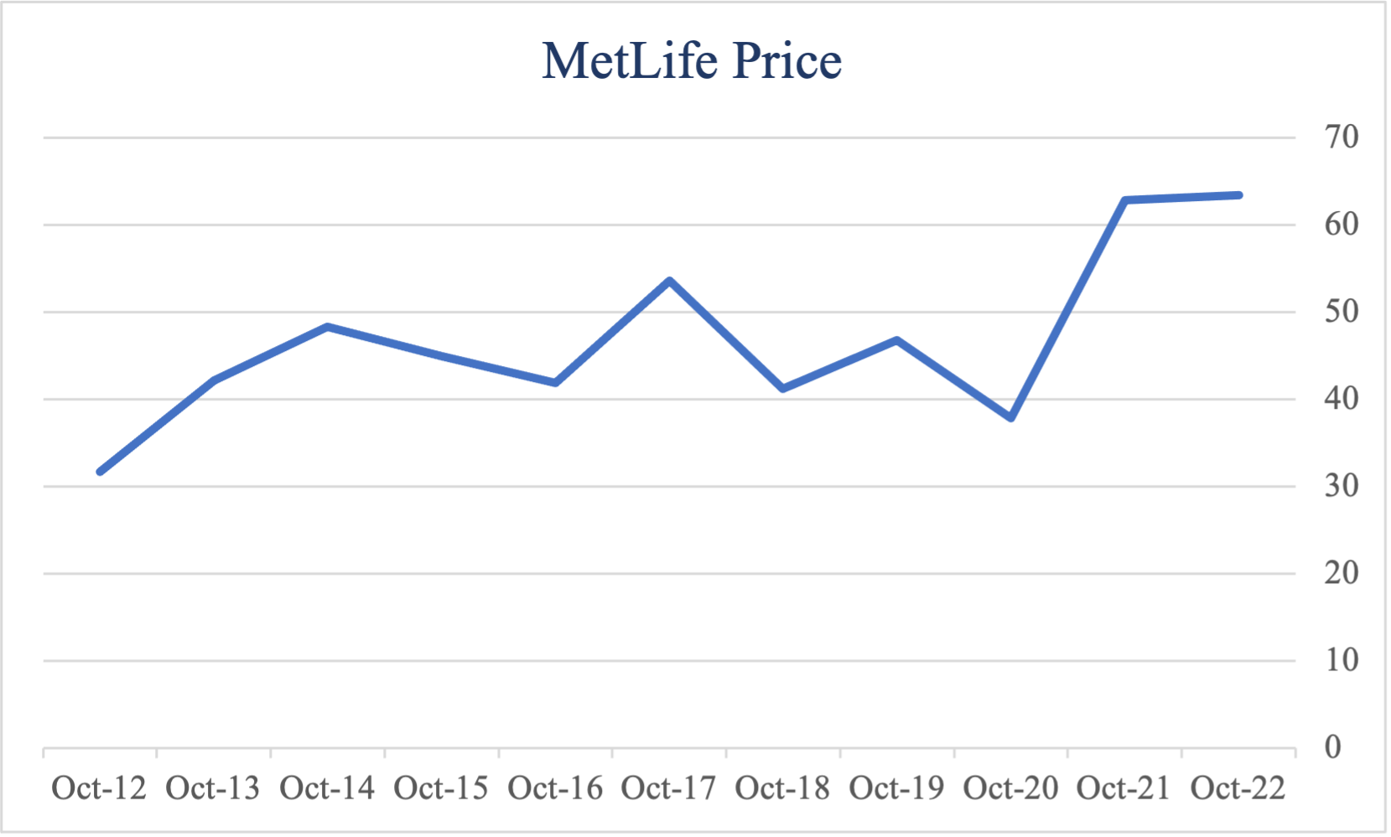
Key Metrics
Market Cap. | 50.94B
Revenue | 68.31B
Debt/Equity | 0.46
P/E | 15.59
P/B | 1.37
Dividend Yield | 3.20%
EPS | $4.01
ROE | 9.22%
ROI | 8.80%
Profit Margin | 5.00%
Beta | 1.02
Solution
Notes:
Ones to note:
-Price fluctuations in 2016 and 2020 (Covid)
-market cap
-revenue
-will explain roe later on
ROI = net income / total cost of investment
-Beta is very close to the market

Slide 9
Industry Analysis
03

Slide 10
Industry Market Capitalization Analysis
Mercury
Jupiter
Saturn
Mercury is the closest planet to the Sun
Venus has a beautiful name, but it’s terribly hot
It’s the iggest planet in our Solar System
Saturn is the ringed one and a gas giant
Notes:
By market capitalization. As of February 2022. Market cap = multiplying total number of shares by the present share price.
*Important because size does not mean better or more profitable but it does ensure financial stability and limits probability of insolvency.

Slide 11
Market Share
New York Life
Prudential
Northwestern Mutual
Mutual insurance company
8.3%
6.66%
New York Life
Mutual insurance company
7.18%
MetLife
Northwestern Mutual
8.93%
MetLife
Insurance, annuities, employee benefit programs, etc.
Prudential
Subsidiaries provide insurance, retirement planning, investment management, etc.
Notes:
Data in terms of FYE 2021
Top 4 all together hold about 17.93% of the market
https://www.investopedia.com/articles/personal-finance/092915/biggest-life-insurance-companies-us.asp

Slide 12
Industry Analysis cont.
-Market size of industry is expected to increase 8.6% by FYE 2022
-Percentage of Americans with life insurance is about 52%
-Recession-resistant business
-Market growth possibilities
-Increase in life insurance policies has been an effect of COVID-19 realities
Notes:
https://www.forbes.com/advisor/life-insurance/life-insurance-statistics/
-Life insurance industry is generally recession resistant because the demand doesn’t drop as sharply during bad economic periods compared to other industries. People are still consistently buying and needing life insurance. Especially with a company as big as MetLife, the probability of bankruptcy. MetLife has a AA- financial strength rating from S&P as of December 2021, proving it to have very good strength and stability.

Slide 13
Financial Analysis
04

Slide 14
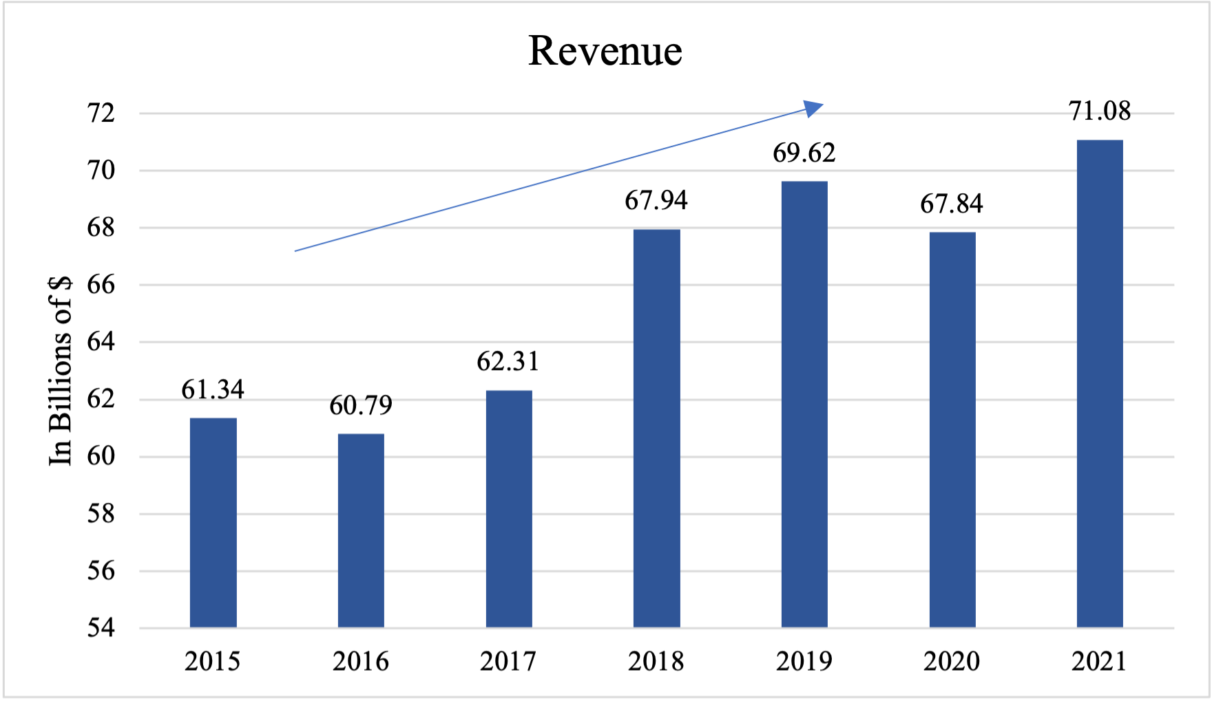
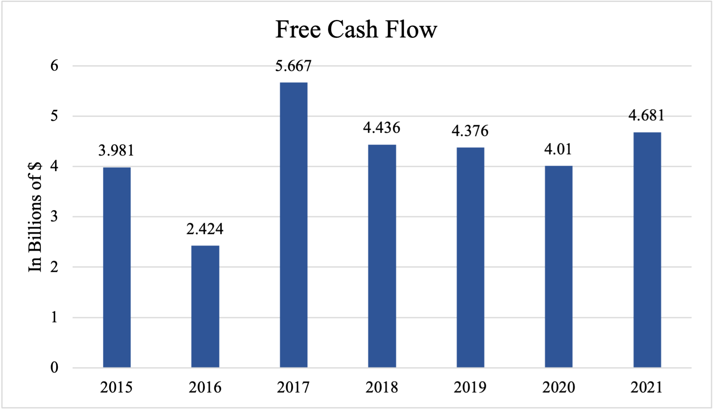
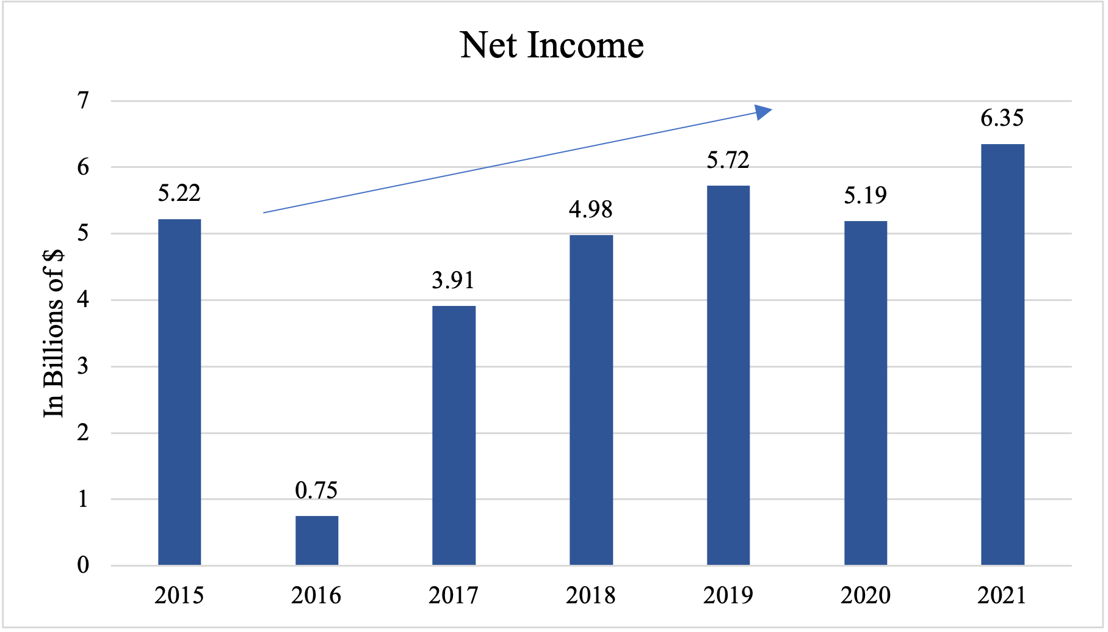
Financial Analysis
CAGR = 2.49%
CAGR = 3.32%
Notes:
FCF = operating cash flow – capex – working capital

Slide 15
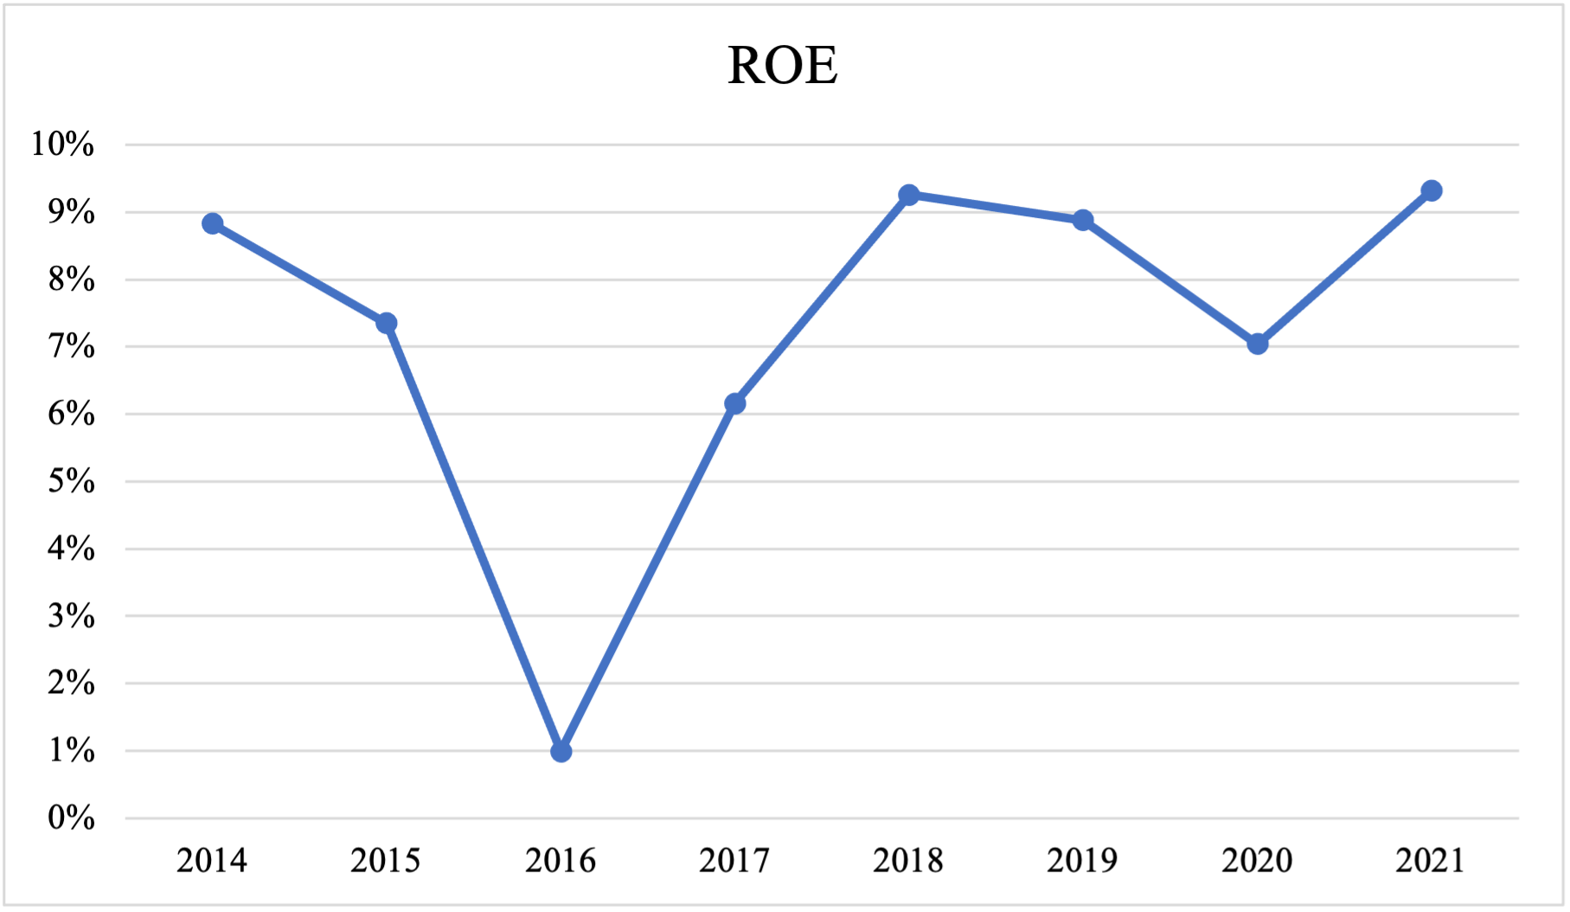
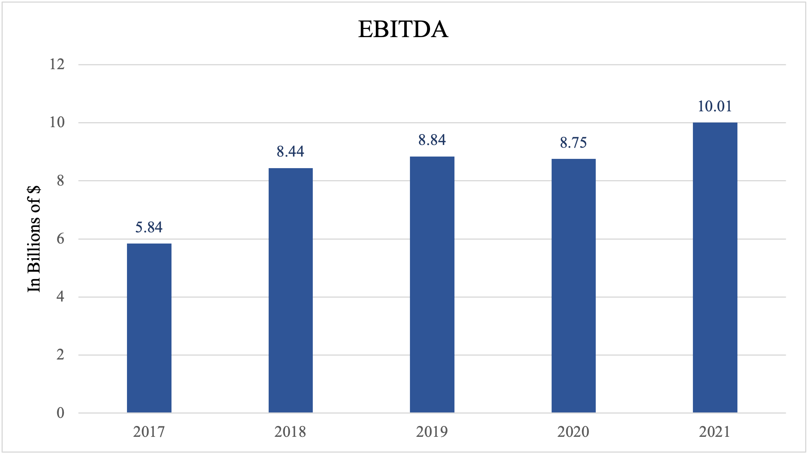
Financial Analysis
Notes:
-ROE: As you can see the ROE took a large dip in 2016. This was caused by the net loss of $3.2 billion, after tax, in net derivative losses reflecting changes in interest rates, foreign currencies and equity markets in the fourth quarter of 2015. MetLife uses derivatives as part of its broader asset-liability management strategy to hedge certain risks, such as movements in interest rates and foreign currencies. This hedging activity often generates derivative gains or losses and creates fluctuations in net income because the risk being hedged may not have the same GAAP accounting treatment. Approximately 94 percent of the net derivative losses in the quarter were attributable to asymmetrical and non-economic accounting.

Slide 16
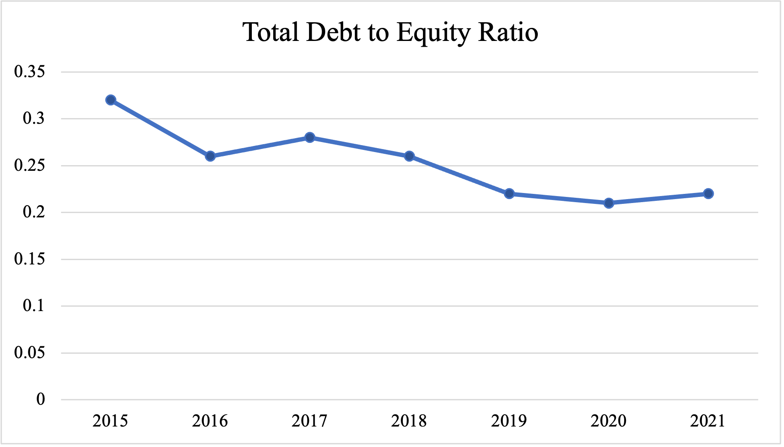
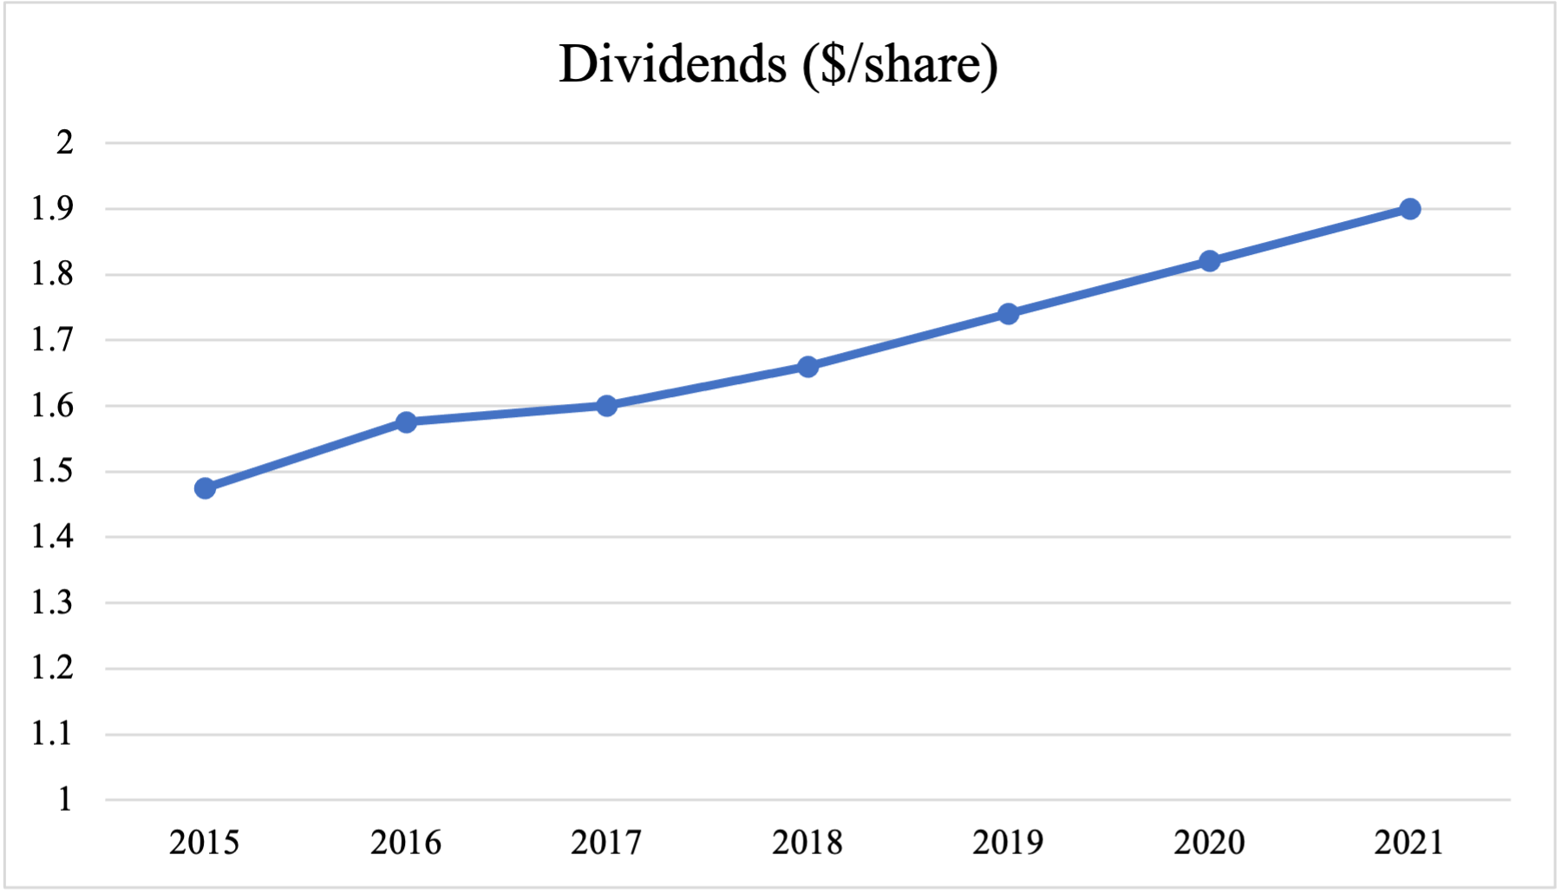
Financial Analysis
Low and continuously decreasing ratio
Increasing at a relatively constant rate

Slide 17
Comparison to Competitors
MetLife is a strong competitor among other life insurance companies
Notes:
-In June of 2005, MetLife acquired Travelers Life Insurance Company and Travelers Life & Annuity Company.
-In November 2014, through a series of mergers, MetLife Insurance Company USA is formed as an insurance company, which includes MICC, MetLife Investors Insurance Company and MetLife Investors USA Insurance Company. Today, MetLife Insurance Company USA is Brighthouse Life Insurance Company, licensed in 49 states.
In August 2017, Brighthouse Financial separated from MetLife

Slide 18
Valuation
05

Slide 19
Dividend Discount Model
Dividend Discount Model
Constant Growth Model
Growth Rate | 5.00%
Number of Years in Stage 1 | 5
Stage 2 Growth Rate | 5.00%
Number of Years in Stage 2
Stage 3 Growth Rate
Growth Path | Constant
Cost of Equity Capital | 8.47%
Dividends per share, LTM | $2.09
 | k / terminal g | 3.50% | 4.00% | 4.50% | 5.00% | 5.50% | 6.00% | 6.50%
 | 6.97% | $62.34 | $73.19 | $88.42 | $111.40 | $150.00
 | 7.47% | $54.49 | $62.64 | $73.54 | $88.85 | $111.93 | $150.71
 | 7.97% | $48.39 | $54.75 | $62.94 | $73.89 | $89.27 | $112.46 | $151.42
 | 8.47% | $43.52 | $48.63 | $55.01 | $63.24 | $74.24 | $89.69 | $112.99
 | 8.97% | $39.55 | $43.73 | $48.86 | $55.28 | $63.54 | $74.59 | $90.12
 | 9.47% | $36.23 | $39.74 | $43.94 | $49.09 | $55.54 | $63.84 | $74.94
 | 9.97% | $33.43 | $36.41 | $39.93 | $44.15 | $49.33 | $55.80 | $64.15
Average | $69.79
Dividend Discount Model
Two Stage Growth Model
Stage 1 Growth Rate | 10.00%
Number of Years in Stage 1 | 5
Stage 2 Growth Rate | 5.00%
Number of Years in Stage 2 | 5
Stage 3 Growth Rate
Growth Path | Linear
Cost of Equity Capital | 8.47%
Dividends per share, LTM | $2.09
 | k / terminal g | 3.50% | 4.00% | 4.50% | 5.00% | 5.50% | 6.00% | 6.50%
 | 6.97% | $76.32 | $87.70 | $103.68 | $127.77 | $168.24
 | 7.47% | $66.62 | $74.97 | $86.14 | $101.82 | $125.47 | $165.20
 | 7.97% | $59.09 | $65.46 | $73.65 | $84.61 | $100.01 | $123.22 | $162.22
 | 8.47% | $53.08 | $58.07 | $64.32 | $72.36 | $83.12 | $98.23 | $121.02
 | 8.97% | $48.16 | $52.17 | $57.07 | $63.20 | $71.10 | $81.66 | $96.50
 | 9.47% | $44.07 | $47.35 | $51.28 | $56.09 | $62.11 | $69.87 | $80.24
 | 9.97% | $40.62 | $43.33 | $46.55 | $50.41 | $55.13 | $61.05 | $68.66
Average | $79.33

Slide 20
Free Cash Flow to Equity Model
Free Cash Flow to Equity Model
Two Stage Growth Model
Stage 1 Growth Rate | 7.50%
Number of Years in Stage 1 | 5
Stage 2 Growth Rate | 5.00%
Number of Years in Stage 2
Stage 3 Growth Rate
Growth Path | Constant
Cost of Equity Capital | 8.47%
Free Cash Flow to Equity, LTM | $4,571.80
 | k / terminal g | 3.50% | 4.00% | 4.50% | 5.00% | 5.50% | 6.00% | 6.50%
 | 6.97% | $182.71 | $209.97 | $248.28 | $306.02 | $403.05
 | 7.47% | $159.45 | $179.48 | $206.24 | $243.83 | $300.51 | $395.75
 | 7.97% | $141.41 | $156.66 | $176.31 | $202.58 | $239.49 | $295.12 | $388.61
 | 8.47% | $126.99 | $138.96 | $153.93 | $173.23 | $199.01 | $235.24 | $289.86
 | 8.97% | $115.22 | $124.82 | $136.56 | $151.26 | $170.21 | $195.52 | $231.09
 | 9.47% | $105.42 | $113.26 | $122.69 | $134.22 | $148.66 | $167.25 | $192.11
 | 9.97% | $97.14 | $103.65 | $111.35 | $120.61 | $131.93 | $146.11 | $164.37
Average | $189.92

Slide 21
Investment Risks
06

Slide 22
Key Risks
Foreign Currency Exchange Rates
Mortality Risk
Muted Market Growth Risk
Foreign exchange currency rates against U.S. dollar
Actual claims higher than expected
Macroeconomic volatility, inflation issues
Notes:
https://www2.deloitte.com/us/en/insights/industry/financial-services/life-insurance-coverage-gap.html
https://www.spglobal.com/marketintelligence/en/documents/top-risks-for-the-global-insurance-industry.pdf
https://www.financierworldwide.com/four-current-regulatory-risks-facing-us-insurers#.Y0g1UC-B1bU
https://www.researchgate.net/publication/358088465_Insurance_Risk_in_Life_Insurance_Sector

Slide 23
Summary
Recommendation: Buy
Current Price: $65.24
Target Price: $77.25
Upside: 18.4%
Key Drivers:
-Rise in healthcare expenditures
-Expansion of global middle class
-Generational aging and longer life expectancies
Notes:
https://www.mckinsey.com/industries/financial-services/our-insights/the-future-of-life-insurance-reimagining-the-industry-for-the-decade-ahead

Slide 24
Thanks!
Questions?

Slide 25
Sources
https://www.mckinsey.com/industries/financial-services/our-insights/the-future-of-life-insurance-reimagining-the-industry-for-the-decade-ahead
https://www.investopedia.com/articles/personal-finance/092915/biggest-life-insurance-companies-us.asp
https://www.forbes.com/advisor/life-insurance/life-insurance-statistics/
https://www2.deloitte.com/us/en/insights/industry/financial-services/life-insurance-coverage-gap.html
https://www.spglobal.com/marketintelligence/en/documents/top-risks-for-the-global-insurance-industry.pdf
https://www.financierworldwide.com/four-current-regulatory-risks-facing-us-insurers#.Y0g1UC-B1bU
https://workspace.refinitiv.com/web/Apps/Corp/?s=MET&st=RIC&app=true#/Apps/CFundamentals?view=CashFlow
https://finviz.com/quote.ashx?t=MET&ty=c&ta=1&p=m&r=max&tas=0
https://www.mckinsey.com/industries/financial-services/our-insights/the-future-of-life-insurance-reimagining-the-industry-for-the-decade-ahead
https://www.reuters.com/article/us-metlife-results-derivatives/metlife-changes-hedging-strategy-after-billions-in-losses-idUSKBN1801Z1
https://s23.q4cdn.com/579645270/files/doc_financials/2021/ar/MLINC-2021.12.31-10K-web-version_FINAL.pdf
https://www.metlife.com/content/dam/metlifecom/us/homepage/about-us/newsroom/earnings-releases/Q4_2016_Earnings_News_Release.pdf

