Slide 1
By Troy Evans
Troy Evans | KO US Equity

Slide 2
Investment Thesis
Projection
Market Profile
Target:
$57.80
$97.72
70% upside
12-month time horizon
Key Drivers:
Expansion into new industries
Growing brands
Price
52 Week Range
Market Cap.
EBITDA
Price / Earnings
Forward Price / Earnings
Price / Book
Dividend Yield
Return on Assets
Return on Equity
Profit Margin
Beta
EV / EBITDA
Fiscal Year End
$57.80
$52.28 – 67.20
$245.55B
$13890000000
24.78
21.55
10.53
3.11%
11.39%
42.13%
23.16%
.54
19.62
Feb 22
Source: Yahoo Finance
Troy Evans | KO US Equity

Slide 3
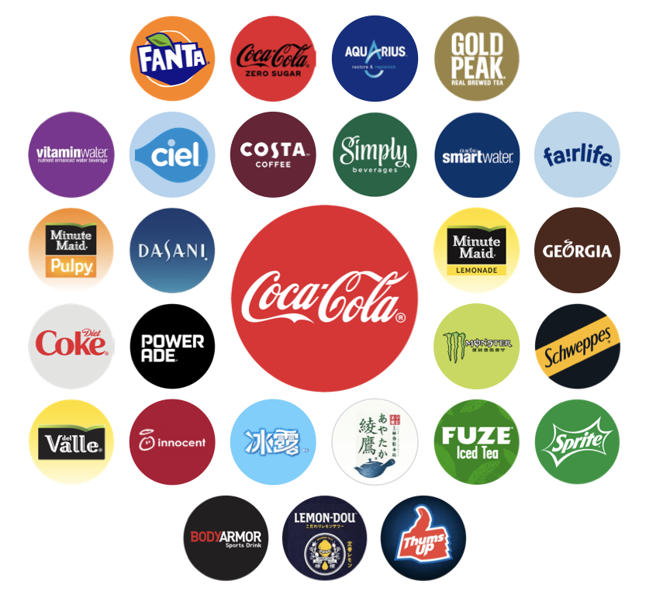
Company Overview
Segments:
Source: Coca-Cola 2021 Annual Report
Troy Evans | KO US Equity

Slide 4
Industry Analysis
Non-Alcoholic Growth
Non-Alcoholic Revenue
Non-Alcoholic Beverage:
All beverages produced without alcohol
Includes ready-to-drink beverages and mixes and concentrates
Consumer necessity
Growth:
Consistent growth YOY
2025 – Expected $1,441,158M global sales
Source: Statista
Source: Statista
Troy Evans | KO US Equity

Slide 5
Competitors
Pepsi
Keurig Dr Pepper
Faster dividend growth
Not expanding into as many brands
Stronger presence in the Coffee industry
Also does not have as many brands as Coca-Cola
Negative dividend growth
Source: Yahoo Finance
Troy Evans | KO US Equity

Slide 6
Catalysts
Growing Industries
Charts
Growing Coffee Industry:
$135.35 billion in 2019
6.53% CAGR since 2012
Expected to grow by at least 7% per year
Coffee Sales after Covid Recession:
19% sales growth from 2020-2021
Tea:
6.75% CAGR since 2012
Ayataka and Costa:
Ayataka is the fastest growing tea brand in Japan
Costa is one of their fastest growing brands
Source: Statista
Source: Statista
Troy Evans | KO US Equity

Slide 7
Catalysts
Sugar Alternatives
Sports & Energy Drinks
Coke Zero:
Saw major growth during and after the pandemic
Currently the fastest growing Coke Product
Outlook:
CEO says the company can expect this growth moving forward
Body Armor:
Plans to scale globally
Increasing endorsements with new athletes
Sports drink industry CAGR of 7.97%
Source: CNBC
Source: Statista
Source: Statista
Troy Evans | KO US Equity

Slide 8
Financial Analysis
Revenue
Revenue
Revenue:
Starting to rebound after lows
Slight decline starting in 2012
Due to shift away from sugary drinks
Spike in most recent year
New low/no sugar products
Increased sales of other brands
Source: Statista
Troy Evans | KO US Equity

Slide 9
Financial Analysis
Total Debt
Gross Profit Margins
Gross Profit:
Stable past 5 years
13.5% dip in 2020
Decrease Primarily from Covid
Economy opening back up brought gross profit back to normal levels
Outlook:
New acquisitions
Higher gross profit margins compared to competitors
Source: Yahoo Finance
Debt:
Big drop from 2018-2019
Relatively stable since
Source: Refinitiv
Troy Evans | KO US Equity

Slide 10
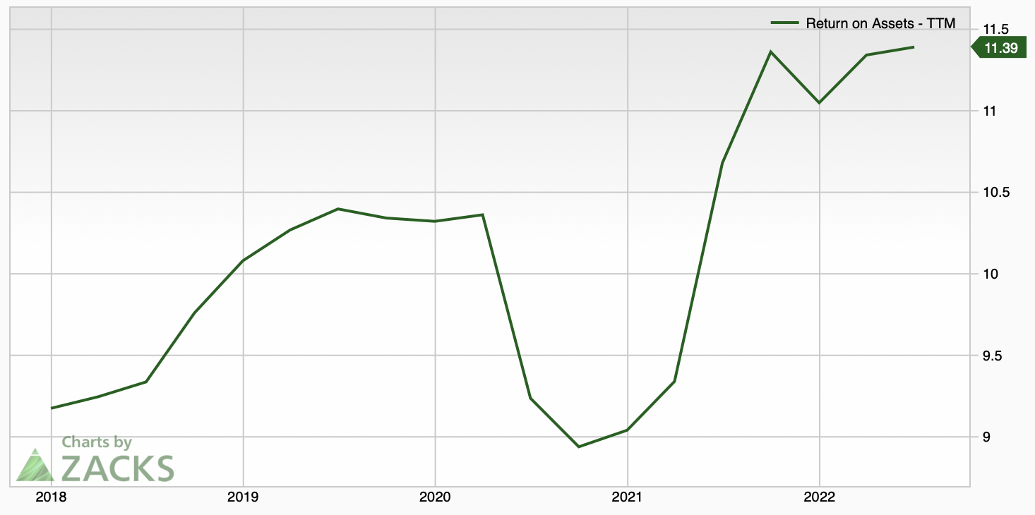
Financial Analysis
Return on Equity
Return on Assets
Industry average: 11.13%
Source: Zacks
Troy Evans | KO US Equity

Slide 11
Financial Analysis
Free Cash Flow
Earnings Per Share
Source: Refinitiv
Source: NASDAQ

Slide 12
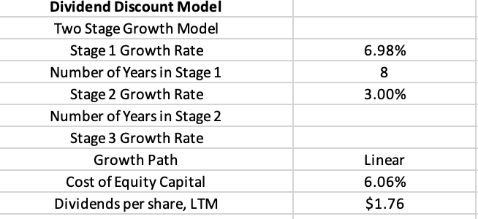
Valuation
Source: Yahoo Finance
Troy Evans | KO US Equity

Slide 13
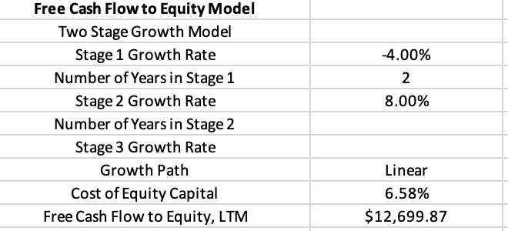
Valuation
Troy Evans | KO US Equity

Slide 14
Risk Factors
Health:
Many beverages contain a lot of sugar
Controversial studies about the effects of artificial sweetener
Recession:
Can decrease cash flows and profits
Possible shift to cheaper products
Taxes:
Corporate tax rate increase
Supply Chain issues:
Costs of raw materials
Troy Evans | KO US Equity

Slide 15
Investment Thesis
Projection
Market Profile
Target:
$57.80
$97.72
70% upside
12 month time horizon
Key Drivers:
Expansion into new industries
Growing brands
Price
52 Week Range
Market Cap.
EBITDA
Price / Earnings
Forward Price / Earnings
Price / Book
Dividend Yield
Return on Assets
Return on Equity
Profit Margin
Beta
EV / EBITDA
Fiscal Year End
$56.78
$52.28 – 67.20
$245.55B
$13890000000
24.78
21.55
10.53
3.11%
8.10%
39.21%
23.16%
.54
19.62
Feb 22
Source: Yahoo Finance
Troy Evans | KO US Equity

Slide 16
Questions?
Troy Evans | KO US Equity

