Slide 1
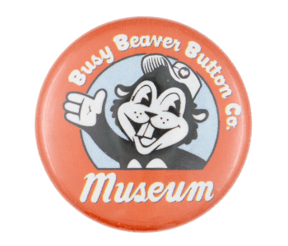
My Internship at the Button Museum
By Hailey Dightman

Slide 2
Background
From August to December 2022, I worked as a remote research intern for the Busy Beaver Button Museum
This satisfied both my history major’s internship requirement and the College of Arts and Sciences’ engaged learning requirement

Slide 3
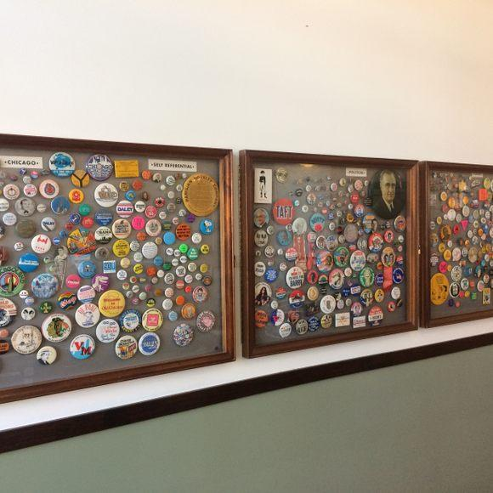
Why I chose the Button Museum
The opportunity to work at a museum: this is something I have been interested in for a long time. I love museums and it was exciting to have the experience of working at one.
Buttons! I love buttons. I’ve worn them on my bags and jackets for years and was fascinated by the idea of doing historical research on them.
Image Source: https://www.atlasobscura.com/places/busy-beaver-button-co

Slide 4
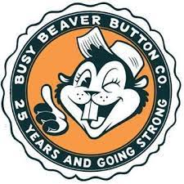
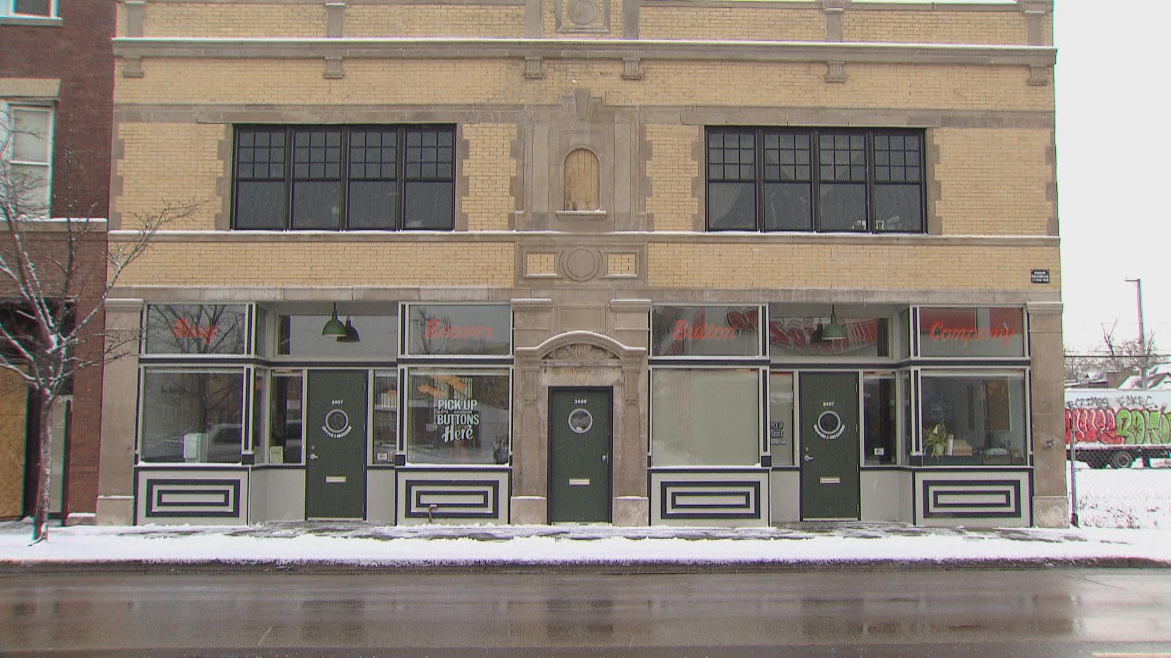
About the Button Museum
The world’s only museum exclusively devoted to buttons and their history
4,500 buttons on display and 6,000 catalogued online (this catalogue is what I worked with)
Located in Logan Square, located in the offices of the Busy Beaver Button Company.
Dedication to telling peoples’ history
Sources: https://news.wttw.com/2018/01/15/inside-world-s-only-button-museum ,
https://www.buttonmuseum.org/about

Slide 5
Role and Tasks
Research: each week, I would chose a button from the museum’s tremendous archive of buttons in need of research. I would conduct research on this button and then craft a summary and description to be posted on the museum’s digital archive.
Integrity checks: this involved checking buttons that have already been researched for language inconsistencies, historical accuracy, information in the correct spots, etc.

Slide 6
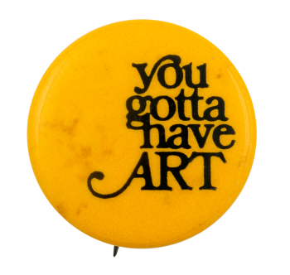
Highlights!
This button took me on a fun and interesting rabbit hole, as my research eventually lead me to the slogan of sorts connected to a 1976 campaign and commercial promoted by the Detroit Institute of Arts (DIA). The commercial was uploaded on the internet, nearly 30 years after its air date, in 2013, when the DIA was potentially at risk when the city filed for bankruptcy and considered selling some of the museum’s art. The button represented an entire 30-year-long narrative.
Finished digital archive with my research: http://buttonmuseum.org/buttons/you-gotta-have-art

Slide 7
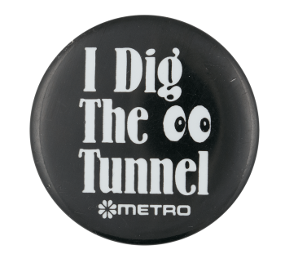
Highlights, con’t
Finding the origins of this button was a difficult process—I searched on google images, tried various combinations of words, and tried screenshotting the button image and cropping just the logo to get a more precise search. I then tried searching for photos of different transit buses and trains in American cities before finding a photo of a King County Metro city bus from 1983. On the front of the bus was an exact match of the button’s logo. This part was exciting as things started falling into place. I grew up in Seattle, and I rode the city's buses and thus was familiar with what tunnels the button was referring to. In 1987, King County Metro system commissioned the building of a pair of tunnels through the downtown area of the city as there was a significant traffic issue. This button was a promotional button for this ambitious project, with the pair of eyes on the button symbolizing the two tunnels. To reach a precise year and subject for this button was exciting, particularly because the button’s origins were so close to home.
Finished digital archive with my research: http://buttonmuseum.org/buttons/i-dig-tunnel

Slide 8
Highlights, con’t
The button I picked this week was a button featuring an Op Art design. This was an exciting discovery for me, as I had just discussed the Op Art movement in my art history class a few weeks ago. I was able to apply some of the knowledge I gained in this class to the research of this button.
This pin-back features a design pattern in the style of Op Art, a 1960s art movement and abbreviation of “optical art”. The style became popular due to its engaging and accessible nature and was incorporated into popular culture and design trends. Retrospectively, the spirals, swirls, and bright colors of Op Art seem almost synonymous with the 1960s and 70s, drawing to mind an age of psychedelics and counter culture with its hypnotic, groovy aspects.
Finished digital archive with my research: http://buttonmuseum.org/buttons/purple-spiral

Slide 9
What did I gain from this internship?
Research skills: while I had experience in historical research for classes and papers, I was inexperienced in museum research. You are not crafting research and information in a scholarly way to be read by a professor. Rather, you are writing to engage the general public.
An understanding of the importance of micro-history. Historical artifacts come in a variety of media, and even the seemingly insignificant artifacts can tell stories and fill in gaps about our cultural history. The stories that buttons can tell was an exciting discovery of this internship.

