Slide 1
Internship at “Japan American society of Chicago
By Shirin Smatova

Slide 2
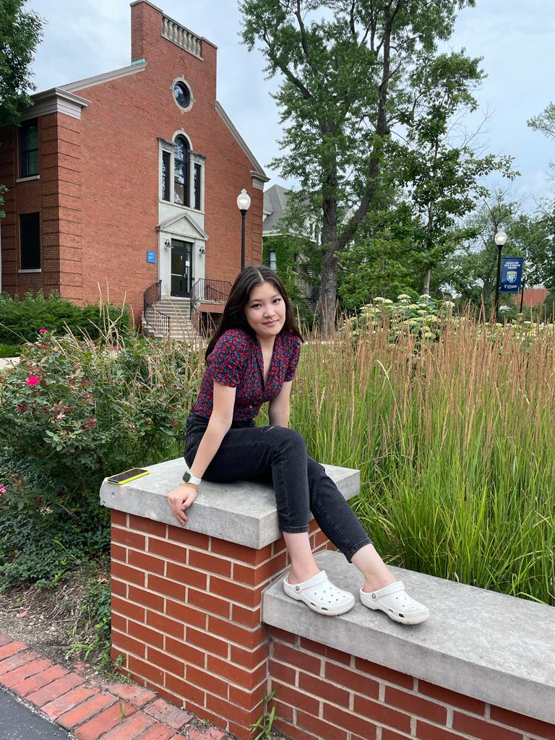
About me
I am Shirin Smatova, a sophomore at Loyola University Chicago and my major is Global Studies and International Relations. My interest is in human rights, with a concentration in rights of immigrants and refuges who are coming to a new county and are seeking help.

Slide 3
Japan America Society of Chicago
Last fall, I interned at The Japan America Society of Chicago which is a not-for-profit association that fosters understanding between Japanese culture and American culture. In short JASC creates and promotes Japanese American friendships.

Slide 4
To be honest, I choose this organization because I am a fan of anime and I was excited to learn Japanese culture and getting to know more about Japan.
I was responsible for making social media posts and banners since one of my responsibilities was to promote their social media page. My experience was great because part of the mission of JASC is to help Japanese people integrate to the American culture.

Slide 5
Celts: Center for engaged learning, teaching, & Scholarship
CELTS had a great impact on me and as a teaching and learning center it helped me a lot. While I was doing my engaged learning experience which was unpaid, CELTS provided me funding opportunities which compensated some financial pressure.
I gained a lot of experience which made me stronger and I want to say thank you to CELTS for giving me this opportunity.

