Slide 1
Cisco Systems, Inc
Armando Menendez Jr

Slide 2
Table of Contents
Investment Thesis
Industry Analysis
Business Description
Financial Analysis
Valuation
Investment Risks

Slide 3
Investment Thesis
Purchase Cisco System Shares
Target Price: $161.04
Upside: > % 334.03
Key Drivers:
Cisco acquiring Valtix
Partnership with Mercedes - Benz
Silicon One
New product
Dividend Discount Model:
Case 1: 80% → $137.50
Free cash Flow to Equity:
Case 1: 10%
Case 2: 10%.
$23.54

Slide 4
Growth Catalyst
Acquisition of Valtix Inc.
Valtix is a Multi – Cloud Network security company
The acquisition is to enhance Cisco’s their multi-cloud firewall by advancing its security features that could give Cisco a competitive advantage
Mercedes - Benz Partners with Cisco
Mercedes - Benz E Class vehicles will have Webex Meetings and Calling to allow for flexibility for hybrid workforce
This collaboration aims to make it easier for people to work comfortably, safely, and in their cars.
Allows Cisco to tap into the automotive industry
Silicone One
By obtaining a higher bandwidth, Cisco claims that its new network architecture can address problems
The Silicon One architecture is a unifying technology that provides service providers and web-scale providers with high-speed routing and web-scale switching
Also, it will enhance networking procedures for numerous computer behemoths who greatly rely on a reliable internet connection

Slide 5
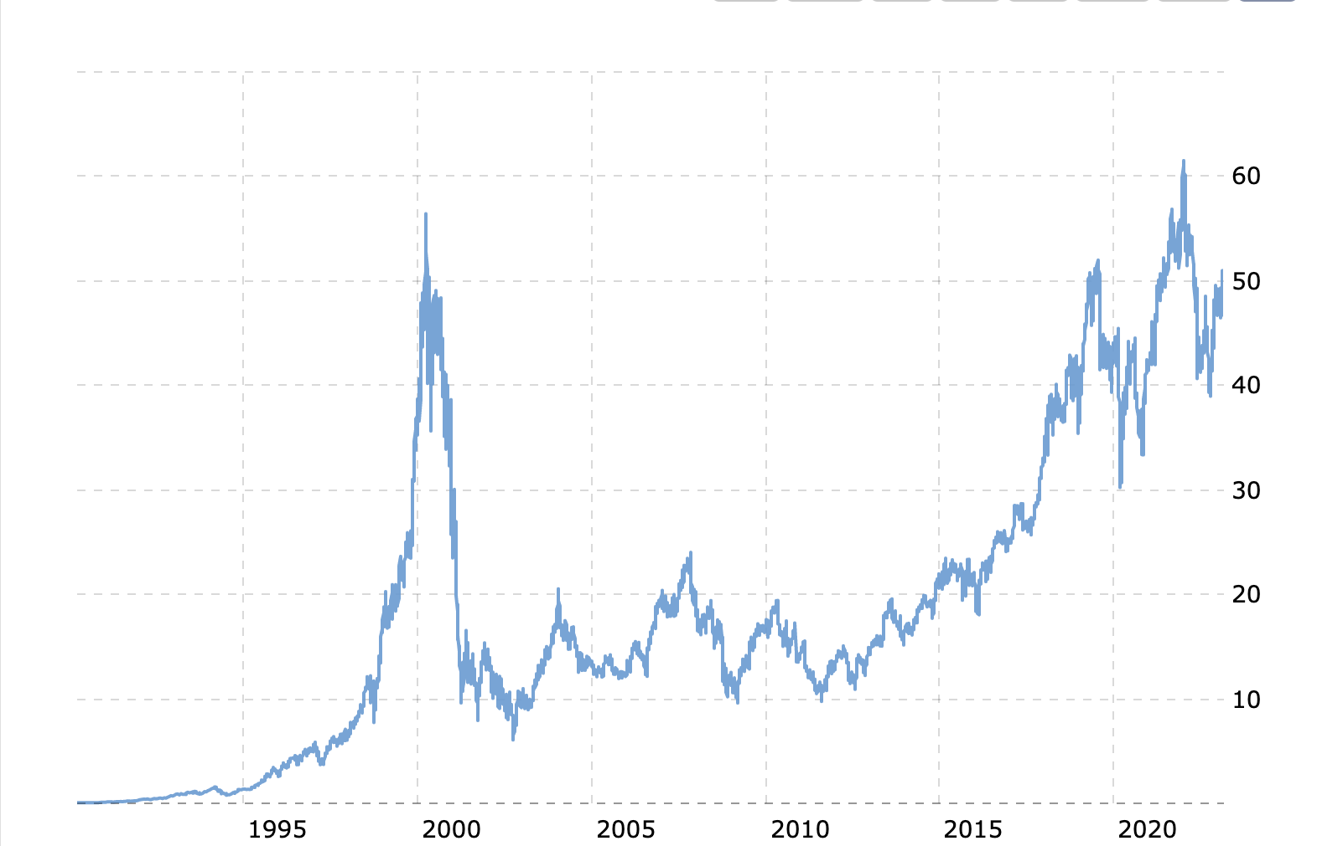
Company Overview
Key Financials
Share Price($) 48.48
Market Cap (billions) 203.04
Dividend Yield% 3.17
Beta 0.99
Debt/Equity 0.22
P/E (TTM) 18.03
ROE% 29.50
Institutional Ownership % 74.83
Sector: Information Technology
HQ: San Jose, CA
Employees: 26,000
Industry: Network Hardware & Software
Stock Performance
Maria Martinez
Chairman & CEO
Maria Martinez
EVP & COO

Slide 6
Industry Analysis

Slide 7
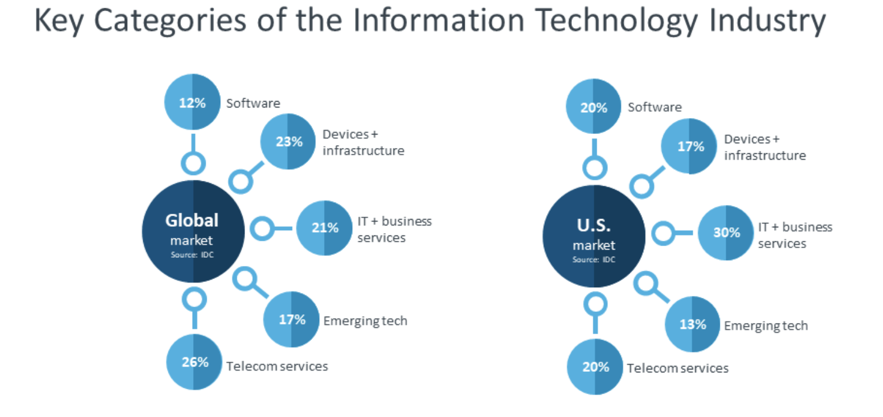
Industry Analysis
The Global Information Technology Sector of $8852.41
Has a 8.2% CAGR
Expected to grow to $11995. 97 billion by 2027
In 2022, it jumped to from $8179. 48 to $8852.41 billion
Asian-Pacific region was the largest region in the Information Systems (IT) market in 2022
Capture as much of the market
Increase tech and operations in Asian-Pacific region

Slide 8
Peer to Peer Comparison

Slide 9
Business Description

Slide 10
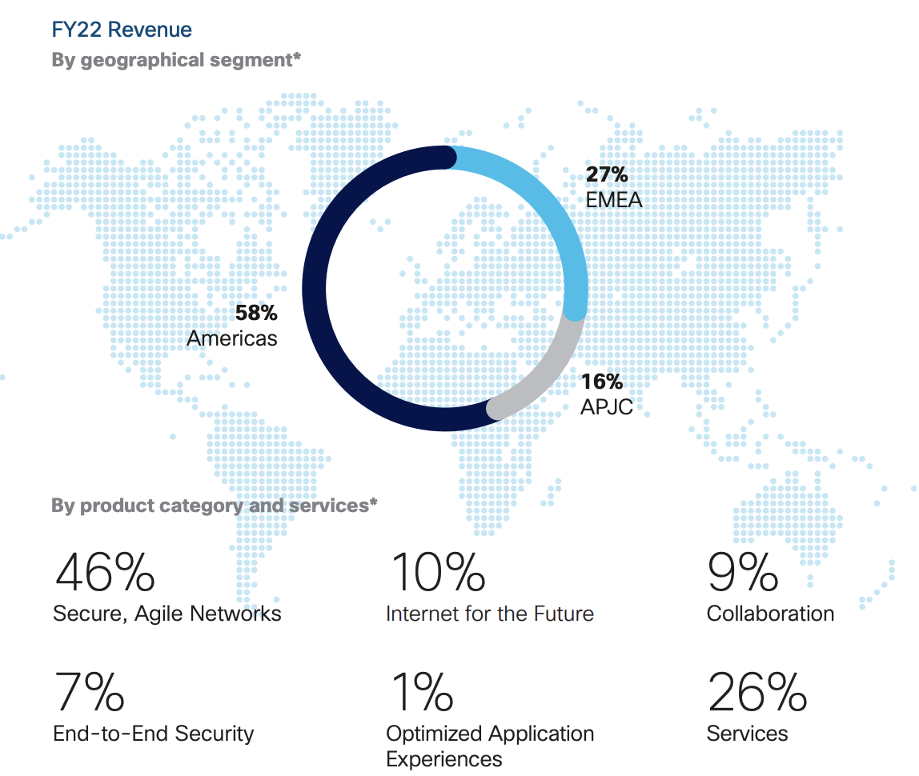
Revenue by Segment and Geography

Slide 11
Financial Analysis

Slide 12
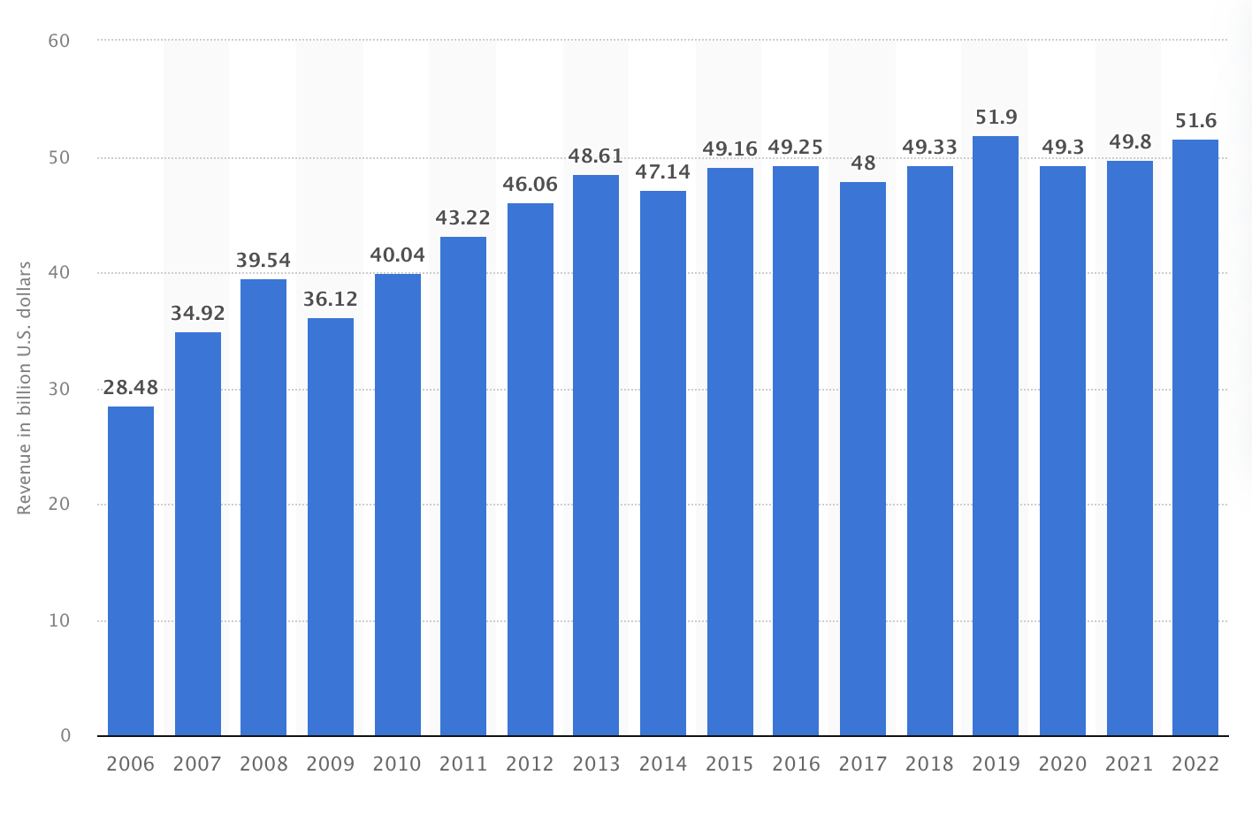
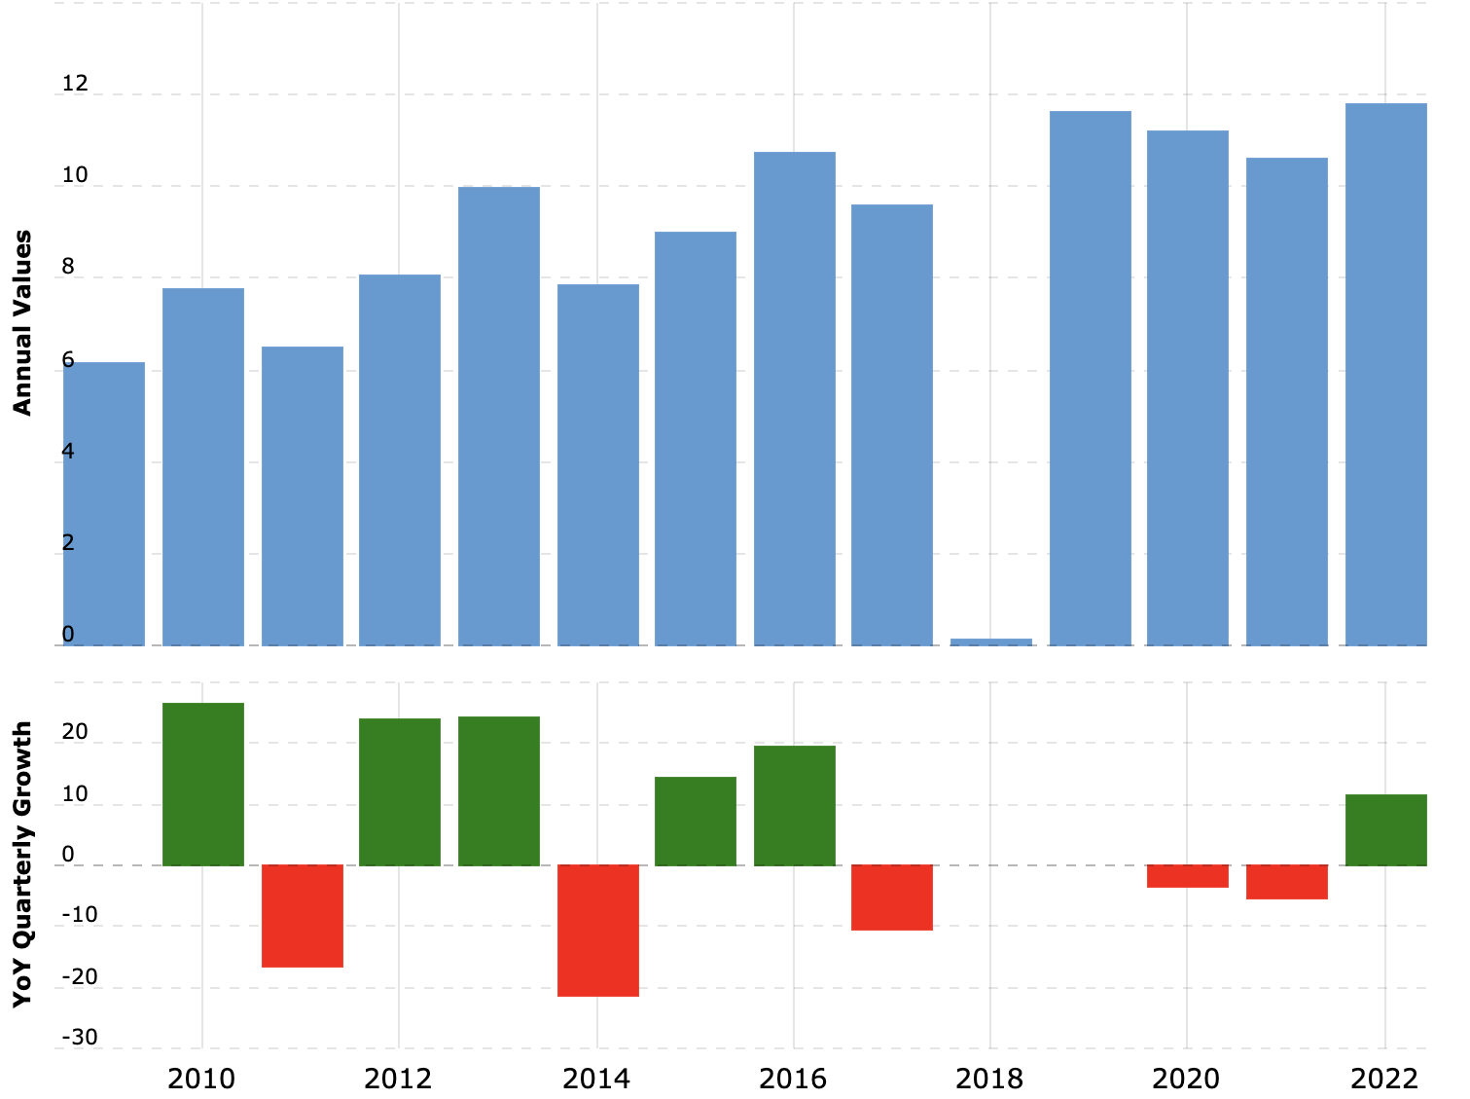
Financial Analysis
Revenue
Net Income
Notes:
Net Income is sitting at 11.81B

Slide 13
Profitability Ratios
Operating Margins
ROE
Notes:
Current ROE is sitting at 27.92
Operating Margins currently at 26.10

Slide 14
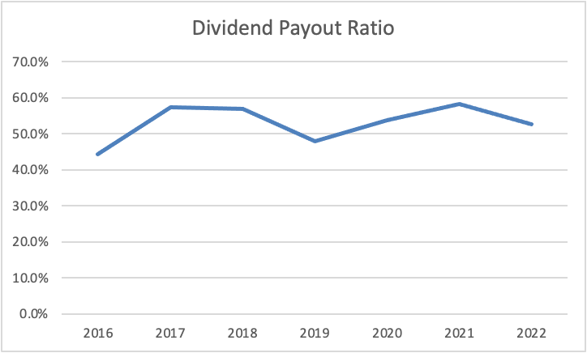
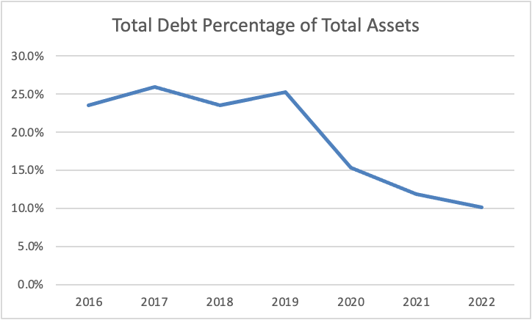
Profitability Ratios

Slide 15
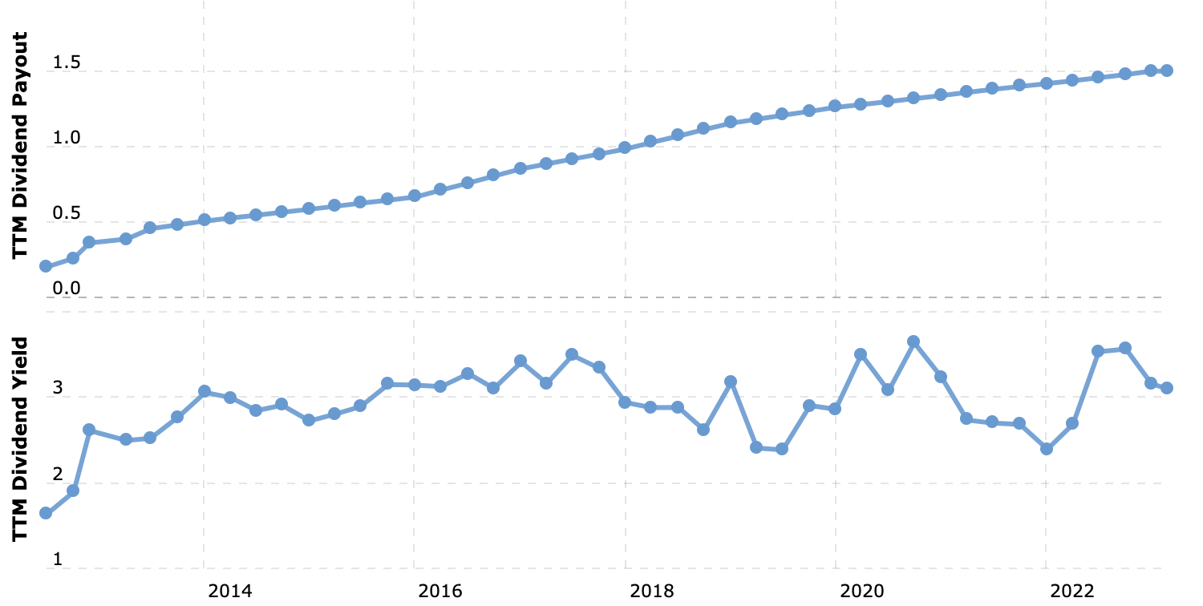
Leverage and Financial Strengths
Total Debt to Equity Ratios
Dividend Payout Ratio
Notes:
Current Total Debt to Equity Ratio is 0.18
DPR is 3.12%

Slide 16
Valuations

Slide 17
Comparable Company Analysis

Slide 18
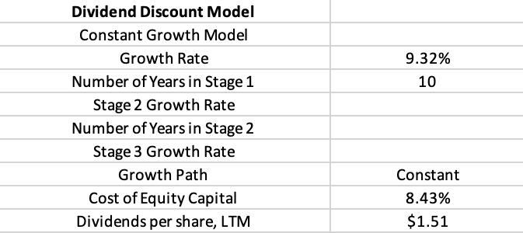
Dividend Discount Model
CASE 1:
RESULTS:

Slide 19
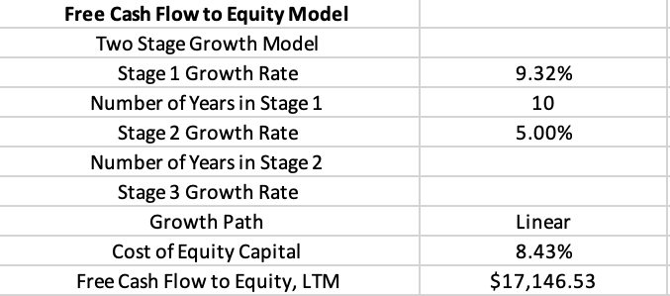
Free Cash Flow to Equity Model
CASE 1:
RESULTS:
Notes:
17.9

Slide 20
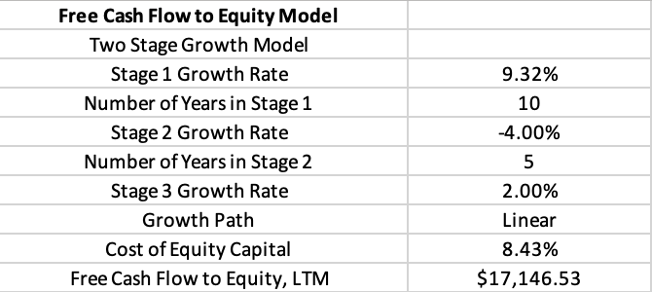
Free Cash Flow to Equity Model
CASE 2:
RESULTS:
Notes:
5.64

Slide 21
Investment Risks

Slide 22
Investment Risks
Cybersecurity Risk
Dependence on technology spending
Exposure to global markets
Notes:
Cybersecurity Risk: Cisco is highly susceptible to cybersecurity risks such as data breaches, cyberattacks, and network vulnerabilities as a provider of networking and cybersecurity solutions. Significant security breaches could harm the company's reputation as well as its financial performance.
Competition: The networking industry is extremely competitive, with many established and emerging players. Cisco's market share, pricing power, and profitability may suffer as competition increases.
Dependence on technology spending: Cisco's revenue is heavily reliant on technology spending, particularly in the networking industry. Any reduction in technology spending could have a significant impact on the company's financial performance.
Exposure to global markets: Cisco operates in a number of countries, making it vulnerable to global economic, political, and regulatory risks. Foreign exchange rates, tariffs, and trade policies could all have an impact on the company's revenue and profitability.

Slide 23
Questions?

