Slide 1
Marathon Petroleum Corp. (MPC)
Claudio Sejdini

Slide 2
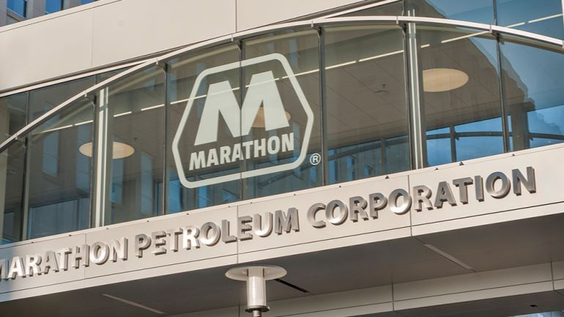
Investment Thesis

Slide 3
Investment Thesis
Current Price: $126.5
Target Price: $179.62
Key Drivers
•Upside: ~ 42%
Dividend Discount Model:
Case 1: 50%
Consistent 10-year growth of Dividends.
Biggest Market Share in a industry with High Barriers of entry.
$72.10
Profitability Ratios and Revenue have grown significantly in last 2 years.
Free Cash Flow to Equity:
Case 1: 25%
Case 2: 25%
$107.52

Slide 4
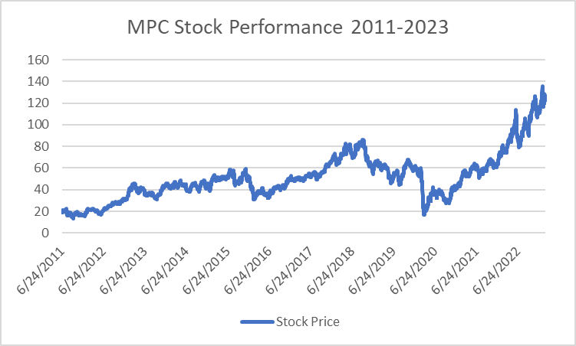
Company Overview
Key Metrics
52 Week Range | $73.18 - $136.46
Market Cap | 55.658B
Revenue | 179.952B
Debt/Equity | 76.1%
P/E | 4.45
P/B | 2.07
EPS | 27.98
Dividend Yield | 2.39%
Return on Equity | 46.54%
Profit Margin | 13.1%
Beta | 1.60
Institutional Ownership | 81.06%
17,700 Employees
HQ: Findlay, Ohio
Michael J. Hennigan
President and CEO
John P. Surma
Non-Executive Chairman
Industry: Oil & Gas Refinery and Marketing
Sector: Energy

Slide 5
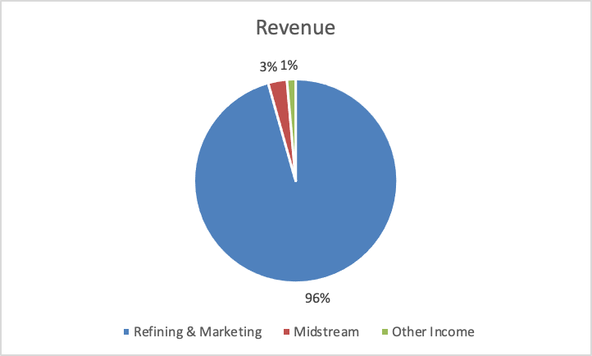
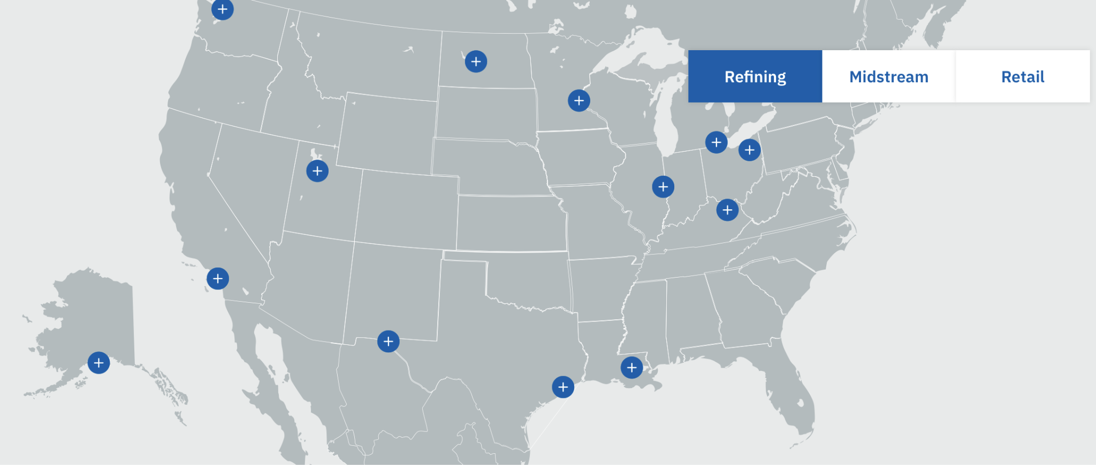
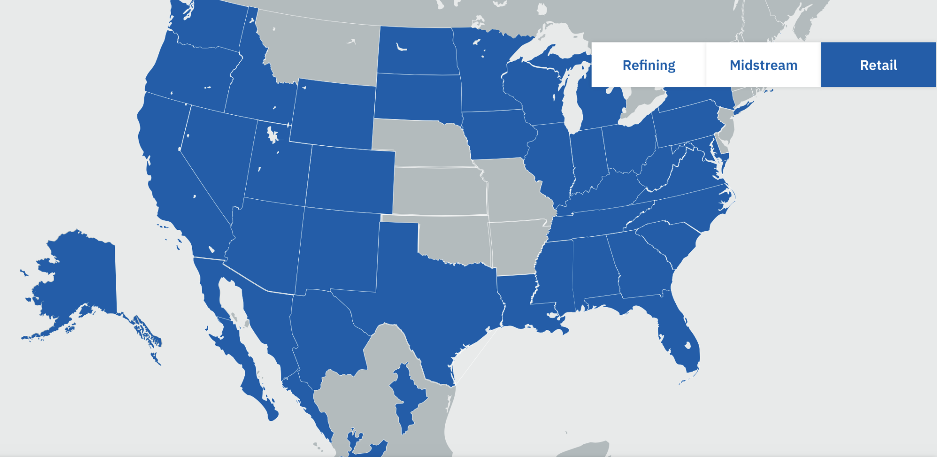
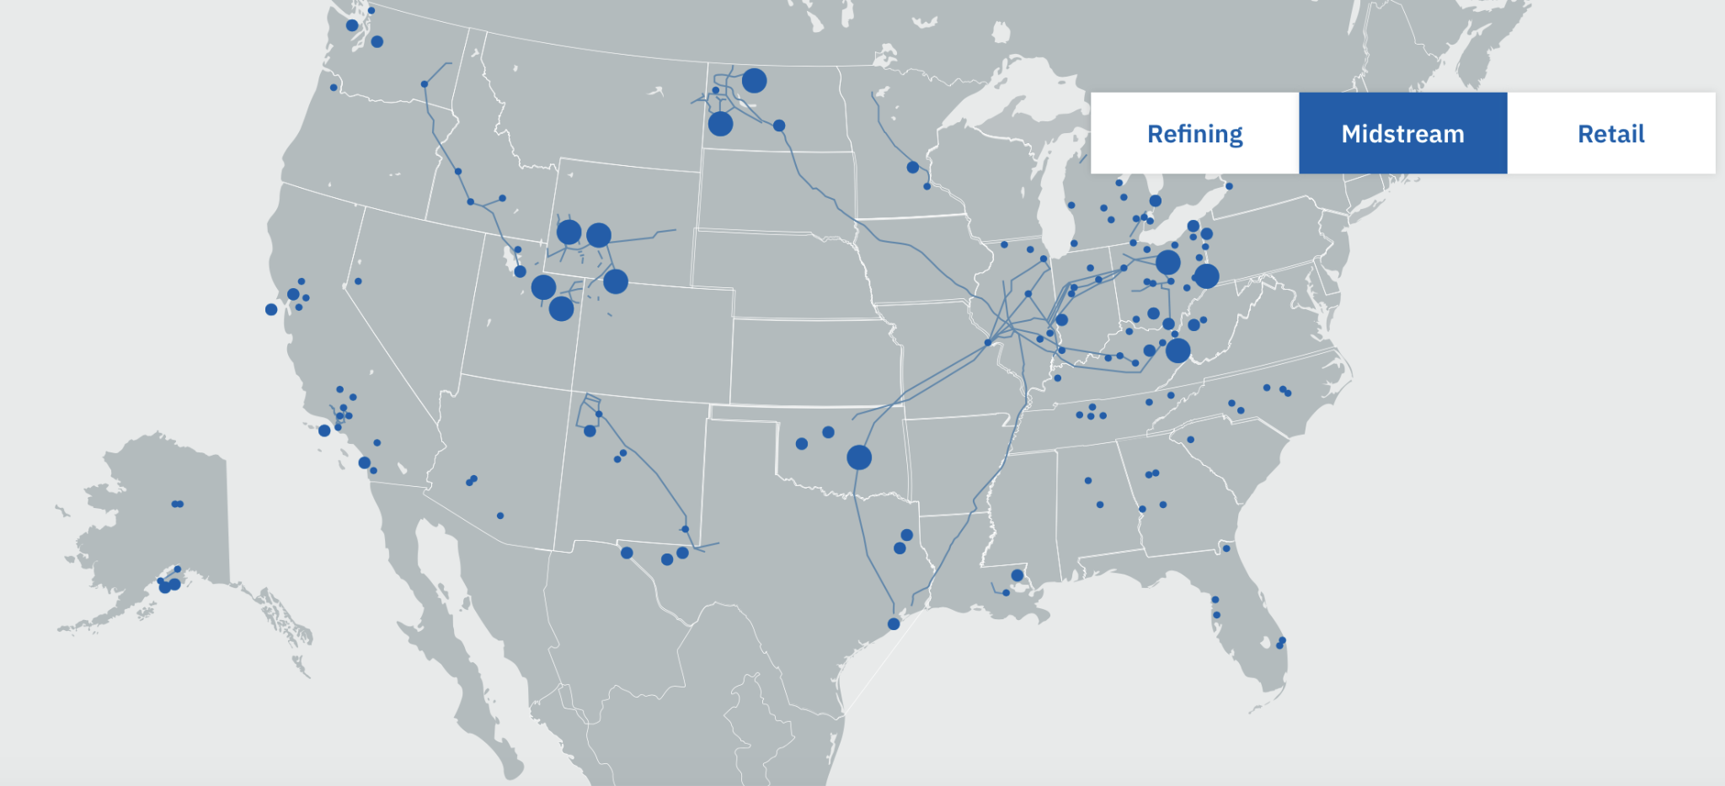
Business Description
Business Operations
Revenue
Refining & Marketing
Marathon has 6150 Gas Station Locations. Arco has 1300.
13 refineries which produce 2.9 million barrels per calendar day.
More operations (products).
Midstream
transport, store, distribute and market crude oil and refined products.
$177.453 Billion in Revenue Breakdown:
$172.087 Billion revenue in Refining & Marketing.
$5.366 Billion revenue in Midstream.
$2.499 Billion revenue in other income.

Slide 6
Industry Analysis

Slide 7
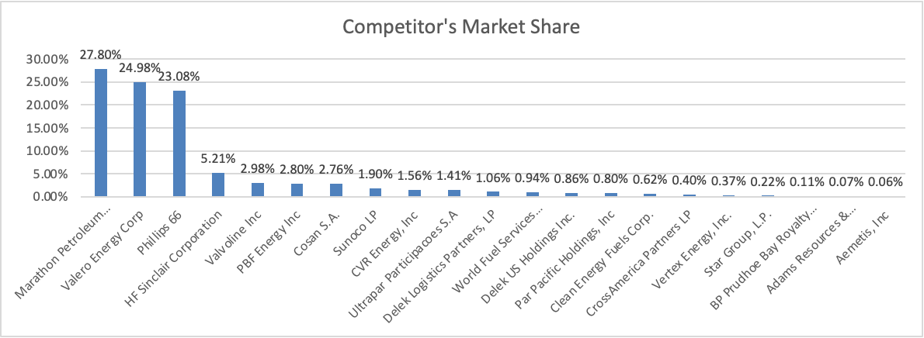
Industry Analysis
In 2022 The Oil & Gas industry witnessed:
Profitability Surged
Demand Tumbled
Margins Diverged
O&G executives view refinery modification for low-emission fuels, such as renewable diesel and hydrogen, as crucial to maintaining growth over the next few years.
However, switching to renewable fuels could be challenging.
O&G M&A was off to a strong start in early 2022. In the first nine months of 2022, O&G M&A fell by about 27% year over year
In 2023 The Oil & Gas industry is expected to have:
Certified natural gas and lower-carbon LNG to increase
Weakening demand
Recession worries
1.6 mbpd increase in global refining capacity

Slide 8
Industry Analysis
Porter's Five Forces Analysis
Threat Of New entrants
Low
Bargaining Power of Suppliers
Low
Rivalry Among Existing Firms
High
Bargaining Power of Buyers
Low
Threat of Substitute Products or Services
Moderate to High

Slide 9
Financial Analysis

Slide 10
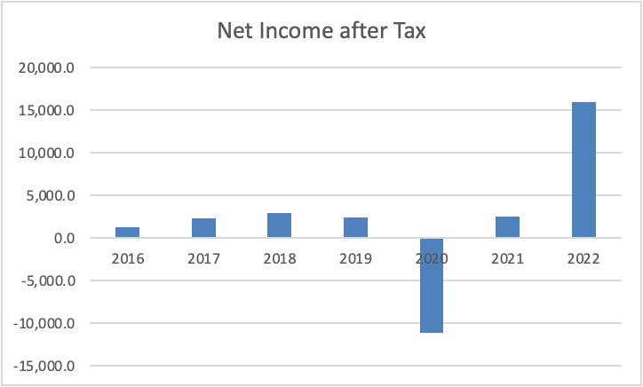
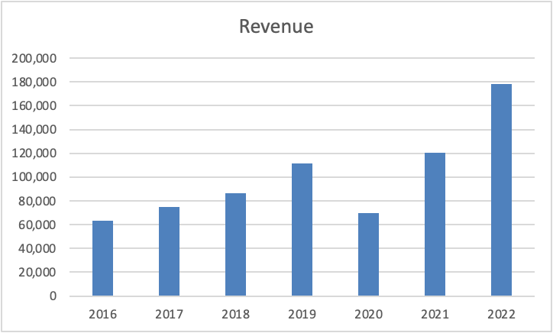
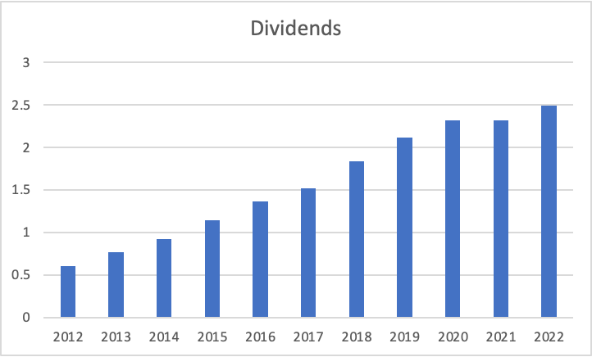
Net Income, Revenue, and Dividends
*Values in millions*
*Values in millions*
Notes:
Explain 2020 crash

Slide 11
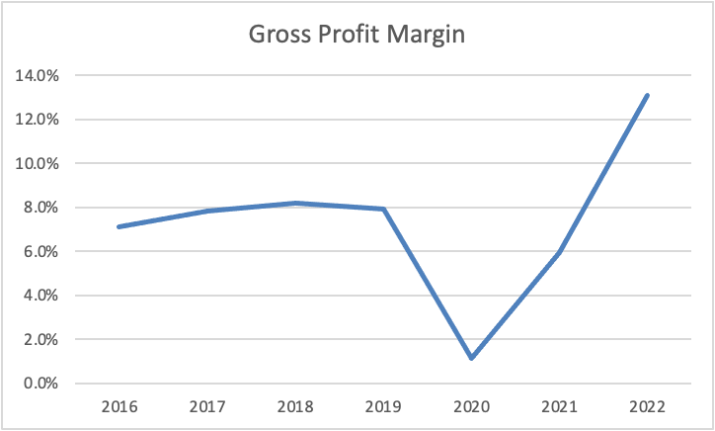
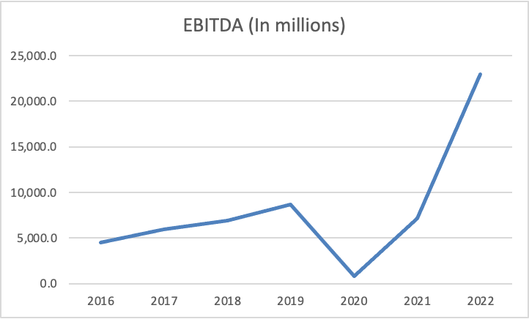
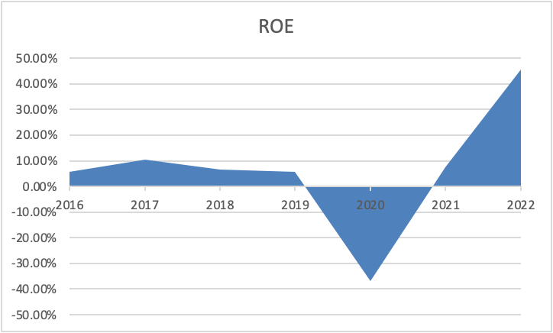
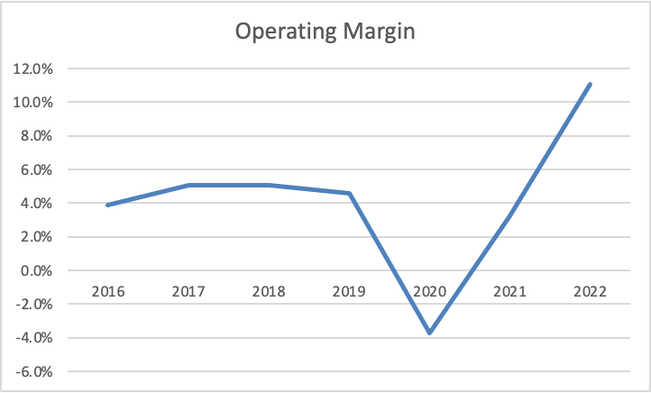
Profitability Ratios

Slide 12
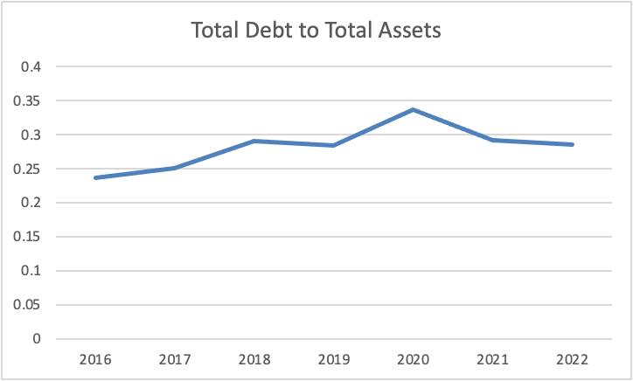
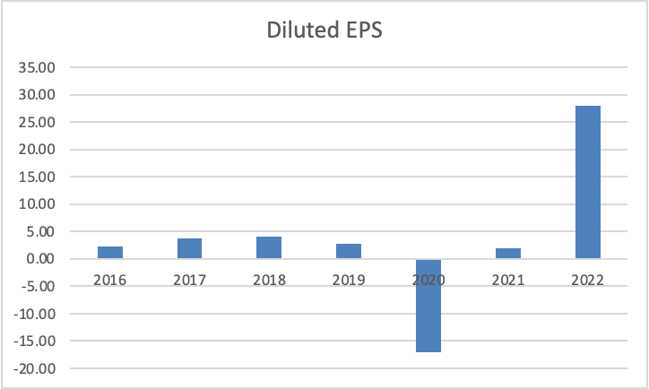
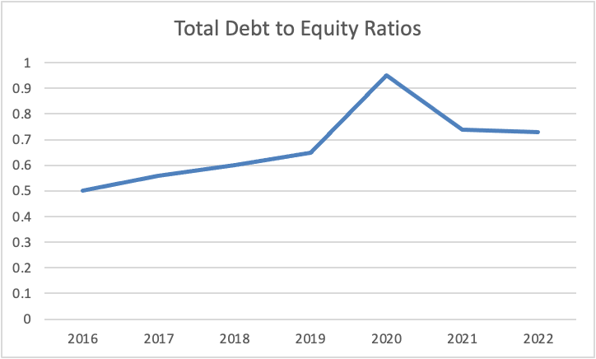
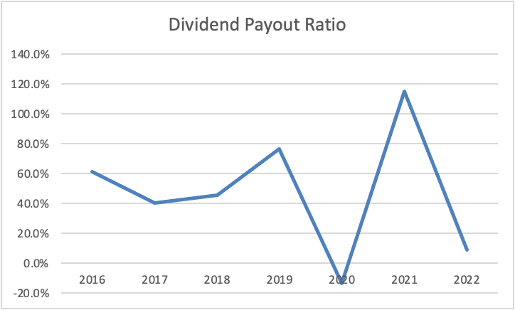
Leverage and Financial Strength
Notes:
2020 was a challenging year for the refining industry due to lower demand for fuel and falling profit margins.Explain 2020 Dividend Payout Ratio % and why its fallen like more money in operating expense compared to last year.
Higher diluted EPS figures should obtain higher valuations from the market with investors more willing to pay a premium for each share of equity.
Low Total Debt to Total Assets makes investors feel comfortable

Slide 13
Valuations

Slide 14
Dividend Discount Model
Case 1
RESULTS
Two Stage Growth Model
Stage 1 Growth Rate | 15.29%
Number of Years in Stage 1 | 10
Stage 2 Growth Rate | 7.00%
Number of Years in Stage 2
Stage 3 Growth Rate
Growth Path | Constant
Cost of Equity Capital | 11.12%
Dividends per share, LTM | $2.49
 | k / terminal g | 5.50% | 6.00% | 6.50% | 7.00% | 7.50% | 8.00% | 8.50%
 | 9.62% | $138.78 | $153.94 | $173.94 | $201.59 | $242.27 | $308.07 | $432.62
 | 10.12% | $122.29 | $133.69 | $148.23 | $167.43 | $193.97 | $233.02 | $296.18
 | 10.62% | $109.06 | $117.87 | $128.81 | $142.77 | $161.21 | $186.68 | $224.18
 | 11.12% | $98.23 | $105.18 | $113.63 | $124.14 | $137.54 | $155.25 | $179.71
 | 11.62% | $89.20 | $94.78 | $101.45 | $109.57 | $119.66 | $132.54 | $149.54
 | 12.12% | $81.56 | $86.12 | $91.48 | $97.89 | $105.69 | $115.38 | $127.75
 | 12.62% | $75.03 | $78.79 | $83.16 | $88.31 | $94.47 | $101.97 | $111.28
Average | $144.20

Slide 15
Free Cash Flow to Equity Model
Case 1
RESULTS
Three Stage Growth Model
Stage 1 Growth Rate | -8.00%
Number of Years in Stage 1 | 5
Stage 2 Growth Rate | -3.00%
Number of Years in Stage 2 | 5
Stage 3 Growth Rate | 2.00%
Growth Path | Linear
Cost of Equity Capital | 11.12%
Free Cash Flow to Equity, LTM | $14,127.18
 | k / terminal g | 0.50% | 1.00% | 1.50% | 2.00% | 2.50% | 3.00% | 3.50%
 | 9.62% | $251.07 | $257.23 | $264.15 | $271.97 | $280.90 | $291.17 | $303.12
 | 10.12% | $238.81 | $244.11 | $250.02 | $256.66 | $264.17 | $272.74 | $282.60
 | 10.62% | $227.75 | $232.34 | $237.42 | $243.10 | $249.47 | $256.68 | $264.91
 | 11.12% | $217.72 | $221.71 | $226.11 | $230.99 | $236.44 | $242.56 | $249.48
 | 11.62% | $208.57 | $212.06 | $215.89 | $220.11 | $224.80 | $230.04 | $235.91
 | 12.12% | $200.20 | $203.26 | $206.61 | $210.29 | $214.35 | $218.85 | $223.88
 | 12.62% | $192.51 | $195.21 | $198.14 | $201.36 | $204.89 | $208.79 | $213.12
Average | $234.78
Net new debt ($ millions) | $1,161.00
Interest on debt ($ millions) | $1,195.00
Shares Outstanding (millions) | 445
Corporate tax rate (%) | 21.94%
Case 2
RESULTS
Three Stage Growth Model
Stage 1 Growth Rate | -8.00%
Number of Years in Stage 1 | 5
Stage 2 Growth Rate | -6.00%
Number of Years in Stage 2 | 5
Stage 3 Growth Rate | 0.00%
Growth Path | Linear
Cost of Equity Capital | 11.12%
Free Cash Flow to Equity, LTM | $14,127.18
 | k / terminal g | -1.50% | -1.00% | -0.50% | 0.00% | 0.50% | 1.00% | 1.50%
 | 9.62% | $208.79 | $212.15 | $215.85 | $219.93 | $224.47 | $229.52 | $235.20
 | 10.12% | $200.49 | $203.44 | $206.68 | $210.23 | $214.15 | $218.50 | $223.35
 | 10.62% | $192.87 | $195.47 | $198.30 | $201.41 | $204.81 | $208.58 | $212.75
 | 11.12% | $185.83 | $188.13 | $190.63 | $193.35 | $196.33 | $199.60 | $203.22
 | 11.62% | $179.32 | $181.36 | $183.57 | $185.97 | $188.58 | $191.44 | $194.59
 | 12.12% | $173.27 | $175.09 | $177.05 | $179.17 | $181.48 | $183.99 | $186.74
 | 12.62% | $167.65 | $169.27 | $171.01 | $172.90 | $174.93 | $177.15 | $179.56
Average | $195.27
Net new debt ($ millions) | $1,161.00
Interest on debt ($ millions) | $1,195.00
Shares Outstanding (millions) | 445
Corporate tax rate (%) | 21.94%

Slide 16
Comparable Company Analysis
Company Name | P/Sales | P/FCF | P/E | P/CF Per Share | P/B per share
Marathon Petroleum Corp | 0.31 | 3.64 | 4.45 | 3.45 | 2.07
Valero Energy Corp | 0.28 | 4.51 | 4.64 | 3.99 | 2.13
Phillips 66 | 0.27 | 5.32 | 4.52 | 4.45 | 1.64
PBF Energy Inc | 0.12 | 2.31 | 1.98 | 1.21 | 1.18
Chevron Corp | 1.26 | 10.71 | 8.92 | 6.26 | 1.96
Exxon Mobil Corp | 1.09 | 10.31 | 8.33 | 5.86 | 2.31
Hess Corp | 3.68 | 44.29 | 20.52 | 10.78 | 5.41
Marathon Oil Corp | 2.02 | 4.4 | 4.98 | 3 | 1.43
Mean | 0.604 | 4.135 | 6.278 | 4.712 | 1.775
Bold: Not included in mean
Notes:
Lower P/Sales good
Lower P/FCF good
Lower P/E good
Lower P/CF good
Lower P/B is good higher might mean over valued

Slide 17
Investment Risks

Slide 18
Investment Risks
Key Risks Include:
Volatile Refining Margins
Significant Debt Obligations
Legal and Regulatory Risks
Recession and Inflation
Speedway Sale

Slide 19
Investment Thesis
Current Price: $126.5
Target Price: $179.62
Key Drivers
•Upside: ~ 42%
Dividend Discount Model:
Case 1: 50%
Consistent 10-year growth of Dividends.
Biggest Market Share in a industry with High Barriers of entry.
$72.10
Profitability Ratios and Revenue have grown significantly in last 2 years.
Free Cash Flow to Equity:
Case 1: 25%
Case 2: 25%
$107.52

