Slide 1
My Academic Internship Experience
Ethan Schneider

Slide 2
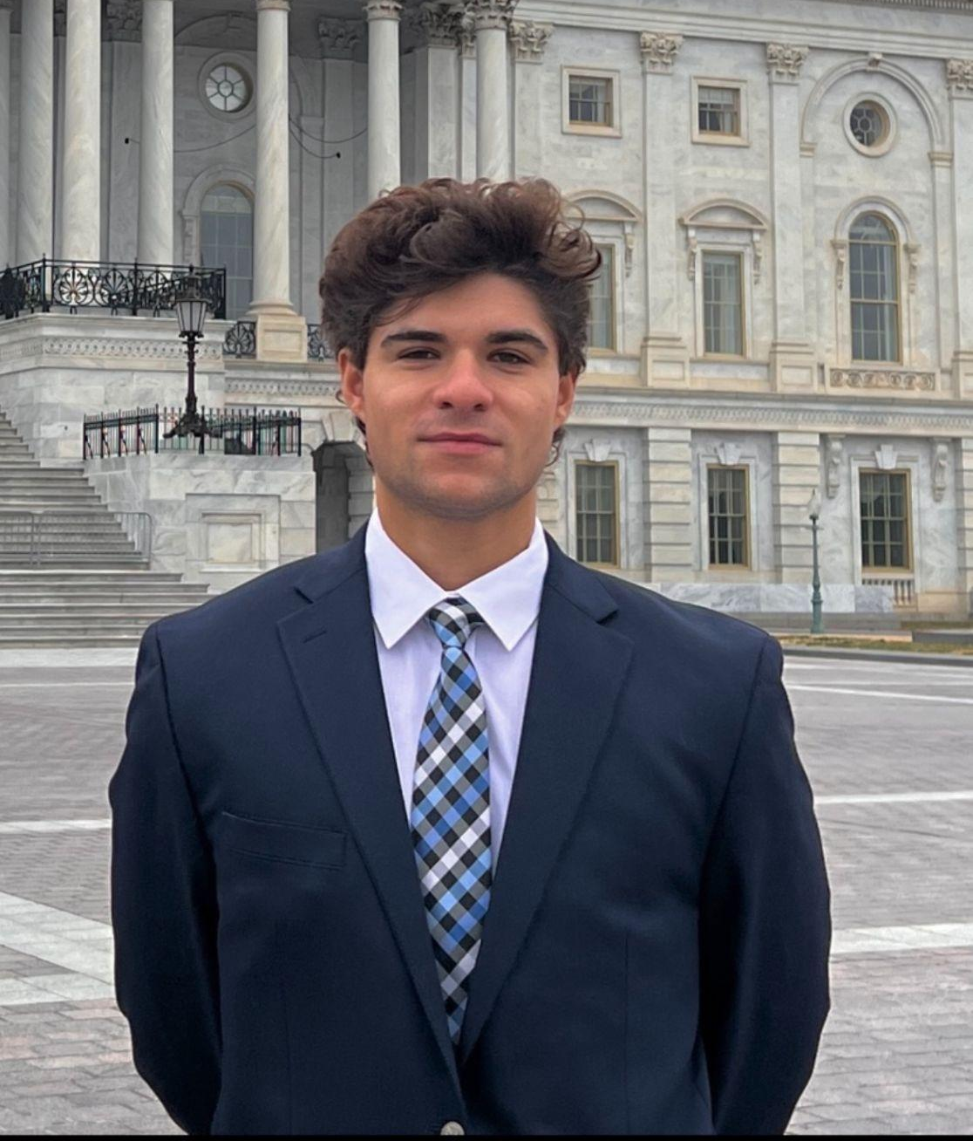
About Me:
I am an undergraduate Senior at Loyola in pursuit of a B.A. in Global Studies and a minor in Arabic Language & Culture. I hold a strong passion about international relations, particularly in the Middle East, as well as for exploring the nuances of different global cultures and languages.

Slide 3
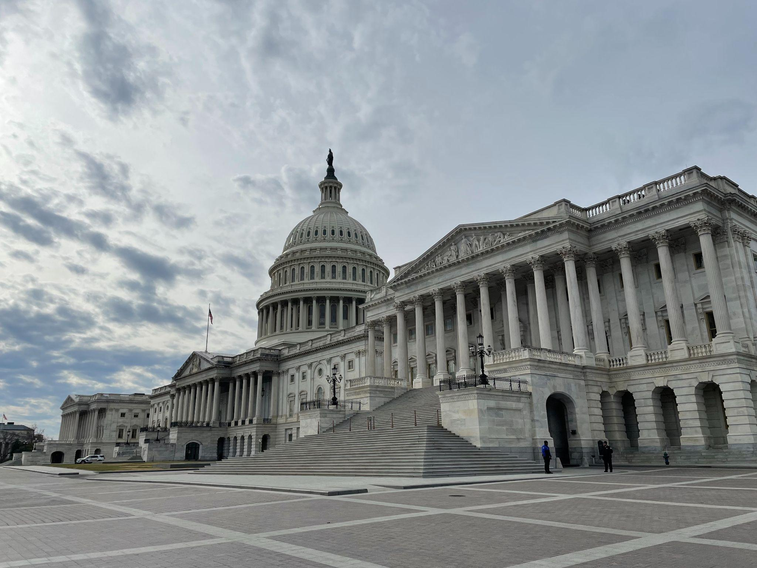
Spring 2023:
This is my final semester at Loyola, and I am currently enrolled in the Washington, D.C. Internship Program. As I finish my remaining classes, I am working full time as an advocacy intern for Churches for Middle East Peace (CMEP).

Slide 4
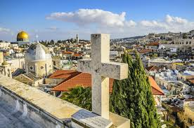
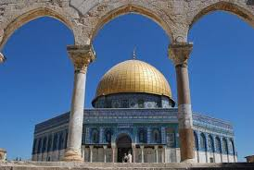
Who is CMEP?
CMEP is a 501(c)(3) non-profit organization based in Washington, D.C. working to encourage U.S. policies that actively promote just, lasting and comprehensive resolutions to conflicts in the Middle East, with a strong focus on the Israeli-Palestine conflict. CMEP is supported by a diverse array of Christian denominations, organizations, and individuals who work together through grassroots advocacy. We are committed to educating the public on the complexities of the conflict and advocating for policies that advance peace and justice. CMEP also works to protect and promote religious freedom for all people in the Middle East.

Slide 5
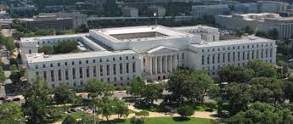
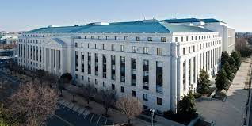
My Work as an Advocacy Intern
Although I technically don't work “on the hill” like many of my fellow Loyola interns/classmates, CMEP’s office is located right across the street from both the Supreme Court and the Capitol Building. Through CMEP’s engagement with U.S. foreign policy in the Middle East, I have participated in advocacy days on the hill with my coworkers and CMEP coalition partners. During these advocacy days, us and our partners meet with the offices of congressmen and congresswomen to discuss legislation that outlines how the U.S. is involved in different Middle Eastern countries. So, yes, I do not work “on the hill” but it is organizations like mine that I often hear my classmates discussing as they tell stories of people who visit their congressional offices! My work with CMEP has been truly fulfilling, especially through my participation in events like these.
Rayburn House Office Building
Dirksen Senate Office Building

