Slide 1
Analysis of the Babies Antibiotic Stewardship Improvement Collaborative (BASIC) Initiative Launched by ILPQC
By: Faiza Sheikha

Slide 2
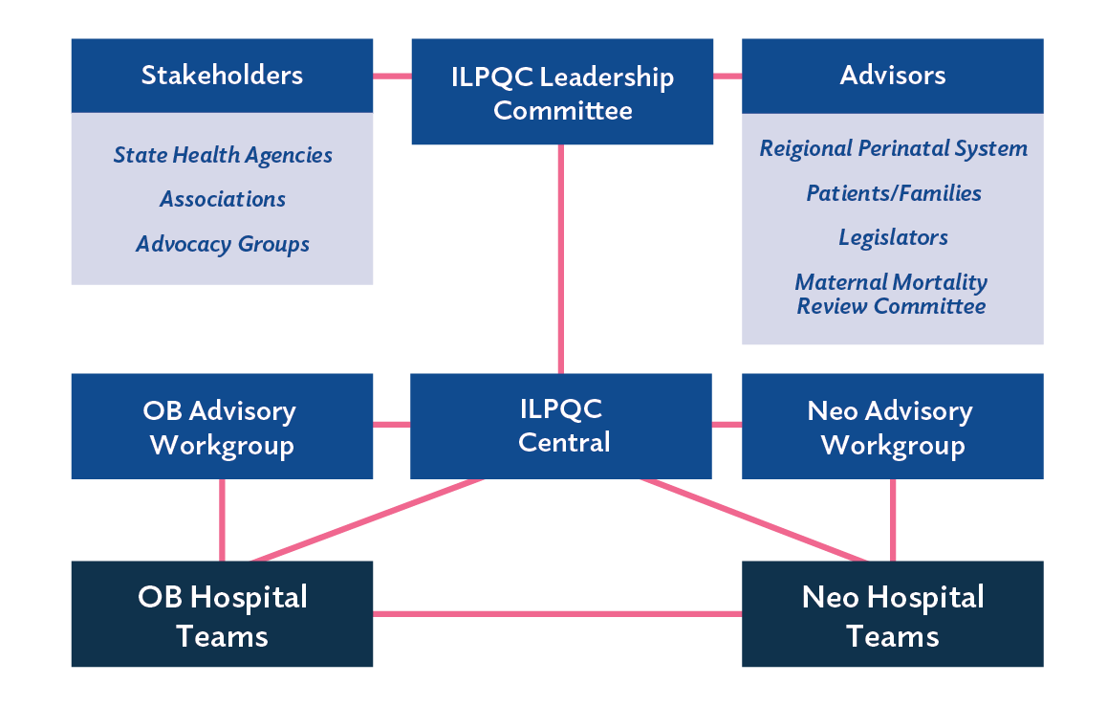
BACKGROUND
ILPQC
Statewide network composed of:
Hospital teams
Perinatal clinicians
Patients
Public health leaders
Policymakers
Goal:
To improve obstetric and neonatal care by reducing maternal and infant morbidity and mortality.
Collaborating with 91 Illinois hospitals participating in 1 or more initiative
Supporting participating hospitals’ implementation of evidenced-based practices using quality improvement science
Organizational Chart
-Executive Director, OB Clinical Lead
-Neonatal Clinical Co-Leads
-State Project Director, Quality Lead
-Project Coordinators
-Nurse Quality Manager
-Director of Data and Operations
-PostDoctoral Scholar
-Technical IT Consultant

Slide 3
Project Background
Antibiotics are essential in fighting infections in newborns. Variations in antibiotic prescribing for newborn infections can lead to:
Antibiotic resistance making it more difficult to treat bacterial infections
Mother-baby separation that can reduce breastfeeding and increase formula supplementation
Chronic conditions, including asthma, allergies, and obesity
Babies Antibiotic Stewardship Improvement Collaborative (BASIC) initiative
Provide appropriate antibiotics, to appropriate newborns, for the appropriate length of time.
Decrease by 20% the number of newborns, born at ≥35 weeks who receive antibiotics
Decrease by 20% the number of newborns with a negative blood culture who receive antibiotics for longer than 36 hours

Slide 4
OBJECTIVES
Is there a clinical improvement among various hospital metrics for newborns, born at ≥35 weeks who receive antibiotics as a result of the BASIC Initiative for Q3 and Q4 of 2022?

Slide 5
Methodology
Analyze hospital characteristics (urbanization, black.hispanic/other patient population, and medicaid patient population) for hospitals who have implemented BASIC and have been successful in stopping 80% or more of the antibiotics delivered to newborns born at ≥35 weeks with a negative blood culture, within 48 hours or less.
Data includes 43 hospitals within Illinois analyzed who have implemented BASIC Initiative, with records of Q1, Q3, and Q4 data.
Data gathered from RedCap, a browser-based, software and workflow methodology for designing clinical and translational research databases
Data coded to match with existing hospital characteristics using data dictionary

Slide 6
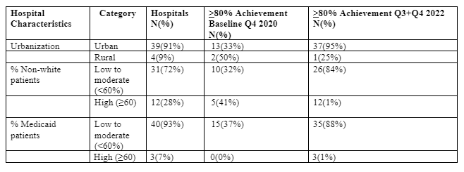
Results
Achievement of the number of newborns, born at ≥35 weeks with a negative blood culture who receive antibiotics for no longer than 48 hours.

Slide 7
DISCUSSION
Review of data

Slide 8
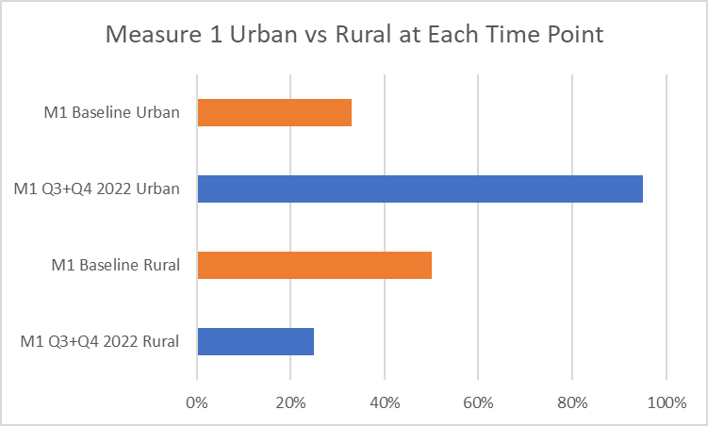
62% increase in Urban hospitals achieving the goal of stopping 80% of antibiotics administered before 48 hours
Decrease in achievement of this goal within rural hospitals by 25%
33%
95%
50%
25%

Slide 9
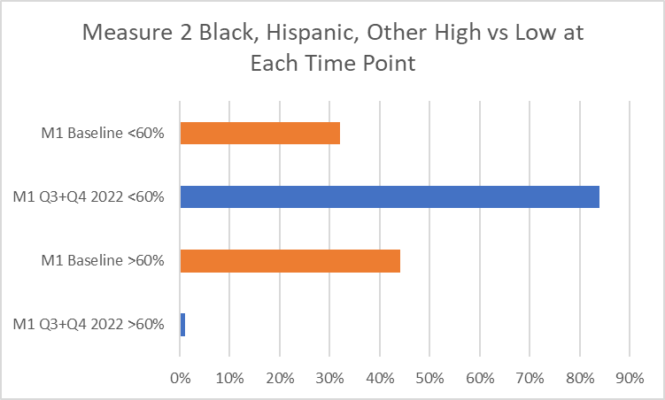
52% improvement in hospitals that
serve <60% of black/Hispanic Patients
40% decrease in hospitals that serve >60% of black/Hispanic patients.
32%
84%
41%
1%

Slide 10
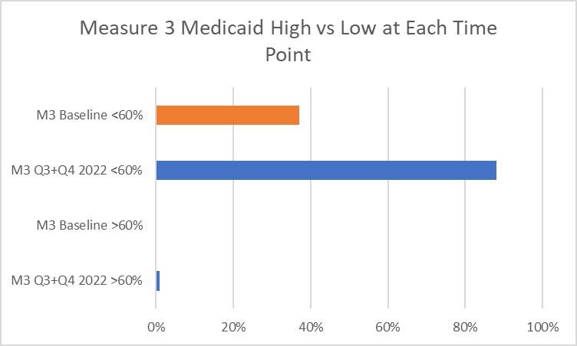
Shows that the hospitals with <60% of Medicaid patients grew
51% between the two-time points and hospitals with >60% of Medicaid patients improved by 1% in
between these two time periods.
37%
88%
0%
1%

Slide 11
Conclusion
Next steps:
Further investigate drop in rural percentage for achievement of the BASIC goal
Further investigate discrepancy in achievement of the BASIC goal for hospitals with a higher percentage of black, hispanic, and other patients
Find cause of hospitals with more medicaid patients decreasing in terms of improvement for the BASIC goal
High improvement in stopping antibiotics delivered within 48 hours for the following:
-Urban hospitals
-Hospitals with less than 60% medicaid patients
-Hospitals with less than 60% black/hispanic/other patients stopping antibiotics delivered within 80%

Slide 12
Thank you

