Slide 1
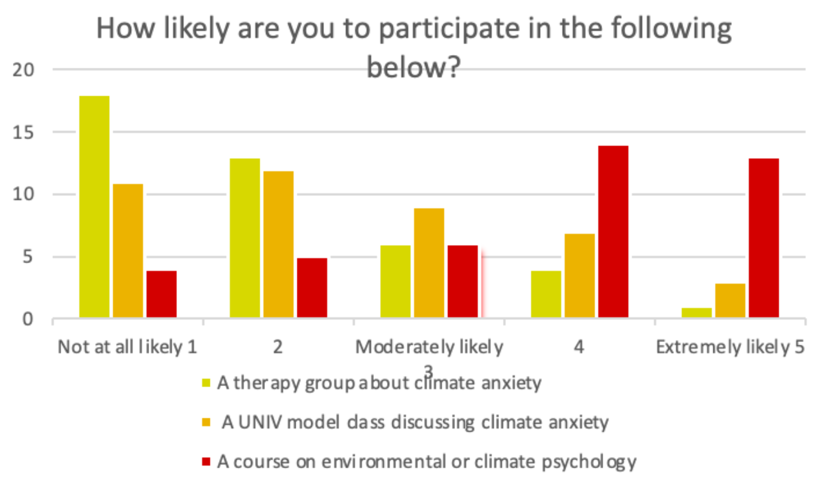
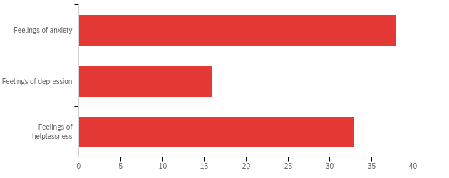
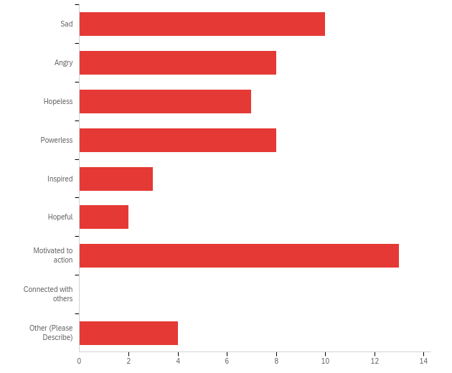
Increasing Awareness and Support for Climate
Anxiety and Environmental Racism On-Campus
I
Hanan Abdillahi, Stephanie Black, Selena Lynch, Valeria Monreal, Hunter Robbins
Mentor: Dr. Tania Schusler
Loyola University STEP Climate Action
Abstract
Results
Discourse on climate anxiety and environmental racism has been growing. Minorities are disproportionately affected by climate change, and we recognize the impacts that climate anxiety has on these populations. Our mission is to ensure every Loyola student feels supported in the advent of the climate crisis. We advanced this mission by inventorying resources at Loyola, building community engagement with these topics through surveys and interviews, and offering recommendations to faculty, staff, and administrators for how they can better support students. We hope to persuade Loyola to offer more information and expand resources for climate anxiety and environmental racism.
Have you experienced any of the conditions below due to climate change?
Introduction
Climate anxiety and environmental racism has increasingly become a priority as the climate crisis captures the world's attention (Browne, 2022). Climate anxiety is derived from observing the “seemingly irrevocable impact of climate change and the associated concern for one’s future and that of the next generations'' (Iberdrola, 2021). Climate change affects mental health “directly through experiences of environmental traumas or indirectly through experiences of anxiety about the future” (Ágoston C, et al, 2022). Those experiencing climate anxiety feel immense guilt for the impact they have on the environment, a burden that grows heavier as the planet dives into further disarray. The internalization of environmental problems has many psychological consequences, ranging from mild to serious cases of stress, panic attacks, sleeplessness, depression, and hopelessness (Dodds J, 2021). As climate anxiety rises among youth, we must ensure that support exists for them.
Minority groups are disproportionately affected by climate change “due to disparities in infrastructure and health resources'' (Dodds J, 2021). According to Green Action, environmental racism “refers to the institutional regulations, policies, or corporate decisions that deliberately target certain communities for locally undesirable land uses and lax enforcement of zoning, resulting in communities being disproportionately exposed to toxic and hazardous waste based upon race” (Environmental Justice & Environmental Racism, n.d.). We must raise awareness to the impacts of environmental racism and better support students affected by this issue. It is also important to explore the impacts that climate anxiety has on these populations, as they feel the existential threat of climate change the most.
Figure 3. Students responding to the survey expressed greatest interest in a course on environmental or climate psychology (N = 52).
Figure 1. Students responding to the survey reported experiencing symptoms of climate anxiety (N =87)
Reflecting on courses at Loyola regarding climate change, which emotions best describe how you felt after the course?
Discussion
Our accomplishments include receiving perspectives from different faculty and staff throughout Loyola and conducting a survey that assesses student's feelings and general knowledge towards the concept of climate anxiety and environmental racism. Based on our results, we determined that students, faculty, and staff are experiencing emotions related to climate anxiety. We also identified solutions to address those concerns.
Students, faculty, and staff have a general agreement that climate anxiety should be explored further, and Loyola should offer more resources related to this subject.
From the survey data, students expressed greatest interest in involvement in an environmental or climate psychology course. Cornell University is one of the only schools in the United States that offers a class on environmental psychology (Cornell SCE, n.d). Loyola could offer a course on environmental psychology as well, with a special focus on climate anxiety.
Recurring dialogue should occur among LUC students, faculty, and staff that allows them to engage deeper with the causes and effects of climate anxiety and/or environmental racism.
Image Source: Today.com
Methods
We researched climate anxiety and environmental racism to provide context.
We researched what other schools (nationally and internationally) are doing to support their students through climate anxiety and environmental racism.
We inventoried the resources available at Loyola to support students through climate anxiety and environmental racism.
We created a survey to gauge how students feel about the two topics and their knowledge on the current initiatives at Loyola. This survey was distributed and completed by students in ENVS 101 and 137.
We interviewed five faculty and staff from different departments to address the cross-sectionality of climate anxiety and environmental racism (Psychology, School of Environmental Sustainability, Wellness Center, Political Science).
All of the above deliverables will culminate in a proposal for Dr. Keith Champagne, Vice President for Student Development & Dr. Will Rodriguez, Assistant Vice President and Dean of Students.
Figure 2. Students responding to the survey experienced varied emotions after learning about climate change in a course (N = 55).
References
50.91% of students surveyed were not aware of Loyola's Climate Action plan.
For students who were asked if Loyola was adequately addressing climate change, 3 said not at all, 39 said somewhat, and 13 said yes very well.
Survey limitations:
We only surveyed students in ENVS 101 and 237.
Some students started but did not finish the survey.
Our sample could be expanded to gain perspectives across the student body.
Ágoston, C., Csaba, B., Nagy, B., Kőváry, Z., Dúll, A., Rácz, J., & Demetrovics, Z. (2022). Identifying Types of Eco-Anxiety, Eco-Guilt, Eco-Grief, and Eco-Coping in a Climate-Sensitive Population: A Qualitative Study. International journal of environmental research and public health, 19(4), 2461. https://doi.org/10.3390/ijerph19042461.
Browne, A. (2022, October 25). What is climate anxiety? Earth.Org. Retrieved January 29, 2023, from https://earth.org/what-is-climate-anxiety/
Cornell SCE. (n.d.). Psych 1500 introduction to environmental psychology. https://sce.cornell.edu/courses/roster/psych-1500
Dodds J. (2021). The psychology of climate anxiety. BJPsych bulletin, 45(4), 222–226. https://doi.org/10.1192/bjb.2021.18
Environmental Justice & Environmental racism. Greenaction for Health and Environmental Justice. (n.d.). Retrieved February 22, 2023, from https://greenaction.org/what-is-environmental-justice/.
Iberdrola. (2021, April 22). Eco-anxiety: the psychological aftermath of the climate crisis. Iberdrola. Retrieved January 29, 2023, from https://www.iberdrola.com/social-commitment/what-is-ecoanxiety.
TodayShow. (2021, September 20). Climate anxiety is real. how to cope when it feels like the world is burning. TODAY.com. Retrieved April 13, 2023, from https://www.today.com/tmrw/climate-anxiety-real-how-cope-when-it-feels-world-burning-t231370

