Slide 1
ISKCON Hinduism
Where?
The International Society for Krishna Consciousness (ISKCON), otherwise known as the Hare Krishna movement. ISKCON belongs to a monotheistic tradition within the Vedic or Hindu culture.
Why?
Hinduism has always been an interesting topic to me. I have done research on their culture before and even have a tattoo of a Hindi Goddess. They looked like a welcoming place and I enjoyed sharing in their culture.
History?
Srila Prabhupada founded ISKCON in July of 1966. Philosophically it is based on the Sanskrit texts. Historic texts of the devotional bhakti yoga tradition, which teaches that the ultimate goal for all living beings is to reawaken their love for God, or Lord Krishna, the “all-attractive one”. They have Seven Purposes of ISKCON; the first being: To systematically propagate spiritual knowledge to society at large and to educate all peoples in the techniques of spiritual life in order to check the imbalance of values in life and to achieve real unity and peace in the world.

Slide 2
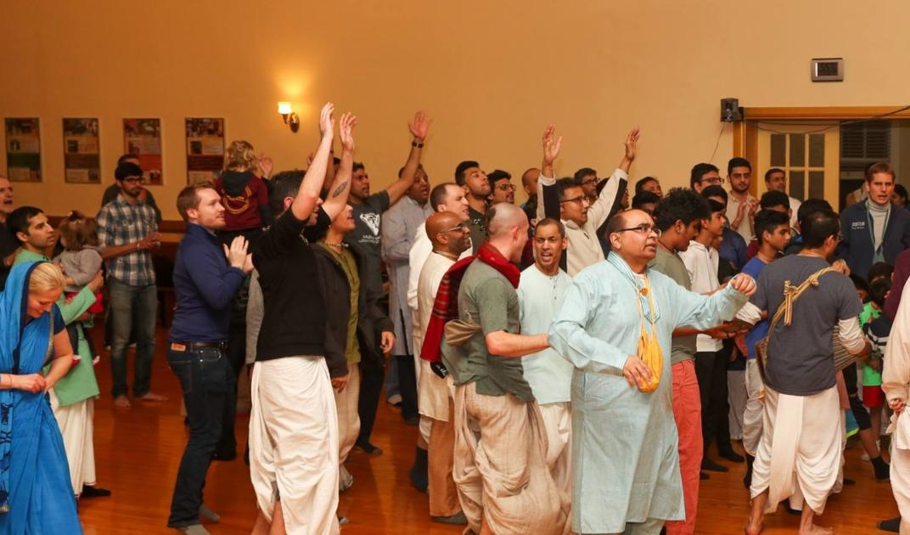
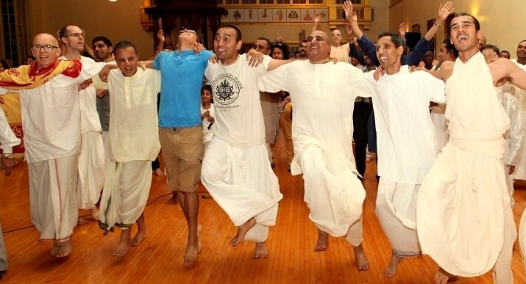
Ritual - Kirtan Traditionally, a Sikh Kirtan is a religious, aesthetic and social event, usually held in a congregational setting on Sundays or over certain festivals to honor the historical Gurus. Hundreds of people gather in a colorful and festive atmosphere to sing and dance in lively, soul-stirring musical meditation.
Interview
Q: What is the most significant factor of practicing Hinduism to you?
A: “To practice anything is to move from theory to application or from academics to actualization. Hinduism teaches, among other things, that life can be lived transcendentally so that we become masters of our lives rather than have our lives tossed hither and thither living a slavish life of material pursuits. Practicing Hinduism is therefore reconnecting ourselves to the natural harmony that is existence. This is the most significant factor in the practise of Hinduism.”

