Slide 1
The Art of Museum Studies:
The May Weber Ethnographic Study Collection
A brief introduction to what I do in the collection and how it has impacted me.

Slide 2
Background:
About the collection and its caretaker
In 2014, Loyola University established the May Weber Ethnographic Study Collection, which consists of about 3,000 objects.
Chicago-based psychiatrist, May Weber, exhibited the objects in the May Weber Museum of Cultural Arts, and Loyola exhibited them at the Loyola University Museum of Art.
The collection was gifted to the university upon Dr. Weber’s passing, and it is currently located on the fourth floor of Mundelein in room 419 and managed by the Department of Anthropology. Students and faculty are welcome to use the objects in the collection for research and teaching purposes.
It is currently under the care of Dr. Catherine Nichols.

Slide 3
What do I do?
Catalogue
Inventory
Archives
Record the object’s information.
Be skeptical of what you read.
Don’t be afraid to ask questions and do more research!
Make sure objects are in correct location.
If they have moved, write it down.
What should stay and what should go?
How do you make the decision?

Slide 4
What else?
Rehousing
Transcription
Make boxes for some of the objects.
How do you decide which objects need a box?
Textiles!!!
Original notes.
Interpret for readability.
More decisions!! How do you make them??

Slide 5
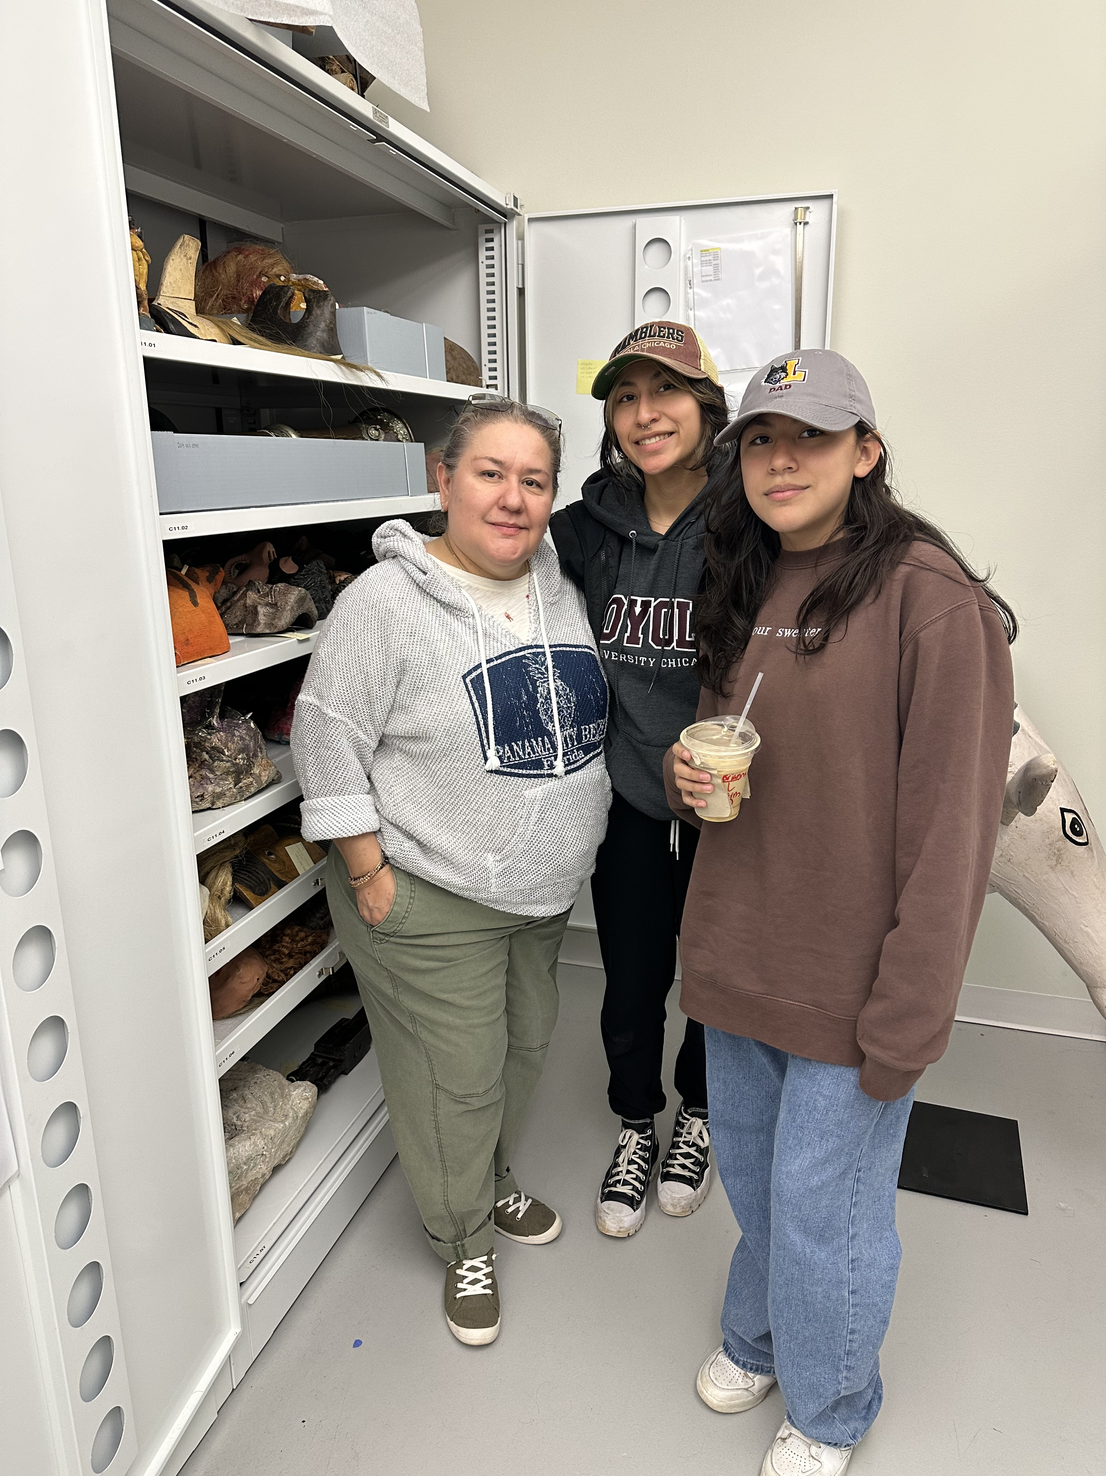
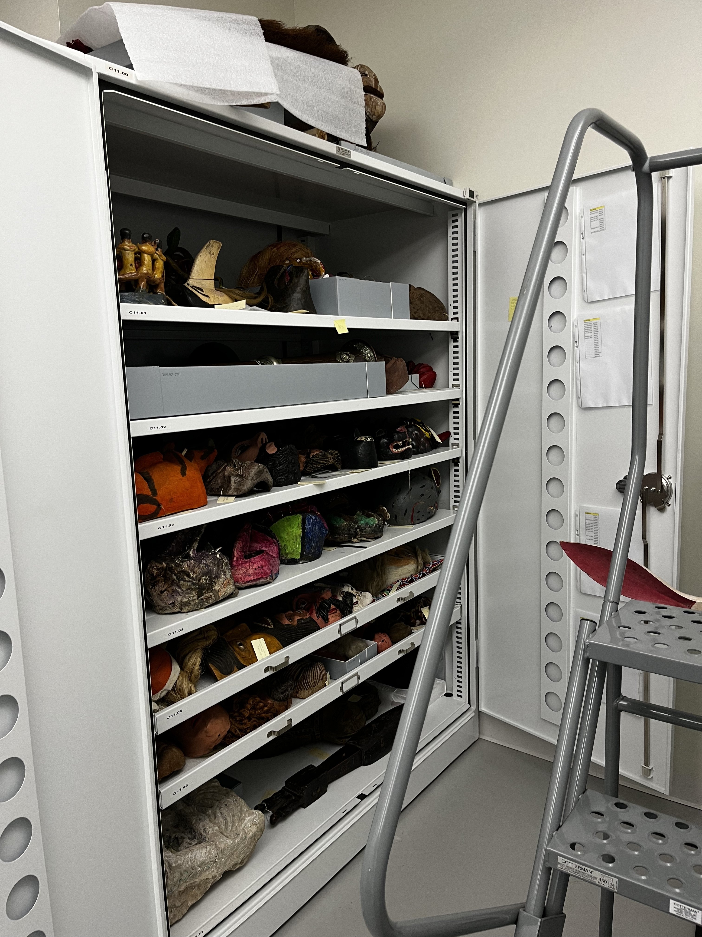
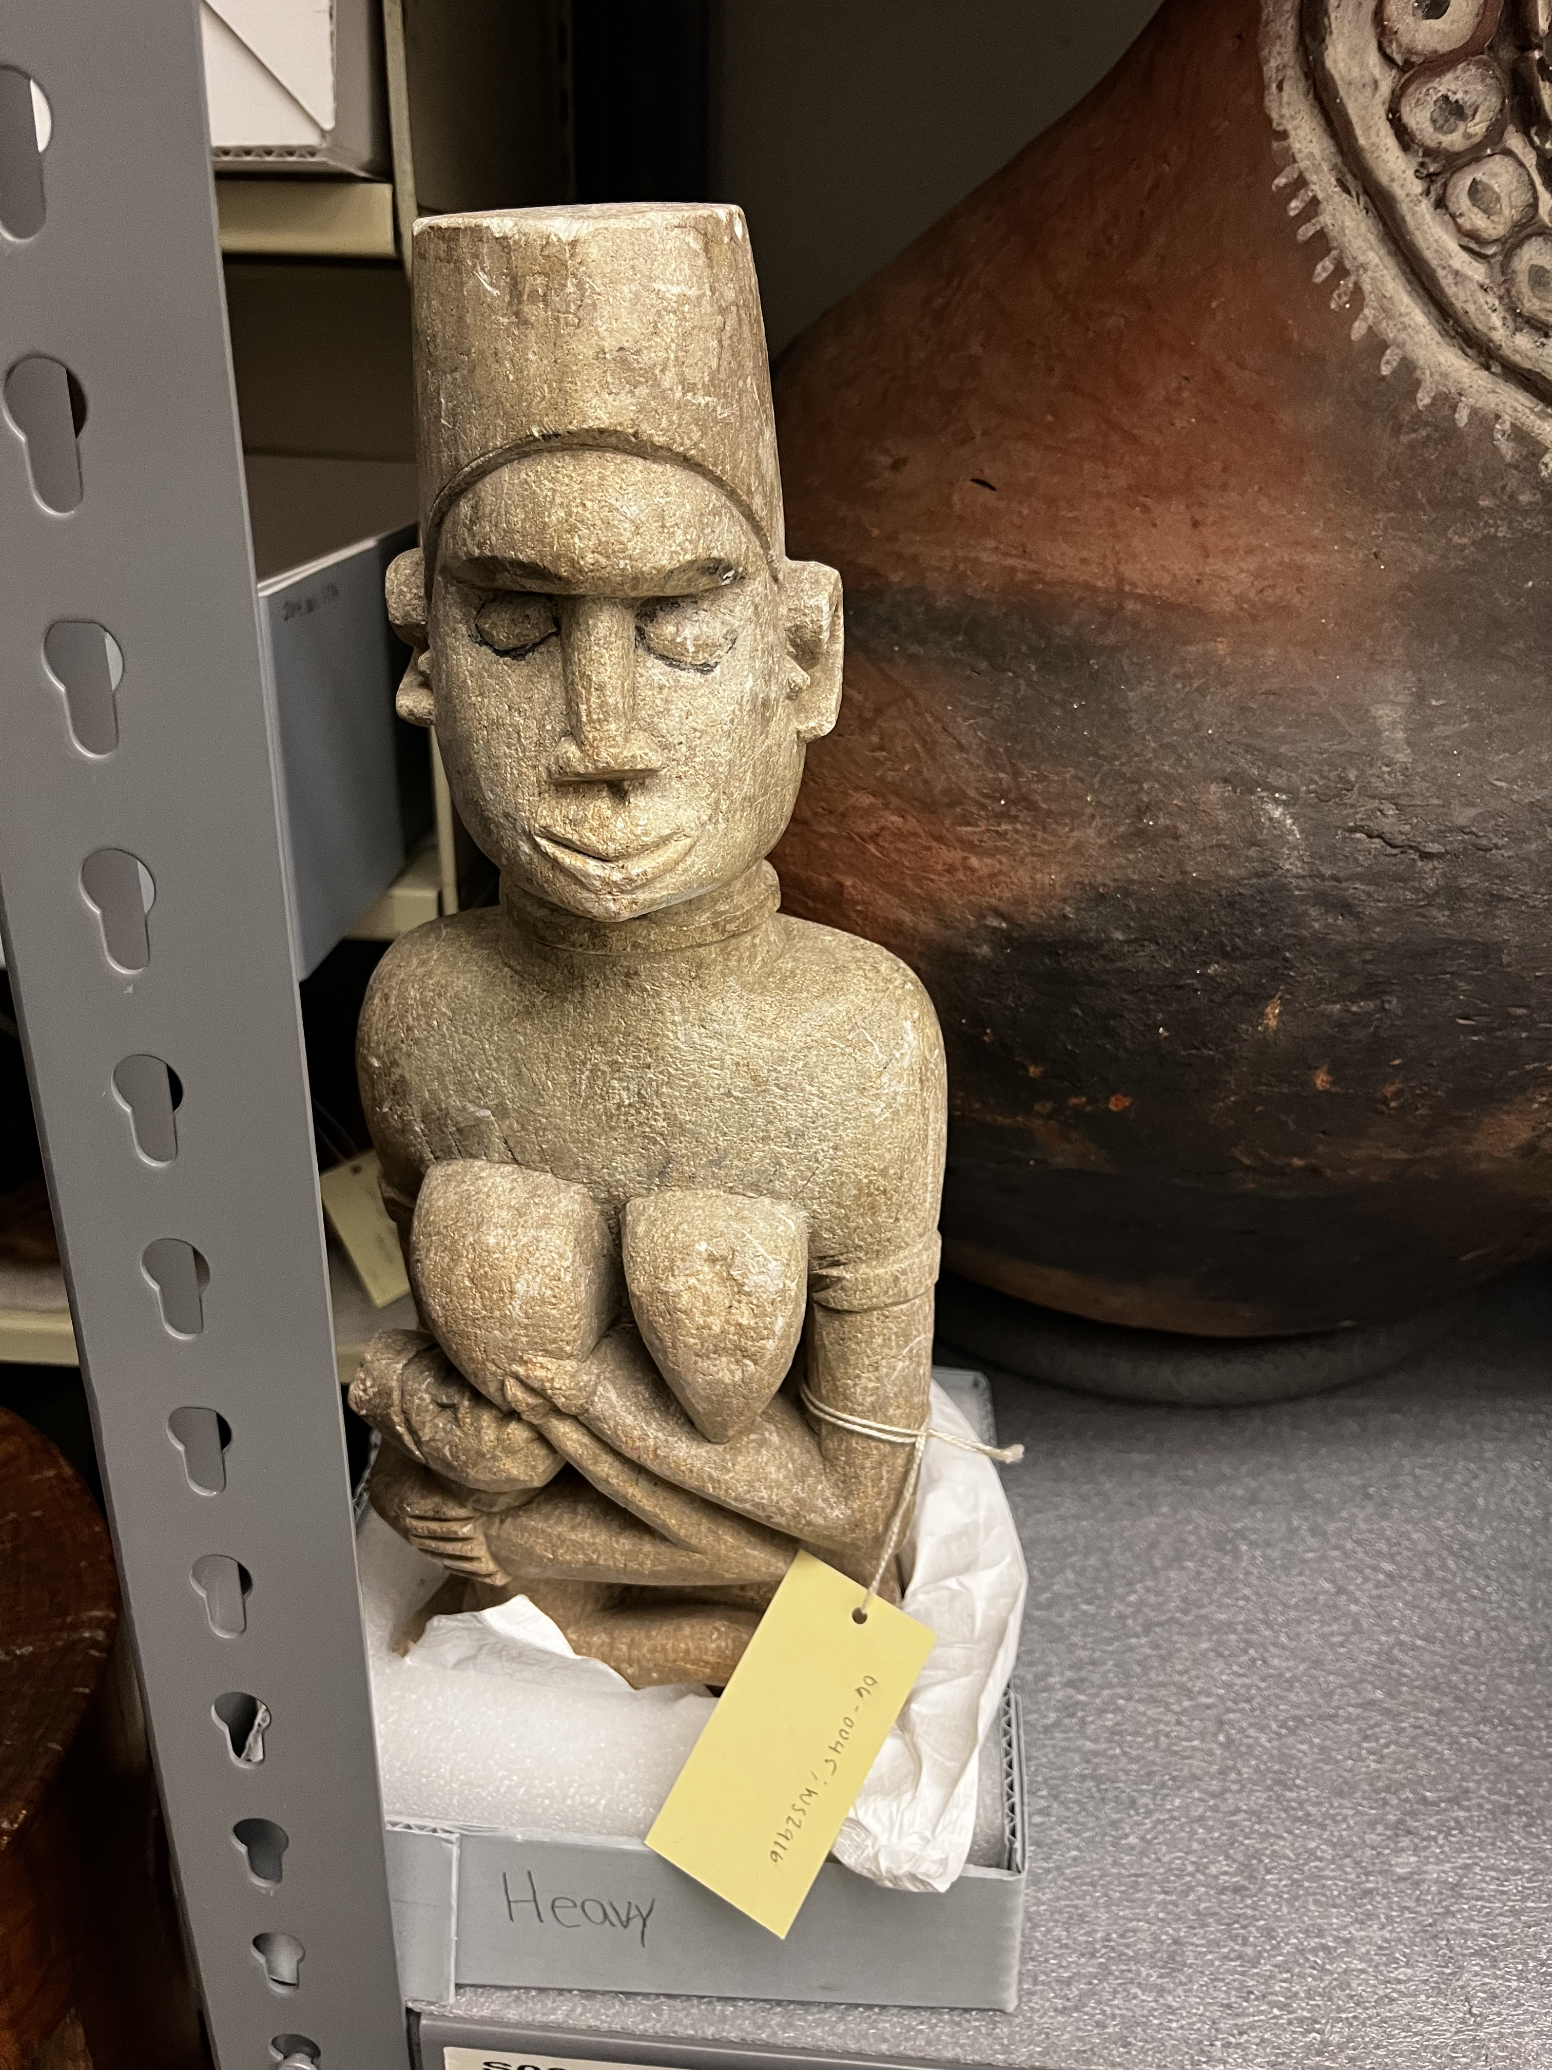
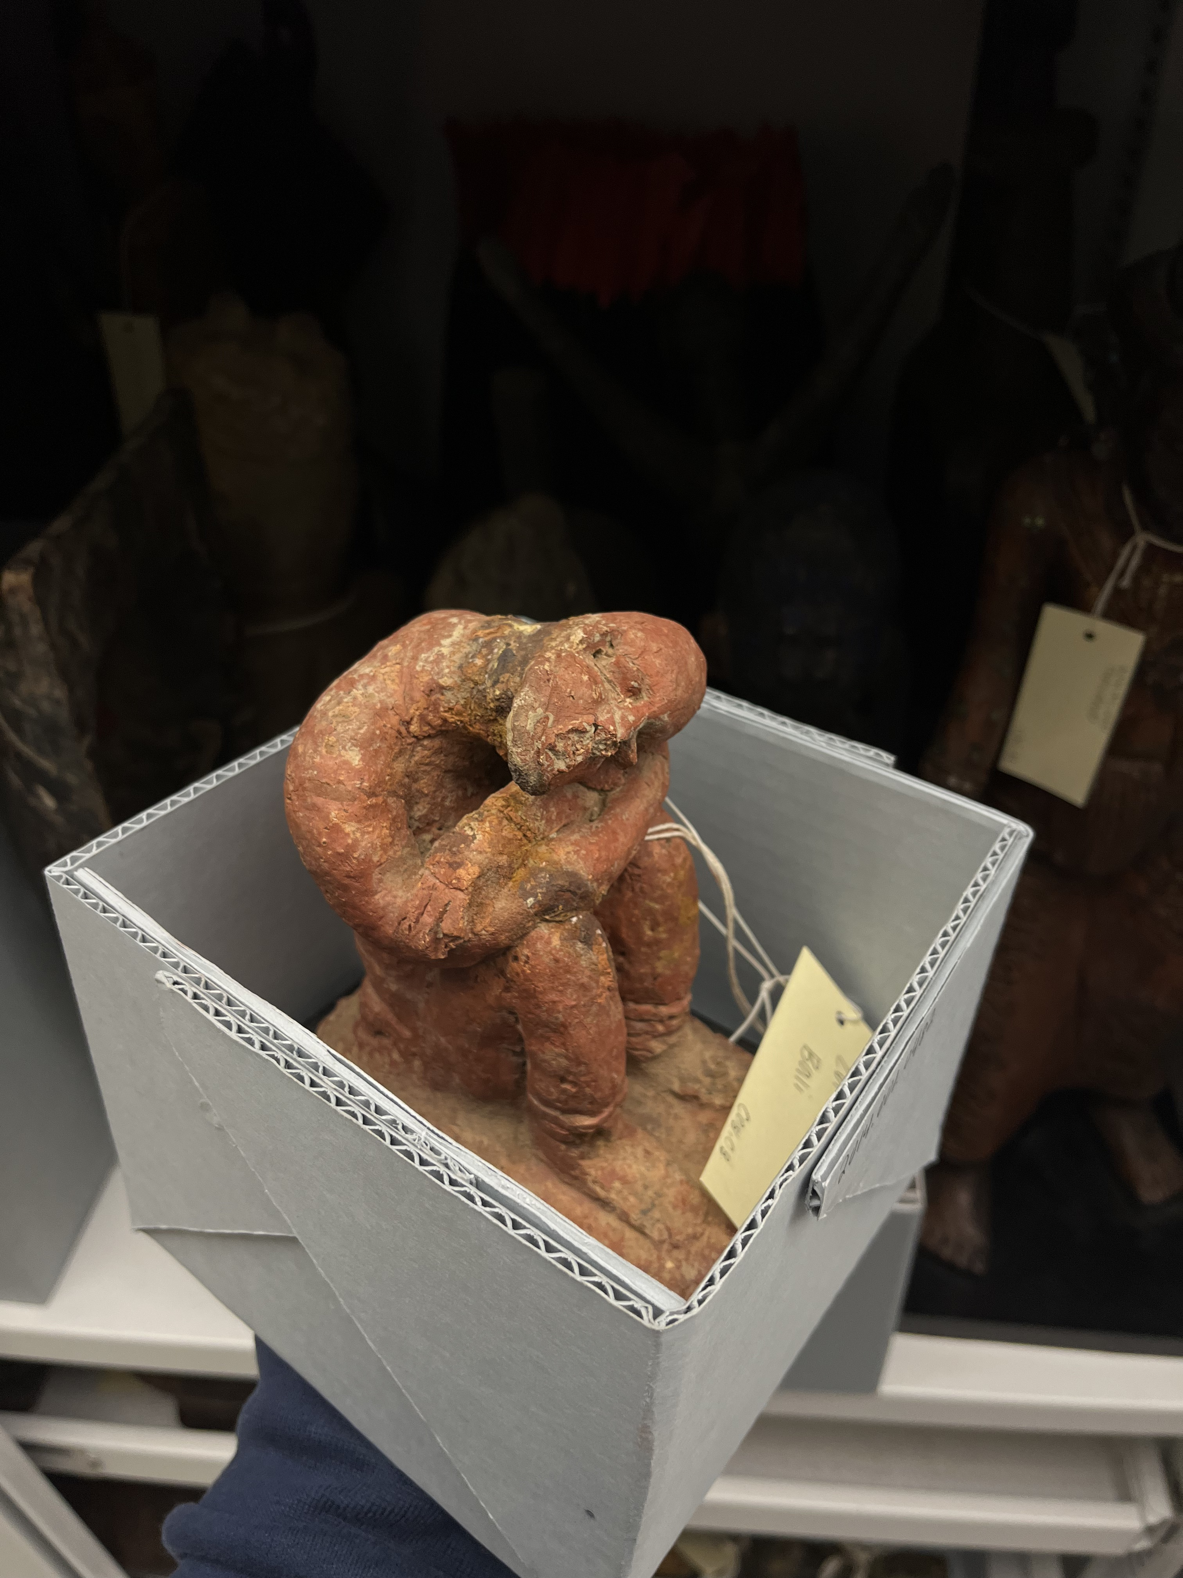
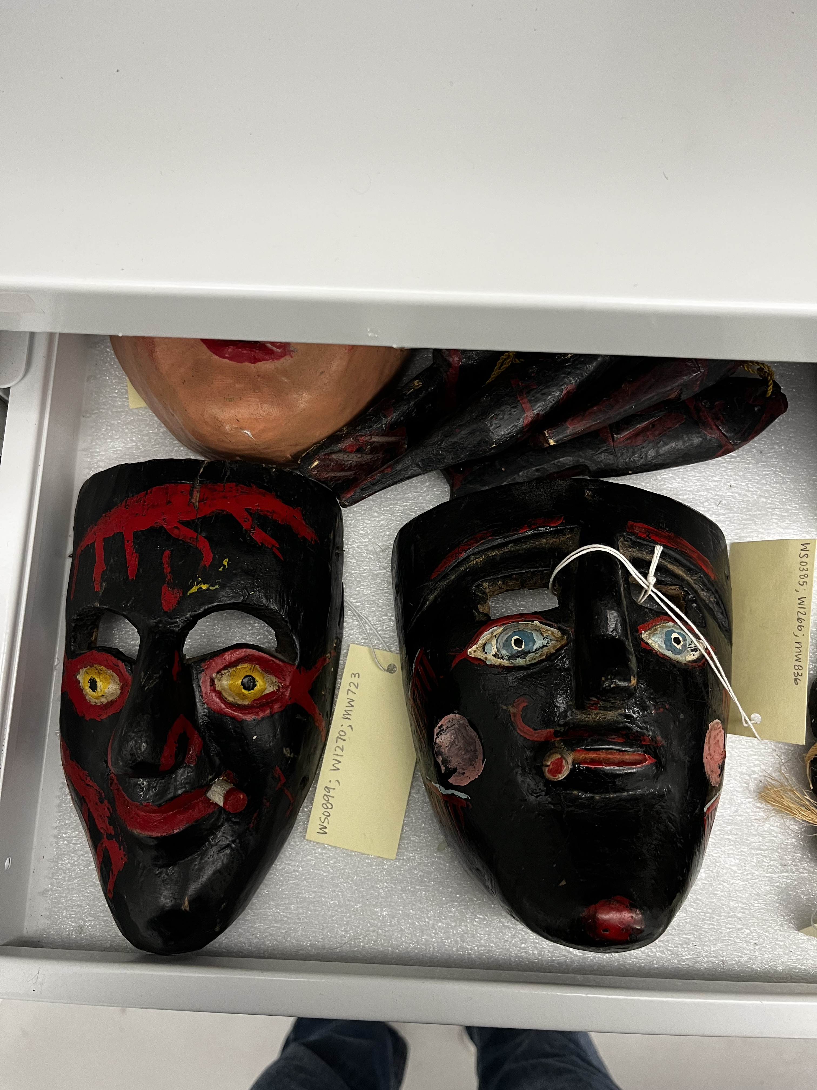
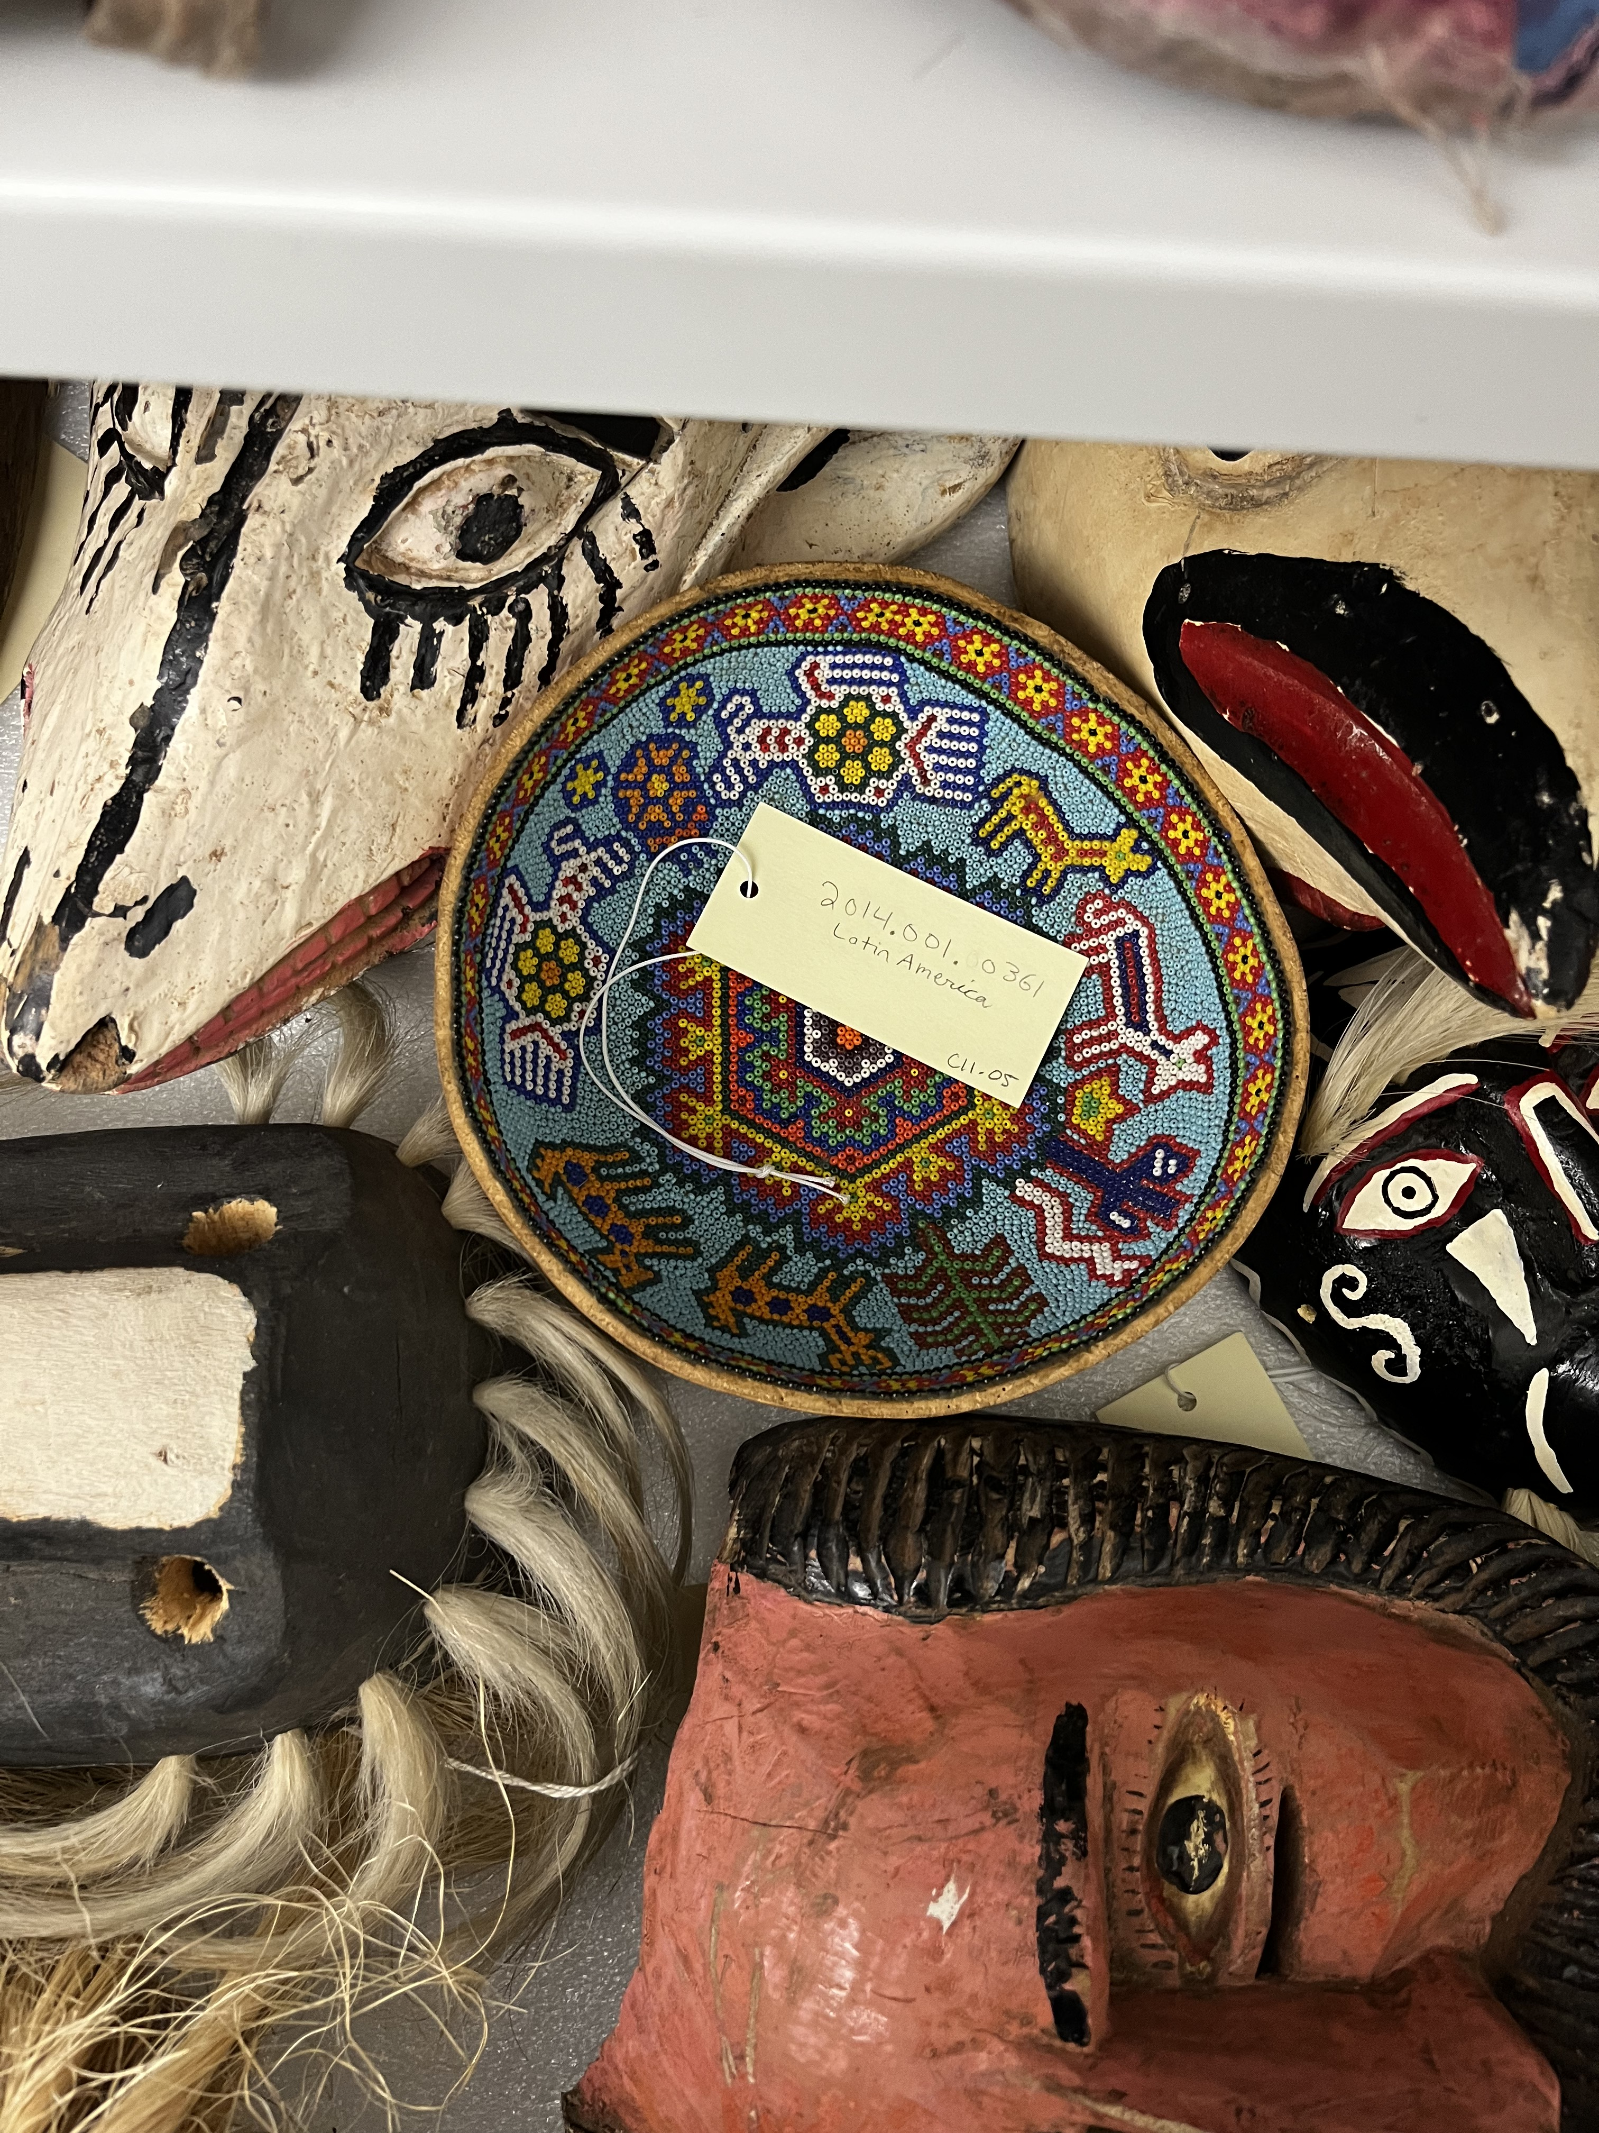
Some pictures!

Slide 6
Thank you!!

