Slide 1
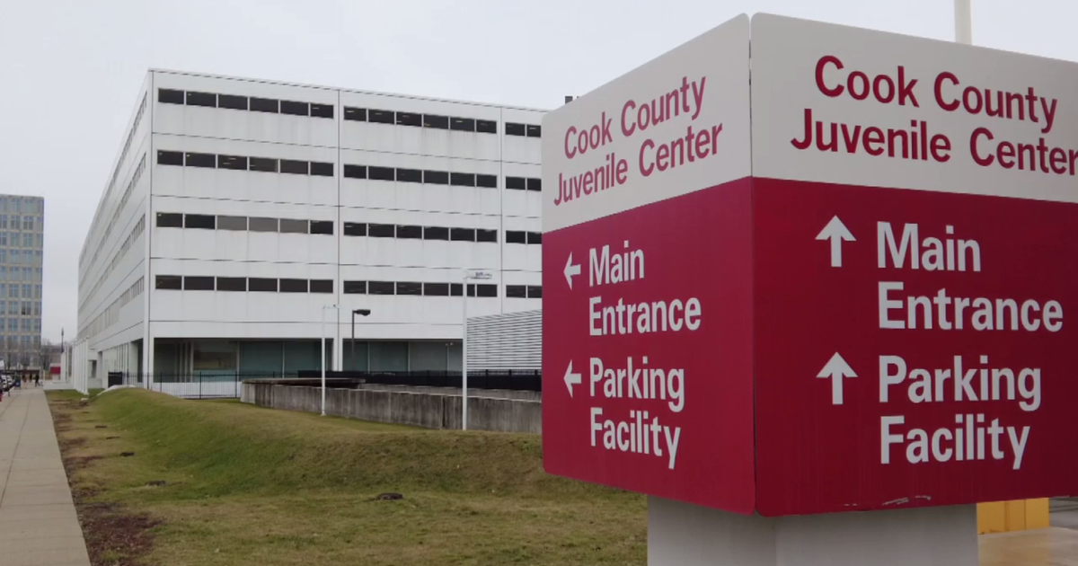
A Day in The Life of a Cook County Juvenile Probation Intern!
As an intern, I worked with the Pre Trial unit. This unit conducts assessments of incoming youth prior to any conviction. Based on the results of the assessments, Pre-Trial probation officers (POs) work to connect individuals to optional service agencies in the community.
Responsibilities:
complete assessments for incoming youth
serve as a case manager to clients
complete progress reports for the court/judge
Other Opportunities:
observe court hearings
shadow field POs as they made home visits
visit the JTDC
meet other POs and judges
Notes:
In addition to screening, I acted as a case manager to some of the youth I worked with. It was my responsibility to complete frequent check-ins with my client to assess their general well-being, as well as ensure that any court-ordered conditions are followed
I often worked alongside screeners to assess several things, such as ____

