Slide 1
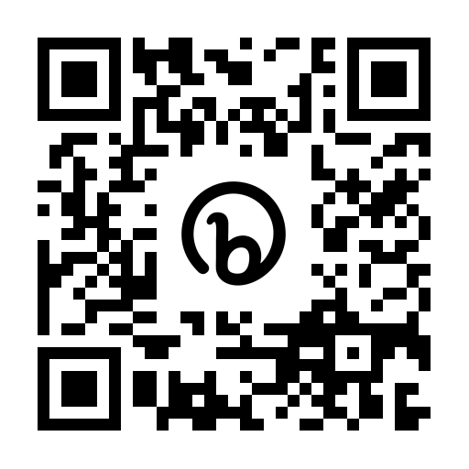
ONE Northside: SJI Presentation
Anna Alexander: Membership and Training Intern
Mentor: Anna Mangahas
Introduction
For my Social Justice Internship I had the pleasure of being able to intern with ONE Northside. ONE Northside is an organization that unites diverse communities of the north side to engage in collective power to eliminate injustices through community organizing.
In my role as a membership and training intern, I worked alongside my mentor in assisting with many of her projects such as ONE People’s Campaign, COPA, and city council.
Reflection
Learning Objectives
After having worked with ONE Northside for the course of a year, I am very appreciative of having had this experience. ONE Northside is such a viable and important organization in the community that advocates for the rights of all community members, and I am grateful to have participated in many of their initiatives. I do believe that I achieved all of my learning objectives, but especially my second and third goals. ONE Northside has allowed me to realize the importance of Advocacy and Social change, and encouraged me to want to continue participating in civic engagement work. It also allowed me to better understand the inner workings of city politics, and the importance of community organizing in order to achieve social change. Both ONE Northside and the SJI internship have provided me with the tools to become a better leader and an active community member. I am very appreciative for the skills and knowledge I have acquired from both groups.
As a result of interning with ONE Northside, I will be able to develop my professional skills in a professional setting by working with a well known nonprofit.
Through my internship with ONE Northside, I hope to be able to put my major (Advocacy and Social Change) to good use by participating in civic engagement.
While interning with ONE Northside, I hope to gain a deeper understanding of city politics though the vessel of non-profit work.
Personal Projects and Work
While working with my mentor, I was able to participate in the city political sector through community organizing initiatives such as campaigning, with their sister organization ONE People’s campaign. I would assist with a lot of behind the scenes work such as making reminder calls for meetings, and events that were occurring. Another project that I was able to assist with involved learning more about Chicago’s new police accountability sector, and attending city council meetings. I was able to learn how to file complaints against police members, and was able to participate the process of filing and witness the end result of a case. The biggest project that I worked on was creating a workable resources document for ONE Northside, full of accessible resources on the north side.
Civilian Office of Accountability (COPA), a project that I assisted my mentor on.
Acknowledgements
This is the QR Code for the resources document that I created for ONS. It is on Google docs so that it can always be accessible and amended when needed.
Anna Mangahas: ONE Northside Membership and Training
Everyone at ONE Northside
Loyola’s CELTS Department

