Slide 1
Race and the Landscape of Chicago Evictions
Presenter: Jonathan Nerenberg
Faculty Mentor: Dr. Peter Rosenblatt

Slide 2
What is an eviction?
More than 80% of Evictions in Chicago are filed because of unpaid rent (LCBH 2019)
However unpaid rent does not always lead to an eviction (Desmond 2016)
Source: LCBH

Slide 3
Consequences of Eviction
Increased likelihood of job loss (Desmond and Gershenson 2016)
Moves to higher poverty, higher crime neighborhoods than might otherwise (Desmond and Schollenberger 2015)
Increases in material hardship and depression (Desmond and Kimbro 2015)
Eviction as “a cause, not just a consequence, of poverty” (Desmond 2016)

Slide 4
research Questions
Do tenants get evicted at disproportionate rates by different sized landlords?
Do landlords evict at different rates across their properties in neighborhoods with different racial compositions?

Slide 5
Data and Methods
Data
Methods
Dataset of all landlords in Chicago
Compiled by DSA
Court records of all evictions in Chicago filed 2010-2017
American Community Survey Data 2013-2017
Neighborhood typology data
Data manipulation and graphing with Stata
Mapping and spatially merging with ArcGIS
Local Moran’s I Cluster Analysis

Slide 6
Findings
Two main patterns:
Landlords evict tenants at different rates in neighborhoods with different racial compositions
Many landlords only own properties in neighborhoods with similar racial compositions

Slide 7
Findings
Landlords file evictions in majority Black neighborhoods at nearly 5 times the rate of majority White neighborhoods
Landlords file evictions in majority Latinx neighborhoods at over 2 times the rate of majority White neighborhoods

Slide 8
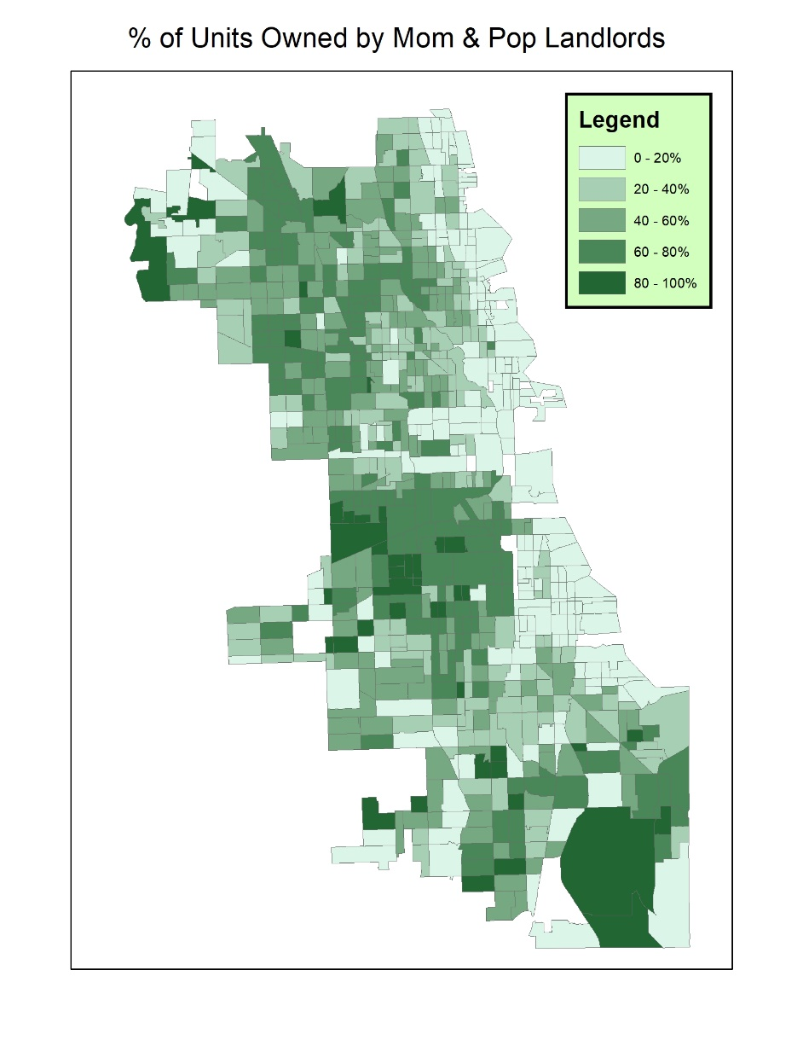
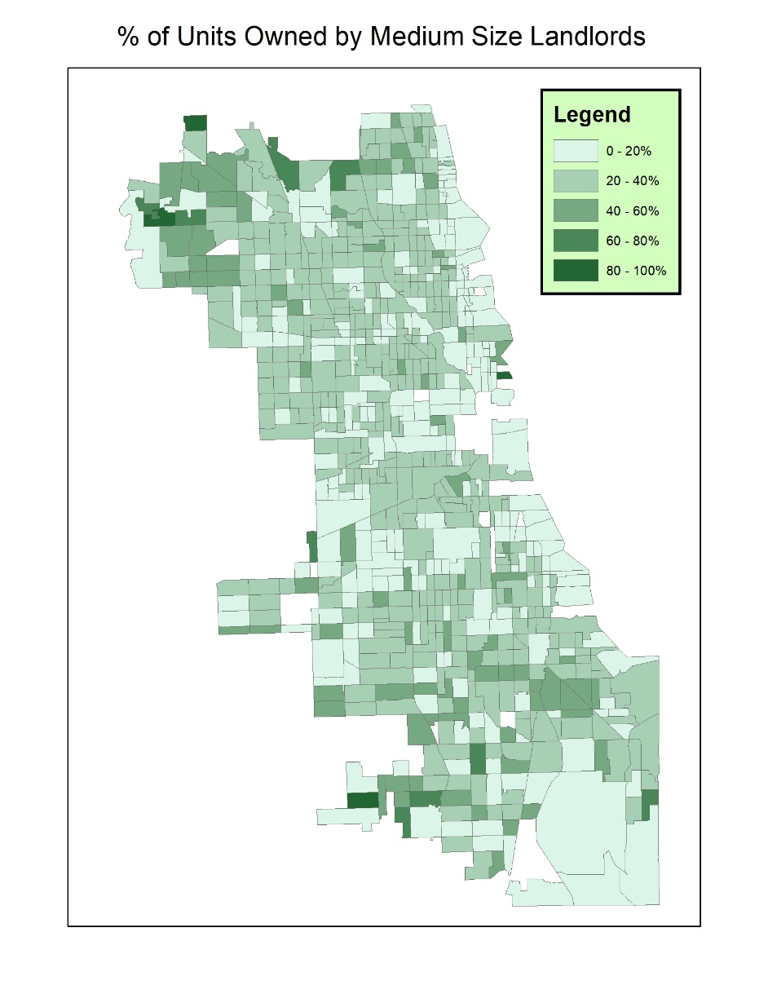
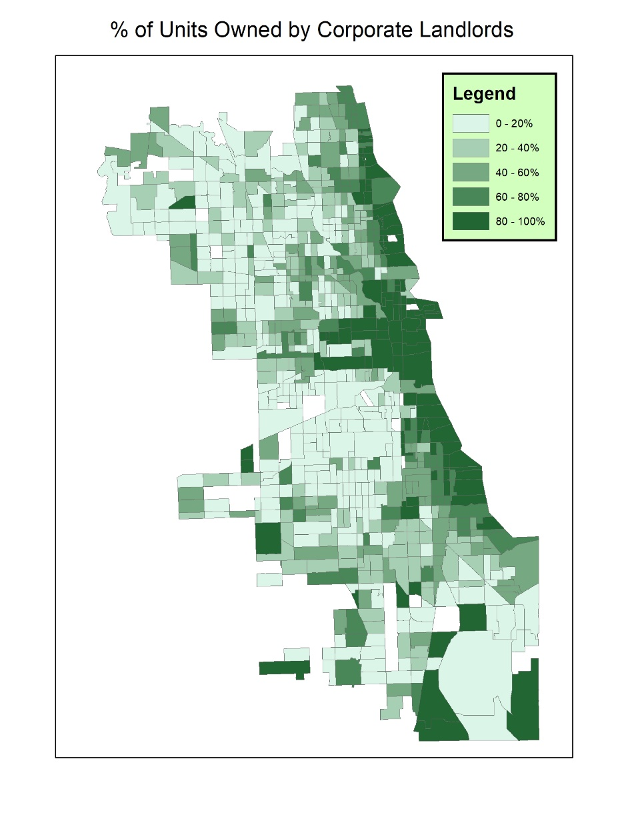
Findings

Slide 9
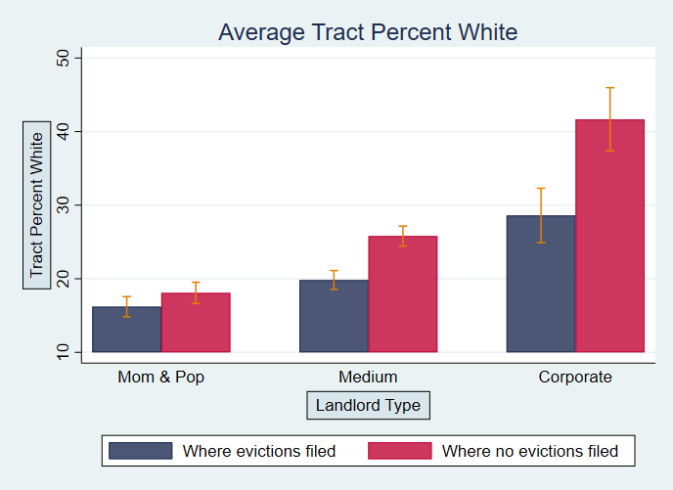
Findings
Every type of landlord was more likely to file an eviction at one of their properties if it was in a higher percentage Black neighborhood
Every type of landlord was less likely to file an eviction at one of their properties if it was in a higher percentage White neighborhood
Discrepancies more pronounced with larger landlords

Slide 10
Findings
Landlords with properties in multiple neighborhoods with different racial compositions clustered their evictions in neighborhoods with certain racial compositions

Slide 11
Findings
Many of the largest landlords almost exclusively own properties in neighborhoods with similar racial compositions

Slide 12
Next steps
The DSA dataset of landlords was created manually and was incomplete
Starting in 2023 we have been creating a new dataset of landlords using network mapping in Python
We need network maps because the same landlords use different LLCs for different properties
Our network analysis only became functional a week ago, so no concrete findings to share yet

Slide 13
Network Visualizations
An example of our landlord network maps

Slide 14
Network Visualizations
Pangaea Properties: Showing all the different LLC names associated with the same landlord

Slide 15
Network Visualizations
Pangaea Properties: Properties where an eviction was filed in 2017 (yellow) and where an eviction was not filed (blue)
Note: Eviction data not yet fully merged with networked data so this visualization is not fully accurate

Slide 16
Next Steps
Urban Affairs Association conference next week (!)
New networked data opens possibilities for new research questions
Spatial divide in property ownership?
Take feedback from conference to guide our next steps

Slide 17
Acknowledgments
Thank you to my faculty mentor, Dr. Peter Rosenblatt, my colleague, Kasi Woods, our collaborator/network expert, Branden Dupont, and the organizations that helped fund my research and travel to the conference: LUROP, CAS-USRE, and the Council on Undergraduate Research (CUR)

