Slide 1
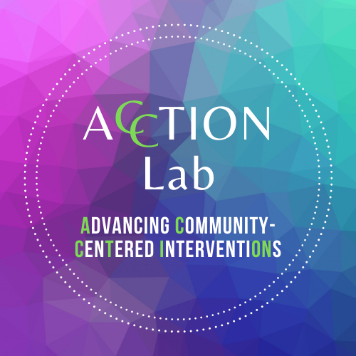
The Contribution of Attention-Deficit/Hyperactivity Disorder Symptom Severity to Nightmare-Based Dreams
Julianna Collazo Vargas
Senior, Neuroscience Major & Psych Minor
Zoe R. Smith, PhD, LCP
Assistant Professor,
Loyola University Chicago

Slide 2
ACCTION Lab
Community-based research team
Focused on creating culturally responsive assessments and interventions for Black and Latine teens with ADHD
Today’s research comes from our "College Student Study,"
With the purpose of understanding Loyola students' experiences with mental health and related outcomes
Notes:
Back in April 2022, I joined Dr. Zoe Smith’s ACCTION Lab at Loyola
We are a community-based research team that focuses on creating culturally responsive assessments and interventions for Black and Latine teens with ADHD
The project we will focus on today looks at the contribution of ADHD symptom severity to nightmare-based dreams.
This work comes from our ongoing "College Student Study," to understand Loyola students' experiences with mental health and related outcomes
I became interested in this work because currently there’s a lack of ADHD literature focusing on the manifestation of ADHD symptomology within adults with ADHD

Slide 3
ADHD(DSM-V)
Most common neurodevelopmental diagnosis
Symptoms include inattention, difficulty with executive functioning, restlessness, and impulsivity
Most research has focused on children with ADHD,
However, ADHD continues into adulthood
This study will focus on adults showing symptoms of ADHD
Notes:
ADHD is the most common neurodevelopmental diagnosis
Symptoms include inattention, difficulty with executive functioning, restlessness, and impulsivity
Most research has focused on children with ADHD, however, given that is a neurodevelopmental diagnosis, ADHD continues into adulthood
Thus, this study will focus on adults showing symptoms of ADHD

Slide 4
ADHD n Sleep
Those with ADHD report sleep problems:
Restlessness, daytime sleepiness, more variability in sleep quality, and nighttime wakening (Langberg et al., 2019; Zunker et al., 2015)
During REM sleep, they experience nocturnal hyperactivity with significant delays in cortisol rhythms
Leading to negative effects on sleep duration and quality (Langberg et al., 2019)
Notes:
A vast majority of people with ADHD report sleep problems, such as restlessness, daytime sleepiness, more variability in sleep quality, and nighttime wakening (Langberg et al., 2019; Zunker et al., 2015)
During REM sleep, they experience nocturnal hyperactivity with significant delays in cortisol rhythms
Leading to negative effects on sleep duration and quality (Langberg et al., 2019)

Slide 5
ADHD n Nightmares
Those with ADHD experience daytime distress causing an increase in negative-toned dreams
Schredl et al. (2016) study examined nightmare experiences for people with ADHD, finding they had higher levels of nightmares
Yet, PTSD symptoms were not taken into account (Schredl et al., 2016)
Notes:
To date, only one study has examined nightmare experiences for people with ADHD, finding they had higher levels of nightmares
Yet, PTSD symptoms were not taken into consideration along with the distinction of hyperactivity/impulsivity and inattentive ADHD symptom presentation
Those with ADHD experience daytime distress causing an increase in negative-toned dreams (Schredl et al., 2016)

Slide 6
ADHD n PTSD
PTSD: diagnosis includes symptoms of hypervigilance, disturbed sleep, reoccurring nightmares, distraction, and much more (DSM-V, 2013)
80% of adults with ADHD meet the criteria for PTSD (Antshel et al., 2013)
Notes:
PTSD is a diagnosis that includes symptoms of hypervigilance, disturbed sleep, distraction, and much more.
People who have experienced trauma and meet the criteria for PTSD are more likely to meet the criteria for ADHD and vice versa
As nightmares are part of the symptomology of PTSD (APA, 2013), it is important to include these symptoms when examining the association of ADHD symptoms and nightmares

Slide 7
Purpose
Investigate the influence of ADHD severity on the occurrence of nightmares and negative toned dreams
Examine the contribution of PTSD symptoms on the nightmare frequency of those with ADHD
Notes:
Investigate the influence of ADHD severity on the occurrence of nightmares and negative toned dreams
Examine the contribution of PTSD symptoms on the nightmare frequency of those with ADHD
Considering nightmares are a part of the diagnostic criteria for PTSD (Lemyre, 2019)

Slide 8
Hypothesis
Those with hyperactive/impulsive ADHD presentations will have higher frequencies with nightmare-based dreams while accounting for PTSD symptomology

Slide 9
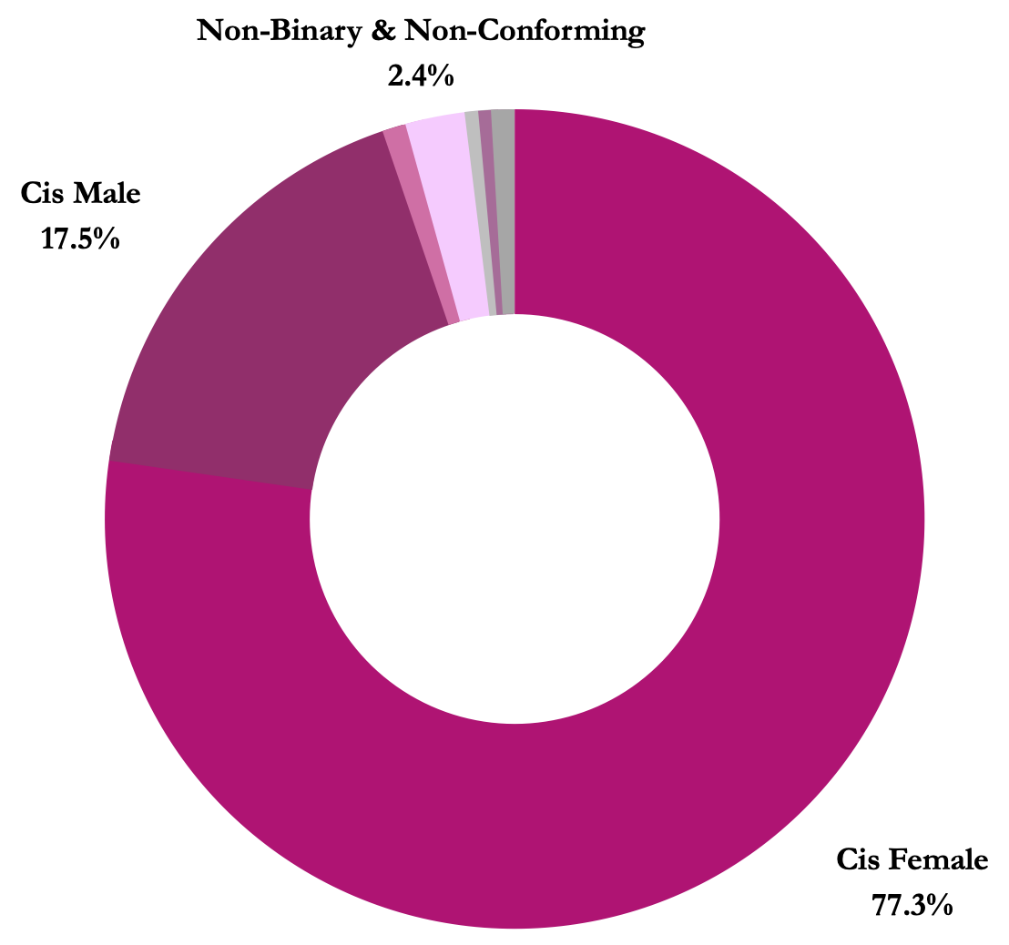
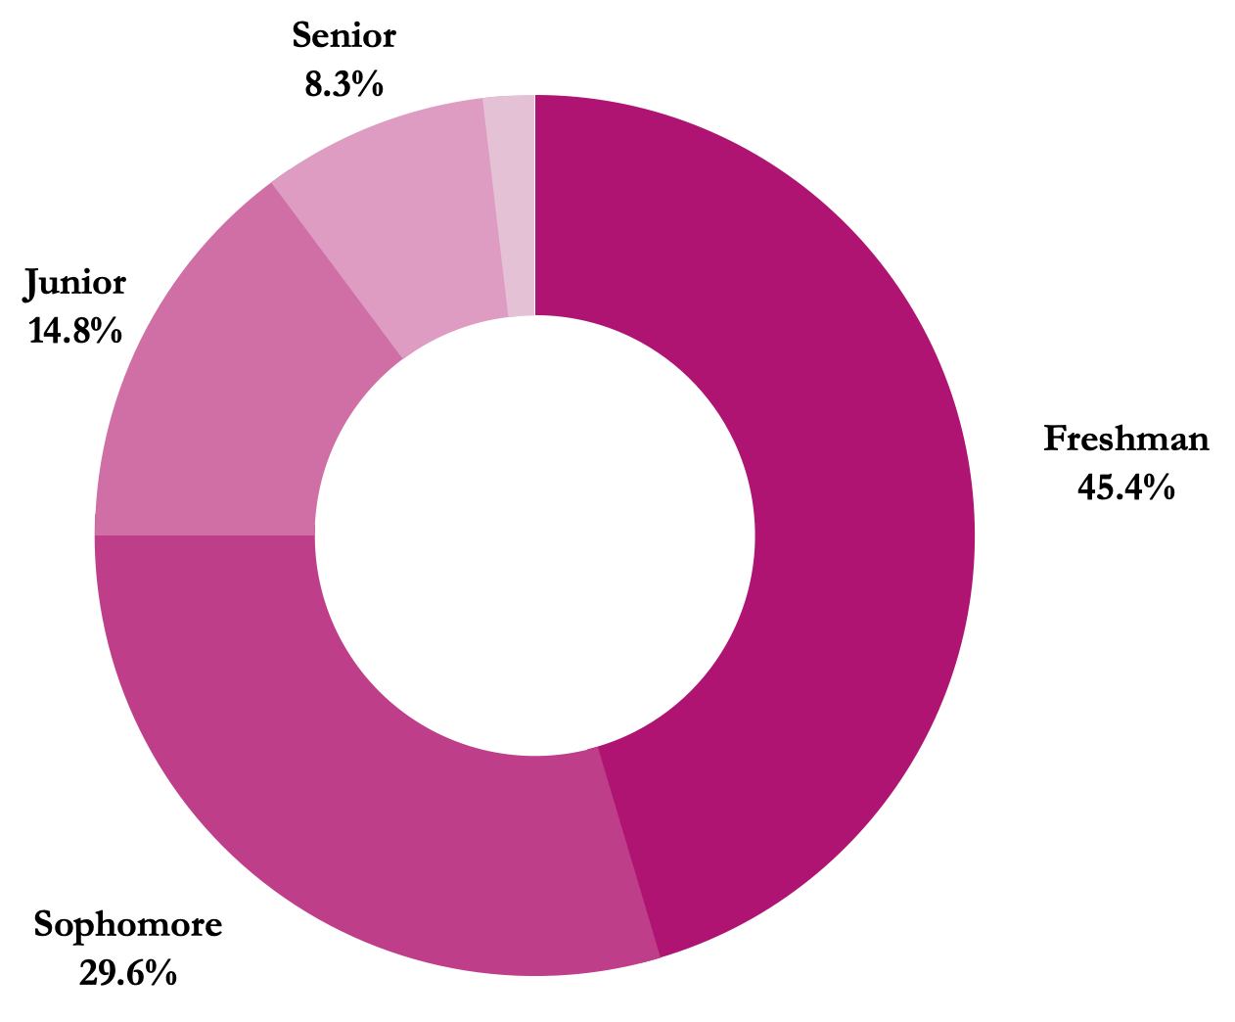
Participants
217 college students (77.3% cis-women)
Assessed through self-report questionnaires from the College Student Study

Slide 10
Study’s Measures
ADHD measured with BAARS-IV questionnaire
PTSD measured with PCL-A5 questionnaire
Nightmare-based dreams measured with MADRE questionnaire
Notes:
BAARS-IV → Never, sometimes, often, very often
PCL-A5 → not at all, a little bit, moderately, quite a bit, extremely
MADRE → scales varied, do you experience reoccurring nightmares related to a situation you have experienced in your waking life?

Slide 11
ADHD assessed
through BAARS-IV
PTSD symptoms assessed through PCL-A5

Slide 12
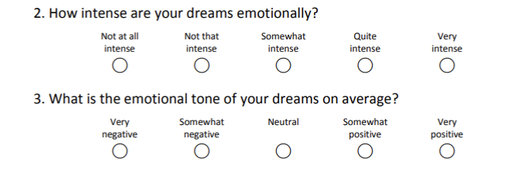
Nightmare-based dreams assessed
through MADRE

Slide 13
More hyperactive/impulsive ADHD symptoms are associated with fewer nightmare-based dreams.
With respect to nightmare-based dreams, the overall hierarchical regression predicted 8.8% of variance (R² = 0.09, F(2,167) = 7.69, p < .001)

Slide 14
More hyperactive/impulsive ADHD symptoms are associated with fewer nightmare-based dreams.
Hyperactive / Impulsive Symptoms
-.27*
Inattentive Symptoms
Nightmares
-.04
PTSD
Symptoms
-.02
*p < .01

Slide 15
Discussion
First study to examine the influence of ADHD symptom severity on the occurrence of nightmare-based dreams while accounting for PTSD symptoms
Findings contradict the current literature
Implies a need to re-assess the reported sleep disturbances for people with ADHD

Slide 16
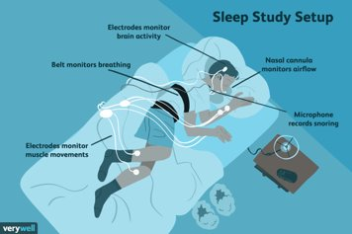
Future Directions
Conducting another study that includes questionnaires on participant’s prescribed medication intake
Applying EEG components to monitor the circadian rhythm
Notes:
Conducting another study that includes questionnaires on participant’s prescribed medication intake
May also want to examine other substances used, like caffeine
Applying EEG components to monitor the circadian rhythm
Also want to understand how other sleep disturbances affect nightmares (e.g., restless leg syndrome, night wakenings)

Slide 17
Thank You!
Julianna Collazo Vargas
jcollazovargas@luc.edu
@juli_collazov
Zoe R. Smith, PhD, LCP
zsmith5@luc.edu
@DrZoeRSmith

