Slide 1
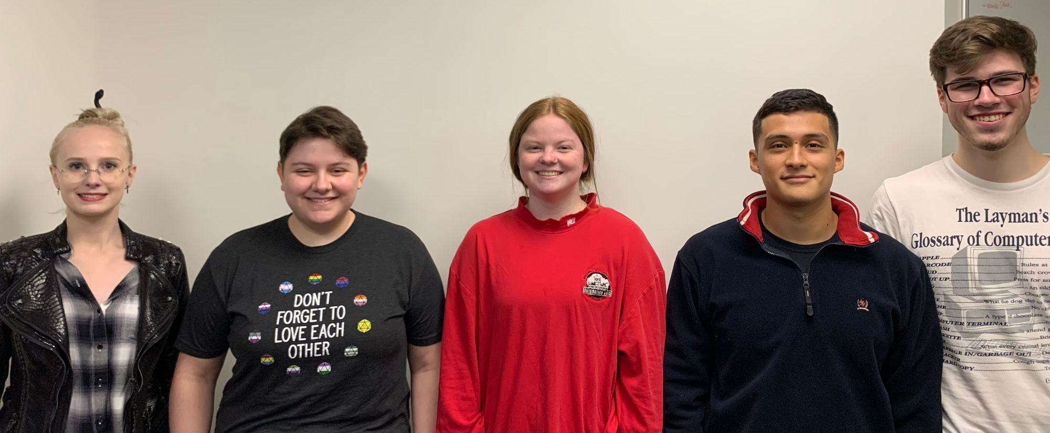
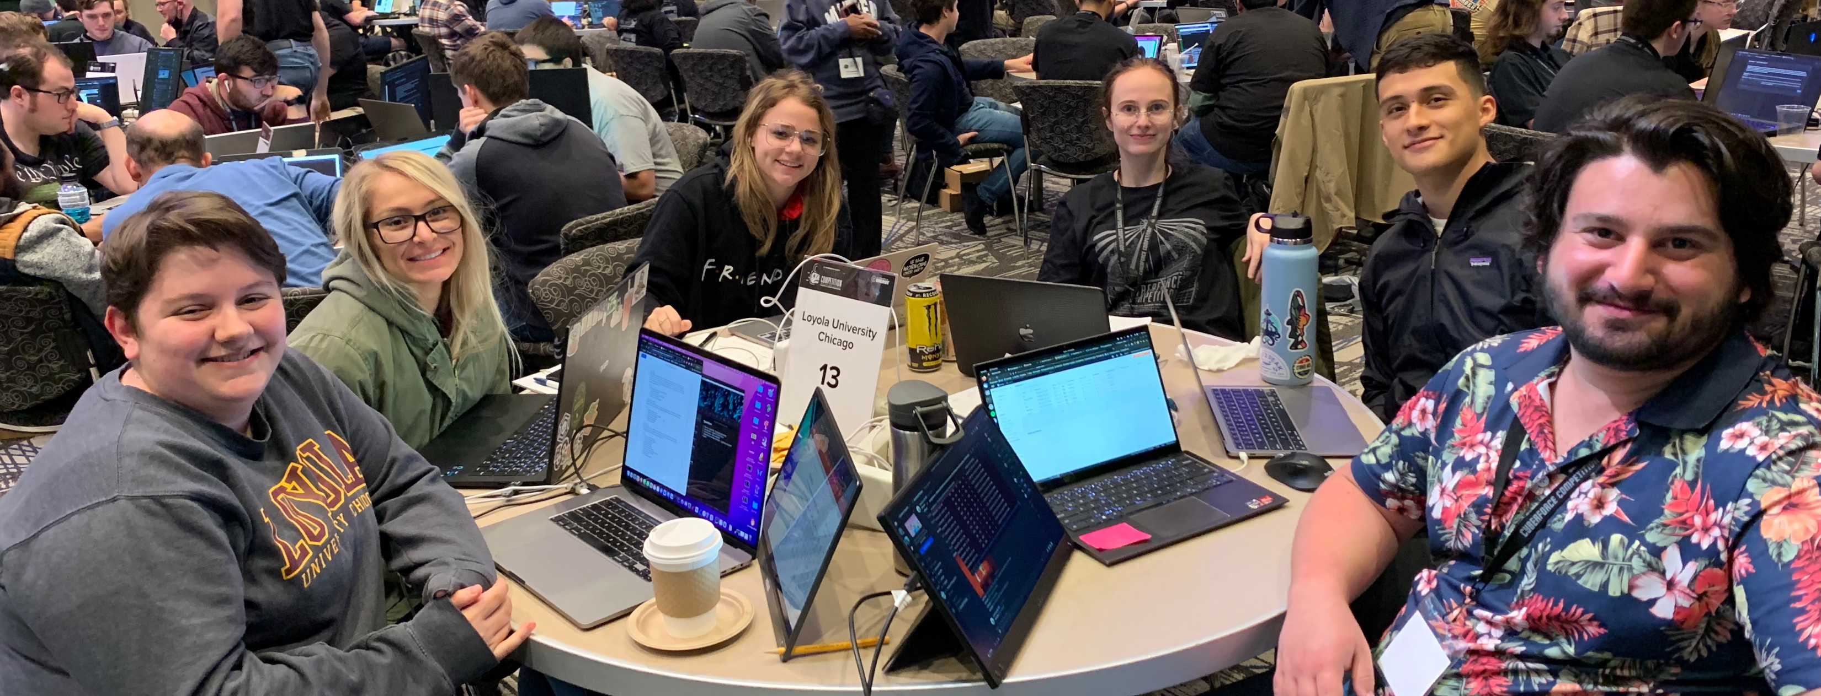
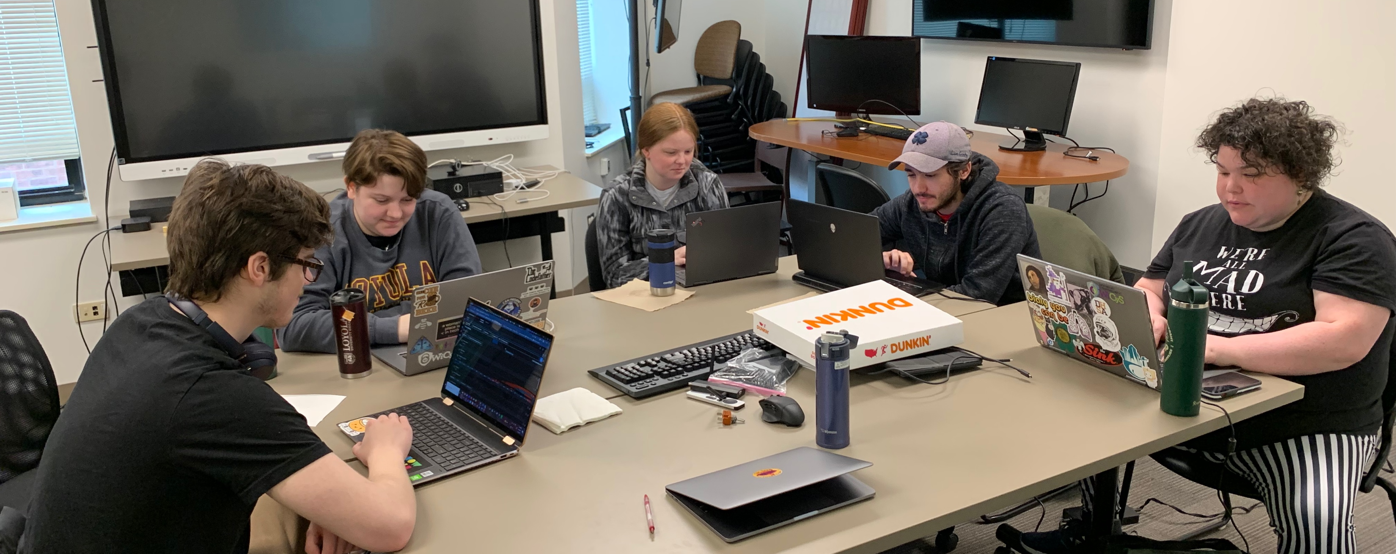
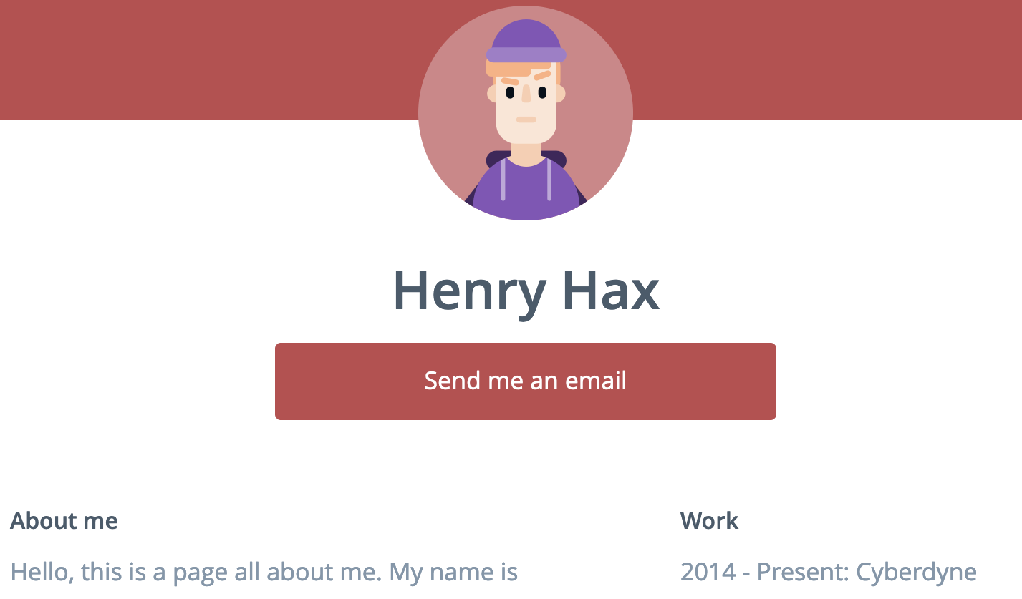
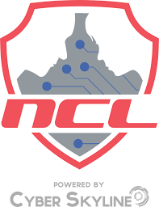
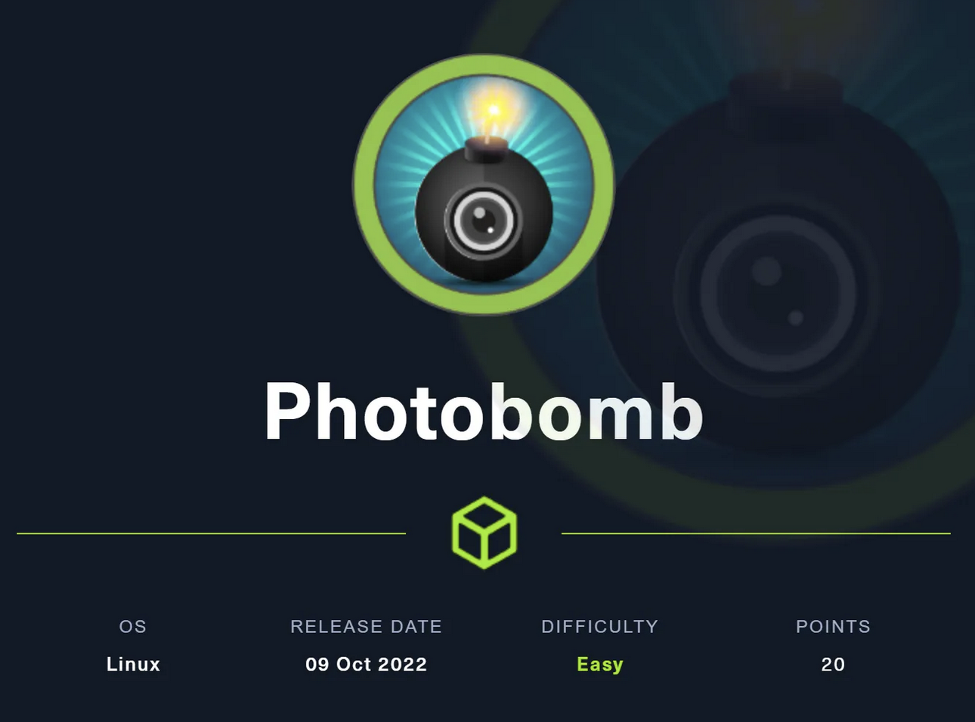
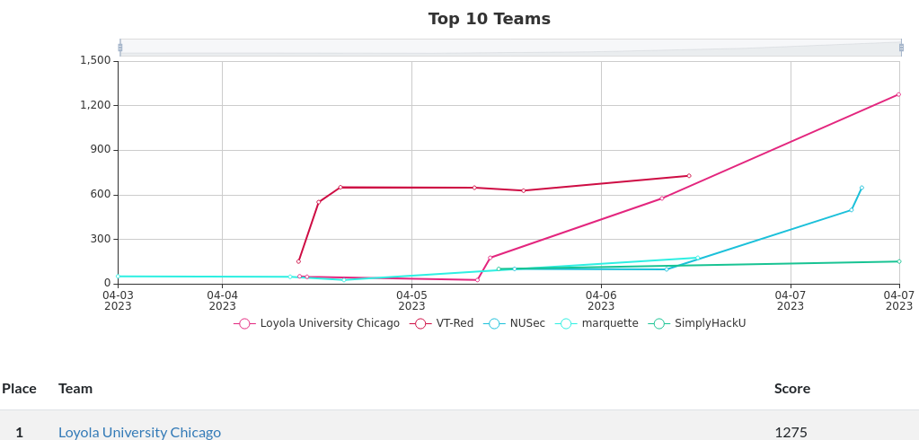
Motorola Solutions Foundation Cybersecurity Experiential Scholarship Program
Madeline M. Moran, Kenneth Hernandez, Erin Robertson, Nathan Ferrell, Amy Kuhl
Mentor: Eric Chan-Tin
About
Cyberforce
Cyberforce is sponsored by the Department of energy and involved testing students in every field from green team website building to blue team defense of servers and CTF anomaly hunting.
We placed 24th overall out of 144 teams.
We received 1st place in green team/website development.
NCAE Cybergames
From Left to Right: Amy Kuhl (junior), Madeline Moran (senior), Erin Robertson (sophomore), Kenneth Hernandez (senior), Nathan Ferrell (sophomore)
Loyola University Chicago received a grant for $25,000 from the Motorola Solutions Foundation, the charitable arm of Motorola Solutions, to support the Cybersecurity Experiential Scholars Program within the College of Arts and Sciences. Through this grant, Loyola supported five undergraduate students as they study, perform research, and explore potential careers in cybersecurity with faculty in Loyola’s Department of Computer Science and the Center for Cybersecurity and Privacy. Loyola’s cybersecurity program earned designation in 2020 as a National Security Agency / Department of Homeland Security National Center of Academic Excellence in Cyber Defense Education through 2025. “Cybersecurity is a critical aspect everywhere; to excel in this area requires an experiential learning program such as participating in cybersecurity competitions”, says Dr. Eric Chan-Tin, Associate Professor of Computer Science and Lead for the Center for Cybersecurity & Privacy. “We are excited to continue our partnerships with Motorola Solutions Foundation to educate our students.” The goal of the Cybersecurity Experiential Scholars Program is to provide a group of students a space to learn and develop their skills together through Cyber Competitions. [1]
NCAE Cybergames is a college centric cyber competition that exposes first-time cyber competitors to blue team infrastructure, like a DNS server and Capture the Flag (CTF) style problems to solve.
The blue team activities involve setting up and maintaining servers and services on a virtual network against the competitions red team.
The CTFs involved everything from network traffic analysis, password cracking, cryptography, and program exploitation.
Placed 7th place overall in the midwestern regional competition.
CyberStart
NCL Team Challenge
The National Cyber League (NCL) powered by Cyber Skyline aims to prepare students for practical cybersecurity challenges that they will likely face in the workforce.
This competition involves everything from open-source intelligence, password cracking, forensic analysis, network traffic analysis, exploitation, scanning and reconnaissance, and log analysis.
This cyber competition across the practice game, individual challenge, and team challenge provided us with a wide variety of CTFs and allowed us to improve over the course of the competition.
CyberStart provides students with hands-on real-world webpage exploitation tasks.
Each task provides a scenario ranging from gathering information about a hacker organization to preventing said organization from accessing vulnerable targets.
Using web exploitation and interactive terminals we were able to discover and utilize numerous methods of exploitation applicable to real world vulnerabilities.
Thank You!
Hack The Box
Hack The Box is a gamified cybersecurity upskilling, certification, and and talent assessment platform allowing students and businesses to sharpen their skills in offensive and defensive security expertise.
We collaborated on a machine called ‘Photobomb’ that asked us to gain access to a secure login by finding a username and password hidden in a website’s JavaScript code.
The Motorola Solutions Foundation, which has donated $100 million over the past 10 years, focuses its giving on three key areas: first responder programming, technology and engineering education, and programs that blend the two. The Foundation has a long-standing commitment to supporting programs that benefit underrepresented populations and aims to partner with organizations that align to its values of accountability, innovation, impact, diversity and inclusion. “The Motorola Solutions Foundation is proud to partner with organizations like Loyola University Chicago that share our values and passion for driving positive change in the community,” said Karem Perez, executive director of the Motorola Solutions Foundation. “We believe in the work that Loyola’s Cybersecurity Experiential Scholars Program is doing and look forward to seeing their continued impact.” As the charitable and philanthropic arm of Motorola Solutions, the Motorola Solutions Foundation partners with organizations around the globe to create safer cities and equitable, thriving communities. We focus on giving back through strategic grants, employee volunteerism, and other community investment initiatives. Our strategic grants program supports organizations that offer first responder programming and technology and engineering education, and align to our values of accountability, innovation, impact, diversity, and inclusion. The Foundation is one of the many ways in which the company lives out its purpose of helping people be their best in the moments that matter. [1]
Hack the Hospital
Hack the Building 2.0: Hack the hospital is a red and blue team cyber competition simulating a subversive story based on real world hospital attacks.
We received first place in the red team challenge for hacking a conveyer belt and preventing its functionality.
[1] Hart, Marina. “Five Loyola Students Selected for 2022 Cybersecurity Experiential Scholars Program.” Loyola Department of Computer Science, Loyola Department of Computer Science, 12 Oct. 2022, https://newsroom.cs.luc.edu/five-loyola-students-selected-for-2022-cybersecurity-experiential-scholars-program/.

