Slide 1
Crime & Rehabilitation in Urban Chicago
Private Enterprise & Peace:
Michael Clausen
Loyola University Chicago

Slide 2
Private Enterprise & Peace Project
Dr. Molly Melin
Professor and Director of Political Science Graduate Student Programs at Loyola University Chicago
Dr. Santiago Sosa
Professor and Director of the Latin American Peace Science Society at Universidad EAFIT, Medellin, Colombia
Areas of Study:
Colombia, Northern Ireland, Senegal, Uganda, Chicago

Slide 3
Private Enterprise & Peace
Examining the impacts of private sector investment on violence reduction and the economic reintegration of former combatants
Studying the effects of private sector investments in international local contexts
Overall goal of examining corporate peacebuilding, negotiation occurrence, and peace duration at a cross national level

Slide 4
How Do Private Sector Actors Foster Peace?
Private Enterprise & Peace
Guiding Question:

Slide 5
What is Peace?
Why We Fight, Dr. Christopher Blattman
Peace is freedom from violence and the fear of violence
Development as Freedom, Dr. Amartya Sen
Freedom is the ability for individuals to live the life they want
Violence makes peace impossible and diminishes freedom at both the individual and societal levels

Slide 6
How Do Private Sector Actors Foster Peace?
Small Scale
Unchecked Interests
Intangible Incentives
Misperceptions
Macro-Level Obstacles to Peace
Uncertainty
Commitment Problems
Facilitating Peace
Rules & Enforcement
Interventions
Notes:
Unchecked Interests
Intangible Incentives
Uncertainty
Misperceptions

Slide 7
Violence In A Chicago Context
The other areas of study within the PEP project examine the rehabilitation of former combatants in a military or insurgent context, but this condition is clearly lacking in Chicago
This sector of the overall project looks at violence through a criminal lens, focusing on the reduction of violent crime and the economic rehabilitation of the formerly incarcerated instead of outright conflict

Slide 8
Private Sector Investment In Community Organizations Will Result In Decreased Levels Of Violence
Hypothesis:

Slide 9
Part 1: Crime Data

Slide 10
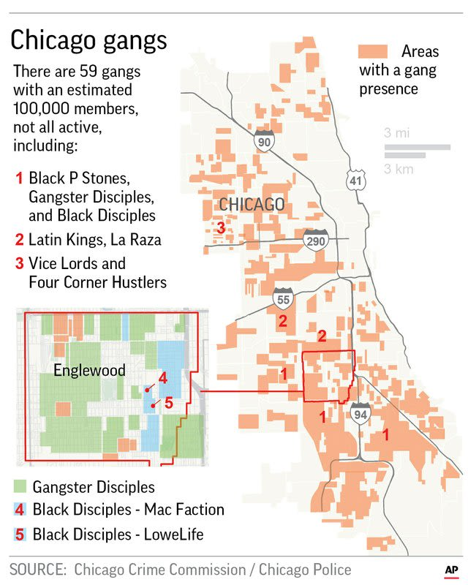
Common Perceptions
Crime is seen as an intractable issue
Gangs
Long History
High presence
High media coverage
Violence
Media promoting an image of omnipresent violence,
Compared to active combat zone – “Chiraq”
10th Highest US City by Homicide Rate

Slide 11
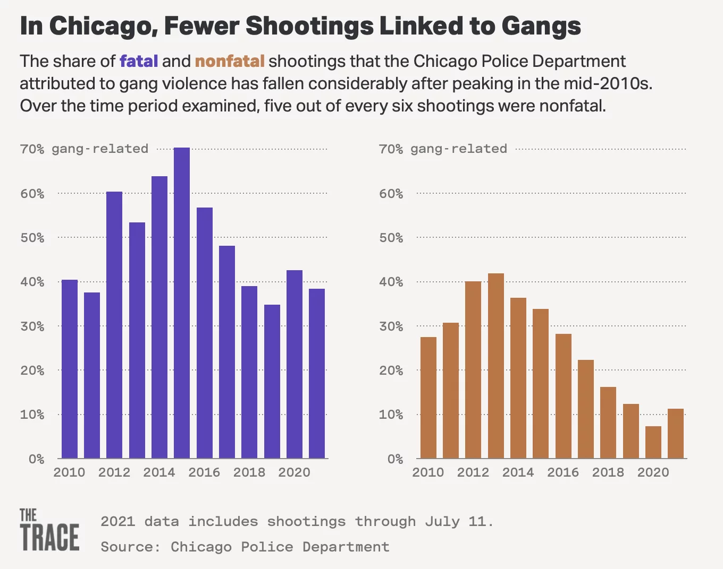
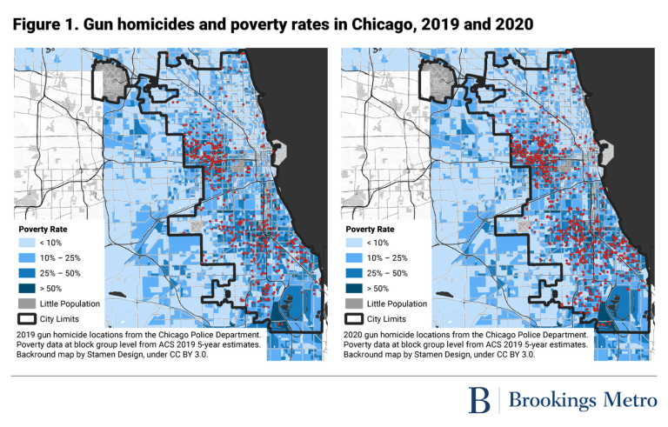
Reality
Violence is neither intractable nor a mystery
Crime, violence, and economics are all interlinked phenomena
The poorest areas are those that fall victim to the most crime, violent or otherwise
Issues of crime and violence are predominantly economic, local, and cyclical

Slide 12
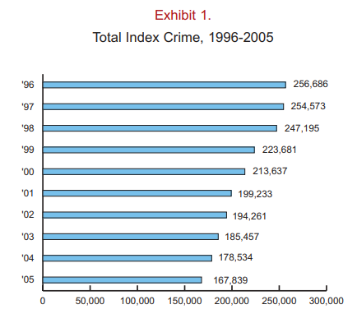
Long Term Trends
Between 2017 and 2021
Overall decline: 29.20%
Average: -5.84%
Between 1996 and 2005
Overall decline: 34.61%
Average: -3.46%

Slide 13
Crime Stats
Between 2017 and 2021, crime in Chicago declined by 29.20%
Property Crime – 34.64% decrease
2017 – 89,242 incidents
2021 – 58,320 incidents
Violent Crime – 12.91% decrease
2017 – 29,852 incidents
2021 – 25,996 incidents
In 2021, the number of total crimes (84,317) was less than the number of property crimes alone only 4 years prior
Notes:
There can be no question that progress is being made – Chicago is, by the numbers, becoming a less violent city. The question is, what factors are causing this decrease?

Slide 14
Gaps in the Data
Major drops in crime represented by the 2017-2021 period are not the norm
Lingering impact of COVID-19 on crime rates
2011-2016 Gap in CPD Annual Reports
Variations in how crime is measured
Crime vs. Index Crime
FBI metric, gives consistency to national numbers but differs from raw number of crime reports
Notes:
CPD’s documentation and release of crime statistics is consistent, convenient, and polished, and provides the most reliable and comprehensive sources for information on crime in Chicago.

Slide 15
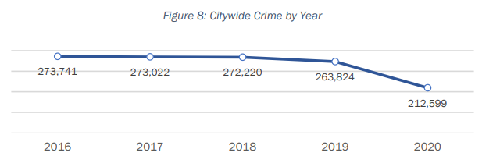
Gaps in the Data – Defining Crime
Notes:
Index crime only complies a set number of crimes: Violent crimes are murder, manslaughter, rape, robbery, robbery, and aggravated assault. Property crimes are defined as burglary, larceny-theft, motor vehicle theft, and arson, leaving out a wide variety of crimes that are not captured by this reporting scheme

Slide 16
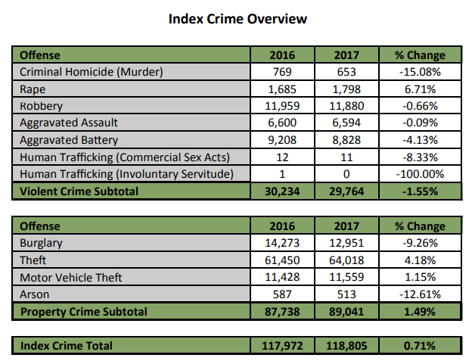
Gaps in the Data – Defining Crime
Yearly Change 2016-2017: +0.71%
Yearly Change 2016-2017: -0.003%
Notes:
Comparing the graph on the right, from the 2020 Annual Report, to the table on the left shows the issues with index crime as a statistic. Index crime increased, but crime dropped overall.
FBI Crime Index using the Uniform Crime Reporting system (UCR), run as a national system by the FBI since 1930, takes 10 categories of crime to use as base indicies

Slide 17
Identifying Structural Obstacles to Peace
More than just crime statistics:
Labor Statistics
Job Placement
Market Participation
Recidivism Rates
Education Attainment
Policing
City Programs
Community Intervention
Community Policing
Neighborhood Inequality

Slide 18
Step 2: Breaking the Cycle

Slide 19
Investigating Peacebuilding – Theory and Practice
Where the Cycle Starts – On Ramps
School Funding & Declining Academic Achievement
Lacking Social Support
Economic Opportunity
Where the Cycle Stops – Off Ramps
Rehabilitation & Prisoner Re-Entry
Job Placement
Community Growth
Active Intervention

Slide 20
Analysis
Three key needs for data analysis
Identification
How are private sector actors involved?
Categorization
Who is involved?
What type of approach?
What level of involvement?
Measurement
What is the impact?
What areas are impacted the most?

Slide 21
Analysis – Identification
How Do we capture private sector investment?
Unlike crime statistics, there is no centralized database of private sector involvements in peacebuilding programs in Chicago
Data is available, but requires additional coding of location, investment type, private sector backer(s), community organization/program type

Slide 22
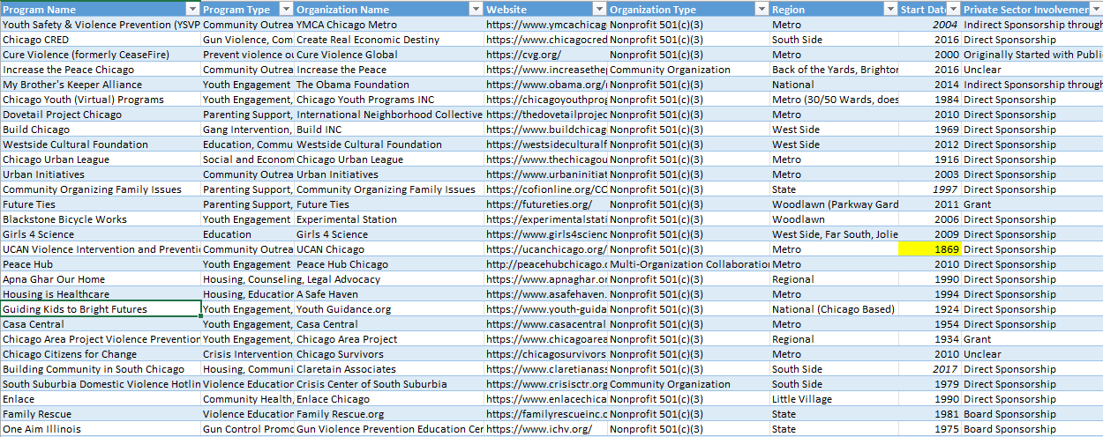
Analysis – Identification
Initial dataset
Reliant on organization/private sector backer digital presence
Useful for initial research, but incomplete picture

Slide 23
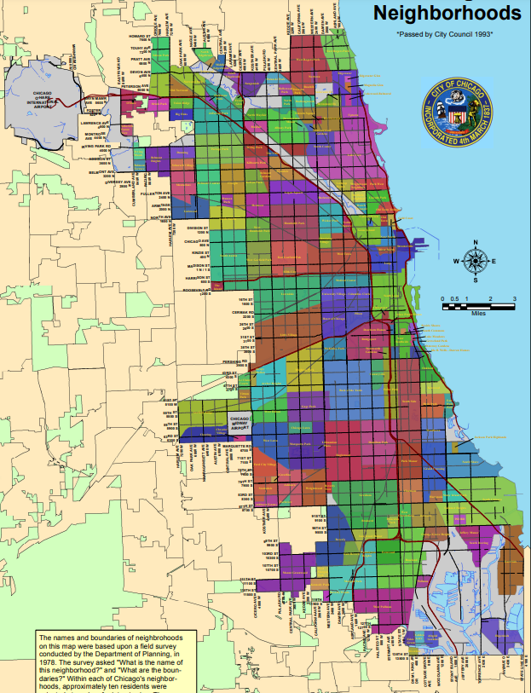
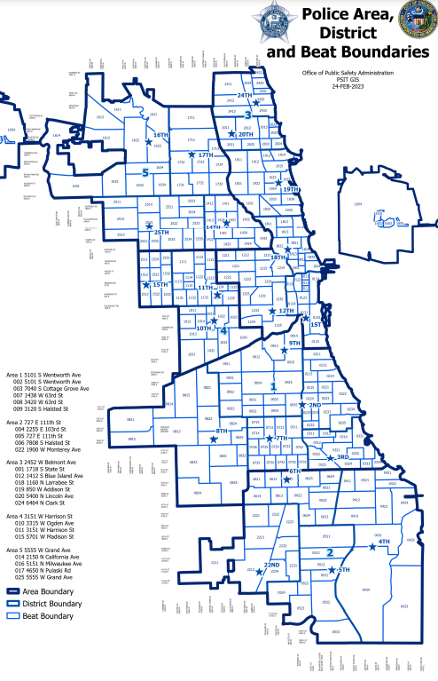
Analysis – Identification
Data collection is being re-oriented from a city/metro level approach to examine Chicago neighborhoods individually
Chicago’s Neighborhoods have established geographic boundaries and can be mapped to examine overlap in crime statistics with CPD police areas/districts/beats
Neighborhood Chambers of Commerce have access to community organization/program data, removing the issues of location coding and outdated digital access

Slide 24
Analysis – Categorization
Data gathered from neighborhood chambers of commerce will be coded by:
Organization Type
Program Type
Preventing On-Ramps vs. Providing Off-Ramps
Private Sector Backer/Funding Type
Neighborhood Location
Categorization done with previous data set, but data quality was poor
Missing geographic component

Slide 25
Analysis – Measurement
Measuring localized (neighborhood) fluctuations in crime over time
Point of analysis is the start-date of each private-sector backed community program
Comparing crime rates in neighborhoods with greater incidence of private-sector backed community programs with those without across 2016-2019 period
Excluding recent data as influenced by COVID-19 Pandemic
Pre-2016 data excluded due to absence of CPD annual reports from this period

Slide 26
Next Steps & Going Global
Next Steps
Data Gathering
Examining Local Impacts
Evaluating Corporate Connections
Global Connections
Comparing private sector impacts on peacebuilding in Chicago to similar programs and policies globally
Comparing experiences and outcomes for former combatants with formerly incarcerated non-militants
Northern Ireland
Colombia

Slide 27
Works Cited
Lavery, Tim. “Gang-Motivated Murders, 1991-2004.” Chicago Police Department, Research and Development Division. City of Chicago, August 2005. https://home.chicagopolice.org/wp-content/uploads/2014/12/Gang-Motivated-Murders-1991-2004.pdf.
Lombardo, Robert M. “Explaining Organized Crime.” Essay. In Organized Crime in Chicago: Beyond the Mafia, 15–36. University of Illinois Press, 2013. http://www.jstor.org/stable/10.5406/j.ctt2tt9mc.5.
Looney, Adam, and Nicholas Turner. “Work and Opportunity before and after Incarceration.” THE BROOKINGS INSTITUTION, March 2018. https://doi.org/https://www.brookings.edu/wp-content/uploads/2018/03/es_20180314_looneyincarceration_final.pdf.
Miller, John W. “The U.S. Economy Sets up Ex-Prisoners for Failure. the Consequences Are Disastrous.” America - The Jesuit Review, September 29, 2021. https://www.americamagazine.org/politics-society/2021/09/29/prisons-rehabilitation-america-pope-franci-241532.
Rowlands, DW, and Hanna Love. “Mapping Gun Violence: A Closer Look at the Intersection between Place and Gun Homicides in Four Cities.” Brookings. Brookings, April 21, 2022. https://www.brookings.edu/2022/04/21/mapping-gun-violence-a-closer-look-at-the-intersection-between-place-and-gun-homicides-in-four-cities/.
Schmitt, John, and Kris Warner. “Ex-Offenders and the Labor Market.” Center for Economic and Policy Research, November 2010, 87–109. https://doi.org/https://cepr.net/documents/publications/ex-offenders-2010-11.pdf.
“Sentiment Dashboard.” Chicago Police Department. City of Chicago, October 2022. https://home.chicagopolice.org/statistics-data/data-dashboards/sentiment-dashboard/.
Sharkey, Patrick, and Alisabeth Marsteller. “Neighborhood Inequality and Violence in Chicago, 1965–2020.” The University of Chicago Law Review 89, no. 2 (March 2022): 349–82. https://www.jstor.org/stable/27132254.
Smith, Chris M., and Andrew V. Papachristos. “Trust Thy Crooked Neighbor.” American Sociological Review 81, no. 4 (2016): 644–67. https://doi.org/10.1177/0003122416650149.

Slide 28
Works Cited
“2021 Annual Report.” Chicago Police Department. City of Chicago, March 2022. https://home.chicagopolice.org/wp-content/uploads/2021-Annual-Report.pdf.
“2021 Annual Use of Force Report.” Office of Constitutional Policing – Research and Development Division. City of Chicago, January 2022. https://home.chicagopolice.org/.
“Annual Statistical Reports.” Chicago Police Department. City of Chicago. Accessed November 11, 2022. https://home.chicagopolice.org/statistics-data/statistical-reports/.
Binswanger, Ingrid A., Marc F. Stern, Richard A. Deyo, Patrick J. Heagerty, Allen Cheadle, Joann G. Elmore, and Thomas D. Koepsell. “Release from Prison — a High Risk of Death for Former Inmates.” New England Journal of Medicine 356, no. 2 (2007): 157–65. https://doi.org/10.1056/nejmsa064115.
Burdick-Will, Julia. “School Violent Crime and Academic Achievement in Chicago.” Sociology of Education 86, no. 4 (2013): 343–61. https://doi.org/10.1177/0038040713494225.
“The Challenges of Prisoner Re-Entry into Society.” SC-UMT, November 30, 2022. https://online.simmons.edu/blog/prisoner-reentry/.
Couloute, Lucius, and Daniel Kopf. “Out of Prison & out of Work.” Out of Prison & Out of Work | Prison Policy Initiative. Accessed February 1, 2023. https://www.prisonpolicy.org/reports/outofwork.html.
Finlay, Keith. “Dim Job Outlook for People Released From Prison During Great Recession.” Census.gov, February 15, 2022. https://www.census.gov/library/stories/2022/02/dim-job-outlook-for-people-released-from-prison-during-great-recession.html.
“Hate Crime Dashboard.” Chicago Police Department. City of Chicago. Accessed November 9, 2022. https://home.chicagopolice.org/statistics-data/data-dashboards/hate-crime-dashboard/.
“Hate Crimes—2021 Review.” Chicago Police Department. City of Chicago, 2022. https://home.chicagopolice.org/wp-content/uploads/Hate-Crimes-Annual-Report-2021-English-1.pdf.
Jupp, John, and Matthew Garrod. “Legacies of the Troubles: The Links between Organized Crime and Terrorism in Northern Ireland.” Studies in Conflict & Terrorism 45, no. 5-6 (2019): 389–428. https://doi.org/10.1080/1057610x.2019.1678878.

