Slide 1
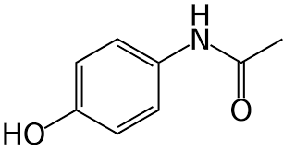
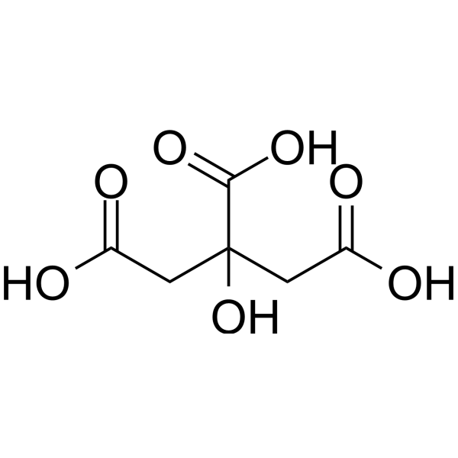
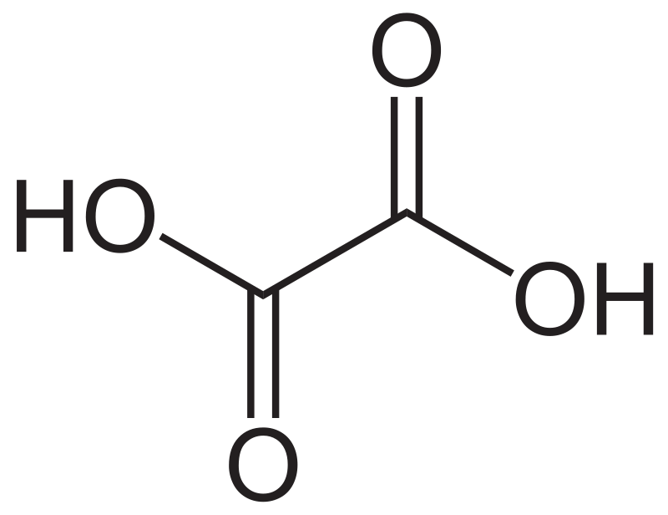
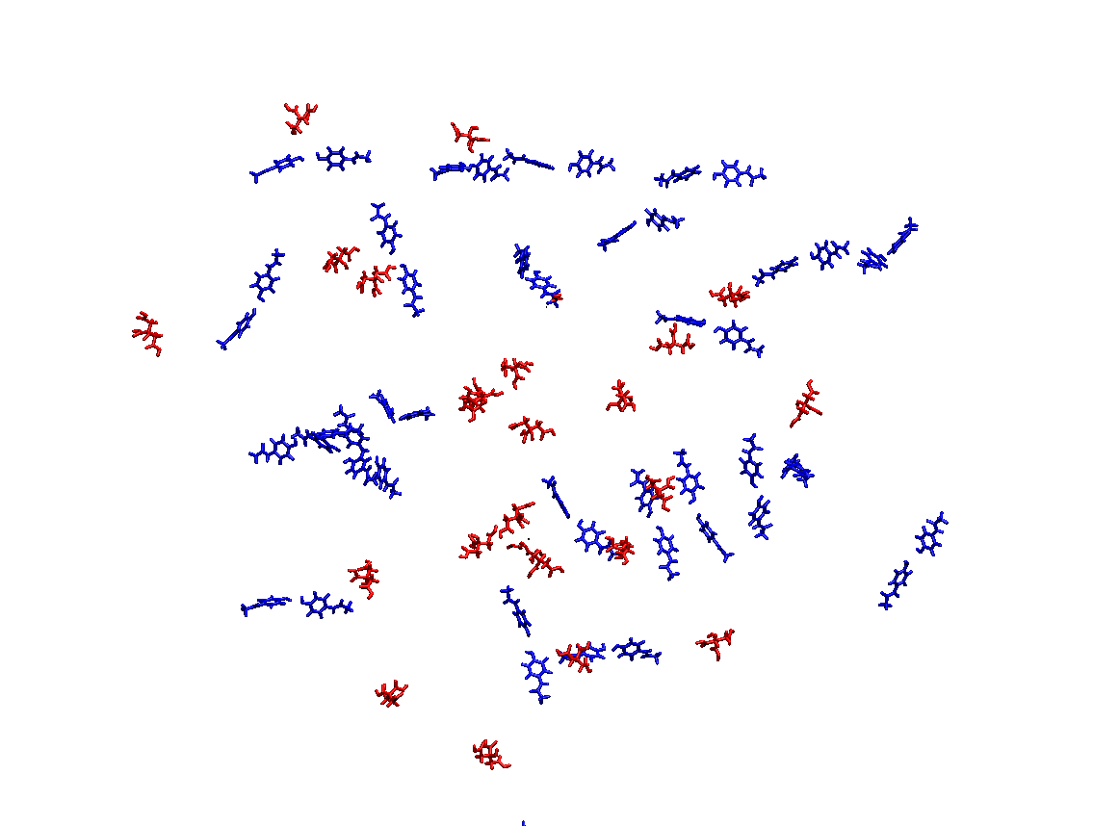
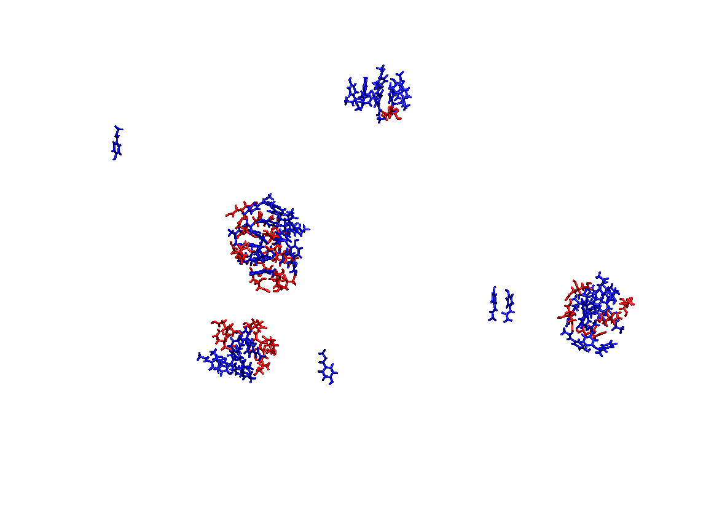
Simulations of the Interactions of Acetaminophen and Various Co-Crystallites Lauren Thompson and Kenneth W. Olsen Department of Chemistry and Biochemistry, Loyola University Chicago 1068 West Sheridan Rd, Chicago, IL 60626
Abstract
Results
Results
To optimize the dissolution of drug molecules, various co-crystallites can be added to the molecule. We studied the interactions between acetaminophen and a variety of co-crystallites that alter the aggregation and dissolution of the crystalline form, specifically the co-crystals citrate and oxalate. Using Molecular Dynamics (MD) simulations, we observed how these various structures of acetaminophen form in water, as well as how they formed in a vacuum. Furthermore, we placed these molecules in a virtual box and observed how the crystal structure dissolved. We will use this data to predict the interactions and relative dissolution rates of these molecules.
a
b
c
d
a
Graph 1. The number of APA atoms within 5 Å of any atom belonging to the cocrystallite, either CIT or OXA, increases sharply between 0 and 12 ns before leveling off. Once the molecules have initially aggregated into groups, these groups interact at a much slower rate.
b
c
e
f
Figure 1. (a) The molecular structure of acetaminophen (APA). The molecular structures of the two co-crystallites used in this assay: (b) oxalic acid (OXA) (c) citric acid (CIT).
g
h
Importance
Graph 2. The number of atoms belonging to a cocrystallite molecule, CIT or OXA, within 5 Å of any APA atoms. The OXA atoms come within 5 Å of APA less rapidly than CIT. This observation may be because OXA has less reactive functional groups that CIT does, meaning it has less ways to interact with APA.
Acetaminophen is a common over-the-counter non-steroidal anti-inflammatory drug (NSAID) that is frequently used to treat fever and pain, with over 60 million Americans taking some form of it weekly. These different forms of acetaminophen are numerous and range from a version that is combined with an opioid, to a version that is found in a Tylenol™ tablet. Despite it being such a commonly used drug known to many, it still poses a risk to users. Acetaminophen, when taken improperly, can cause liver disease, and this acetaminophen toxicity is the cause of 56,000 emergency room visits annually in the United States¹. The consequences of acetaminophen misuse are serious and need to be addressed. While a multifaceted approach is needed and must include large-scale effort to educate consumers about the dangers and proper use of acetaminophen, this research on the optimization of acetaminophen interactions can help the issue. By simulating the interactions of acetaminophen and various cocrystals, we hope to better understand factors that determine dissolution rate and solubility, and translate this knowledge into the pharmaceutical industry, in order to maximize efficiency and reduce dangerous acetaminophen consumption.
Figure 3. Atoms belonging to molecules of APA that are within 5 Å of any atoms of a CIT molecule at time (a) 0 ns. (b) 4 ns. (c) 8 ns. (d) 16 ns. (e) 28 ns. (f) 60 ns. (g) 109 ns. (h) 162 ns.
Discussion
a
b
Molecular Dynamics simulations have been used to predict the interactions between a drug, acetaminophen, and two co-crystallites, citric acid and oxalic acid. The complexes between these molecules were formed rapidly (15 ns) in vacuum simulations (Graph 1, 2). Similar simulations done in water did not form complexes in the first 150 ns. This lack of complex formation in water is likely due to interactions between the drug and the co-crystallites with water, as well as the increase in viscosity (and decrease in diffusion) in water compared to vacuum. The complexes formed in the vacuum simulations provide a model for amorphous solid dispersions commonly used for delivery of drugs with poor aqueous solubility. This is increasingly prevalent as many drugs currently in development are highly hydrophobic. The structures of the amorphous predicted solids show domains within each complex that are only APA or only the co-crystallites (Figure 3, 4). The co-crystal structures of these compounds have closest contacts in one direction of only APA or only the co-crystallite, suggesting that the structure for the amorphous solid nano-complexes may have some similar interaction to those seen in the perfect-order crystalline state. Now that we have developed a method for predicting the structures of amorphous solid dispersions, we can investigate the effect of different co-crystallites in drug dissolution.
c
d
Creating MD Simulations
The structures of acetaminophen and the oxalate and citrate co-crystallites were obtained from Cambridge Structural Database (CCDC). Topography and parameter files for the molecules used were created using CGenFF (cgenff.parameters.org). Using programs such as PackMol², VMD³, and NAMD⁴, conditions were set in a vacuum, and 162 nanoseconds (ns) were simulated. These simulations were run in a vacuum to efficiently simulate the behavior of the molecules in an organic solvent with a very low dielectric constant.
e
f
g
h
References
a
b
1. Agrawal S, Khazaeni B. Acetaminophen Toxicity. StatPearls. Treasure Island (FL): StatPearls Publishing; 2022 Jan. https://www.ncbi.nlm.nih.gov/books/NBK441917/
2. L. Martínez, R. Andrade, E. G. Birgin, J. M. Martínez. Packmol: A package for building initial configurations for molecular dynamics simulations. Journal of Computational Chemistry, 30(13):2157-2164, 2009.
3. Humphrey, W., Dalke, A,. Shulten, K. (1996) VMD - Visual Molecular Dynamics. J. Molec. Graphics. 14, 33-38
4. Phillips, J. C., Braun, R., Wang, W., Gumbart, J., Tajkhorshid, E., Villa, E., Chipot, C., Skeel, R.D., Kale, L. Schulten, K. (2005) Scalable molecular dynamics with NAMD. J. Comp. Chem. 26, 1781-1802
Figure 2. (a) 25 APA molecules and 25 CIT molecules arranged in space in a cube at the beginning of the simulation. (b) The molecules aggregated into clusters after being allowed to move in space in a vacuum system.
Figure 4. Molecules of APA and OXA, 25 of each, assembled in a cube in a vacuum and then allowed to interact.. Their aggregation progression is shown at time: (a) 0 ns. (b) 4 ns. (c) 8 ns. (d) 16 ns. (e) 28 ns. (f) 60 ns. (g) 109 ns. (h) 162 ns.
Notes:
LESS WORDS MORE FIGURES

