Slide 1
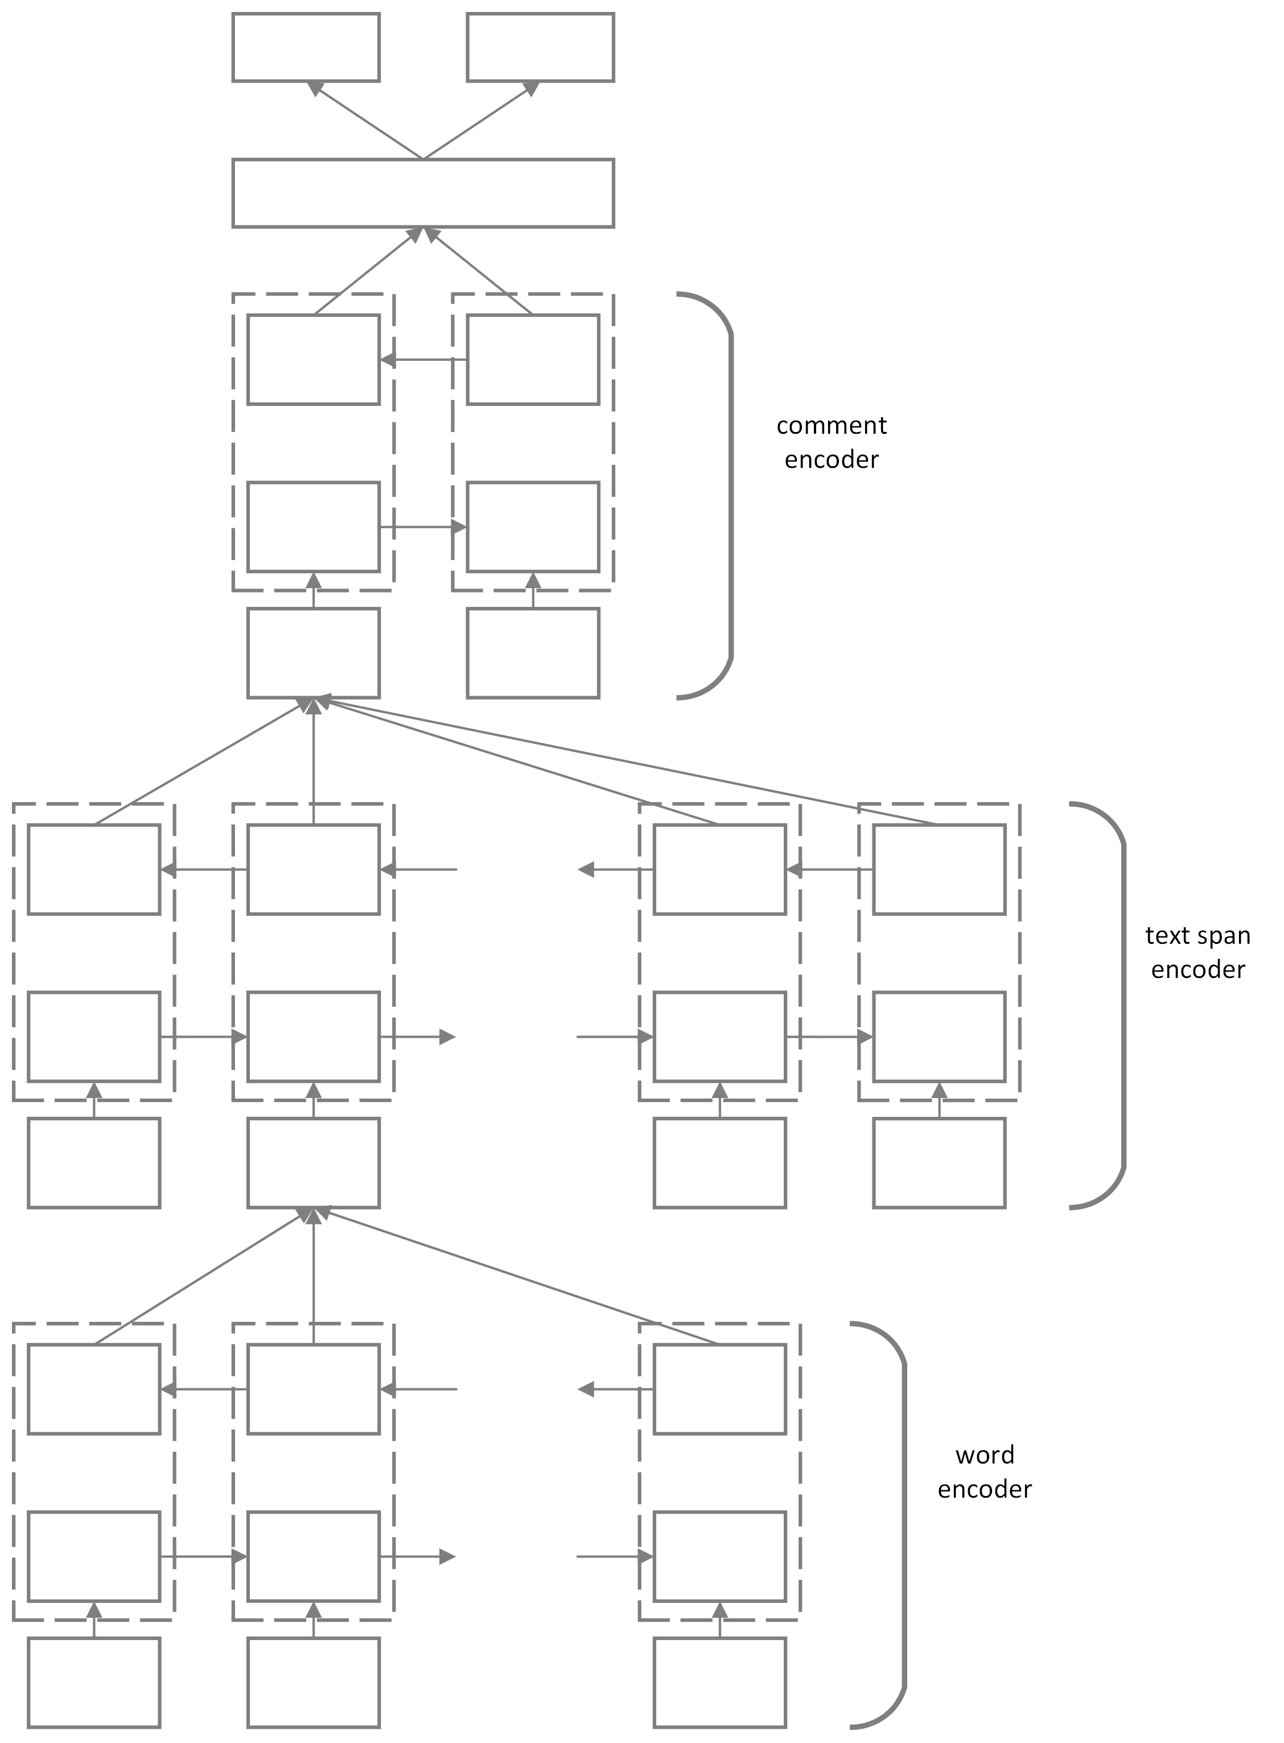
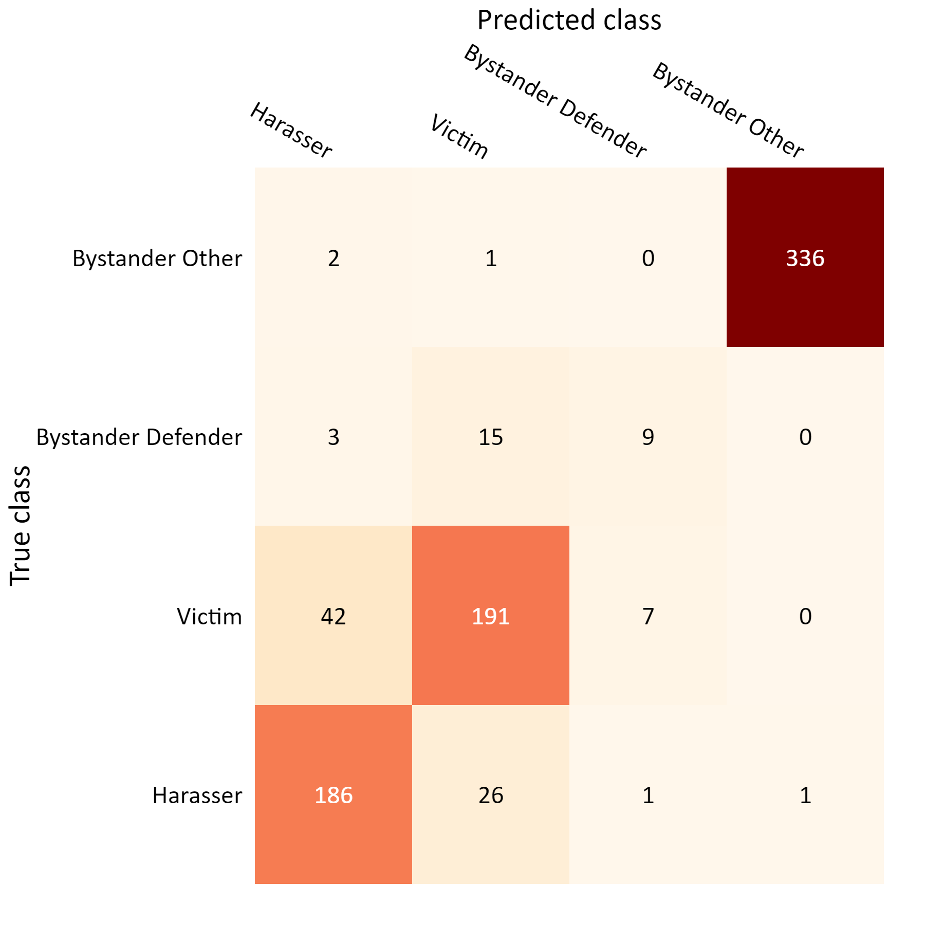
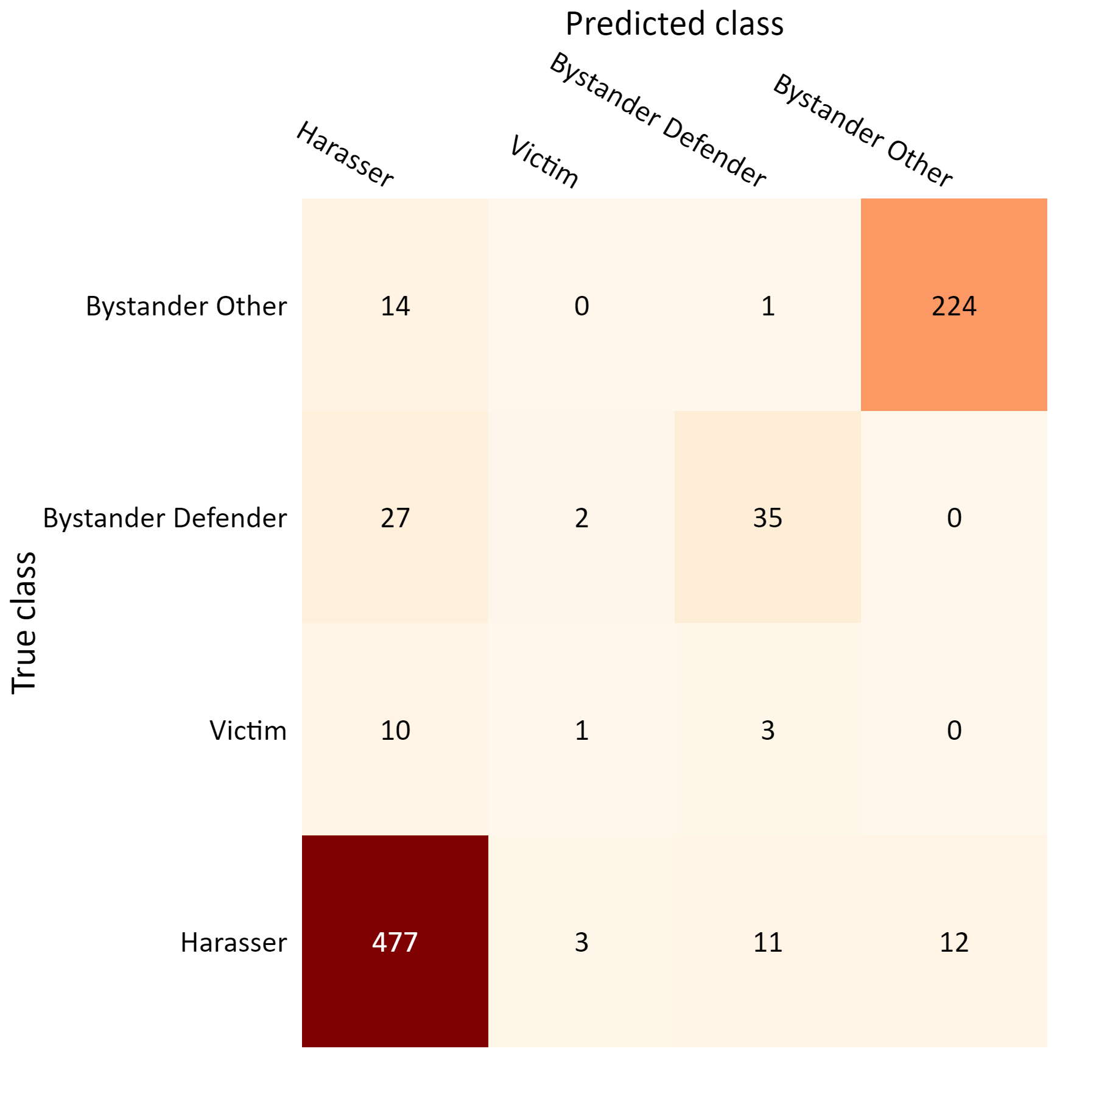
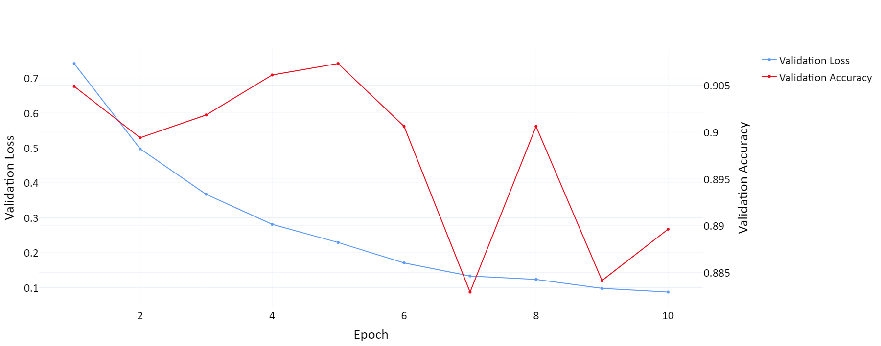
Identifying Participant Roles in Cyberbullying Through Hierarchical Attention Networks
Patrick Furman¹, Yasin Silva¹, Deborah Hall²
1: Loyola University Chicago, 2: Arizona State University
Abstract
Model Framework
Preliminary Results
An initial proof-of-concept model achieved 90.7% accuracy on the validation set but it showed some signs of overfitting due to limited data.
The model performed very well at identifying harassers and unrelated bystanders, but was less confident identifying bystander defenders and victims, particularly within question comments
Cyberbullying is a widespread form of online harassment with serious negative consequences for victims. In a cyberbullying instance, participants can be classified as harassers, victims, or bystanders. Identifying the roles of participants in cyberbullying instances can facilitate more effective intervention in these instances. We propose a hierarchical attention network to automatically classify the roles of users in cyberbullying conversations on ASKfm, a social media platform where users can ask and answer questions anonymously. Our model combines word, sub-sentence, and sentence-level attention mechanisms to represent the structure of posts on the ASKfm platform and capture relevant features for classification.
$$h_{q}$$
$$h_{a}$$
Key Components
Hierarchical representation of a post in three levels
Attention at each level to distinguish important features
$$v$$
Class | F1 Scores for Questions | F1 Scores for Answers | Combined F1 Scores
Harasser | 0.9253 | 0.8322 | 0.8972
Victim | 0.1000 | 0.8076 | 0.7789
Bystander Defender | 0.6140 | 0.4091 | 0.5570
Bystander Other | 0.9432 | 0.9941 | 0.9731
$$c_{1}$$
$$c_{2}$$
Methods
Basic data preprocessing – removal of punctuation, tokenization, and padding shorter comments
Word embeddings used from a word2vec model pretrained on Twitter data [1] to capture semantic meaning common to social media and fine-tuned on ASKfm dataset [2]
Information for a post is broken down into three levels: comments, text spans, and words. These components are used to generate a post-level representation following a HAN framework [3]
Participant roles are predicted simultaneously based on the post-level representation for the authors of both the question and answer comments
1a. Confusion matrix for answers
1b. Confusion matrix for questions
$$t_{11}$$
$$t_{12}$$
$$t_{1n}$$
$bow$₁
2. Model validation loss and accuracy during training
Future Work
Comparison with alternative transformer-based architectures not reliant on text span labels
Multi-stage models to include general cyberbullying detection and text span labeling
Conversation-level analysis to identify patterns across several posts for a single user
$$w_{21}$$
$$w_{22}$$
$$w_{2n}$$
Data Structure
Posts for users are grouped into conversations each of which consists of one Q&A pair
Each comment is labeled with the degree of cyberbullying harmfulness (none, mild, severe) and for cyberbullying-related comments the role of the author (harasser, victim, bystander defender, bystander assistant) in the interaction is identified
Each comment in a Q&A pair may contain any number of highlighted text spans (as shown below) identifying what type of language is used
Text spans can be labeled multiple times and may overlap
References
[1] Godin, Fréderic, et al. "Multimedia lab@ acl wnut ner shared task: Named entity recognition for twitter microposts using distributed word representations." Proceedings of the workshop on noisy user-generated text. 2015.
[2] Van Hee C., Verhoeven B., Lefever E., De Pauw G., Daelemans W. and Hoste V. (2015c). Guidelines for the Fine-Grained Analysis of Cyberbullying, version 1.0. Technical Report LT3 15-01, LT3, Language and Translation Technology Team–Ghent University.
[3] Cheng, Lu, et al. “Hierarchical Attention Networks for Cyberbullying Detection on the Instagram Social Network.” Proceedings of the 2019 SIAM International Conference on Data Mining, 2019, pp. 235–243., https://doi.org/10.1137/1.9781611975673.27.
¶ [awh thats cute that you send yourself messages just for people to think you're not hated]^{GEN_INSULT} :') looooool you're so gay. [So's your mom]^{ATTACKING_RELATIVES} :)
¶ It wasn't me & [don't talk about my mom]^{ASSERTIVE_SELF_DEF} hate in me all you want but you've just past the limit [I am going to find out who you are & I swear you are going to regret it.]^{THREAT_BLACKMAIL}
Acknowledgement
This work was supported by National Science Foundation Award # 2227488 and a Google Award for Inclusion Research
http://bullyblocker.cs.luc.edu/

