Slide 1
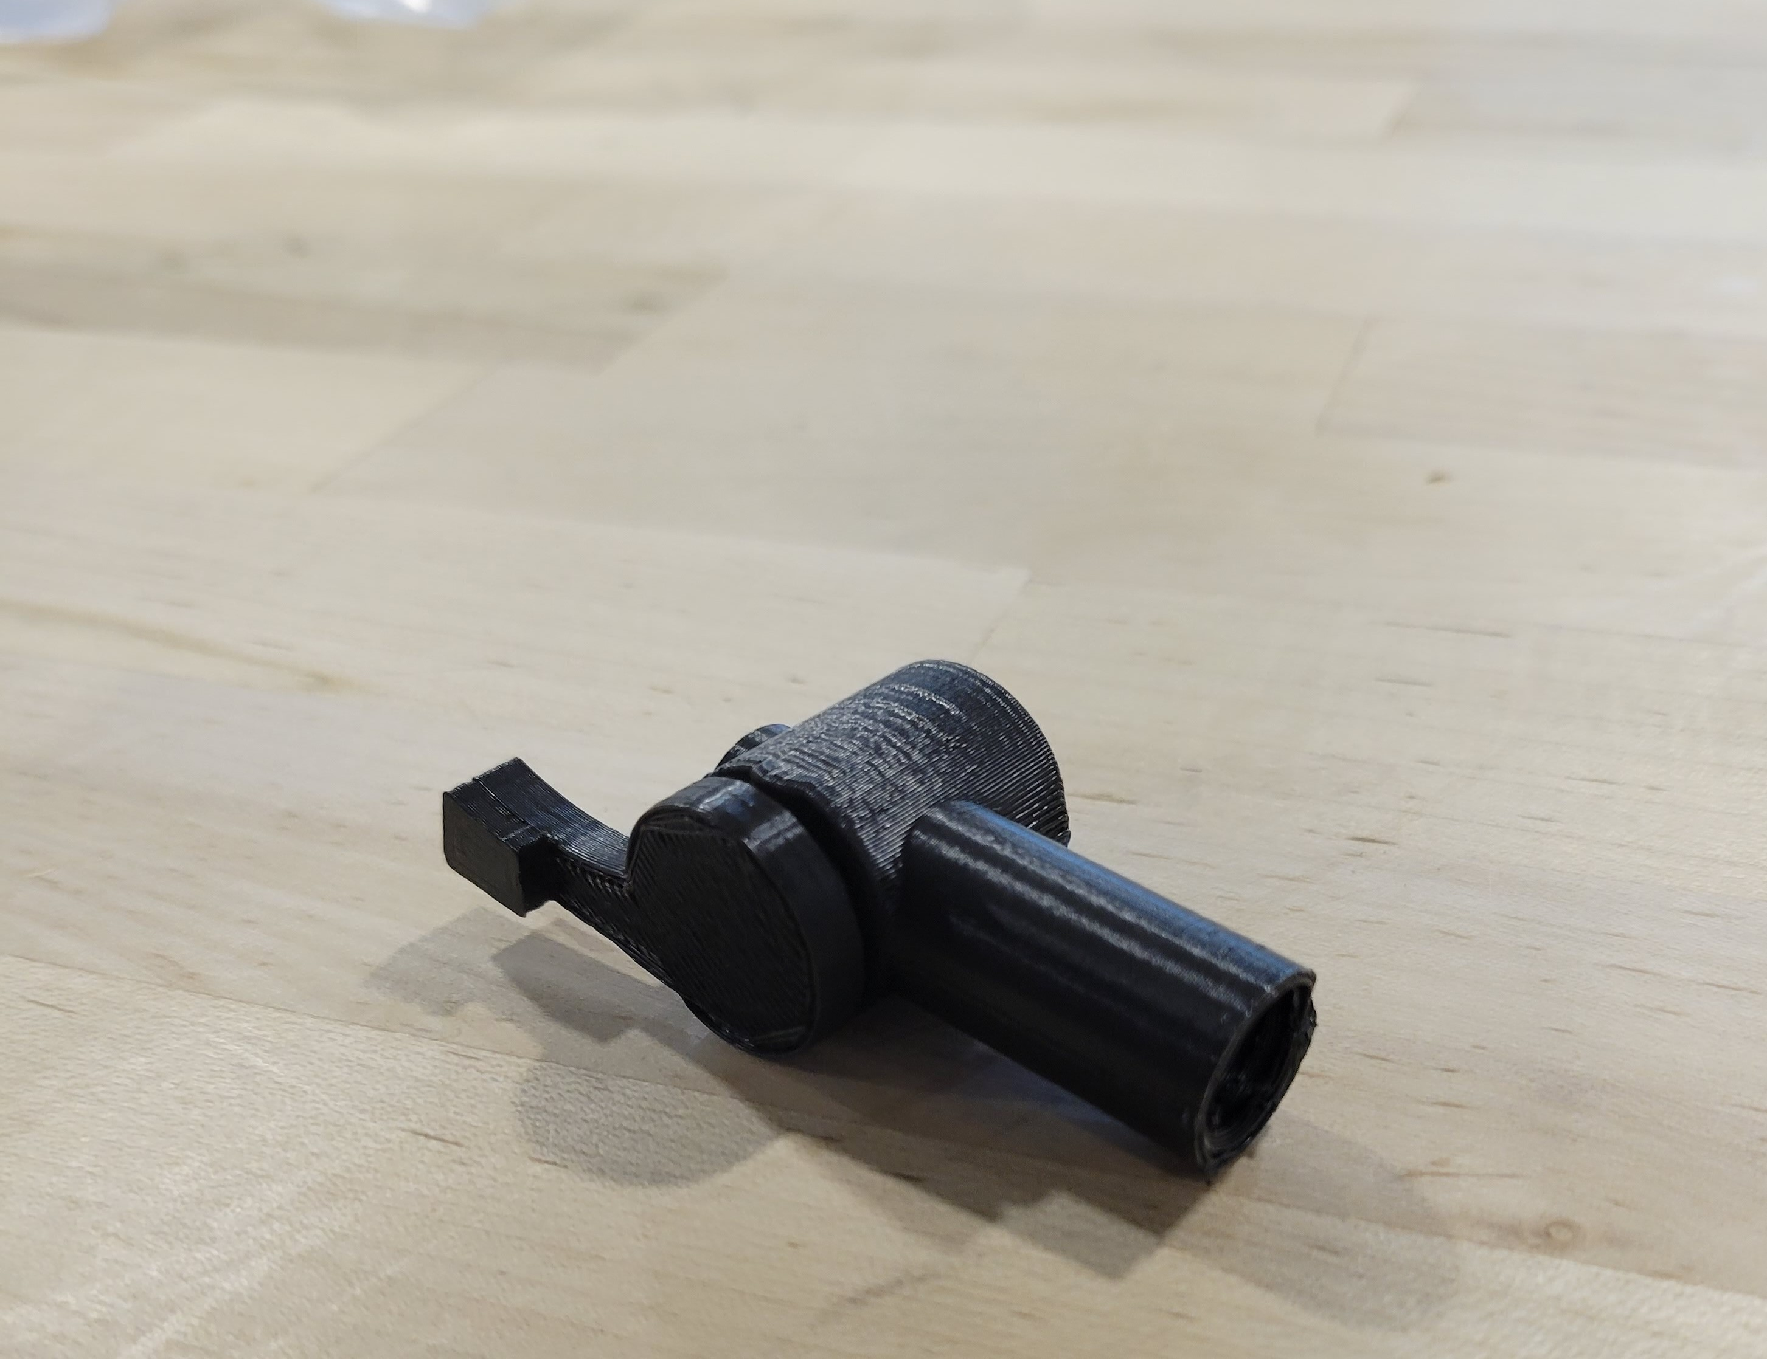
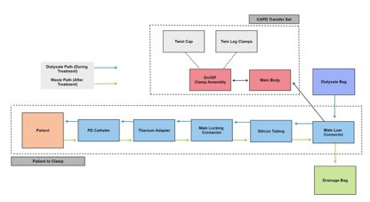
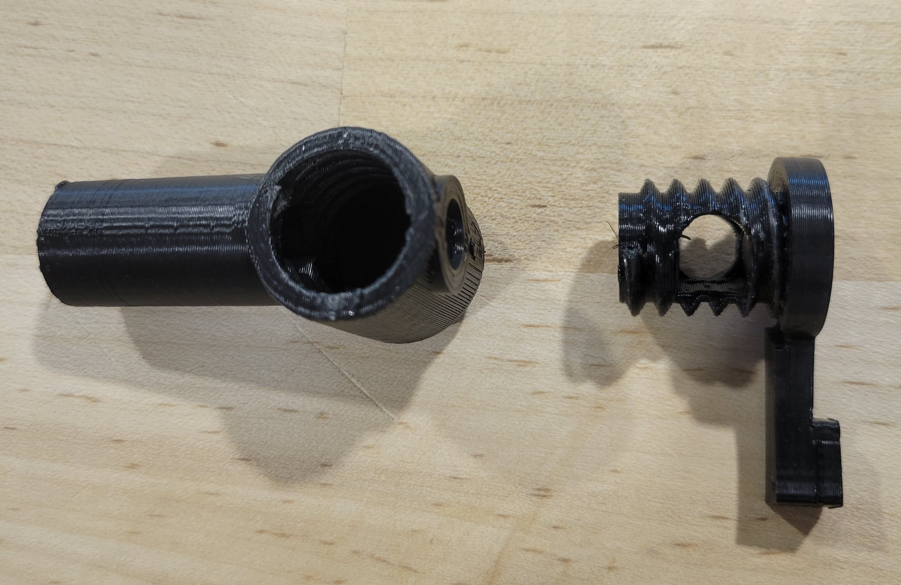
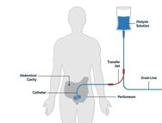
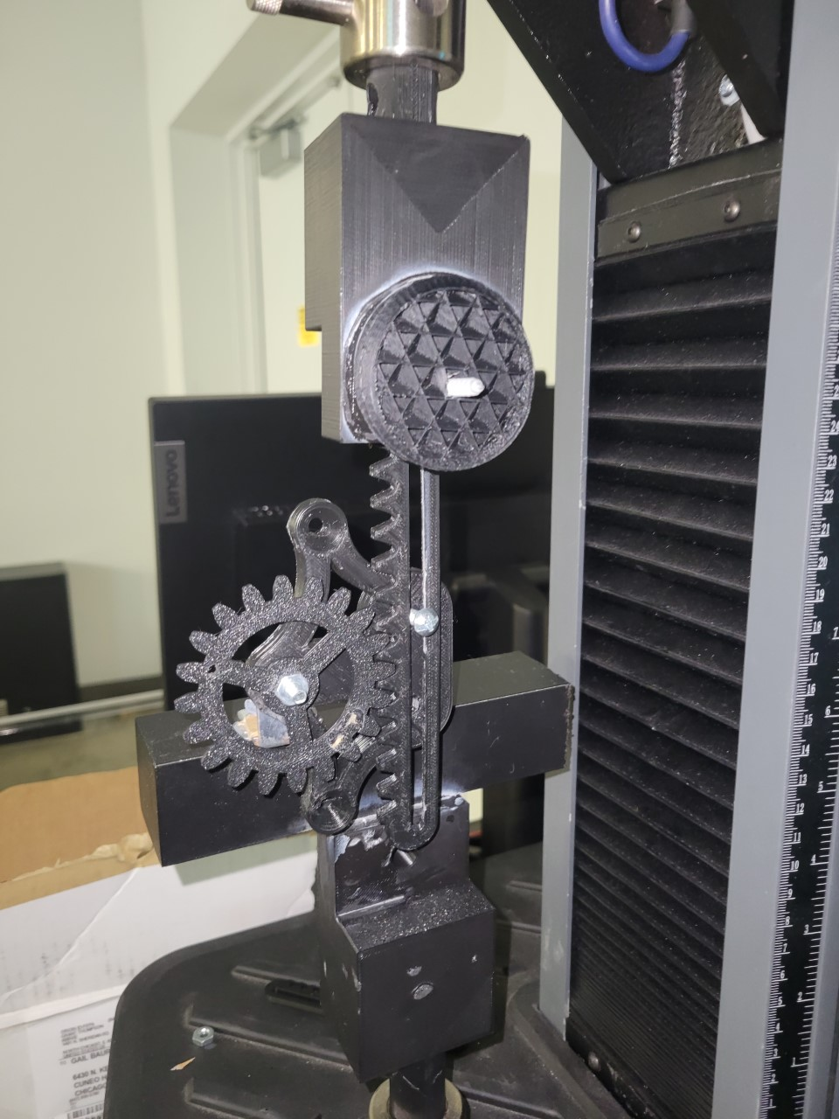
Redesigning transfer set for peritoneal dialysis
Sponsor: Baxter International; Advisors: Dr. Johnson and Dr. Baura
Sharf Abutaleb, Jaad A'Rafat, Chris Castillo, Peter Saba
Abstract
This project encompasses the use of improving the previous transfer set (MiniCap Extended Life PD Transfer Set – 5C4160) in peritoneal dialysis treatment. These improvements include a focus on ergonomics, ease of use, biocompatibility, cost efficiency, safety, wearability, psychological and physical comfort, and manufacturability. Engineering standards from various universal engineering handbooks are applied to the project to ensure compliance with FDA guidelines and conditions. Important considerations are mentioned in accordance with decisions regarding the overall design of the new transfer set clamp including public health, safety, welfare, global, cultural, social, environmental, and economic factors. The design progress measure is given to address the current state of the project’s schedule and elaborate further on whether the project remains on track with the project plan developed at the beginning of the semester.
Introduction
Peritoneal dialysis is a treatment that affects over 38 million people worldwide for end stage kidney disease. Patients with this condition must undergo a series of steps to successfully eliminate the toxic waste, primarily, through the direct instillment of dextrose solution to cleanse their kidney followed by the direct drainage of the waste out of the body. With sponsorship from Baxter, a medical device giant, a group of Loyola engineering students have redesigned an integral part of renal therapy with a new transfer set prototype. This transfer set is the medical device that allows for peritoneal dialysis patients to properly undergo their treatments. The clamp of the transfer set dictates the status of flow mechanics within the transfer set, allowing for a free flow or no flow in the system. This new, reimagined prototype for the transfer set clamp will help elderly patients (over the age of 65), and those with low dexterity, to efficiently engage and disengage the clamp when needed using research in materials, patient psychology, and more.
Baxter's problem statement
"Explore better options to occlude the silicone tubing segment on the transfer set that are intuitive, easy to manipulate and give a sense of security for patients performing the treatment."
Results
After working through the development of several different designs, the final transfer set prototype (below) was printed.
System Diagram
Target Demographic
Average PD patient age: ~ 60 to 70 years old
Neuropathy: Poor sense of touch, inability to differentiate fine details or textures through touch
Low Dexterity/Strength
Loss of fine motor skills
Poor eyesight
Next steps
Once the proper testing equipment is configured, the final prototype will be tested to ensure the quality and robustness of the design. The figure below displays a pinion and rack to create a linear actuator that will simulate the use of the transfer set over time.
Design Matrix
CLEANLINESS [C]:
I: Easy to clean, hard to get dirty
II: Hard to clean, less likely to get dirty
OR
Easy to clean, more likely to get dirty
III. Hard to clean, easy to get dirty.
SECURITY [S]:
I: Strong locking mechanism with clear cue
II: Strong locking mechanism with vague cue
III: Weak locking mechanism with clear cue
IV: Weak locking mechanism with vague cue
EASE OF USE [E]:
I: Less force and time than initial design.
II: Equal force and time than initial design.
III: More force and time than initial design.
MANUFACTURABILITY [M]:
I: Manufacturable-friendly
II: Manufacturable with some complications
III: Not manufacturable-friendly
Design Requirements
Must be a closed system
Less pieces; less cost
No undercut extrusions; manufacturability
No interference with direct flow path
Optimal cleanability
Optimal comfortability
One-handed (preferred but not required)
Design justification
The fundamental principle behind the lever design is to offer a mechanical advantage to the user by implementing a lever arm to apply shear force to the silicon tubing.
By creating a fulcrum between the silicon tubing and the force of the user, the user can use the lever close the silicon tubing with less force than it would take to close by hand. This accounts for low dexterity and strength.
The lever is an intuitive solution to physical ailments such as neuropathy and poor eyesight as it requires the user to orient the lever arm in a distinguishable position.

