Slide 1
49th Ward Internship Experience
Zoe Ashcraft

Slide 2
Background
Aldermen are elected members in City Council, Chicago’s legislative branch, who serve for 4 years.
Chicago has 50 elected aldermen who each represent a district (or ward) in the city.
Council is called into session to consider ordinances, orders, and resolutions whose subject matters can vary from code changes to environmental protections.
In addition to legislation, alders take a variety ward-specific requests - whether its infrastructure improvements or development proposals.
Notes:
Talk about how this is unique to Chicago - highlight that I did not know what an alderman was until I started my education in the city.

Slide 3
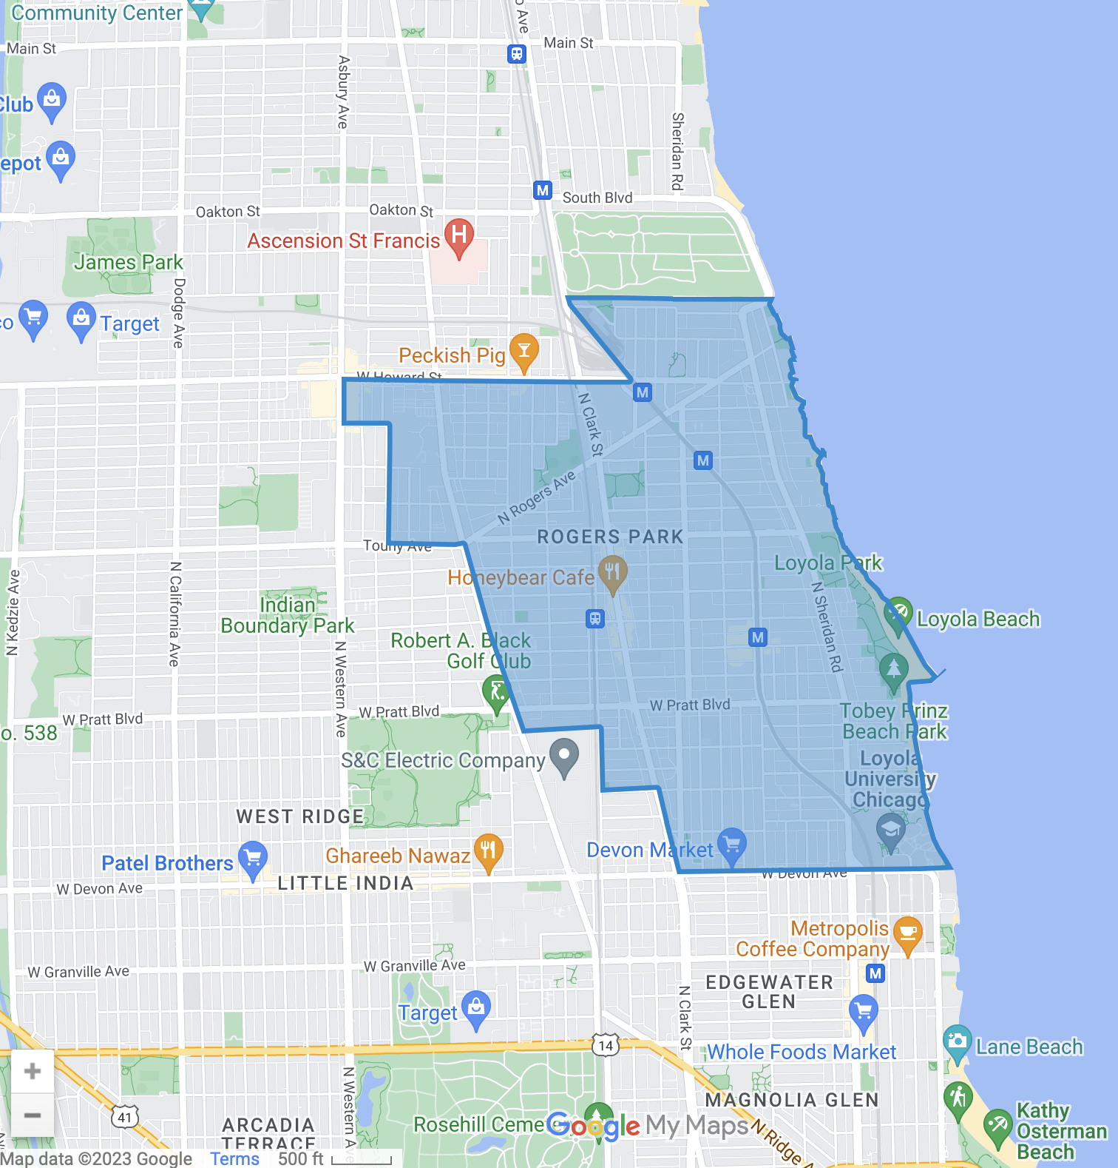
The 49th Ward
Comprised of Rogers Park and parts of West Ridge
Bordered by Evanston to the north and Edgewater to the south
Represented by Alderwoman Maria Hadden
Notes:
Loyola is in the 49th ward!

Slide 4
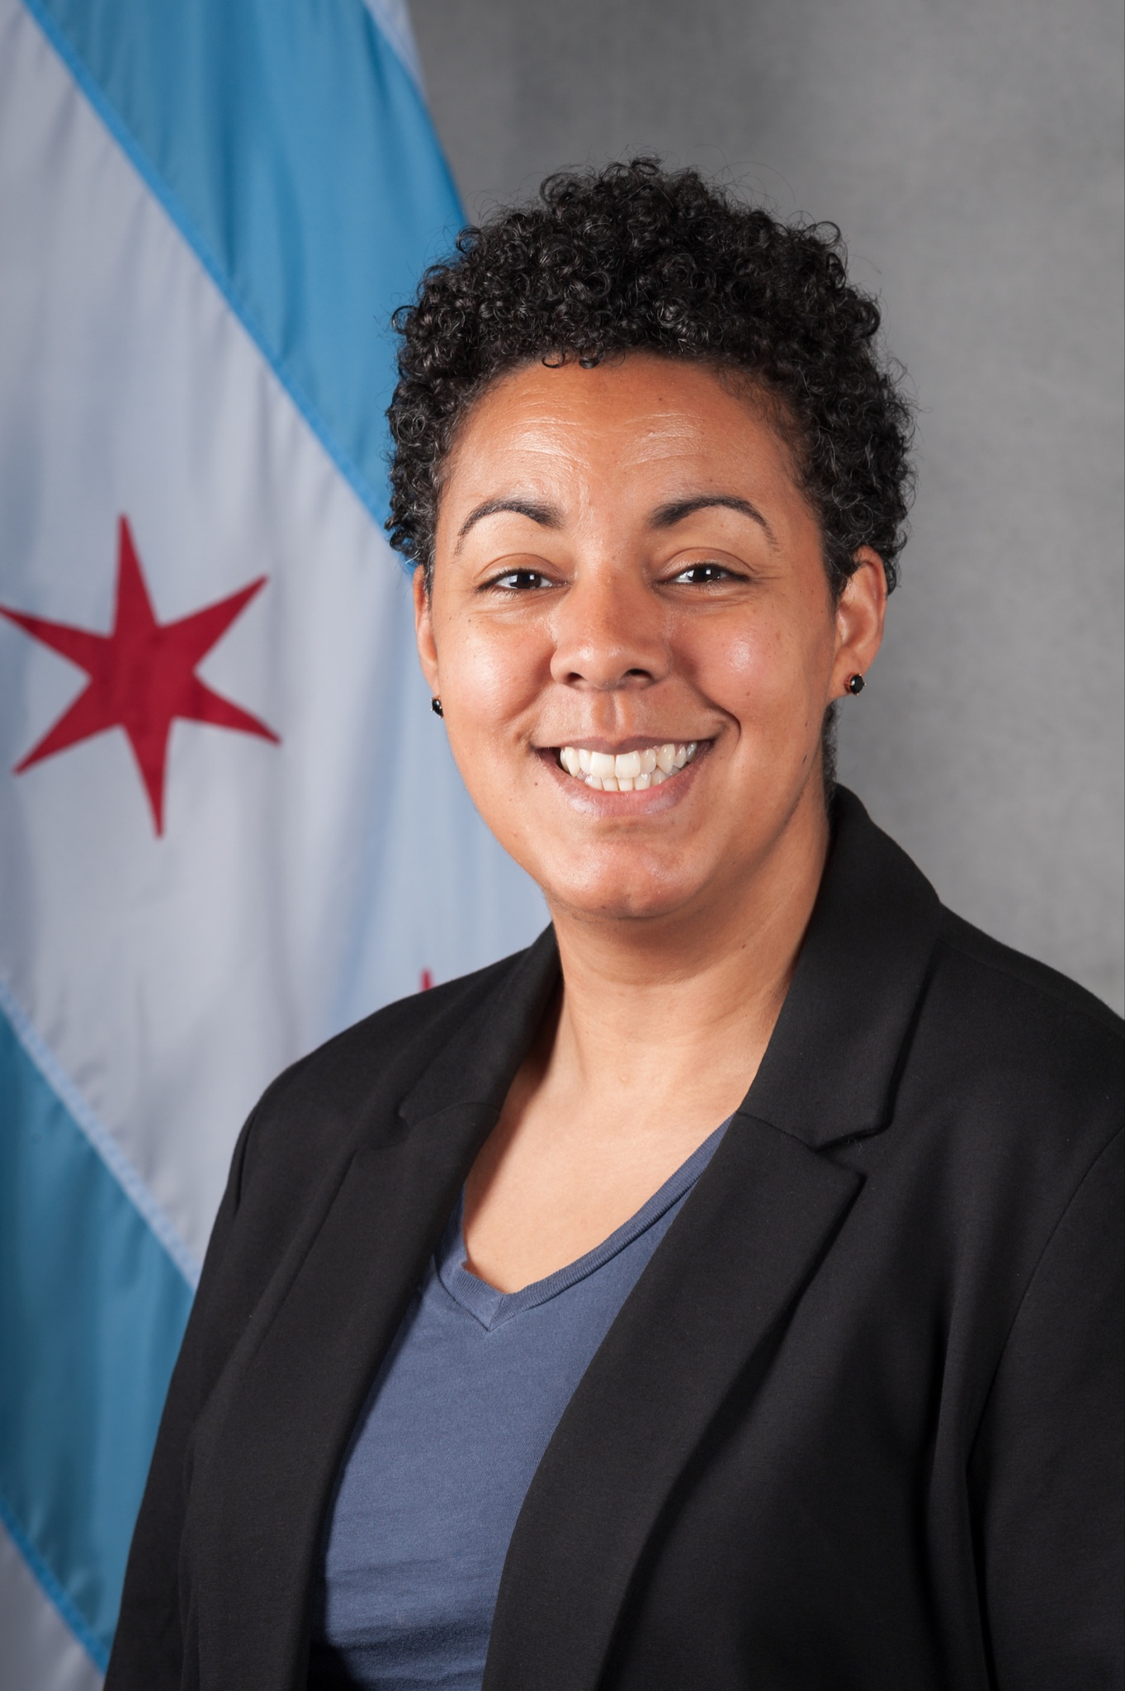
Alderwoman Hadden
Ald. Hadden graduated from The Ohio State University with a B.A. in International Peace and Conflict Studies before she moved to Chicago.
She is the first Black, queer woman elected to Chicago City Council.
Before becoming Alderwoman, she was the Executive Director of Our City Our Voice, a national nonprofit organization she founded to enable communities and local governments across the country to redesign democracy for more empowered and equitable participation.

Slide 5
Issues We See
01
02
Infrastructure
Housing
03
04
Federal Issues
Resources
These issues can range from potholes to cracked sidewalks to blocked sewers.
Housing issues can include neighbor disputes, troubles with management companies, and inquires about affording housing.
Federal issues can range from lost USPS packages to immigration questions. While we cannot help with these issues, we can connect them to the right party.
We connect constituents to a wide variety of resources - mental health help, food banks, legal resources etc.
Notes:
Federal - we work closely with Congresswoman Jan Schakwosky so we often refer these folks to her! Also, a staff member interns in her office, so we have some unique insight on how to help individuals the best and the innerworkings of Schakowsky’s office.
Resources - we work very closely with Trilogy and often point constituents who need mental health help in their direction. Additionally, A Just Harvest has a close relationship with us along with Rogers Park Food Not Bombs.
General Resources (and housing specifically) - Northside Community Resources! An incredible resource in Rogers Park. We work very closely with their staff and often make comments about not knowing what we’d do without them. Oftentimes, they are the first resource we direct our constituents to.
MISC - we see so many other issues within the Ward that do not fit into these categories. In the office, we describe each concern as being a puzzle. We think and adapt to each situation in order to solve it.

Slide 6
My Role
I primarily work the front desk - answering phone calls and helping anyone who stops by the office in person
Submit 311 service requests on behalf of constituents
Maintain multiple spreadsheet logs to track a variety of issues
Daily permits in the ward, water billing issues, etc.
Work on projects that help the office run smoother/issues get resolved faster

Slide 7
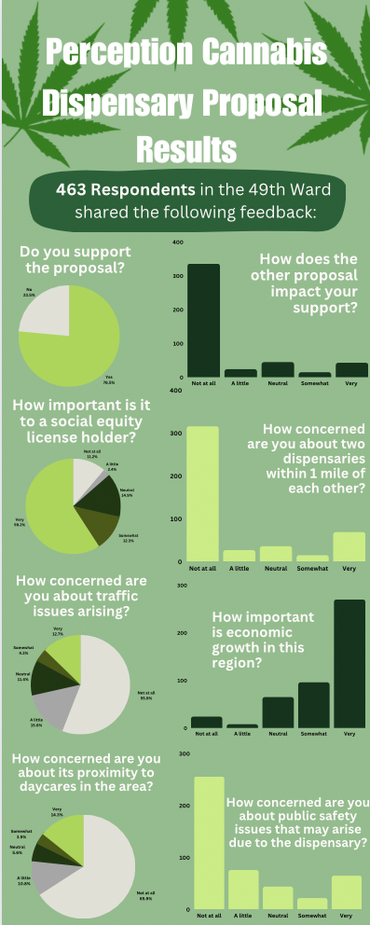
Project Example
Organizing/reviewing community feedback for 2 potential businesses in the area
Creating an infographic with the information
Notes:
After the survey was closed, I confirmed whether the respondents lived in the ward, found out how far the individual lived from the proposed business site, and made a list of the top concerns individuals had to see how we could address them.

Slide 8
What Made This Semester Unique
Election year!
We dealt with an influx of calls relating to the election.
However, we are a government office.
Could not answer any political question
Could answer logistical questions - polling place, how to register, etc.
Provided me with insight about how Chicago elections work that I never would have gotten if it was not election season - both at a local level and the mayoral level.

Slide 9
What I Learned
Information:
Different departments in the city
How work in the city gets done
More in-depth knowledge about Rogers Park
Importance of community and leadership
Skills:
Teamwork & Independence
Communication skills
Customer service
Newfound appreciation for making a change at a local level

Slide 10
Key Takeaways
01
02
Teamwork Matters
Brush Off Negativity
03
04
Vote!
Chicago Pride
The 49th Ward Office works efficiently and effectively because the staff works together.
The office often hears the most from those who criticize the work we do. Just because those select few are the loudest does not mean our work goes without appreciate. Government service matters.
The city of Chicago has many moving parts. It would not run without the hard work of those working in public service. Also - the city itself is pretty great!
Aldermen make a huge difference both locally and in City Council. It’s important to pick who you want to represent you.

Slide 11
—Margaret Mead
“Never doubt that a small group of thoughtful, committed citizens can change the world; indeed, it's the only thing that ever has.”
Notes:
I would like to leave you all with a quote that has helped remind me just how important the work I do is. Sometimes my days feel repetitive and like no genuine action is being done. I just have to remember to: “never doubt that a group of thoughtful, committed citizens can change the world; indeed, it’s the only thing that ever has. Thank you for your time.

Slide 12
Thank You!

