Slide 1
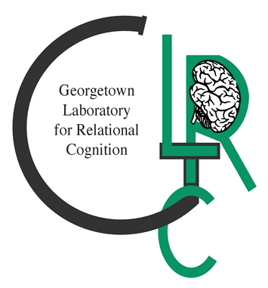
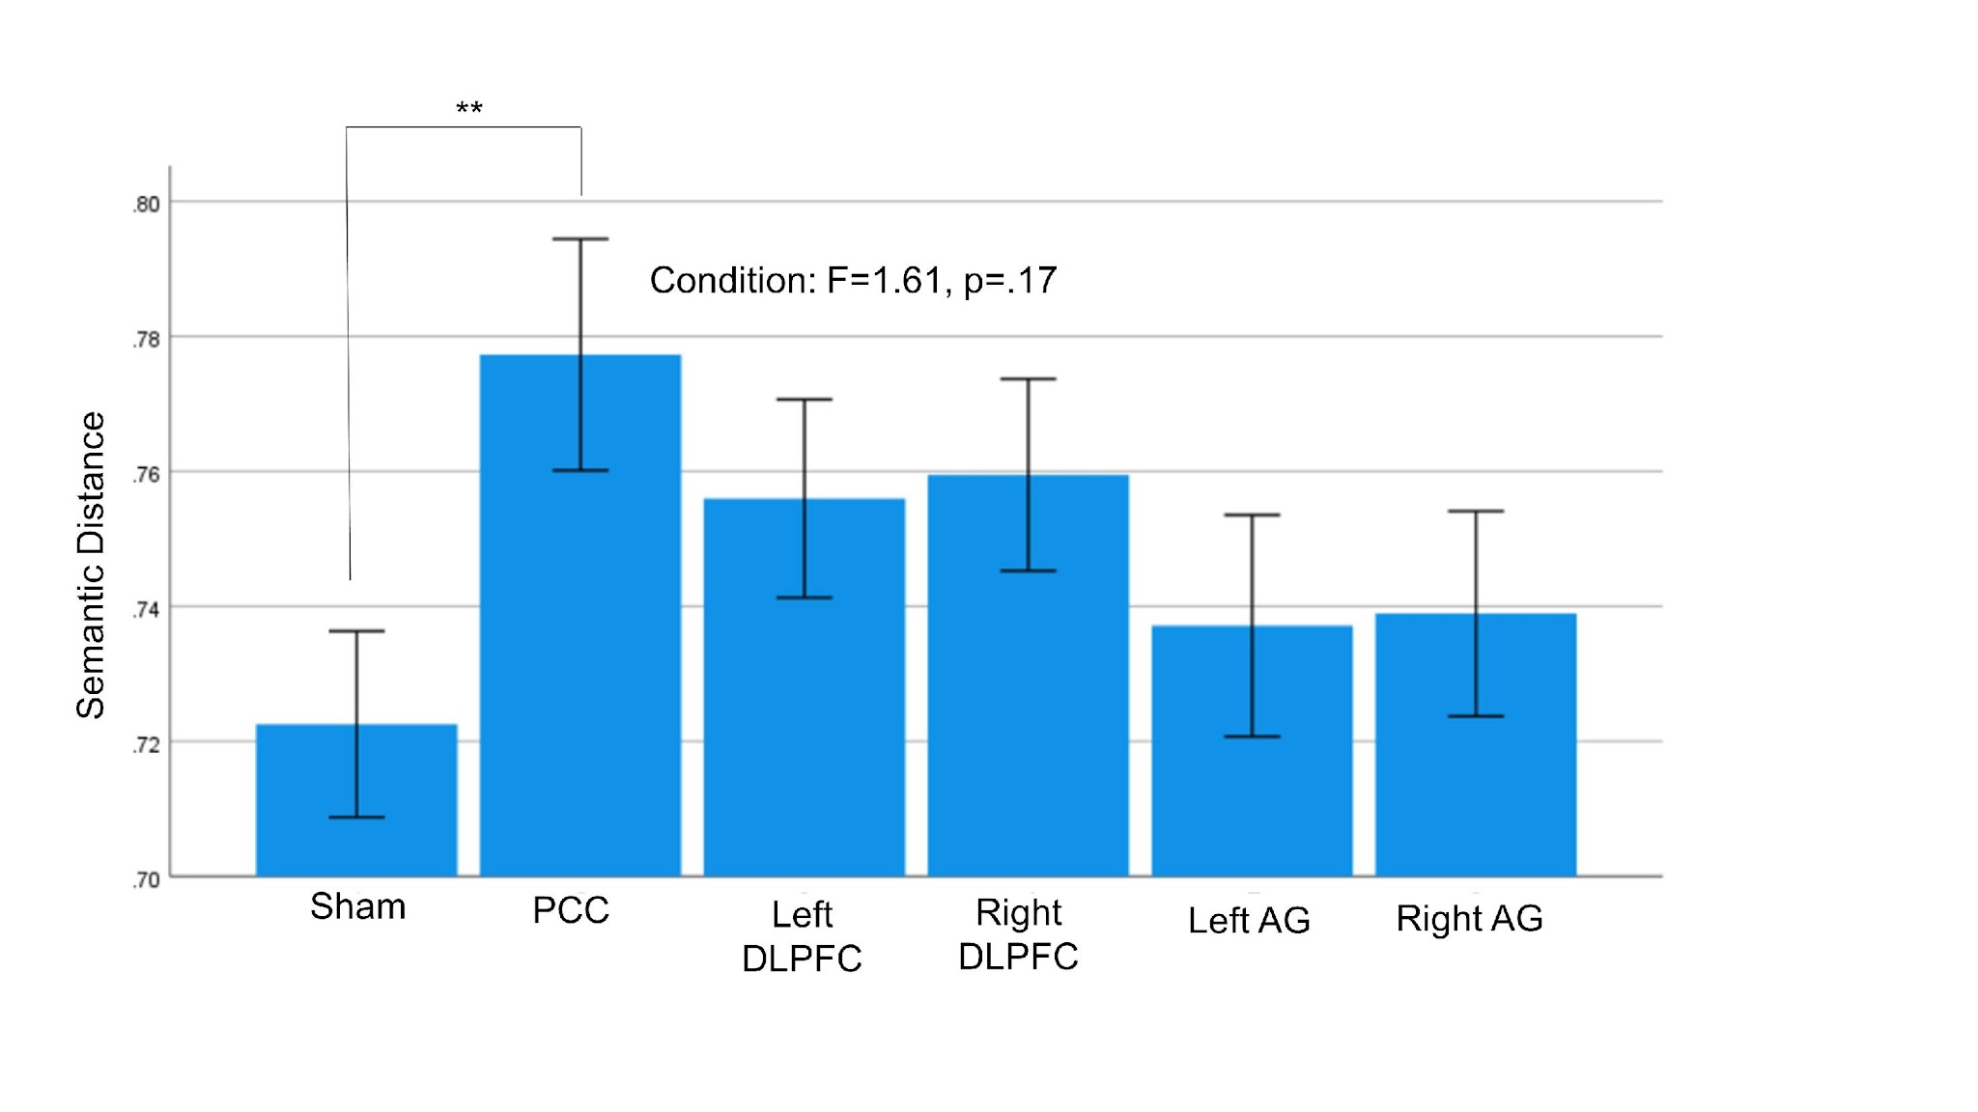
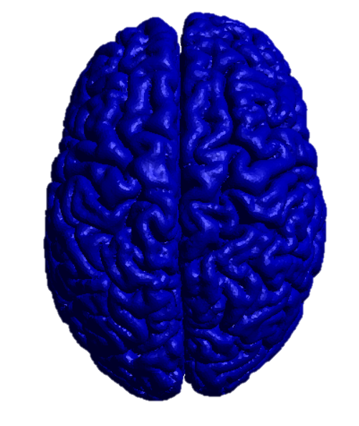
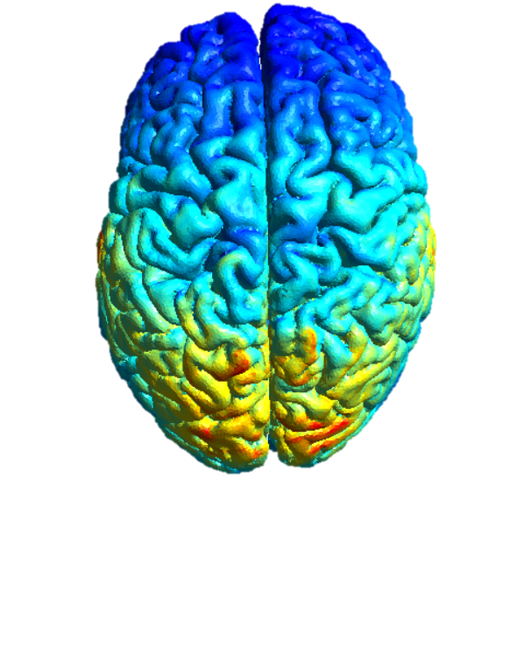
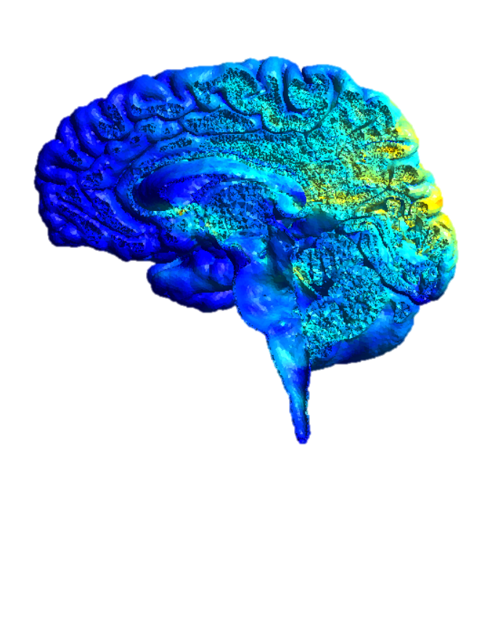
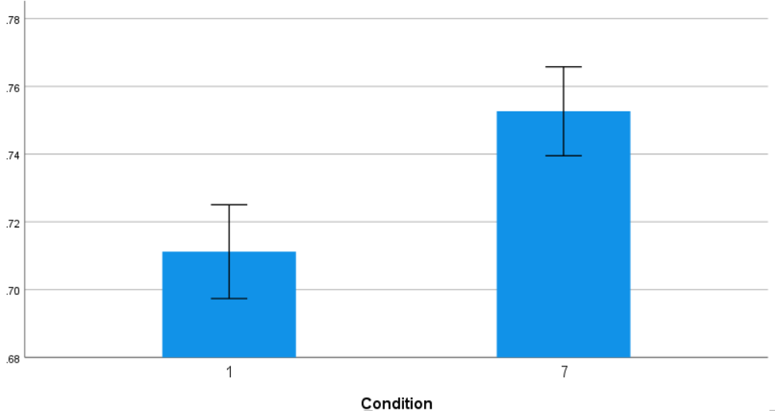
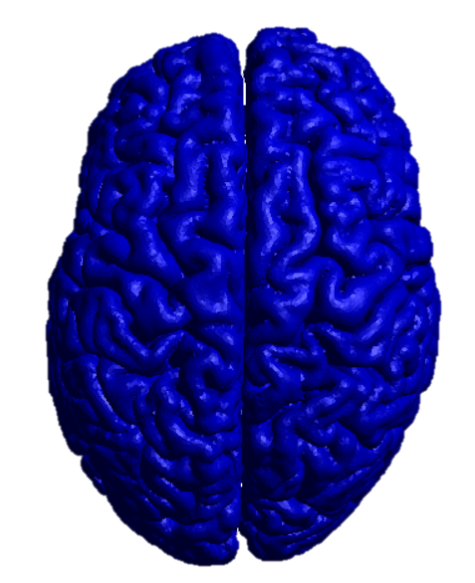
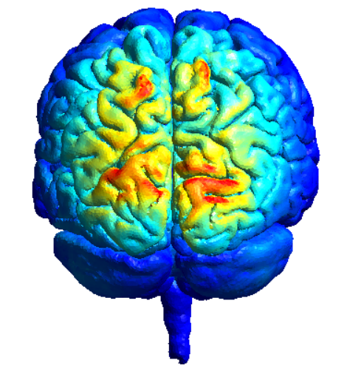
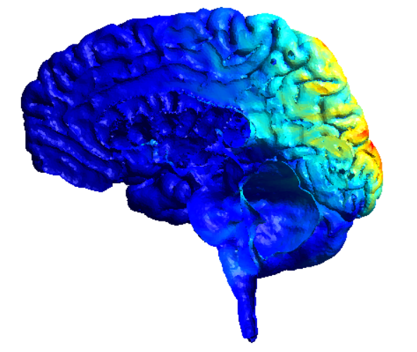
Neuromodulation of the Default Mode Network Enhances
Forward Flow: A Three Study Review
DJ Capetillo¹, Robert Cortes², Sydney Samoska¹, Roger Beaty³, Adam Green², & Robert Morrison¹
¹Loyola University Chicago ²Georgetown University ³Penn State University
Introduction
Study 1: Forward Flow
Results
Previous neuroimaging research has found that creative cognition is associated with activity and connectivity within the executive control network (ECN) and default mode network (DMN). To date this line of research has been correlational.
Recent neuroimaging research has highlighted the upregulation of the DMN using ⍺-tACS
To operationalize creativity, we used the Forward Flow task
Study 1 aimed to provide evidence of the role of the DMN in creative cognition
Study 2 aimed to replicate the effect of DMN upregulation using ⍺-tACS
Study 3 will evaluate the behavioral effects of tDCS, ⍺-tACS, and transcranial random noise stimulation (tRNS) compared to sham
Goals:
Enhance creative output in participants by use of tDCS and ⍺-tACS.
Replicate behavioral effects across studies.
Study 1
No significant differences between sham and any other stim condition for the Forward Flow
Significant difference in Forward Flow score (p=.003) between sham and PCC conditions using tDCS
Study 2
Significant difference in Forward Flow score (p=.018) between sham and PCC conditions using ⍺-tACS
Study 3
Preliminary findings show strong effects in Forward Flow between both tDCS and sham conditions (p=.02), as well as ⍺-tACS and sham conditions (p=.02)
Sham N=16
Posterior Cingulate Cortex N=17
Study 2: Forward Flow
Methods
*
Study 1
Data collected equally across 3 universities
N=36, between-subjects, double-blind
2 mA HD-tDCS using Soterix 4x1 vs sham
Study 2
Data collected equally across 3 universities, N=36
N=36, between-subjects, double-blind
2 mA alpha frequency HD-tACS using Soterix 4x1 vs sham
Study 3
Data collected at Georgetown
tDCS, alpha-tACS, and sham
N=14, between-subjects, double-blind
Conclusions
& Future Directions
The findings from both Study 1 and Study 2 support a causal role of the DMN in Forward Flow performance
Replicate behavioral effects of both stimulation types
Conduct a within-subjects design paired with neuro-imaging (fMRI at Georgetown and EEG at Loyola) to examine the effects of tDCS, ⍺-tACS, tRNS, and sham conditions
Sham N=18
Posterior Cingulate Cortex N=20
Tasks
Forward Flow
Table, Snow, Paper
Remote Associates Test
15 items, 15 seconds each
Verbal Fluency Task
2 tasks (letter L, fruits & vegetables)
Alternative Uses Task
Fork, Lamp, Clock, Soap, Stick, Marble
We would like to thank the Loyola University Chicago Carbon Undergraduate Research Fellowship, Cura Scholars Program, Mulcahy Fellowship, Provost Fellowship
WISER Fellowship, Psychology Department and Dr. Toby Dye for their generous support of this project.

