Slide 1
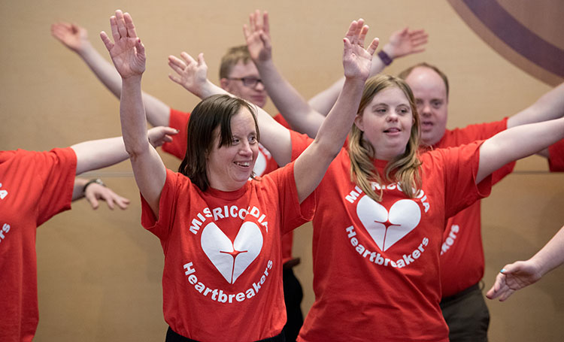
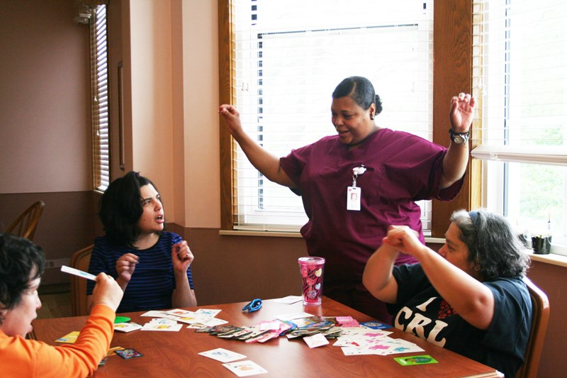
Developmental Internship At Misericordia
Kishan Patel - Intern
Internship Overview
This internship is a year long organizational and community leadership opportunity through the lens of a Social Justice Internship placement. As a course suggestion, students will work approximately 10 hours per week (totaling 250-275 hours) over the course of the year. Students will reflect on their work experience in the context of organizational leadership, civic engagement, asset-based community development, leadership in the community, and personal development.
Academic internships provide Loyola University Chicago students with an opportunity that is related to this course for purposes of reflection and deeper understanding of the complex inter-connectedness between leadership, organizations and civic engagement as experienced through work.
Introduction
The Developmental Training Program at Misericordia support participants through the development of life skills, core learning objectives, vocational skills, and employment. This is achieved in an environment that promotes person centered planning and an individualized approach. Participants also enjoy a variety of services and experiences, such as wellness, community, art, cultural events, horticultural programs, therapeutic and sensory activities. The DT Programs are committed to enable all participants to attain a maximum level of social recreational activities, community-based experiences, and personal skill development.
Interns have the opportunity to assist DT Instructors in a variety of classroom and extracurricular environments. Interns also assist with unit-based curriculum and lesson plans.
Identity and Motivations
A brief background on myself, I am Kishan, a junior Advertising/Public Relations major with minors in Biology on a pre-med track. I am from Illinois, but I went to high school in Ohio when my parents moved a few of their businesses there. On a higher note, I am glad to be in Chicago, but the adjustment to city life is still occurring. While on campus, I have made it my goal to just be as involved as I possibly can be, and some organizations that I am involved in are LUServe, L4C, AMSA, Phi Delta Epsilon, AAHANA, ISA, Hearts 4 the Homeless, HSO, MSF, and a few others. A big portion of my involvement has revolved around service intentionally, largely for my passion for the cause now and in the future as a physician, but also because it has drastically shaped the person I have become.
After first learning about this opportunity, I was curious to create a connection with my professional aspirations of becoming a physician with attempting to learn more about the individuals that consider Misericordia their home.
Reflection
After coming to a conclusion with my wonderful time at Misericordia, I cannot express the gratitude I have for the experiences I have had. Throughout the year, I have learned to apply many of the lessons the residents have taught me to my everyday life and work. As an EMT, I often provide care to patients with developmental disabilities, many of whom can identify with some of those that are residents at Mis. I hope to continue learning throughout my career and become an advocate for the residents who have taught me more than I can recount.
Residents at UChicago doing exercises
Learning Objectives
1. As a Social Justice Intern, I want to be able to grow my perception of individuals that I did not have much experience working with.
2. I want to be able to communicate my experiences in a multi-faceted fashion by communicating with my supervisors.
3. I want to be able to connect with results through having various interactions with them in a classroom setting.
Residents using ASL to learn how to play board games

