Slide 1
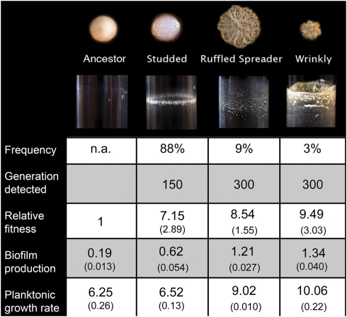
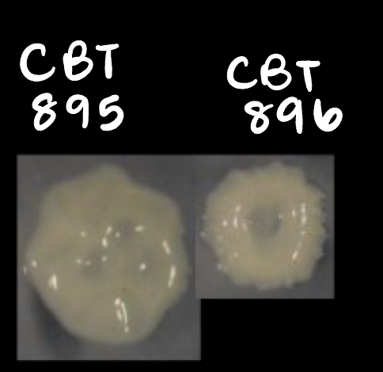
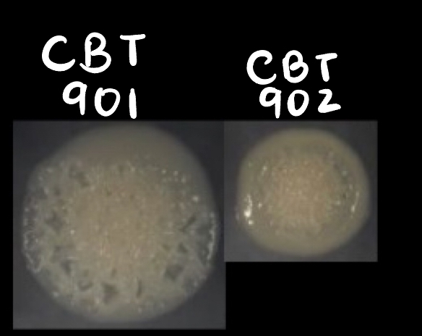
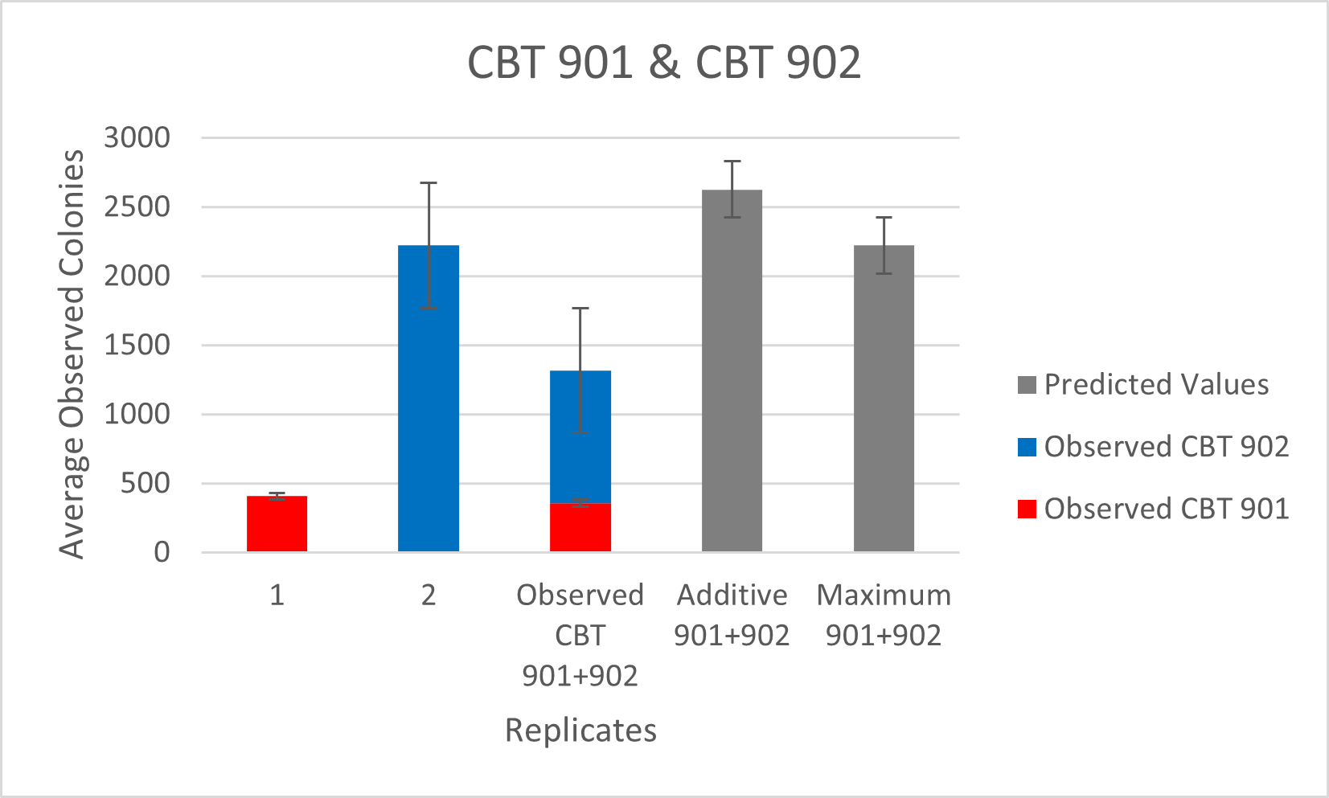
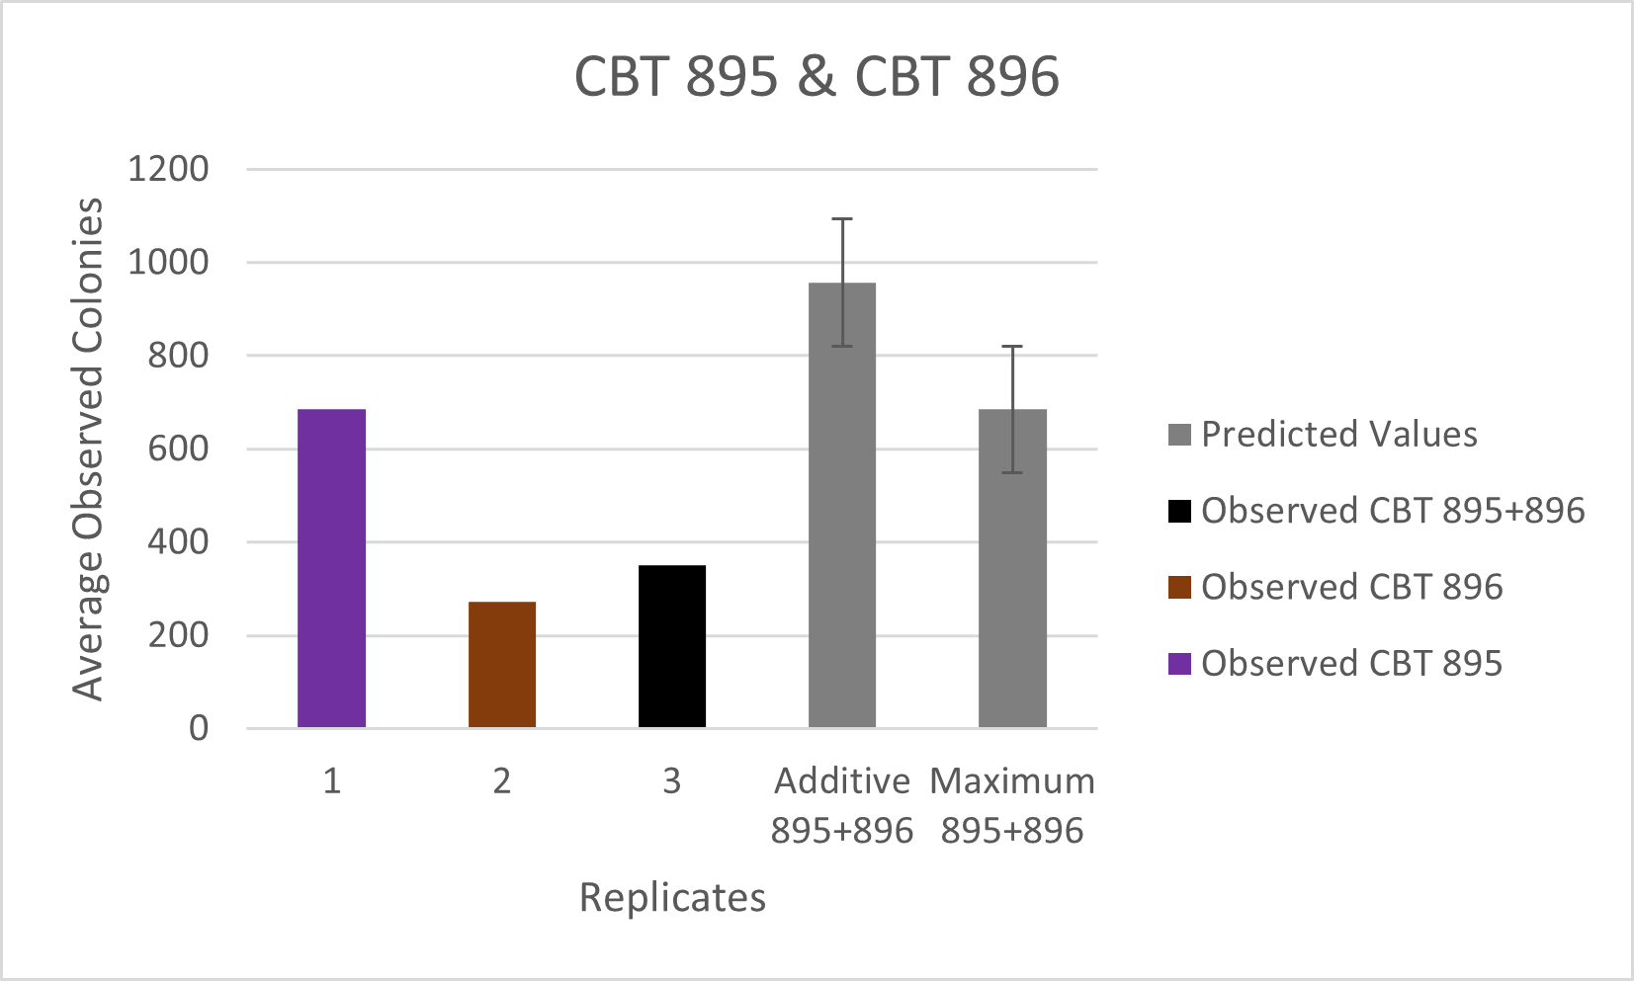
Interactions Displayed by Burkholderia cenocepacia Morphotypes When Grown in Mixed Cultures
Milan Patel
Advisor: Dr. Caroline Turner
Overview
Conclusion
Burkholderia cenocepacia is an opportunistic pathogen that commonly forms biofilms in the lungs of cystic fibrosis patients. The bacteria's unique morphotypes, including studded, ruffed spreader, and wrinkly, have been shown to differ in fitness, biofilm production, and other characteristics. However, it is unclear how these different strains interact in mixed cultures. In this study, we aim to assess the interactions between morphologically different B. cenocepacia strains in mixed cultures and determine if they may exhibit a synergistic or antagonistic relationship. Our results may shed light on the interactions that underlying B. cenocepacia morphotypes display when grown in mixed culture.
The two-sample t-tests resulted in a significant difference between the observed colonies and expected values. The test results suggested that the strains tested did not display pure competition nor did the strains display a complete lack of competition. Interestingly, in the observed 901+902 plates, clear distinguishing colonies for each strain were observable. Relationships between morphotypes of bacterial strains may help shed light on the mechanisms of competition and coexistence in microbial communities.
Colony morphology and characteristics of Burkholderia cenocepacia (Poltak et al., 2011)
Methods
Results
Burkholderia cenocepacia colonies that were selected for biofilm growth in both high carbon (1% C) and low carbon (0.03% C) solutions while also displaying unique morphologies were revived from the Turner et al. stock.
Additive and maximum correspond to predicted additive metric and predicted maximum value metric, respectively. Replicates 1 and 2 were grown in monoculture, all other replicates were grown in mixed population or predicted values.
Next Steps
Use Loreau and Hector’s additive partition of biodiversity effect metric to assess if the CBT 901 and CBT 902 strains exhibit a selection or complementarity effect when grown in mixed culture (Loreau & Hector, 2001)
Run further experiments with a combination of various strains with different morphotypes grown form the Turner et al. experiment
CBT 895 and CBT 896 were low carbon selected (Turner et al., 2018)
CBT 901 and CBT 902 were high carbon selected (Turner et al., 2018)
After growth and conditioning of the bacteria in 1% high carbon M9 galactose minimal media, mixed populations (CBT 895+896 and CBT 901+902) were created. Mixed population cultures were plated, counted, and then assessed via two simple metrics:
Predicted additive method: This metric was created by adding the sum of the counted colonies in monoculture. If the number of observed colonies grown in mixed cultures was close to the predicted additive number, it would suggest no competition was present within the two strains.
Predicted maximum value metric: This metric was created by taking the maximum value in the observed monocultures for the two populations being competed against in a mixed culture. If the number of observed colonies in mixed culture was close to the calculated maximum value metric, it would suggest pure competition between the two strains.
Finally, two sample t-tests (α=0.05) were performed to determine any significant differences between the observed colonies and expected values.
*Note: For observed CBT 901+902 replicates, visible differences in colonies were distinguishable.
References
Poltak, S. R., & Cooper, V. S. (2011). Ecological succession in long-term experimentally evolved biofilms produces synergistic communities. The ISME journal, 5(3), 369–378. https://doi.org/10.1038/ismej.2010.136
Turner, C.B., Marshall, C.W. and Cooper, V.S. (2018), Parallel genetic adaptation across environments differing in mode of growth or resource availability. Evolution Letters, 2: 355-367. https://doi.org/10.1002/evl3.75
Loreau, M., & Hector, A. (2001). Partitioning selection and complementarity in biodiversity experiments. Nature, 412(6842), 72–76. https://doi.org/10.1038/35083573
*Note: unlike in CBT 901+902 mixed population, individual strains were indistinguishable in the CBT 895+896 population (left black).
Loyola University Chicago
Department of Biology

